Slide 1
Consistency

Slide 2
The Bible - 66 books of unified text
Genesis | Exodus | Leviticus | Numbers | Deuteronomy | Joshua | Judges | Ruth | 1 Samuel | 2 Samuel | 1 Kings | 2 Kings | 1 Chronicles | 2 Chronicles | Ezra | Nehemiah | Esther | Job | Psalm | Proverbs | Ecclesiastes | Song of Solomon | Isaiah | Jeremiah | Lamentations | Ezekiel | Daniel | Hosea | Joel | Amos | Obadiah | Jonah | Micah | Nahum | Habakkuk | Zephaniah | Haggai | Zechariah | Malachi | Matthew | Mark | Luke | John | Acts | Romans | 1 Corinthians | 2 Corinthians | Galatians | Ephesians | Philippians | Colossians | 1 Thessalonians | 2 Thessalonians | 1 Timothy | 2 Timothy | Titus | Philemon | Hebrews | James | 1 Peter | 2 Peter | 1 John | 2 John | 3 John | Jude | Revelation
1 | 2 | 3 | 4 | 5 | 6 | 7 | 8 | 9 | 10 | 11 | 12 | 13 | 14 | 15 | 16 | 17 | 18 | 19 | 20 | 21 | 22 | 23 | 24 | 25 | 26 | 27 | 28 | 29 | 30 | 31 | 32 | 33 | 34 | 35 | 36 | 37 | 38 | 39 | 40 | 41 | 42 | 43 | 44 | 45 | 46 | 47 | 48 | 49 | 50 | 51 | 52 | 53 | 54 | 55 | 56 | 57 | 58 | 59 | 60 | 61 | 62 | 63 | 64 | 65 | 66

Slide 3
The Bible - 66 books of unified text
66 books, written over
>1,600 years,
40 independent authors
20 different occupations
10 different countries
3 different languages
Incorporating a cast of 2,930 characters
Genesis | Exodus | Leviticus | Numbers | Deuteronomy | Joshua | Judges | Ruth | 1 Samuel | 2 Samuel | 1 Kings | 2 Kings | 1 Chronicles | 2 Chronicles | Ezra | Nehemiah | Esther | Job | Psalm | Proverbs | Ecclesiastes | Song of Solomon | Isaiah | Jeremiah | Lamentations | Ezekiel | Daniel | Hosea | Joel | Amos | Obadiah | Jonah | Micah | Nahum | Habakkuk | Zephaniah | Haggai | Zechariah | Malachi | Matthew | Mark | Luke | John | Acts | Romans | 1 Corinthians | 2 Corinthians | Galatians | Ephesians | Philippians | Colossians | 1 Thessalonians | 2 Thessalonians | 1 Timothy | 2 Timothy | Titus | Philemon | Hebrews | James | 1 Peter | 2 Peter | 1 John | 2 John | 3 John | Jude | Revelation
1 | 2 | 3 | 4 | 5 | 6 | 7 | 8 | 9 | 10 | 11 | 12 | 13 | 14 | 15 | 16 | 17 | 18 | 19 | 20 | 21 | 22 | 23 | 24 | 25 | 26 | 27 | 28 | 29 | 30 | 31 | 32 | 33 | 34 | 35 | 36 | 37 | 38 | 39 | 40 | 41 | 42 | 43 | 44 | 45 | 46 | 47 | 48 | 49 | 50 | 51 | 52 | 53 | 54 | 55 | 56 | 57 | 58 | 59 | 60 | 61 | 62 | 63 | 64 | 65 | 66

Slide 4
Write a story about your school life

Slide 5
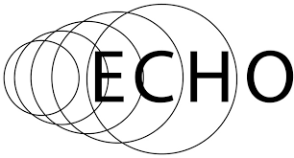
Biblical cross references
What are they?

Slide 6
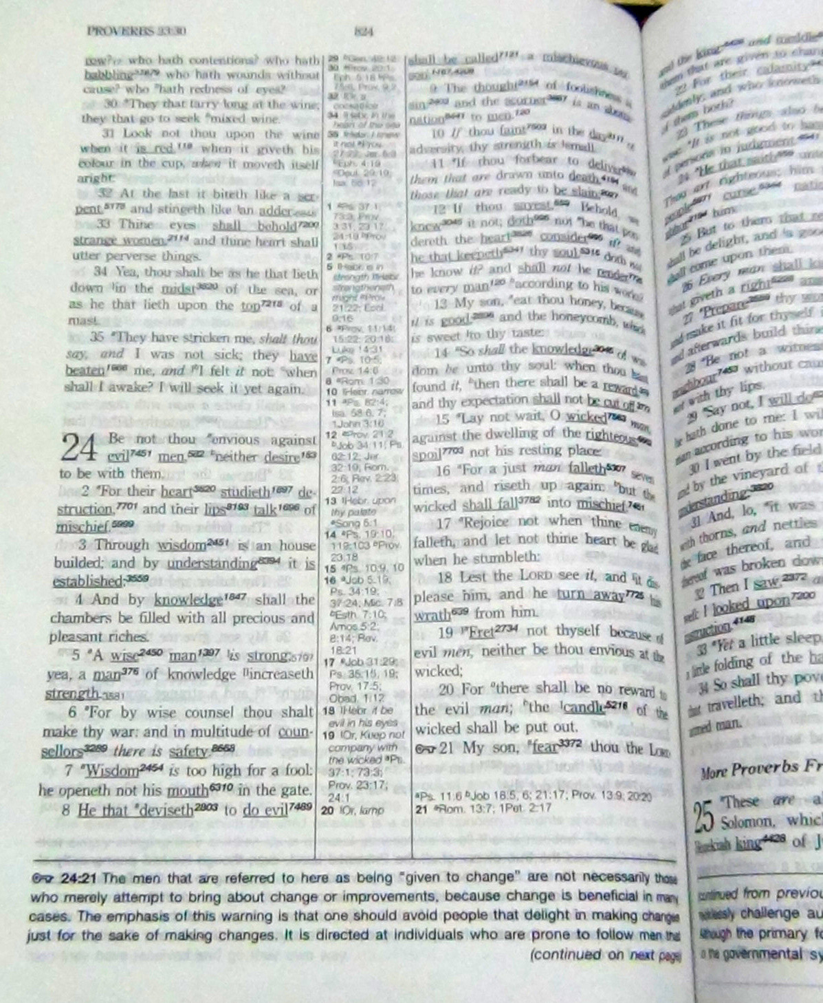

Slide 7
Coincidences?
Numbers 13:33 And there we saw the giants, the sons of Anak, which come of the giants: and we were in our own sight as grasshoppers, and so we were in their sight.
Joshua 11:21-22 And at that time came Joshua, and cut off the Anakims from the mountains, from Hebron, from Debir, from Anab, and from all the mountains of Judah, and from all the mountains of Israel: Joshua destroyed them utterly with their cities. There was none of the Anakims left in the land of the children of Israel: only in Gaza, in Gath, and in Ashdod, there remained.
1 Sam 17:4 And there went out a champion out of the camp of the Philistines, named Goliath, of Gath, whose height was six cubits and a span.
Notes:
These passages were written at totally different times by different authors, yet they agree perfectly.
The first passage shows that when Israel entered the land there were giants there.
The second passage shows that later Israel destroyed most of them, but left a few were left in Ashdod, Gath and Gaza.
The third passage mentions that Goliath's home town was Gath..he must have been a descendent of the Anakites…ring of truth.

Slide 8
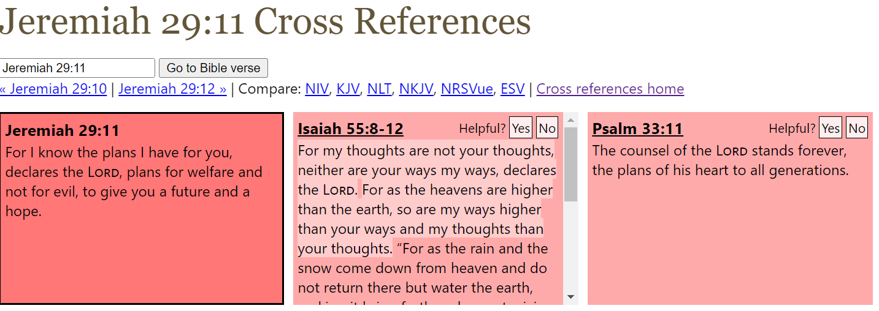
Biblical cross references

Slide 9
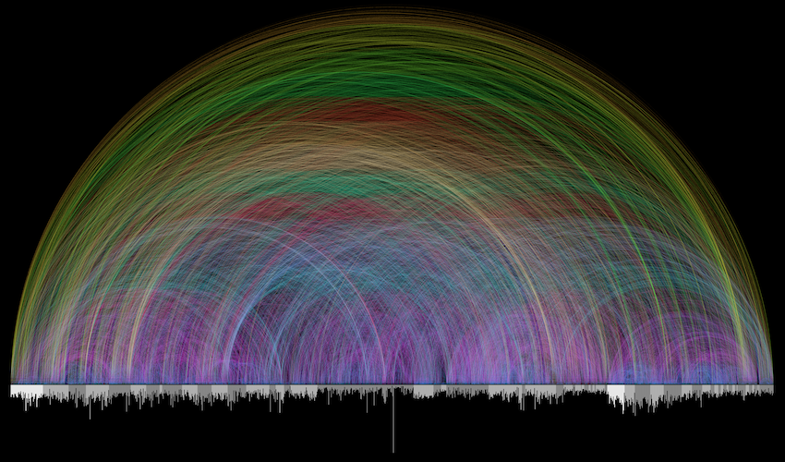

Slide 10
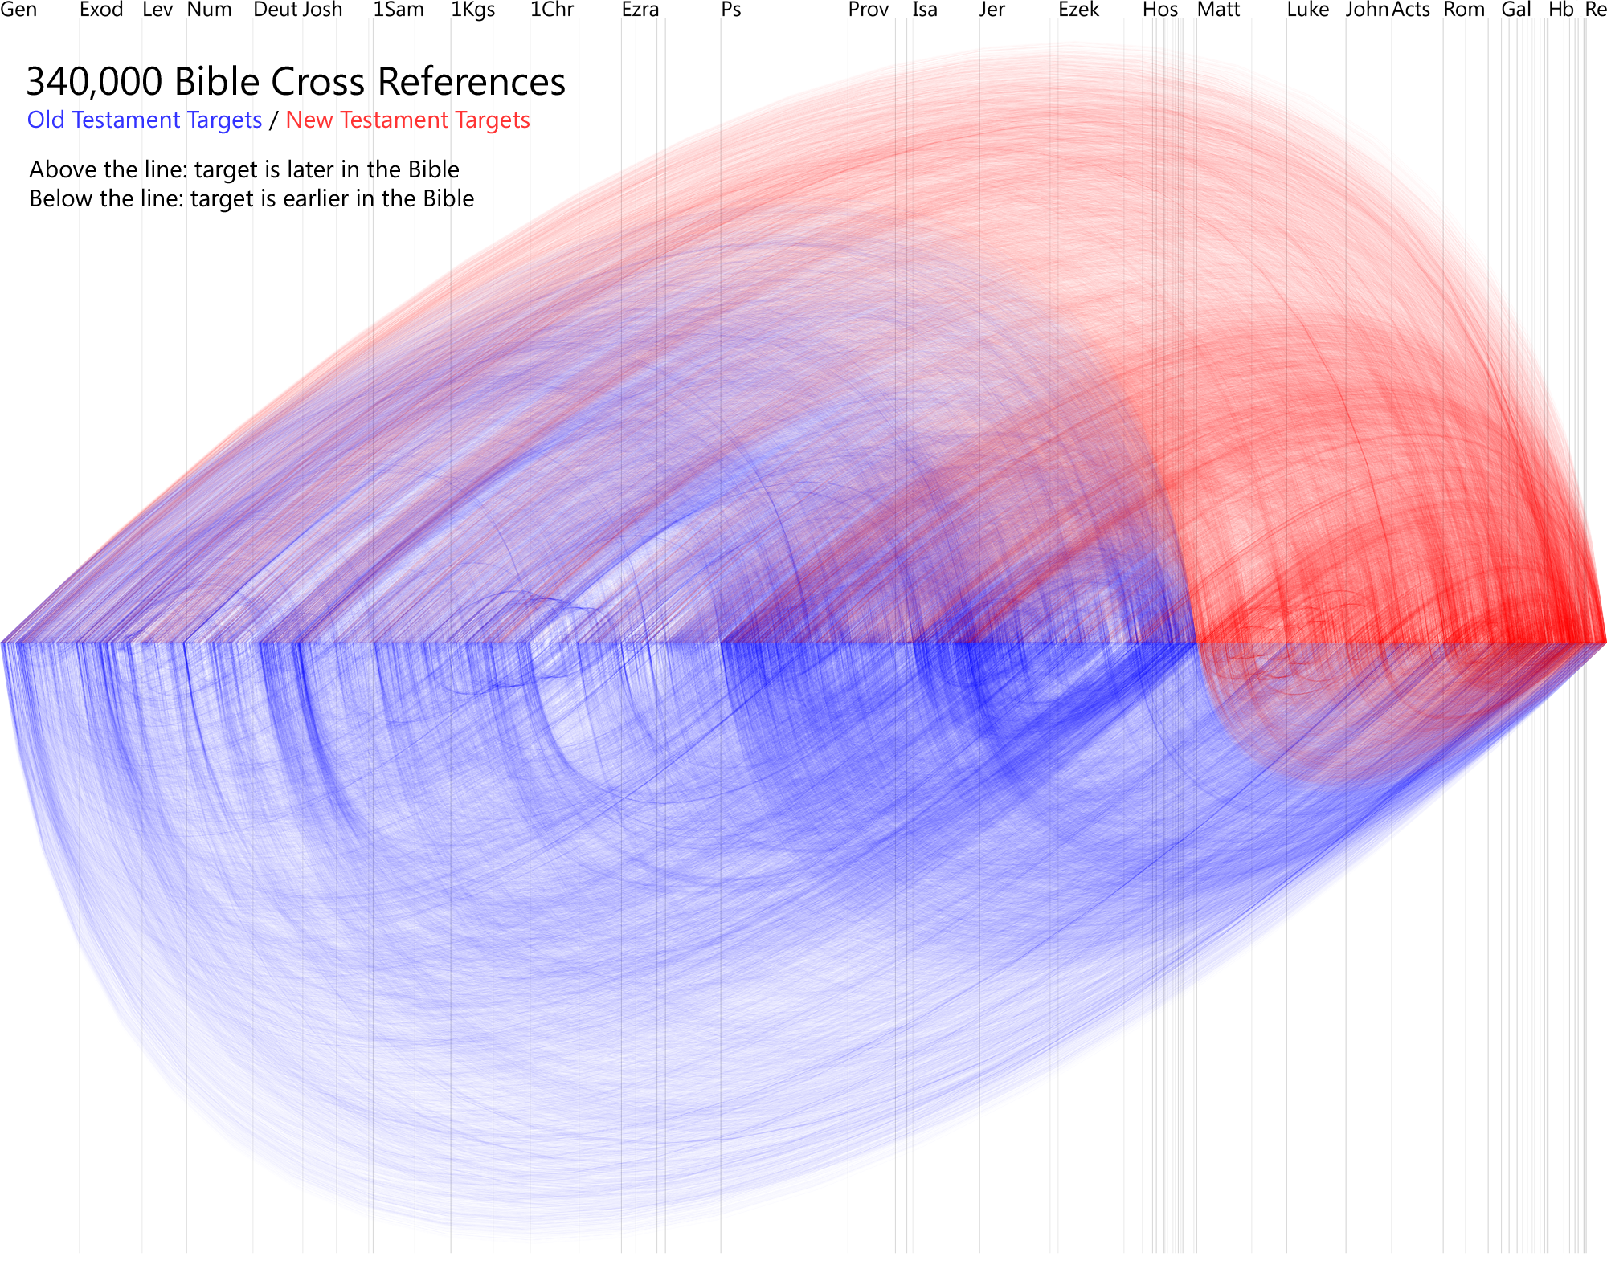

Slide 12
What is the mathematical probability that the bible could be written by a few authors that made it all up?

Slide 13
Here are some considerations:
Number of Authors: The Bible is a collection of 66 books written by multiple authors over a period of about 1,500 years. This diversity of authorship makes it less likely that a small group of individuals could have collaborated to fabricate the entire text.
Content and Genre: The Bible contains various genres, including historical narratives, poetry, prophecy, letters, and apocalyptic literature. The complexity and depth of these genres would be challenging for a small group of authors to invent consistently over time.
Historical and Cultural Context: The events, customs, and locations described in the Bible are often corroborated by external historical and archaeological evidence. Fabricating such detailed accounts that align with known history and geography would be difficult for a few authors to achieve.
Theological Unity: Despite being written by multiple authors from different cultural backgrounds and time periods, the Bible exhibits a remarkable theological coherence and unity of message. This suggests a divine influence or overarching guiding force behind its composition.
Manuscript Evidence: The Bible has a vast manuscript tradition with thousands of ancient copies and fragments, which allows scholars to trace its transmission and verify its textual integrity. Fabricating such a large body of text and distributing it widely would be a monumental task for a small group of authors.

Slide 14
“While it's theoretically possible for a small group of individuals to collaborate on a literary work, the complexity, diversity, historical accuracy, and theological coherence of the Bible make it highly improbable that it could have been entirely fabricated by a few authors. However, assigning a specific mathematical probability to this scenario would be speculative and highly subjective.”

Slide 17
The Dead Sea Scrolls a witness to the reliability of the Old Testament Scriptures
A Bedouin shepherd boy, in 1947, discovered many large jars in a cave on the west side of the Dead Sea.
Eventually 40 000 leather fragments were taken from this & other caves. More than 500 books have been reconstructed from these well preserved scrolls. They were hidden by the Jews from the religious community of Qumran about 68AD (to stop the Romans from destroying them). So they are over 1900 years old!
Of what significance is this discovery? Well, up to then the oldest copy of the Old Testament was dated at 900 AD. Now they had copies of the O.T. dating at about 100 BC… a thousand years earlier! Was there any major difference – any corruption of the text? NO! The 2 texts were almost identical. A marvelous testimony to the accuracy of the transmission process.

Slide 18
Copying the Old Testament Scriptures
The Jews were very careful when they copied God's Word. This job was entrusted to men of learning. They were called scribes. Although they copied out other legal contracts and records, one of their jobs was to copy out the Old Testament on to scrolls. These scrolls would often be made from parchment or animal hides.
To avoid mistakes the scribes, when copying, would:‑
often get another scribe to check all work.
count the letters and words on a line.
The discovery of the Dead Sea Scrolls vindicated trust in the accurate translation of the original Old Testament. Until they were discovered, the oldest copy of the Old Testament was dated about 900 A.D. The Dead Sea Scrolls dated to about 100 B.C. and were almost identical with these later copies - proof, that the manuscripts can be trusted!
Notes:
U tube for kids…….lots hears one– one swear word the speakers apologises before..
https://www.youtube.com/watch?v=SLQB-Y97bxk

Slide 19
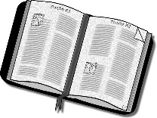
The Jewish Scribes Accuracy
The Jewish Scribes (Massoretes) “… numbered the verses, words & letters of every book. They calculated the middle word & the middle letter of each. They enumerated verses which contained all the letters of the alphabet, or a certain number of them; & so on.
These trivialities, as we may rightly consider them, had yet the effect of securing minute attention to the precise transmission of the text; & they are but an excessive manifestation of a respect for the sacred Scriptures which in itself deserves nothing but praise.
The Massoretes were indeed anxious that not jot nor tittle, not one small letter nor one tiny part of a letter of the Law should pass or be lost.”
‘Our Bible & the Ancient Manuscripts’ p38 Sir Frederic Kenyon

Slide 20
The New Testament Manuscripts
It was because the Jewish scribes were so particular that the Higher Critics directed most of their criticism at the New Testament texts. They claimed that:
most of the letters, gospel accounts and records weren't eye witness accounts at all.
most of these writings were penned during the 2nd or 3rd centuries (some as late as the 4th!)
even if they were written earlier, that they must have been corrupted from the original writing.
Are these criticisms valid? We must test the claims!

Slide 21
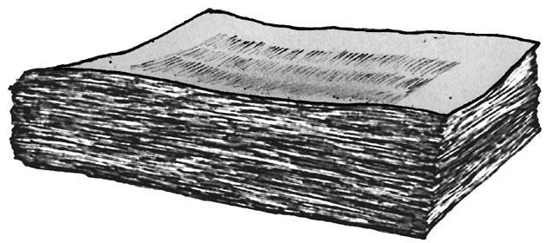
Bibliographical Test of the N.T. Manuscripts
As no one has any originals of any ancient writings, we must apply the same test to the New Testament that we would to other ancient texts. This test is called the Bibliographical Test. It is an examination of the textual transmission by which documents reach us – ie. Since we don’t have the original documents, how accurate are the copies…
As no one has any originals of any ancient writings, we must apply the same test to the New Testament that we would to other ancient texts. This test is called the Bibliographical Test. It is an examination of the textual transmission by which documents reach us – ie. Since we don’t have the original documents, how accurate are the copies…
Bibliographical Test.
The number of manuscripts (MSS) (for comparison)
The time interval between the original and a current copy. (This helps to see the possibility of corruption.)
Codex Sinaiticus earliest complete manuscript of the New Testament
Notes:
We can’t pick up actual original writings……….. but we have the next best thing

Slide 22
Comparison of Ancient Writings & N.T.
Author | Written | Earliest Copy | Year Span
Homer (Iliad) | 900 BC | 400 BC | 500
New Testament | 40-100 AD | 125 AD | 25
Caesar | 100-44 BC | 900 AD | 1000
Tacitus | 100 AD | 1100 AD | 1000
Pliny | 61-113 AD | 850 AD | 750
Thucydides | 460-400 BC | 900 AD | 1300
Suetonius | 75-160 AD | 950 AD | 800
Herodotus | 480-425 BC | 900 AD | 1300
Demosthenes | 383-322 BC | 1100 AD | 1300
Sophocles | 496-406 BC | 1100 AD | 1400
Aristotle | 384-322 BC | 1100 AD | 1400
So it can be seen that the New Testament texts must be accepted before any other ancient document, on the basis of weight of evidence.
Notes:
The time between when the book was written to the earliest copy available is only 25 years or so !!

Slide 23
Surviving New Testament Manuscripts
Greek | Other
Uncials 267 Miniscules 2764 Lectionaries 2143 Papyri 88 Recent Finds 47 | Latin Vulgate 10000+ Ethiopic 2000+ Slavic 4101 Armenian 2587 Syriac Pashetta 350+ Boharic 100 Arabic 75 Old Latin 50
Total 5309 | Total 19263
Uncials are manuscripts written totally in CAPITAL LETTERS & miniscules totally in lower case letters.

Slide 24
New Testament Quotations by Early Writers
1st Century | Ignatius, Bishop of Antioch 70-110 AD, quoted from:- Matthew, John, Acts, Romans, 1 Corinthians, Galatians, Ephesians, Philippians, Colossians, fames, 1&2 Thessalonians, 1&2 Timothy, l Peter.
2nd, 3rd & 4th Century | Justin Martyr 330 Irenaeus 1819 Clement of Alexandria 2406 Origen 17922 Tertullian 7258 Hippolytus 1378 Eusebius 5176
 | TOTAL 36289

Slide 25
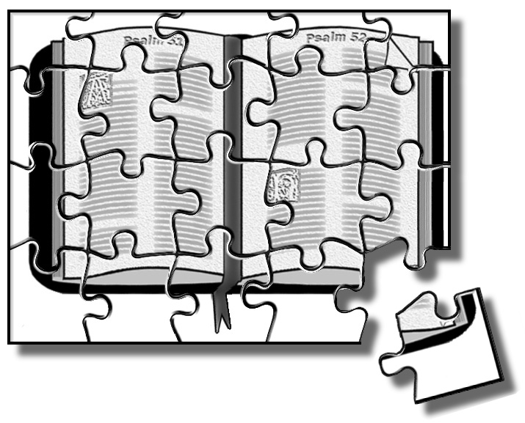
Sir David Dalrymple’s Conclusion
So, renowned researcher Sir David Dalrymple said:“As I possessed all the existing works of the Fathers of the 2nd & 3rd Centuries, I commenced to search, and up to this time I have found the entire New Testament except 11 verses."
So he goes on to say,
“if all the manuscripts were burnt at one time,
we would still have been able to piece the New Testament together.” Therefore he drew the following conclusion:
"If the New Testament were a collection of secular writings, their authenticity would generally be regarded as beyond all doubt."

