Slide 1
Government Intervention
Yr 12 Economics Heritage College

Slide 2
Market Failure - Recap
What is Market Failure?

Slide 3
Government Intervention
It is regulatory action taken by the government that seek to change the decisions made by individuals, groups and organisations about social and economic matters.

Slide 4
Videos
What was the market failure?
What were the government interventions used?
Do you think it will be effective?

Slide 5
Minimum Price
This involves the government setting a lower limit for prices, e.g. the price of potatoes could not fall below 13p.
Why would the government implement this?

Slide 6
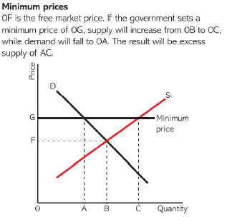

Slide 7
Minimum Prices – Where else can this be implemented?
Notes:
Labour market

Slide 8
Maximum Price
This involves putting a limit on any increase in price e.g. the price of housing rents cannot be higher than £300 per month.
Why would the government implement this?

Slide 9
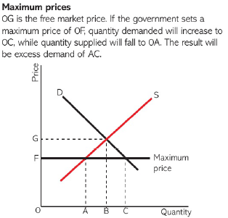

Slide 10
Try to find some examples of Minimum and Maximum prices being implemented
Did they work?

Slide 11
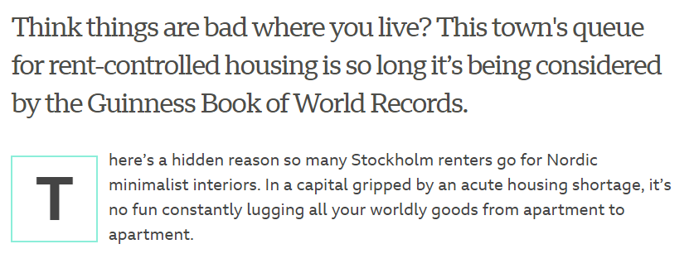

Slide 12
Taxes
To counter market failure from negative externalities

Slide 13
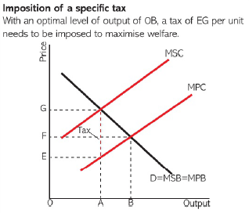

Slide 15
What is the problem with taxes?
Difficult to target
Unpopular
Raise government revenue vs reducing market failure

Slide 16
Subsidies
To counter market failure from positive externalities

Slide 17
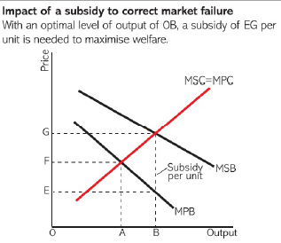
Subsidies

Slide 18
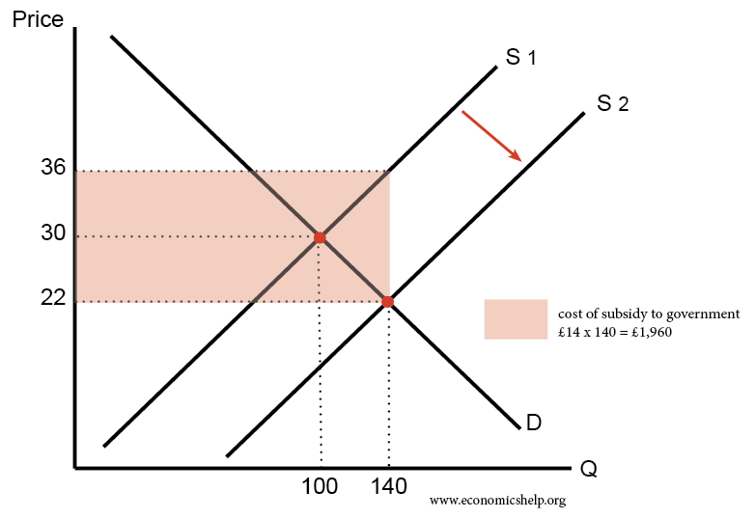

Slide 19
What is the problem with subsidies?
Difficult to target
Difficult to remove

Slide 20
Collusion, Merger and Takeover
The role of the ACCC.
The ACCC promotes competition and fair trade in markets to benefit consumers, businesses, and the community.

Slide 21
Government Regulation
Limiting the amount of toilet paper
Notes:
Why did this happen – asymmetric information

Slide 22
Public goods
Defence, prisons service, police service, street light etc.
If not provided by the government might not be provided at all or provided insufficiently.

Slide 23
Carbon permits and carbon tax
Carbon permits, also known as carbon offsets, are permits that allow the owner to emit a certain amount of carbon dioxide or other greenhouse gases.
Under a carbon tax, the government sets a price that emitters must pay for each ton of greenhouse gas emissions they emit.

