Slide 1
Lesson 6

Slide 2
Learning Intention
I will understand that business can be broken into different sectors and that each sector has certain characteristics

Slide 3
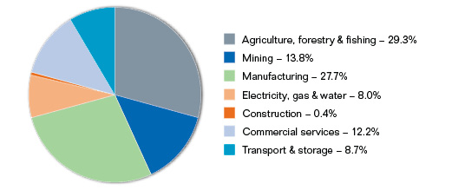
Classifying Australia’s businesses
The Australian business environment can be broken into many different parts.
Sectors
Industries
Sizes
Geographical spread
Legal Structures

Slide 4
Classification by sector
These are generally businesses in the same field
For example:
Retail, mining, primary industry, education
It can also be separated into the public and private sector
Public – Government owned businesses
E.g. Centrelink, Public Schools, Public Hospitals etc..
Private – Privately owned businesses
Ranging from very small businesses through to large multinational businesses
Note – Even though a business may be a public company, this doesn’t mean it is in the public sector. Remember, shareholders are private owners of the business

Slide 5
Recent trends in business sectors
What are some of the current trends in these major business sectors of Australia’s economy?
Use the following sites in determining current trends
https://www2.deloitte.com/us/en/misc/search.html#qr=retail%20outlook
www.ibisworld.com.au
www.pwc.com
www.abs.gov.au
https://www.rba.gov.au/chart-pack/

Slide 6
Analysis and Evaluation Task
Choose an industry and conduct a brief analysis of the data that has been gleaned from each report.
You can create a fishbone diagram to analyse this
Evaluate the impact that this trend will have on business

Slide 7
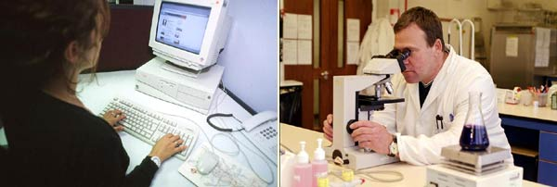
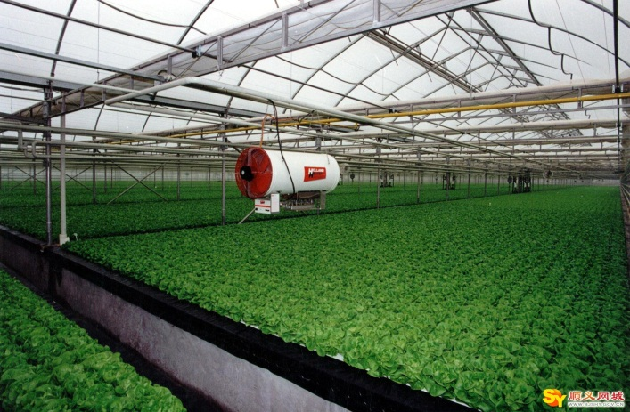
Classification by Industry
5 Industry types
Primary – directly associated with natural resources
Secondary – taking raw material and making it into a finished or semi-finished product
Tertiary – involved performing a service for other people
Quaternary – Transfer and processing of knowledge or information
Quinary – services that have traditionally been performed in the home

Slide 8
Activity
Consider the following table and answer the question
Suggest reasons why the primary sector accounts for only 4% of total employment while the tertiary sector contains 76% of total employment.
What does this tell you about the future employment prospects within the two sectors?
Industry Sector | Private Sector % | % of total employment
Primary | 10% | 4%
Secondary | 21% | 20%
Tertiary | 69% | 76%

Slide 9
Classification by size
3 general sizes
Small
Medium
Large
Small-Medium sized enterprises
SME’s
The vast majority of Australian businesses

Slide 10
Classification by Geographical spread
International business
produces its products in only one country but exports them around the world
Transnational Corporations (TNC’s)
large business with a home base in one country operating partially or wholly owned businesses in other countries

Slide 11
Learning Intention
I will learn that the different legal structures of businesses will affect the way that they operate.
I will learn that, depending on the type and size of business, different structures would be more appropriate than others.

Slide 12
Classification by Legal Structure
Businesses can be either incorporated or unincorporated
Incorporation is the process that business go through to make the business a separate legal entity to the owner
The legal structure of business can separate businesses into 5 general areas
Sole Trader
Private Company
Public Company
Trust
Co-operative

Slide 13
Number of businesses by legal type in Australia
Unincorporated enterprises – sole trader and partnership | 81.5%
Incorporated enterprises – Private companies Public companies | 15.5% 1%
Trusts, co-operatives and other privately owned business enterprises | 1.5%
Total privately owned business enterprises | 99.5%
Government owned business enterprises | 0.5%

Slide 14
Sole Trader
A business owned and operated by one person
Owner provides all the finance
Only legal requirement is that the business name is registered if its different to the owners name
Owner takes all the responsibility for
Running the business
All business debts – unlimited liability (the business and the owner are one and the same)

Slide 15
Sole Traders
Advantages
Low cost of entry
Simplest form of business
Complete control
Less costly to run
No partner disputes
Owner keeps all profits
Less government rules
No tax on profits, only income tax
Disadvantages
Unlimited liability
End of business when owner dies
Difficult to run when sick
Need to carry all losses
Burden of management
Wide variety of tasks
Difficult in raising finance for expansion

Slide 16
Partnerships
A legal business structure that is owned and operated by between 2 and 20 people
Medical and stockbrokers can have up to 50 partners
Solicitors, Accountants and Vets can have up to 400 partners
Can be made verbally or in writing
What would be the benefit of having a written partnership agreement?

Slide 17
Partnerships
Advantages
Low start up costs
Less costly to operate than a company
Shared responsibility and workload
Minimal government regulation
No taxes on profits, only personal income
On death of one partner, business can keep going
Disadvantages
Unlimited liability
Liability for all debts, including those other partners rack up – even before partnership begins
Possibility of disputes
Finding a suitable partner
Divided loyalty and authority

Slide 18
Limited liability
Companies are incorporated
Limited liability is a feature of corporate ownership that limited each owners financial liability to the amount of money he or she has paid for the businesses shares

Slide 19
Private companies
Usually has between 1 and 50 shareholders. Private companies tend to be small to medium sized, often family owned businesses
Shares are only offered to people the business wishes to have as part owners
Shareholders can only sell their shares to people approved by other directors
Hence the name ‘private’

Slide 20
Public companies
Listed on the stock exchange
Generally very large businesses
Characteristics
At least one shareholder, with no maximum number
No restriction on the transfer of shares or raising money from the public by offering shares
Must issue a prospectus when selling shares for the first time
Must have at least 3 directors (2 must live in Australia)
The letters Ltd. In its name
Must publish its financial accounts each year

Slide 21
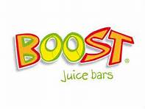
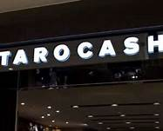
Franchises
A licence to operate a privately owned business as if it were part of a chain of stores
Franchisor = the organisation granting the franchise
Franchisee = the persona or organisation purchasing the franchise

Slide 22
Franchisor
Advantages
Fast and selective distribution
Avoids costs of construction
Doesn’t have to operate outlets
Franchise agreement ensures some control
Motivated franchisees
Disadvantages
Unsuitable franchisees
Disagreement over conditions and terms of contract

Slide 23
Franchisee
Advantages
Opportunity to start with limited finances
Guaranteed customer base
Established name
Management back-up
Proven business methods
Disadvantages
Franchisor retains a lot of control
Limited scope for individuality in business operations
Disagreements over conditions and terms of contract
If too successful, franchisor may open their own outlet nearby

Slide 24
Becoming a franchise
What are the benefits involved in becoming one of these franchises?
Look up the following websites and find out what you need to do in order to have one of these franchises
www.boostjuice.com.au
www.mcdonalds.com.au
www.kipmcgrath.com.au

Slide 25
Trusts
Many businesses use this structure in Australia
It’s main purpose is to minimise the tax that a business pays.
https://www.youtube.com/watch?v=j8TaHNz821E

Slide 26
Co-operatives
Another form of incorporated business, however it is different in that its members are businesses themselves. That is, it is a business made up of businesses.

Slide 27
Legal requirements of Business
Legal requirements
Tax
All businesses are required to pay tax in the following ways
Company tax – tax on profits
PAYE tax – tax withheld from employees and paid directly to the ATO
GST – 10% on all goods and services sold. (Some products do not contain a GST component)
All business must complete a Business Activity Statement (BAS) every 3 months where GST is calculated.
You may get a refund if you have paid more GST than you have received
You may have to pay GST if you have Collected more GST than you have paid.
If this is the case, you pay the difference
ABN
All Australian Businesses must have an ABN to operate

Slide 28
Summary Questions
Create a T-Chart comparing and contrasting a Sole Trader and Partnership.
A Private Company is the best form of business structure. Or is it?
Imagine you were a small ice cream shop owner. Why would you become a partnership? What would you hope to achieve from choosing this structure over another?
How would this ice cream business be different if they were a sole trader?
What if the laws changed to make it cheaper for you to become a private company. How would life be different for you now? What would your business look like?
How would this help you achieve your business, social and personal goals

