Slide 1
The direction of Education
…and the role of
Heritage College
Notes:
Related to the strategic plan (on dashboard), and particularly the section devoted to Excellence in Learning (Student Agency) – but also elements of Curriculum Development, particularly in regards to STEM. For reference, this is on page 8-10 of the Strategic Plan.
Strategic plan was put together by the council, in consultation with a wide range of stakeholders (teachers, leaders, parents, students and council). In addition to what we saw as needs as stakeholders (teachers/parents), we’ve also had significant consultation with outside bodies such as AISSA (and others) as well as keeping up to date with a number of the trends in education that are going on locally, nationally and internationally. And it’s all really heading in one broad direction.
This presentation is really to give us, as teachers, the underlying rationale for some of the changes that we’re looking to implement over the next 3 years and how we’re all going to be involved in that – to varying degrees.
What you’ll notice from a lot of the direction of education is that it does take more of a humanistic approach (as education generally has for many years), and so what we need to do is to take away the humanist perspective, look at the direction and see it through a biblical lens. A lot of the direction would align with what we would think and you’ll no doubt see that as we go through this and we can put it in our own context.

Slide 2
Our WHY
Underpins everything we do
Current trends MUST be seen through the “Heritage Lens”
Bible centred, ethos based
Friends for life
Notes:
Before we start, this is a really important part for us. Our bedrock.
While the direction of education takes a secular humanist (and in some areas, a more progressive) approach (which is in contrast generally to the bible) where the person is right, without reference to God or a higher authority. We need to take on board the scriptural perspective, and see how current directions fit within a biblical framework, and not the other way around.
Our Why, is important. The WHY of schooling underpins a lot of the direction of current research. And so, context is highly important, but not only that, it's highly valued. Education, and the research supports this, should not be a ‘one size fits all schools approach’. The Why is important.
The why of the school – Adapt, then adopt (Martin Westwell – CEO of DECD)
The why of the student – SACE direction with THRIVE initiative – its into this that we can very easily weave our context
The WHY also fits into student wellbeing – which is another major direction that education is moving

Slide 3
Our mission
At Heritage, we are dedicated to providing a God-centred educational environment. We want all students to achieve their full potential, and so we encourage them to strive for excellence and to use their talents to serve others and God.
Heritage Mission Statement
Notes:
Our lens is many things and is unique to the specific culture of Christadelphians across Adelaide. Our culture, is going to be different from other Heritages, not better, just different. Every school is different. Every school has their own lens that they need to look at the direction of education (and even the Australian Curriculum) through.
Our lens can be summed up through the objectives of the school.

Slide 4
Heritage Objectives
To help students develop Godly characteristics based on the Bible, in support of the role of parents.
To provide a quality education within a biblical context.
To inspire our students to reach their full potential (intellectual, social, spiritual, and emotional).
To create a safe, happy, and spiritual environment where all students feel loved, valued, and respected.
To assist students to develop the required skills to earn a living and live for Christ.
Notes:
Heritage College Objectives (first 5)
Godly characteristics – we do this is pretty well. This doesn’t change. God doesn’t change, his character doesn’t change. What is right, is always going to be right. What's right doesn't change, and what's wrong doesn't change (despite what society might say)
Quality education – what defines quality is going to change. What even is quality? What does it even mean? We'll likely have different perspectives. Different systems around the world have different criteria/definitions. The key for us, is that whatever we take quality to mean, it must be done in a biblical context, and that this is a defining element of the 'quality' of the education we provide.
But what about the quality of content and skills?
If I was to give the same kind of teaching, both with content and skills, that was directed when I first started teaching, then the quality of that education is going to be poor. It’s not going to set students up for life post school. E.g. teaching kids about how a floppy disk works is not relevant and serves no purpose. The needs of students has also changed – e.g. attention span is significantly less than when I first started at heritage (not a negative, just different) and so for us to provide a quality education, we need to be alert to these kinds of changes going on for our young people and therefore adapt to it
Full potential – This is an interesting one. I like the word 'inspire'. And this is where student agency is actually inbuilt into our objectives as a college. This is something that we'll touch on later
Safe, happy, spiritual – similar to the first one. We do this pretty well. Our kids are generally happy and safe, and I’d say that it’s a pretty spiritually focused environment for them to be in.
Skills – for life and in Christ – skills for life – significantly different over time. Skills for life in Christ haven’t really changed other than understanding how people change
So, when we look at the direction of education, everything must pass through this lens. BUT, the nature of these objectives, by their very nature require us to change over time.

Slide 5
A quick preface
Content is important – it's at the core
Students must have a good grasp of basic content in order to think about it
Notes:
Content is foundational to learning, it gives kids grounding. BUT, for us as teachers, what are we getting them to DO with that content.
Content and skills continue to take centre stage. There are also other elements that are increasingly important too – which is what this presentation is about.

Slide 6
Current Education Direction
Global
National
State
Local
Notes:
There is alignment between the global, national and state directions. Some slight differences. In fact, there is probably greater alignment between state and global than there is with national. (Education is constitutionally a state jurisdiction – which is why different states can do what they like, to an extent)

Slide 7
The 4th Industrial Revolution
https://www.youtube.com/watch?v=v9rZOa3CUC8
Notes:
When looking at the direction of Education, we need to think about what we are providing our students and parents as a school. And we need to be continually asking the question as to whether what we're doing here is a) keeping up with changes in education and b) more broadly with the environment students will be going in to post school
Schools and Churches are the only institutions that would be recognisable to someone who time travelled from the start of the industrial revolution to today.
Schools generally take an industrial model – factory for making kids. In one end and out the other.
Re-envisioning of education. Not because it needs changing, but because society is changing at breakneck speed and we need to adapt to keep up or we risk doing damage to our students and not equipping them for life post school.
If we always do what we always did, we’re not going to get what we always got, we’re going to get worse. So, change is our reality. We need to start thinking about education differently.

Slide 8
A Changing World
Giving our students the best opportunity for success will be reliant on us being alert to changes
Consider businesses who ‘missed’ the changes.
Notes:
Banks missed crypto
Kodak missed apple
Taxi’s missed uber
Hotels missed Air BnB
Blockbuster missed Netflix
Borders missed e-books
We're not talking about changing the business model (though I do find that interesting), but we ARE talking about change. That society is changing and that we, as professionals, need to change what we do in preparing our students to be ready for when they leave us.

Slide 9
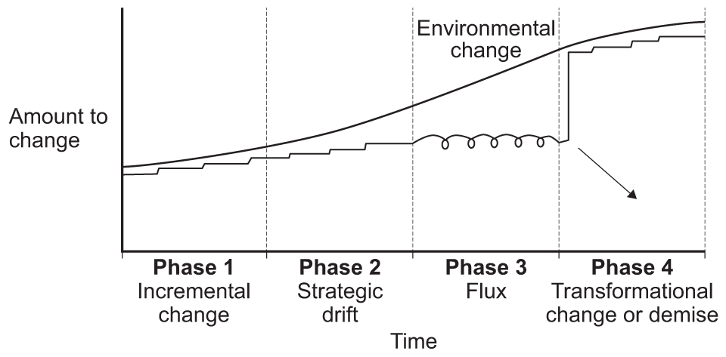
Strategic Drift
Over time, paradigms about what works to deliver success can become entrenched. However, reality of what is required may drift away from organisational position – Strategic drift
Johnson & Scholes, (2002)
Notes:
Times are changing, and we need to try and keep up with the change.
Phase 1 – We are always making adaptations E.g. to curriculum docs, lesson plans, resources etc... And they can reflect the changes going on in society to an extent. Also tweaks to curriculum such as V9
Phase 2 – but what happens over time is that we keep making these smaller changes, but the environment is changing at a faster pace than we are.
Phase 3 – and so, if we don't change we end up in the state of flux. No mans land. The environment is now changing faster and faster, and so we need to try and keep up with that.
Phase 4 – If we don't keep up, it gets to crisis point. You either make a wholesale change to the entire business model or you cease to exist
The lesson really is, what worked yesterday is unlikely to work tomorrow – in many cases. And it certainly wont equip students for the world of tomorrow. So, we need to be alert to what is going on 'environmentally' and adapt to it.
But we don't like doing that, as a general rule
Change is inevitable

Slide 10
OECD Learning Compass
The major direction that Education is heading as outlined by the OECD
https://www.oecd.org/education/2030-project/teaching-and-learning/learning/learning-compass-2030/
Notes:
Focus on the whole student, developing character, developing agency
Generally, there is a lot of alignment between what they’re saying and the lens that we would look through. The one element for us that is missing in this, is spiritual

Slide 11
OECD Learning Compass
Notes:
Spiritual is the paper it’s written on
Outside the compass, at the centre of the compass and throughout the compass. It is everything
This is where and how we weave our 'why' into it. Particularly relevant are the values and attitudes, but also how we equip students with them so that they can work together with others, in the community and ecclesially.

Slide 12
Jobs Outlook
Non-routine cognitive includes:
Abstract thinking
System thinking
Collaboration
Ability to experiment
Notes:
This direction in education, is in response to what is happening, particularly in regards to economic needs.
Routine jobs are decreasing significantly, and have further decreased since 2016. Our focus needs to be on the non-routine, and particularly the non-routine cognitive
So what does non-routine cognitive look like? What does it mean. Generally considered to be 4 key skills:
Abstract thinking – the ability to manipulate models
System thinking (how things interrelate) – the work of Peter Senge is particularly relevant here, and particularly transformation through consideration of different worldviews or perspectives on things
Collaboration
Ability to experiment
These are things we already know – Entrepreneurial thinking group touched on a lot of those same concepts, as well as the concepts in the OECD Learning Compass without even seeing it. They’re self-evident truths.

Slide 13
Entrepreneurial Mindset
This is NOT about business
An entrepreneurial mindset is resilient, resourceful, and solutions-oriented — even when the conditions say otherwise. People with these mindsets are lifelong knowledge-seekers who are curious and creative, and they are critical thinkers.
Notes:
One of the areas we’ve identified through research, discussions with experts from AISSA and the SACE Board is developing in students an Entrepreneurial mindset. It’s the wrong word to use, because it gives the idea that it's business. It is NOT business.
It’s probably the wrong word because of the connotations with business. This is NOT about business, accounting, economics – it does not fall into the realm of HASS, it falls into the realm of every single subject. It’s about a set of characteristics that, while exhibited by entre and intrapreneurs, is actually something that the OECD, the jobs market, economic and educational bodies across the world identify as critical for student success leading into the 4th Industrial Revolution.
They are characteristics like:
Resilience
Resourcefulness
Being problem and solution oriented – even in the face of opposition or challenges
lifelong learners
Curious
Creative
Critical thinkers
Willing to make mistakes and try new things
Willing to be wrong and to find out why – and VALUE being wrong because it's a learning experience
These are the kinds of characteristics that we are going to need to more fully develop in our students. In some things, like critical thinking we do a fantastic job. We want to take that fantastic job and apply it to these other kinds of areas too. It’s not saying that we don’t do these things, but, for our kids, we want (and need) to have more emphasis on them.
These kinds of qualities start in primary and are developed throughout schooling until the kids leave in Yr 12

Slide 14
2022 Skills outlook (World Economic Forum)
Notes:
If we have a look at the skills that workplaces are requiring now, it’s a stark difference to what was the case even 10 years ago.
When I saw this list initially I felt quite threatened - a lot of what we do in schools is based in the black square. But that's not where the skills of the future are going to be needed.
At the same time as feeling threatened though, when you look at the other side, I actually felt quite optimistic about where we can go with this
Analytical thinking and innovation – right at the top
Creativity
Design
Leadership
Problem solving
Emotional intelligence
This is coming from the World Economic Forum and was written before they knew about ChatGPT and other AI tools that have taken the world by storm.

Slide 15
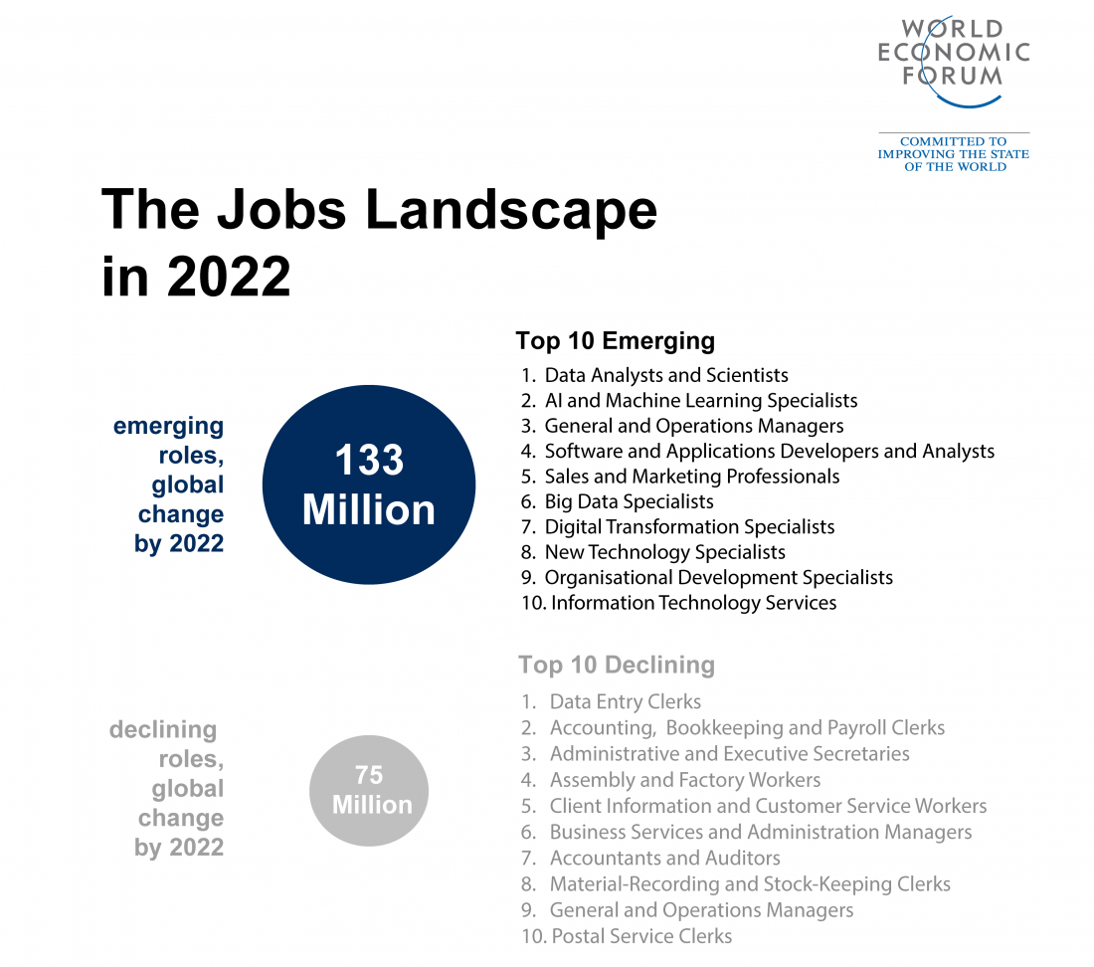
Notes:
If we are going to prepare our children/students for the jobs of the future, then emphasis needs to be put on those kinds of skills/characteristics that are going to allow them to succeed when they leave Heritage

Slide 16
National direction
Version 9 of the Australian Curriculum
Content is less of a focus – 21% reduction
Greater emphasis on student well-being and the whole student
The capabilities – continue to be embedded within curriculum
Notes:
Capabilities – probably need to take more of a centre stage position though
There is clear alignment between what the OECD Learning compass and World Economic Forum's Education 4.0 are saying, with the national direction.

Slide 17
State Directions
The SACE
Thrive initiative
Capabilities focus
EIF/AIF – requires a complete shift in thinking from what do I want to ‘do’ to who do I want to ‘be’. It is capability focused.
SACE Learner profile
Notes:
These movements/trends/directions have all been taken into consideration by other bodies:
Australian Curriculum – the embodiment of the capabilities in curriculum
The SACE and their THRIVE Initiative – which is being watched globally with keen interest
The Capability focus of the new EIF and AIF subjects at the SACE Board (replacing PLP and RP) – emphasis is no longer on ‘what I want to DO’ but now it is on ‘who I want to BE’ - been in the pilot phase for 2 years with it being rolled out over the next couple of years (TBA)
The subject redesign of many SACE Subjects away from content and into greater depth and capabilities alignment
E.g. Business – content has been stripped away to be very problem and solution focused. Thrown out all my resources. Total course redesign. Moved away from becoming a 'teacher' towards becoming a 'facilitator'. Theory doesn't exist in the course any longer.
E.g. Economics – stripped out content and got rid of a topic and a major element of another – effectively cut out 6-7 weeks of content to allow students to focus on project based and authentic learning. Now it’s a lot more aligned to the capabilities
This has happened over a number of subject areas
So, to keep on doing what we’ve always done, means that what we’re doing in the SACE is going to be deficient and not setting our students up for success.
SACE is also piloting a Learner Profile which maps the capabilities. Last year, over 200 students got an additional capabilities certificate as part of their SACE.

Slide 18
‘Assessing capabilities’
Currently not assessed (except 1 performance standard in Research Project)
Notes:
This is where there is a disconnect
If this is the direction education is going and capabilities are not assessable, do we put as much emphasis as we do, on content and grades. I leave you to just ponder that. It’s an interesting question, but something that is far bigger than what we’re dealing with – it goes into entire worldview/perspectives of education, our community, teaching philosophy etc…
1 performance standard across every SACE subject means that it’s valued at less than .5% in the SACE. And then its an extremely broad and ambiguous performance criteria. BUT that’s not the direction the SACE wants to go, nor is it what workplaces want, not is it what uni’s want, nor is it what the direction that governments and leading economic global thinkers want.
When something is assessed, it gets attention. (that’s social economics) But you can’t (at present) assess capabilities, nor is it mandated to.
BUT, grades drive education – from a parent and student perspective. In fact, from my point of view, there is far too much emphasis on this.
The reality of where education is heading is that grades (and in particular) an ATAR, is becoming less and less relevant.

Slide 19
What about Grades?
ATAR is used less often, with only 1 in 4 students using the ATAR as a means of University Entry
Medical includes UCAT and Interview
Grade based entry
Yr 11 Entry
Stat Test
Other pathways into uni
Notes:
The direction is about development of the whole person.
Where then, do grades fit into that?? We are driven by results:
School systems – it’s a measure where we can say we’re better than someone else (how schools compete for enrolments) – but its becoming increasingly irrelevant
SACE Results
NAPLAN League tables
This is NOT the direction that leading thinkers in education think we should be going.
So why then do we measure?
Emphasis on NAPLAN – is not about league tables – but social economics tells us that’s where it will lead (which it does)
Emphasis on ATAR – Universities are less likely to use the ATAR as a means of course entry – we saw that during covid
Universities are increasingly more about getting students into courses who have the right characteristics, rather than a high ATAR – because it means that the drop out rate is a lot less, students get better outcomes, and the uni makes more money…
Grades therefore, while an important ‘snapshot’ of a child’s progress, can not be our focus. It should only be there to guide us on what to do with them next. As a school we realise this. We have it underpinning our assessment policy. Grades are not our focus.
No-one is saying to throw grades away, that’s a step too far, but we need to see them (and educate our community) to see them in their proper context. Less emphasis, I think, is better.

Slide 20
What does all this mean for Heritage?
Notes:
This has come from the research on current education directions/trends, work that College Leadership has undertaken with AISSA, consultation with teachers as key stakeholders as well as with Parents and Students.
We’re not talking wholesale change – but we’re talking some change. What that change looks like, is very much up for discussion. We’ve got the direction, but how we get there is largely something that we need to work together to achieve and allow that change to emerge from us as teachers as opposed to me or others in the leadership team telling us that this is what we're going to do and how we're going to do it.
We need to think carefully about what kind of a learner we are developing. And you can see there, for 2023, that there is a very big focus on the capabilities.

Slide 21
What kind of learner are we developing?
Notes:
Handout (5 mins to discuss)
The educational thinking is heading us toward the more empowered approach and student agency (taking control of their own learning)
Some of these things we need to remember to see through the Heritage Lens E.g. see their own ‘why’.
We might say “Helps students set goals for learning and focus on the ‘why’ within a biblical framework”
Local discovery of our students
Ron Ritchardt 2018. Where do we sit? Are we giving students the opportunities they need to be successful, reach full potential, providing quality education?
Engaged line – is where we probably sit, with some on the top line
Grades focus – from parents and grandparents too
Students are interested, but scared to experiment due to parent expectations and our community operates within a paradigm of right and wrong/ Truth and Error with traditional emphasis on knowledge

Slide 22
Discussion
Where do we sit as teachers?
Were do our students sit?
What are our key success criterion?
Is there a difference between student and teacher actions and success definitions?
What might be some challenges for us as teachers in bridging any gaps?
What might empowered teacher actions look like at Heritage?
Notes:
5 mins

Slide 23
Challenges we’ve identified
Grades focus – legally obliged to report
Risk reluctance of students – don’t want to ‘fail’ or make mistakes
Capabilities – limited integration into curriculum?
Effort grades not as highly valued as Knowledge and Skills
Notes:
Grades focused – massive in secondary. Test scores, assignment grades, ATAR attainment, Dux celebration. Kids getting monetary rewards for every A they receive. School becomes less about the learning, and more about competition and the achievement. It's like they get self-worth from the grade they receive. That's unhealthy – particularly for those who struggle. Started to move away from that with the HeLP award.
Risk Reluctance (for want of a better word) – Entrepreneurial thinking group – students don’t want to make a mistake. But mistakes are crucial for learning. Mistakes are embraced in an entrepreneurial mindset.
Capabilities – How well are these integrated into curriculum. Analysis of documents shows that it’s highlighted, but capabilities are certainly not an overt part of planning in any curriculum documentation. Sometimes its implied, but rarely, if ever specifically focused on.
Effort grades are not as highly valued as academic grades

Slide 24
Other players in this space
We’re not alone
SACE Directions
DECD
AISSA
Other schools?
Notes:
The good news in this is that we’re not alone. The SACE Board has given a lot of direction with their THRIVE agenda
DECD – has a large focus now on the Why of the school. Martin Westwell (DECD CEO) quoted as saying about the new AC v9 – Adapt THEN Adopt. It MUST ADDRESS THE WHY OF EACH SCHOOL.
AISSA – many PD sessions are being run around these concepts. E.g. innovation sessions, also SCRG

Slide 25
The root cause to attack
“emphasis on open education, inquiry-based learning, collaborative learning, projects, process learning, authentic learning and constructivism”
(Gutek, 2004)
Notes:
The strategic plan emphasis is on Student Agency, Entrepreneurial thinking, developing capabilities and passion projects. They’re all very related things, and all fall in line with the direction of education globally, nationally and in SA. How we do this, is obviously going to be seen through our own lens. That’s what we’re doing here in this strategic plan.

Slide 26
Day hikes – how can we progress this?
Few have been taken, but more are needed to explore the possibilities and the way forward
Entrepreneurial thinking group – trialling a PBL week later in the year and incorporating PBL into lessons in preparation
Research/Readings – confirming/solidifying ideas
PD Sessions attended (SACE and AISSA)
Notes:
Project Based Learning – Also Problem based learning

Slide 27
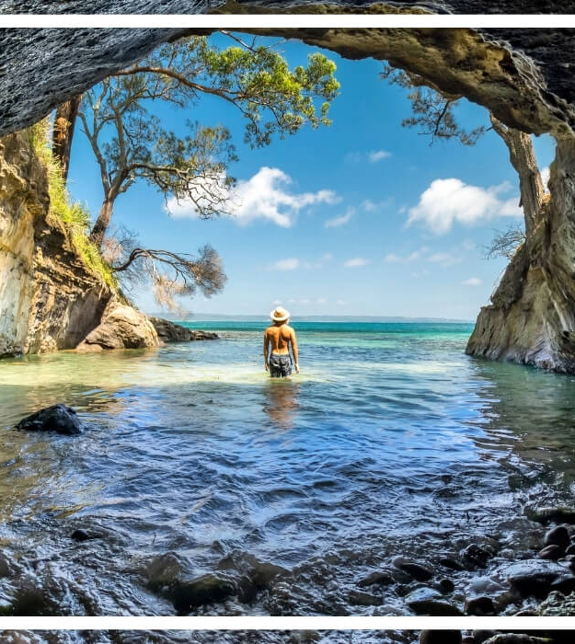
Potential day hikes
Experiment with different structures – timetable, lessons, times etc…
Rework capabilities in a Heritage context
Community partnership exploration
Subject integration of PBL
New subjects?
Pilot programs
Notes:
These are just ideas at this stage (off the top of my head). There could be many more that we can do, or may need to think about.

Slide 28
The Case for Change
The world is changing from a job requirement and educational emphasis perspective locally and globally and we need to prepare our students for this
We've been doing well; but our enquiries suggest that there are some problems with
Grades focus from students and parents
Risk and mistake aversion from students
Capabilities development
Student Agency in learning
But there are opportunities now to change! We get to design and deliver the change we need to help our students and families (what if we...?)

Slide 29
Next Actions
Call for a smaller group interested in progressing these ideas Primary & Secondary to go on ‘day trips’
Notes:
This can be part of existing Professional learning teams potentially down the track. At this stage we're starting the ball rolling, so would like anyone interested in this to get involved in a smaller group to continue the exploration of possibilities and then see where it goes from there.
We need to think about how we're going to get from where we are now, to where we need to be in 2025.

