Slide 1
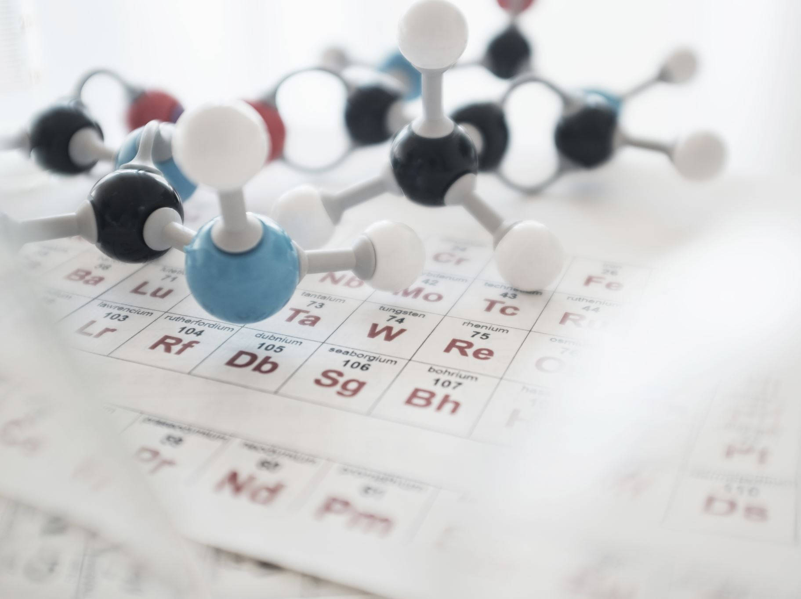
Introduction to the Periodic Table
Atomic Number ● Symbol ● Atomic Weight
Element ● Compound ● Mixture

Slide 2
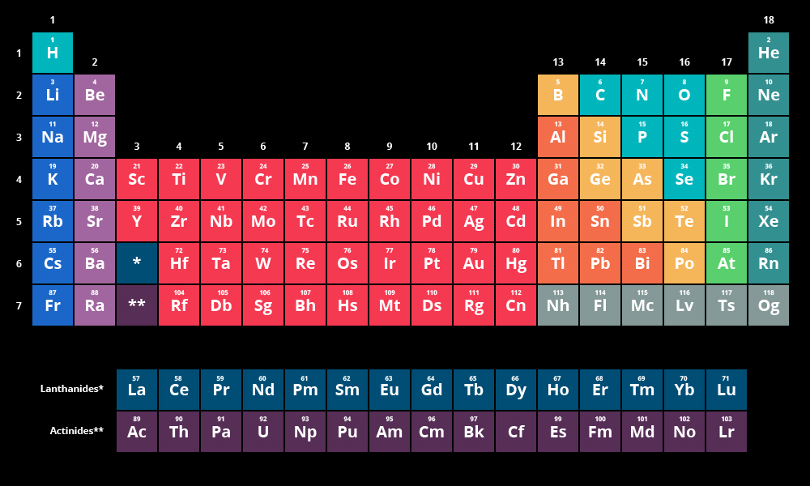
I am Dmitri Mendeleev!
Dmitri Mendeleev was a Russian scientist and inventor. He was born on February 8th, 1834
Dmitri Mendeleev's Periodic Table of Elements was created in 1869. It is a table that visually organizes all of the existing elements by their increasing atomic weights, which he originally measured in "Daltons."
I made the PERIODIC TABLE !

Slide 3
I am Dmitri Mendeleev!
In the original (Table), there were open spaces for elements that had not been discovered yet. Over time more scientists have added elements to it and have expanded off of his work. It was important because it organized in a visually meaningful way all of the elements and aspects which relate to atomic theory. For example, the atomic weight increases by row and by left to right. The columns link elements with similar chemical behavior and electron structure. These relationships also show up in the Periodic Law.

Slide 4
What is the PERIODIC TABLE?
Shows all known elements in the universe.
Organizes the elements by chemical properties.

Slide 5
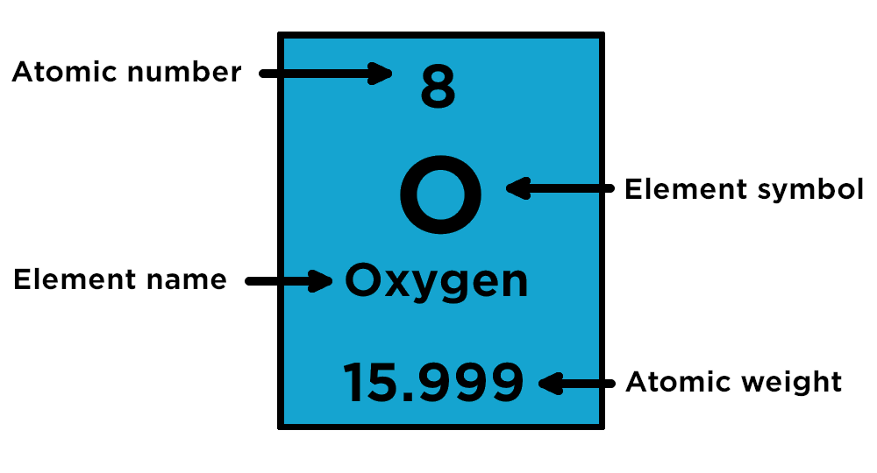
How do you read the PERIODIC TABLE?

Slide 6
What is the ATOMIC NUMBER?
The number of protons found in the nucleus of an atom
Or
The number of electrons surrounding the nucleus of an atom.

Slide 7
What is the SYMBOL?
An abbreviation of the element name.
Question…is it always just the first letter or two of the element?
Na, K, Fe, Ag, Au, Hg, Pb etc

Slide 8
What is the ATOMIC WEIGHT?
The number of protons and neutrons in the nucleus of an atom.

Slide 9
How do I find the number of protons, electrons, and neutrons in an element using the periodic table?
# of PROTONS = ATOMIC NUMBER
# of ELECTRONS = ATOMIC NUMBER
# of NEUTRONS = ATOMIC _ ATOMIC
WEIGHT NUMBER

Slide 10
Elements, Compounds, and Mixtures

Slide 11
What is an ELEMENT?
A substance composed of a single kind of atom.
Cannot be broken down into another substance by chemical or physical means.

Slide 12
What is a COMPOUND?
A substance in which two or more different elements are CHEMICALLY bonded together.

Slide 13
What is a MIXTURE?
Two or more substances that are mixed together but are NOT chemically bonded.

Slide 14
Element, Compound or Mixture?

Slide 15
Element, Compound or Mixture?

Slide 16
Element, Compound or Mixture?

Slide 17
Element, Compound or Mixture?

Slide 18
Element, Compound or Mixture?

Slide 19
Element, Compound or Mixture?

Slide 20
Isotopes
Atoms of the same element with different mass numbers.
Nuclear symbol:
Mass #
12
6
C
Atomic #
Hyphen notation: carbon-12
Notes:
Each isotope has a different number of neutrons.

Slide 21
Isotopes
Neutron
+
+
+
Electrons
Nucleus
+
+
+
Proton
Nucleus
Nucleus
Proton
+
+
+
Neutron
Carbon-12
+
+
Neutrons 6
Protons 6
Electrons 6
Electrons
+
Carbon-14
Neutrons 8
Protons 6
Electrons 6
Nucleus
Notes:
The chemistry of each element is determined by its number of protons and electrons.
In a neutral atom, the number of electrons equals the number of protons.
Symbols for elements are derived directly from the element’s name.
Nuclei of atoms contain neutrons as well as protons.
The number of neutrons is not fixed for most elements, unlike protons.
Atoms that have the same number of protons, and hence the same atomic number, but different numbers of neutrons are called isotopes.

Slide 22
⁶Li ⁷Li
3 p⁺
3 n⁰
3 p⁺
4 n⁰
2e– 1e–
2e– 1e–
Neutron
Neutron
Electrons
+
Electrons
+
Nucleus
+
+
Nucleus
+
+
Proton
Proton
Nucleus
Nucleus
Lithium-6
Lithium-7
Neutrons 3
Protons 3
Electrons 3
Neutrons 4
Protons 3
Electrons 3

Slide 23
Isotopes
17
Cl
37
Chlorine-37
atomic #:
mass #:
# of protons:
# of electrons:
# of neutrons:
17
37
17
17
20
37
17
Cl
Notes:
Atoms that have the same number of protons, and hence the same atomic number, but different numbers of neutrons are called isotopes.

Slide 24
Average Atomic Mass
weighted average of all isotopes
on the Periodic Table
round to 2 decimal places
Avg.
Atomic
Mass
(mass)(%) + (mass)(%)
=
100

Slide 25
Average Atomic Mass
EX: Calculate the avg. atomic mass of oxygen if its abundance in nature is 99.76% ¹⁶O, 0.04% ¹⁷O, and 0.20% ¹⁸O.
Avg.
Atomic
Mass
=
(16)(99.76) + (17)(0.04) + (18)(0.20)
=
16.00
amu
100
Courtesy Christy Johannesson www.nisd.net/communicationsarts/pages/chem

Slide 26
Average Atomic Mass
EX: Find chlorine’s average atomic mass if approximately 8 of every 10 atoms are chlorine-35 and 2 are chlorine-37.
Avg.
Atomic
Mass
(35)(8) + (37)(2)
=
=
35.40 amu
10

Slide 27
100
17
Cl
Mass spectrum of chlorine. Elemental chlorine (Cl₂) contains
only two isotopes: 34.97 amu (75.53%) and 36.97 (24.47%)
90
35.4594
80
Cl-35
70
60
AAM = (34.97 amu)(0.7553) + (36.97 amu)(0.2447)
AAM = (26.412841 amu) + (9.046559 amu)
AAM = 35.4594 amu
50
Abundance
40
30
Cl-37
20
10
0
34
35
36
37
Mass
Notes:
Mass spectrum of chlorine. Elemental chlorine (Cl₂) contains
only two isotopes: 34.97 amu (75.53%) and 36.97 (24.47%)

Slide 28
Mass Spectrophotometer
magnetic field
heaviest
ions
stream
of ions of
different
masses
lightest
ions
electron
beam
gas

Slide 29
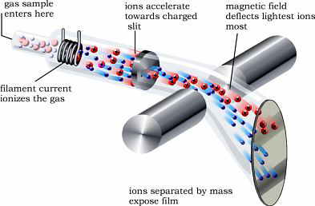
Weighing atoms
.
gas sample
enters here
ions accelerate
towards charged
slit
magnetic field
deflects lightest ions
most
filament current
ionizes the gas
The first mass spectrograph was built in 1919 by F. W. Aston, who received the 1922 Nobel Prize for this accomplishment
ions separated by mass
expose film
mass spectrometry is used to experimentally determine isotopic masses
and abundances
interpreting mass spectra
average atomic weights
- computed from isotopic masses and abundances
- significant figures of tabulated atomic weights gives some idea
of natural variation in isotopic abundances
Copyright © 1997-2005 by Fred Senese

Slide 30
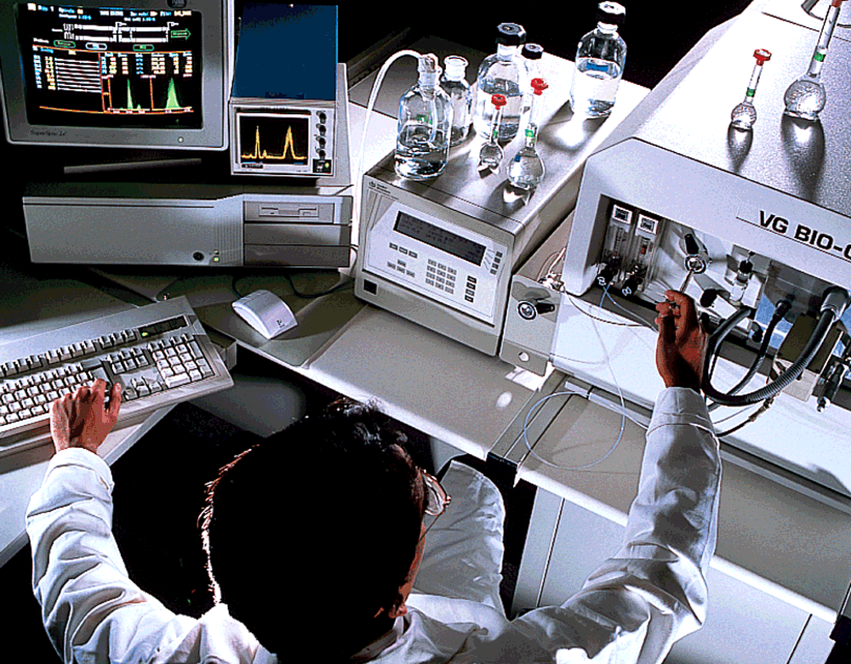
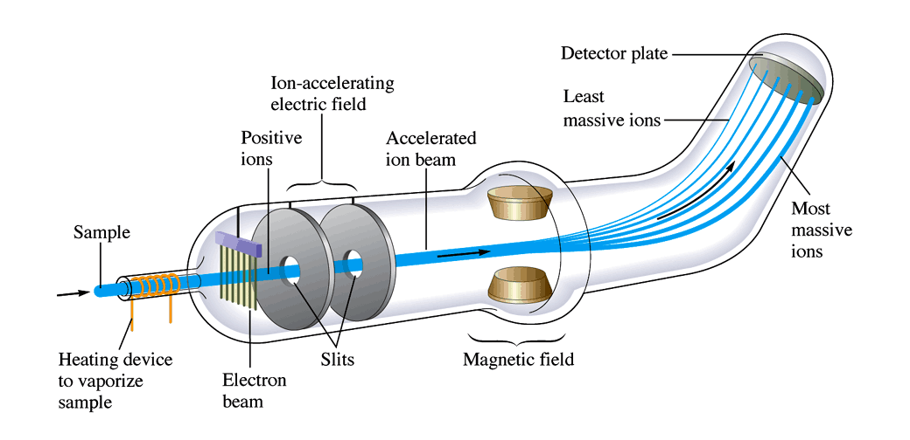
Mass Spectrometer
Notes:
Gives a ratio of the masses to each other that can be multiplied by the amu’s to get the atomic mass.

Slide 31
Mass Spectrometry
198 200 202
Photographic plate
196 199 201 204
-
+
Mass spectrum of mercury vapor
Stream of positive ions
Hill, Petrucci, General Chemistry An Integrated Approach 1999, page 320
Notes:
A gaseous sample is ionized by bombarding it with electrons in the lower part of the apparatus (not shown), producing positive ions.
The ions pass through an electric field in which they are brought to a particular velocity. The ions then pass through a narrow slit
into a curved chamber. A magnetic field is applied perpendicular to the beam of ions. All the ions with the same mass-to-charge ratio
are deflected into the same circular path. (In most cases, the ionic charge is 1+ and the mass-to-charge ratio is the same as the mass.)
Modern spectrophotometers use electronic detection devices (TOF = time of flight detectors) rather than photographic plates or film to
establish mass-to-charge ratios and relative number of ions.

Slide 32
Mass Spectrum for Mercury
(The photographic record has been converted to a scale of relative number of atoms)
The percent natural abundances
for mercury isotopes are:
Hg-196 0.146%
Hg-198 10.02%
Hg-199 16.84%
Hg-200 23.13%
Hg-201 13.22%
Hg-202 29.80%
Hg-204 6.85%
198 200 202
30
25
20
15
10
5
196 199 201 204
Mass spectrum of mercury vapor
Relative number of atoms
196 197 198 199 200 201 202 203 204
Mass number

Slide 33
80
Hg
200.59
The percent natural abundances
for mercury isotopes are:
Hg-196 0.146%
Hg-198 10.02%
Hg-199 16.84%
Hg-200 23.13%
Hg-201 13.22%
Hg-202 29.80%
Hg-204 6.85%
A
B
C
D
E
F
G
(% "A")(mass "A") + (% "B")(mass "B") + (% "C")(mass "C") + (% "D")(mass "D") + (% "E")(mass "E") + (% F)(mass F) + (% G)(mass G) = AAM
(0.00146)(196) + (0.1002)(198) + (0.1684)(199) + (0.2313)(200) + (0.1322)(201) + (0.2980)(202) + (0.0685)(204) = x
0.28616 + 19.8396 + 33.5116 + 46.2600 + 26.5722 + 60.1960 + 13.974 = x
x = 200.63956 amu

