Slide 1
Welcome to the World of STEM:
Exploring Science, Technology, Engineering, and Mathematics

Slide 2
What is STEM?
STEM stands for Science, Technology, Engineering, and Mathematics.
These fields play a critical role in shaping the world around us.
STEM encourages curiosity, critical thinking, problem-solving, and innovation.

Slide 3
What Skills Will I Develop?
STEM education cultivates a wide range of valuable skills: Critical thinking: Analysing problems and developing logical solutions.
Problem-solving: Applying creative and innovative approaches to overcome challenges.
Collaboration: Working effectively in teams to achieve common goals.
Communication: Articulating ideas and concepts clearly and concisely.
Data analysis: Collecting, interpreting, and drawing conclusions from data.
Technological literacy: Understanding and utilizing technology for various purposes.
Research skills: Conducting experiments, gathering information, and drawing evidence-based conclusions.

Slide 4
How Do I Do Well in This Subject?
Be curious: Ask questions, explore new ideas, and seek deeper understanding.
Stay engaged: Actively participate in class discussions and hands-on activities.
Practice problem-solving: Challenge yourself, and real-world scenarios.
Embrace teamwork: Collaborate with classmates, exchange ideas, and learn from one another.
Seek support: Don't hesitate to ask questions or seek assistance when needed.
Develop strong study habits: Review and reinforce concepts regularly.
Apply concepts to real-life situations: Connect what you learn to practical applications.

Slide 5
What is Aeronautics?
Aerodynamics: The study of how air interacts with the aircraft's surfaces, wings, and control systems to generate lift, manage stability, and control motion.
Aircraft Design: The process of creating and developing aircraft, including the selection of appropriate materials, structural design, systems integration, and performance optimization.
Propulsion Systems: The design and engineering of engines and power systems that provide thrust to propel aircraft through the air, such as jet engines, turboprops, or rocket engines.
Flight Mechanics: The study of the forces and motion of an aircraft during flight, including topics like stability, control, maneuverability, and performance characteristics.
Avionics: The electronics and computer systems used in aircraft, including navigation systems, communication systems, flight controls, and instrumentation.

Slide 6
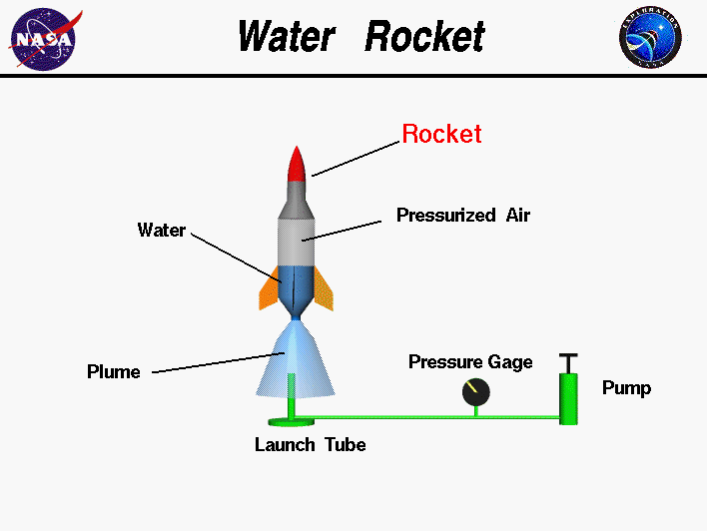
Stage 1 – Water bottle rockets
Aerodynamics: The study of how air interacts with the aircraft's surfaces, wings, and control systems to generate lift, manage stability, and control motion.
Aircraft Design: The process of creating and developing aircraft, including the selection of appropriate materials, structural design, systems integration, and performance optimization.
Propulsion Systems: The design and engineering of engines and power systems that provide thrust to propel aircraft through the air, such as jet engines, turboprops, or rocket engines.
Flight Mechanics: The study of the forces and motion of an aircraft during flight, including topics like stability, control, maneuverability, and performance characteristics.
Avionics: The electronics and computer systems used in aircraft, including navigation systems, communication systems, flight controls, and instrumentation.

