Slide 1
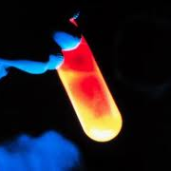
Introduction to Chemical Reactions

Slide 2
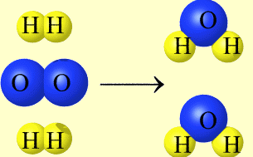
What is a Chemical Reaction?
It is a chemical change in which one or more substances are destroyed and one or more new substances are created.
BEFORE
H₂ gas
and
O₂ gas
AFTER
H₂O liquid

Slide 3
Parts of a Chemical Reaction
Reactants → Products
Reactants: Substances that are destroyed by the chemical change (bonds break).
Products: Substances created by the chemical change (new bonds form).

Slide 4
Other symbols in chemical reactions
(s) = solid
(l) = liquid
(g) = gas
(aq) = aqueous solution (the substance is dissolved in H₂O)
“+” separates two or more reactants or products
“→” yield sign separates reactants from products

Slide 5
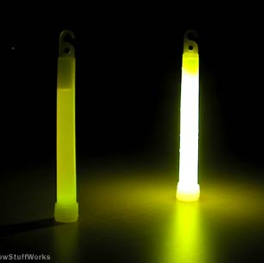
Evidence for a Chemical Reaction
1) Evolution of light or heat.

Slide 6
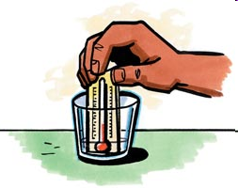
Evidence for a Chemical Reaction
2) Temperature change (increase or decrease) to the surroundings.

Slide 7
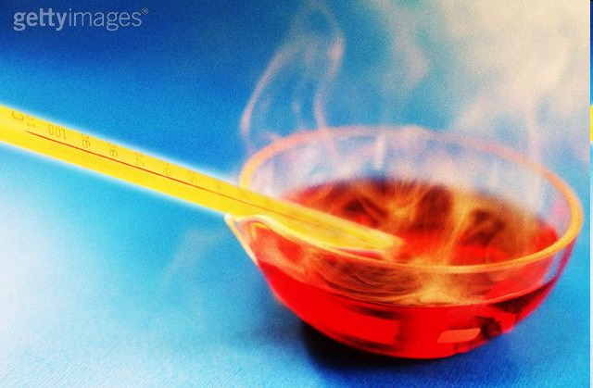
Evidence for a Chemical Reaction
3) Formation of a gas (bubbling or an odor) other than boiling.

Slide 8
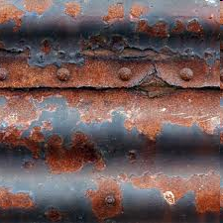
Evidence for a Chemical Reaction
4) Color change (due to the formation of a new substance).

Slide 9
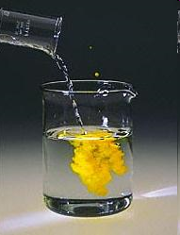
Evidence for a Chemical Reaction
5) Formation of a precipitate (a new solid forms) from the reaction of two aqueous solutions.

Slide 10
Word Equations
Statements that indicate the reactants and products in a chemical reaction.
Ex. Iron (s) + chlorine (g) → iron (III) chloride (s)
This is read as:
“Solid iron and chlorine gas react (combine) to produce solid iron (III) chloride”

Slide 11
Translating Word Equations to Unbalanced Equations
A unbalanced equation uses chemical formulas rather than words to identify the reactants and products of a chemical reaction.
The word equation
Iron (s) + chlorine (g) → iron (III) chloride (s)
The unbalanced equation
Fe(s) + Cl₂(g) → FeCl₃ (s)
A unbalanced equation is not yet “balanced” by coefficients!

Slide 12
One more example…
6 Na (s) + Fe₂O₃ (s) → 3 Na₂O (s) + 2 Fe (s)
The numbers preceding the chemical formulae are coefficients. They are used to balance the reaction.
The numbers within the chemical formulae are subscripts.
You can read the above balanced reaction as:
“6 atoms of solid sodium plus 1 formula unit of solid iron (III) oxide yields 3 formula units of solid sodium oxide and 2 atoms of solid iron” or…
Chemical reactions can never be read in terms of grams, only in terms of particles or groups of particles (moles).

Slide 13
Conservation of Mass
During a chemical reaction, atoms are neither created nor destroyed (Conservation of Mass).
Hydrogen and oxygen gas react to form water:
H₂ _{(g)} + O_{2 (g)} → H₂O _{(l)}

Slide 14
Conservation of Mass
H₂ _{(g)} + O_{2 (g)} → H₂O _{(l)}
What is wrong with this equation above? Doesn’t it appear that one oxygen atom “went missing”?
According to conservation of mass, the proper way to write this reaction is:
2H₂ _{(g)} + 1O_{2 (g)} → 2H₂O _{(l)}

Slide 15
Not All Properties are Conserved During Chemical Reactions!
CONSERVED | NOT CONSERVED
Mass Types of atoms Number of each atom | Color Physical state (solid, liquid, gas) Volume Number of moles of reactants/products

