Slide 1
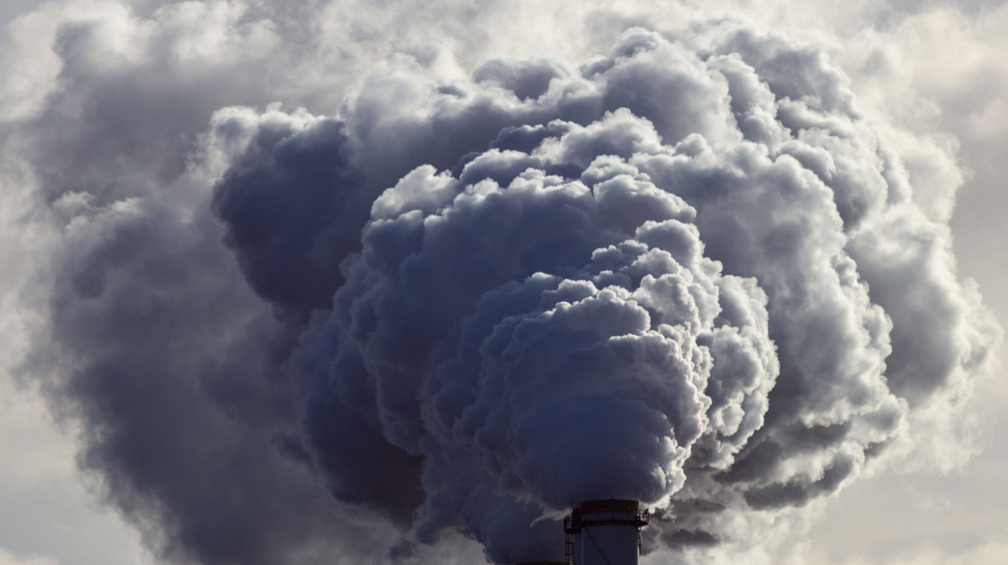
Oxygen reactions Combustion, Respiration and corrosion

Slide 2
Definition of Combustion:
Combustion is a chemical reaction that occurs when a substance reacts with oxygen gas (O₂) to produce heat, light, and usually other products.

Slide 3
Components of Combustion:
Fuel: The substance that undergoes combustion. It can be solid, liquid, or gas, and examples include wood, gasoline, and natural gas.
Oxidizing Agent: Typically oxygen (O₂) from the air, which is necessary for the combustion process to occur.
Combustion Reactions:
The general equation for a combustion reaction is: Fuel + Oxygen → Carbon Dioxide + Water (+ Heat and Light)

Slide 4
Complete vs. Incomplete Combustion:
Complete Combustion:
Occurs when there is sufficient oxygen available, leading to the production of carbon dioxide (CO₂) and water (H₂O) as the primary products.
Incomplete Combustion:
Occurs when there is limited oxygen, resulting in the production of carbon monoxide (CO) and soot (unburned carbon) in addition to carbon dioxide and water.

Slide 5
Common Combustion Reactions
Complete Combustion of Methane (Natural Gas):
Methane + Oxygen → Carbon Dioxide + Water
CH₄+ O₂ → CO₂ + H₂O
Incomplete Combustion of Methane (Limited Oxygen):
Methane + Oxygen → Carbon Monoxide + Water + Carbon (Soot)
CH₄ + O₂ → CO + H₂O + C
Combustion of Wood (Complex Mixture):
Wood (Cellulose) + Oxygen → Carbon Dioxide + Water + Ash (Mineral Residue)
C₆H₁₀O₅+ O₂ → CO₂ + H₂O + Ash (Mineral Residue)

Slide 6
Respiration
Definition of Respiration: Respiration is a chemical reaction that takes place within cells, where organic molecules (typically glucose) are broken down to release energy for cellular activities.
This energy keeps your body warm and provides energy for movement.

Slide 7
Aerobic Respiration
Glucose + Oxygen → Carbon Dioxide + Water
C₆H₁₂O₆ + 6 O₂ → 6 CO₂ + 6 H₂O

Slide 8
Corrosion
Definition
Corrosion is the gradual wearing away or deterioration of a material, usually a metal, due to chemical reactions with its environment, often involving substances like oxygen or moisture.

Slide 9
Chemical reaction
Metal + oxygen → Metal oxide
Eg – Iron rusting
4Fe + 3 O₂ + 6 H₂O → 4 Fe(OH)₃

