Slide 1
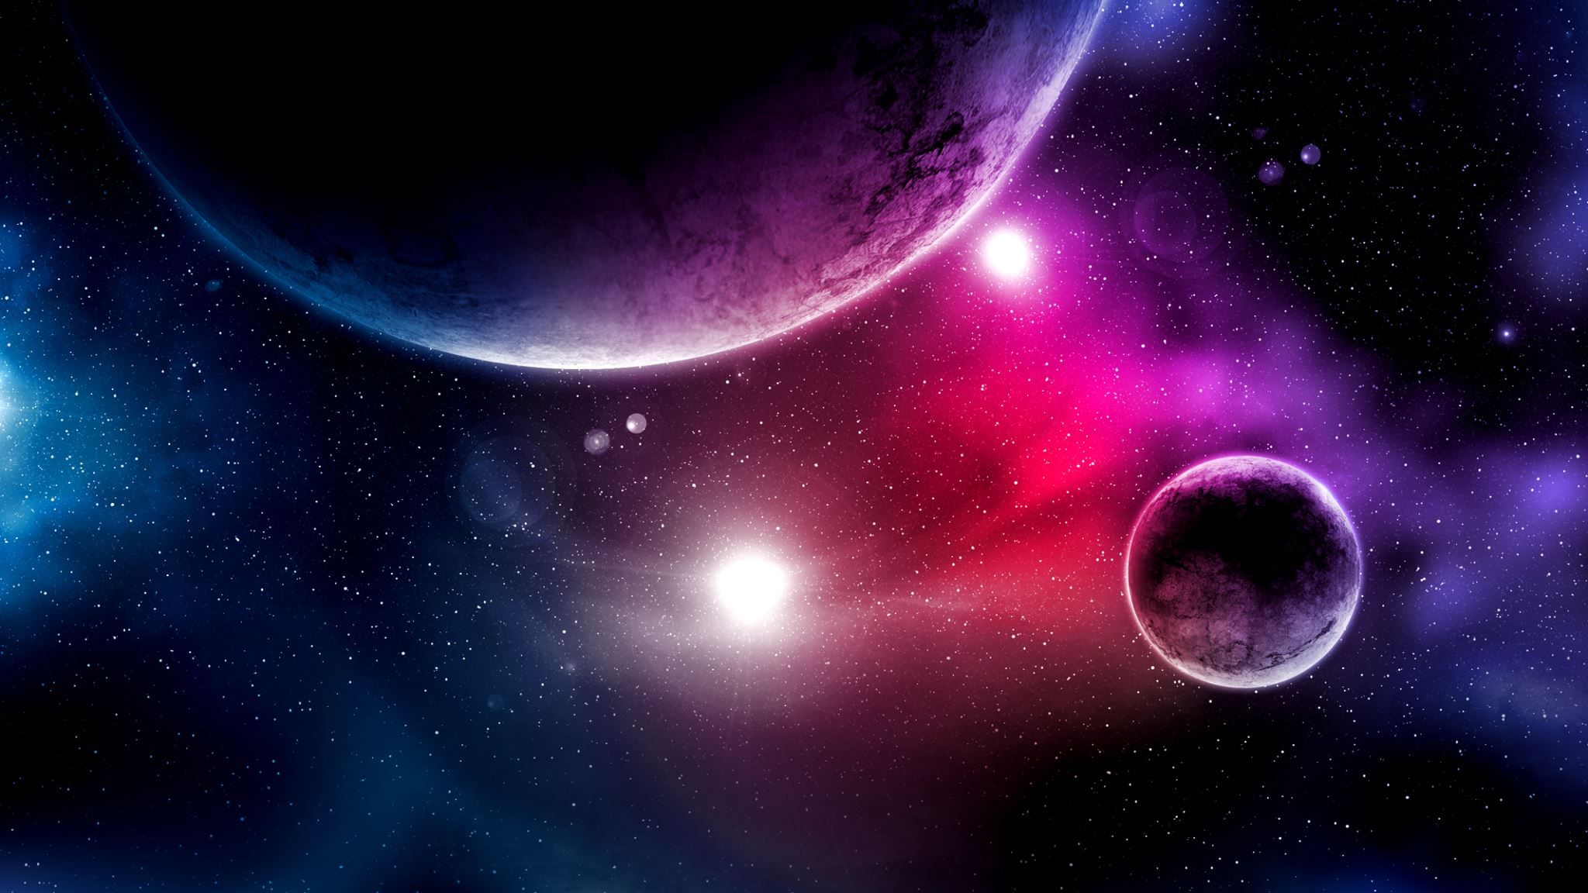
The universe

Slide 2
Representing and Calculating large distances
We use the speed of light as the measure for long distances
The Speed of light = c = 299 792 458 m / s
Or
c = 3x10⁸ m/s (in scientific notation)
Or 1,080,000,000 km/h
Or about 7.5 times around the world per second

Slide 3
Light measurements
1 Light second = 299 792 458 m
1 light minute = 17,987,547.480 km
The distance between earth and the sun is 8.3 light minutes
The distance between Pluto and the sun is 330.6 light minutes
An alternative to light years is a parsec
1 Parsec = 3.26 light years

Slide 4
Amazing videos…
Powers of 10 – the story of the universe
How big is the milky way?

Slide 5
Our nearest star

Slide 7
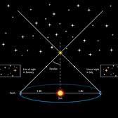
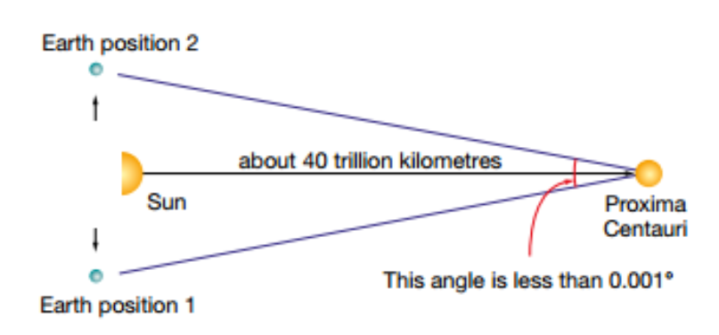
Parallax
Stellar Parallax and distance between stars

Slide 8
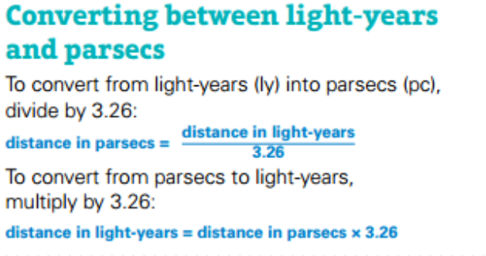
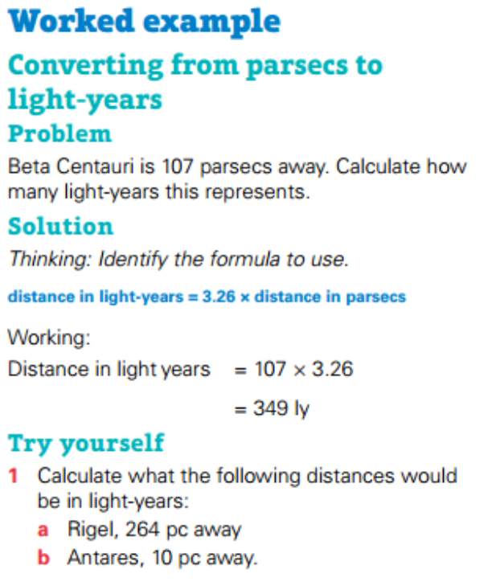
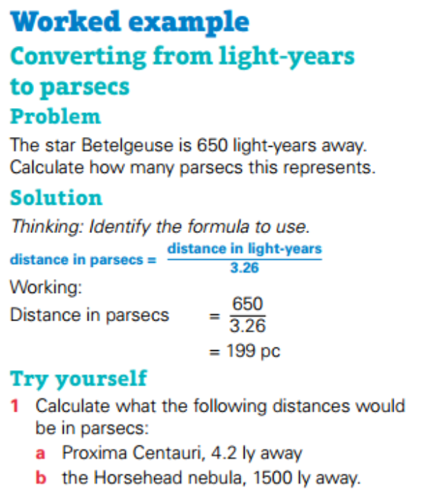
Calculations

Slide 9
Challenge Question:
- What is the distance from the sun to the earth?
- If the parallax angle between a nearby star is 0.0003 degrees, how far away is the star?

Slide 10
What is gravity?

Slide 11
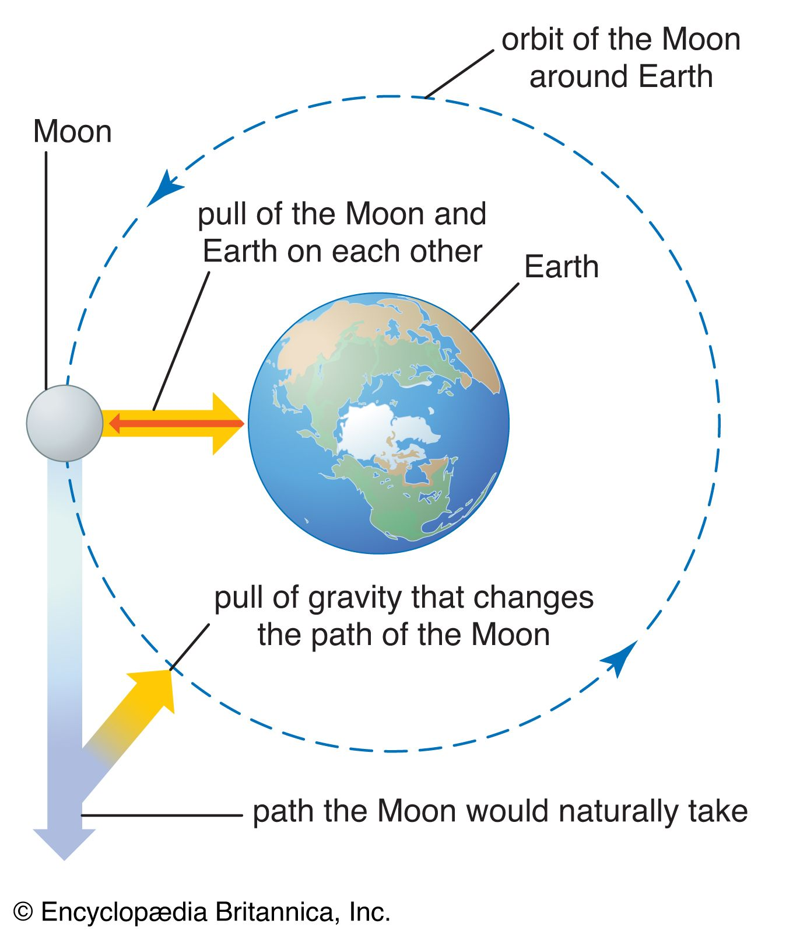
What is gravity?
The force that attracts a body towards the centre of the earth, or towards any other physical body having mass.

Slide 12
Gravity Lab – Make a universe!

Slide 13
A gravity experiment visualisation

Slide 14
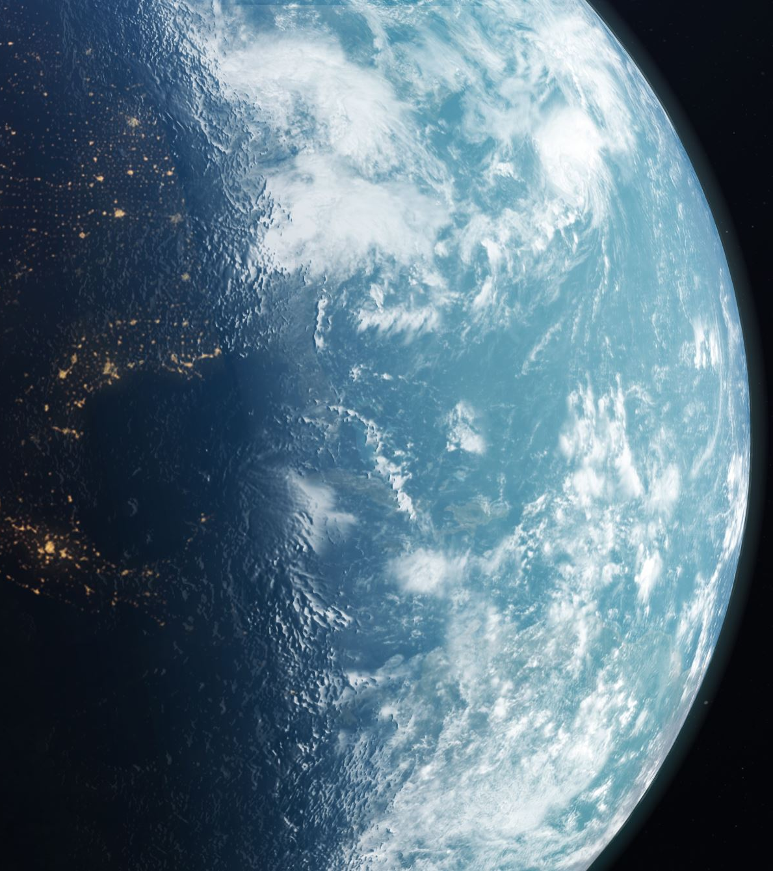
Discussion Questions: Form groups – you have 5 minutes to discuss and research one of the points below, then feedback to the class.
How does the mass of an object affect the strength of its gravitational pull?
Think about the concept of weightlessness in space. Why do astronauts appear weightless in orbit?
What are the differences between weight and mass, and how are they related to gravity?
What is escape velocity, and how does it relate to overcoming the gravitational pull of a planet or celestial body?
How does gravity influence the behaviour of light? Explain gravitational lensing and its implications for our understanding of the universe.
Discuss the concept of tidal forces and their impact on Earth and its oceans.

