Slide 1
The Life of a STAR

Slide 2
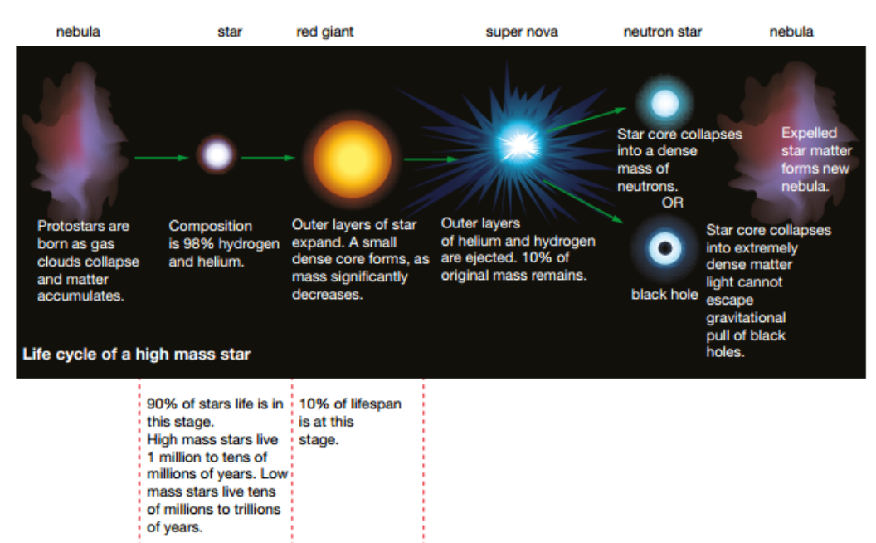

Slide 3
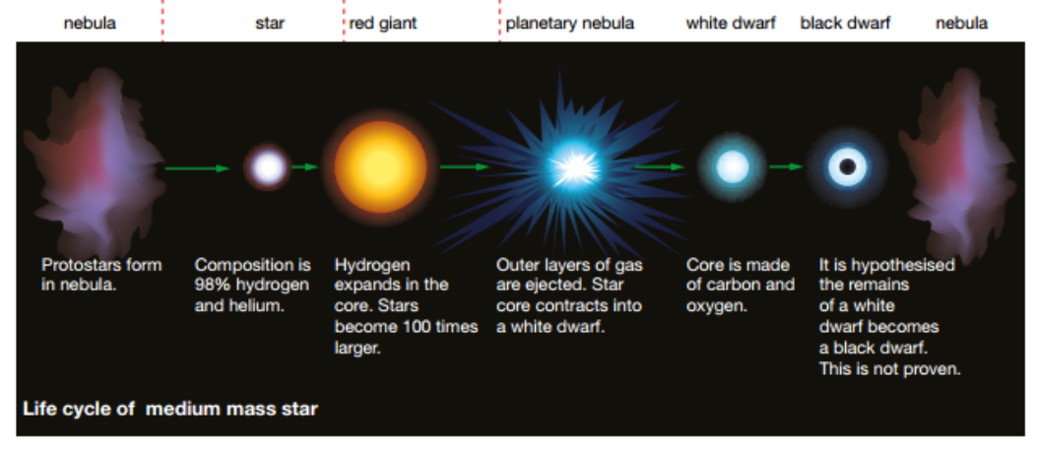

Slide 4
Complete the practical from page 348, recording your results and review in your book.

