Slide 1
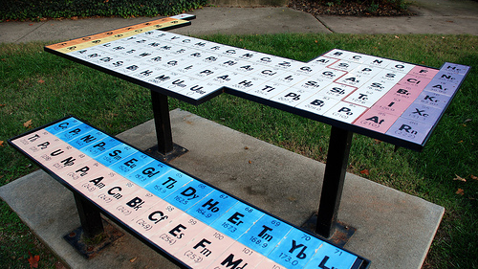
Learning
The Periodic Table of Elements

Slide 2
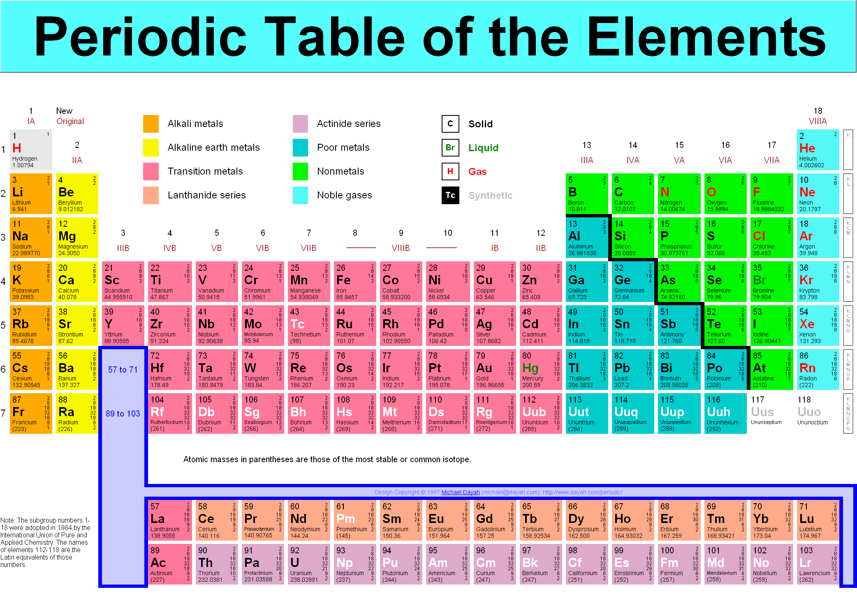
Notes:
“Periodic Table of Elements” image – linked to a webpage that has an interactive Periodic Table that can be clicked on for more information about each element in detail. May or may not be used during lesson.
Click the outer, black edges of the slide during presentation if you do not wish to link to the webpage.

Slide 3
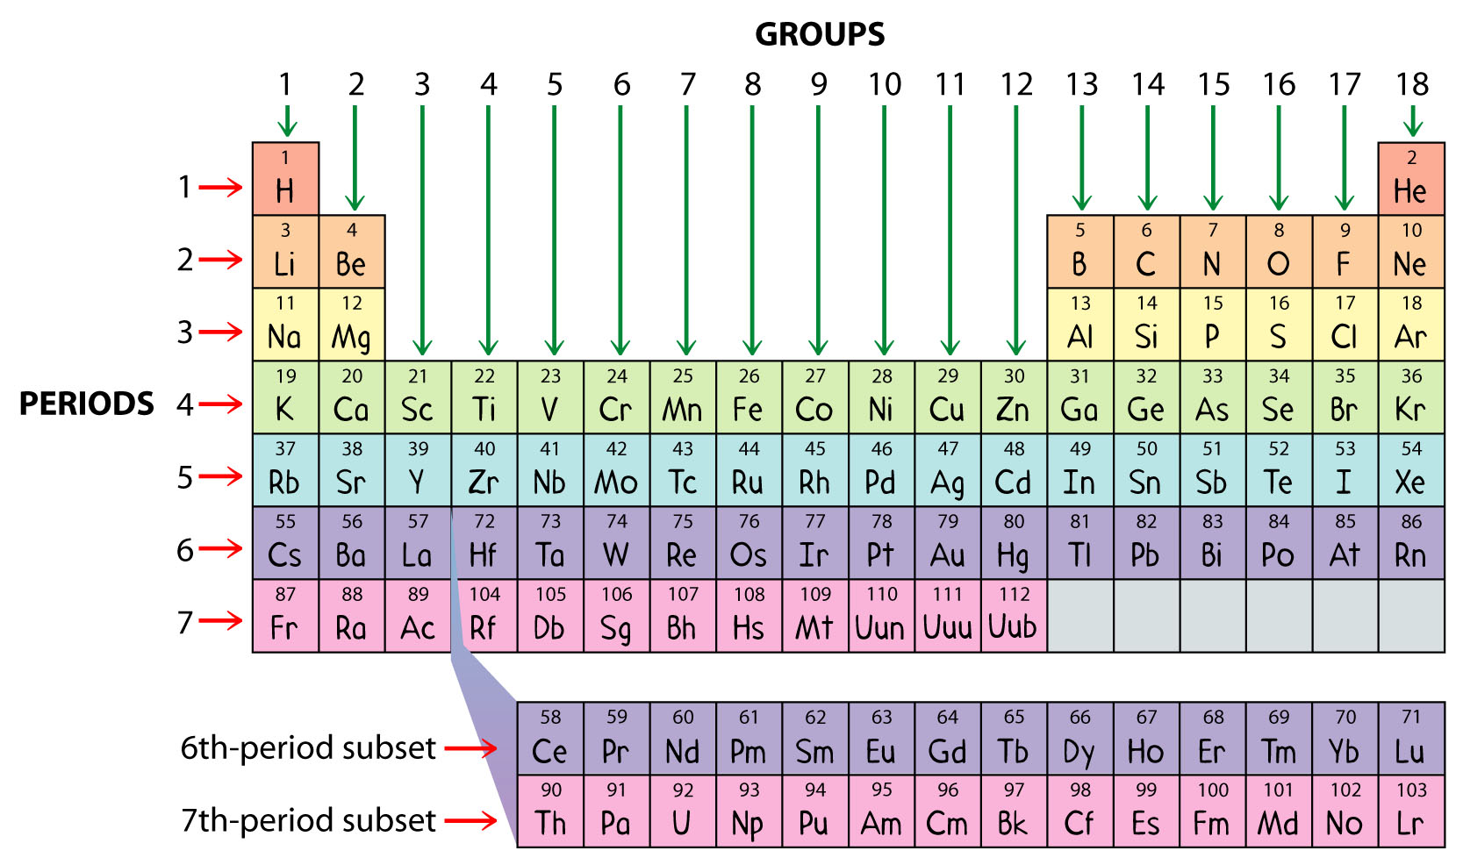
How is it Arranged?
The elements are put into rows by increasing ATOMIC NUMBER.
The horizontal rows are called Periods and are labeled 1 to 7.
The vertical column are called Groups and are labeled 1 to 18
The red li periods nes show the different periods and the green l groups ines show the groups.

Slide 4
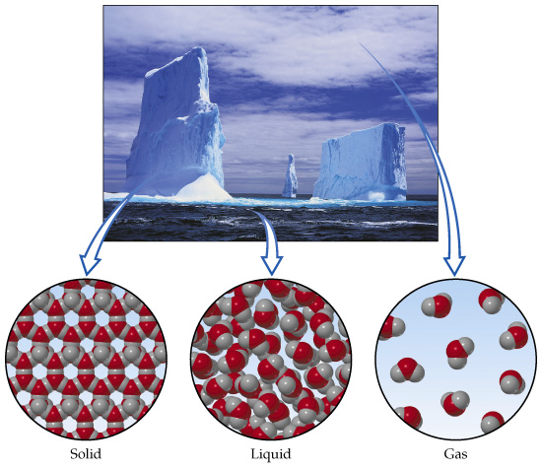



Three States of Matter
Substances are made up of particles.
The state of the substance depends on the arrangement of the particles.
The Three States of Matter
Solid
Particles held tightly
Very close together
Regular arrangement
Vibrate
Can’t move from place to place
Liquid
Particles held weakly
Very close together
Random arrangement
Vibrate
Constantly move past each other
Gas
No attraction between particles
Far apart
Random arrangement
Vibrate
Move quickly in all directions

Slide 5
Grouped Elements Have Similarities
Elements in the same group have similar properties. Remember, groups are columns.
Chemical Property - a property used to characterise materials in reactions that change their identity. Eg: burning something.
Physical Property - a characteristic of a substance that can be observed without changing the substance into something else. Eg density, colour, melting point, boiling points, electrical conductivity, etc..

Slide 6
Metals, Nonmetals and Metalloids
The major categories of elements are the metals, non-metals, and metalloids.
Metals are lustrous, malleable, and are good conductors of heat and electricity.
Non-metals are elements that do not share the properties of metals.
Metalloids are elements that share some, but not all the properties of metals.

Slide 7

Metals - Lustrous, Malleable, and
Good Conductors?
These are physical properties of metals
Lustrous means shiny or reflective of light.
  Coins and jewelry are shiny and reflective .
Malleable means capable of being shaped.
  Aluminum foil is shaped or molded around food items to keep them fresh.
Being a Good Conductor means being able to allow electricity and heat to flow through.
        When you think about the wires we use for
  electrical devices, they are mostly made of
  copper and other metals.

Slide 8
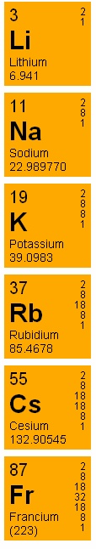
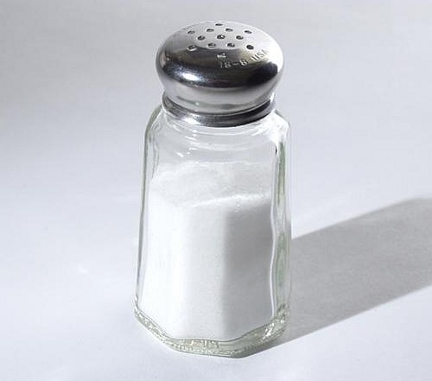
Alkali Metals
Elements in Group 1 (not including Hydrogen).
Very reactive metals. Always combine with something else in nature.
Salt – an Alkali Metal,
Sodium, and another
element, Chlorine,
combined.

Slide 9
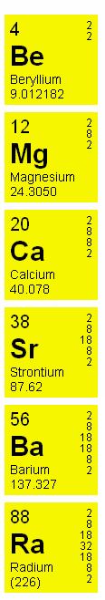
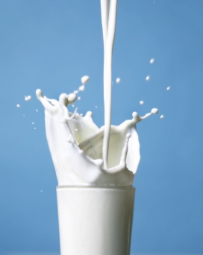
Alkaline Earth Metals
Elements in Group 2.
Reactive Metals that are always combined with non-metals in nature.
Several of these elements are important mineral nutrients, like Calcium.

Slide 10
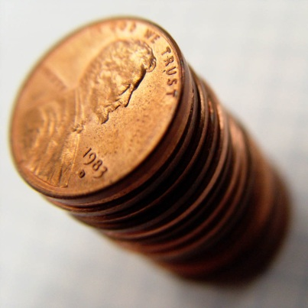
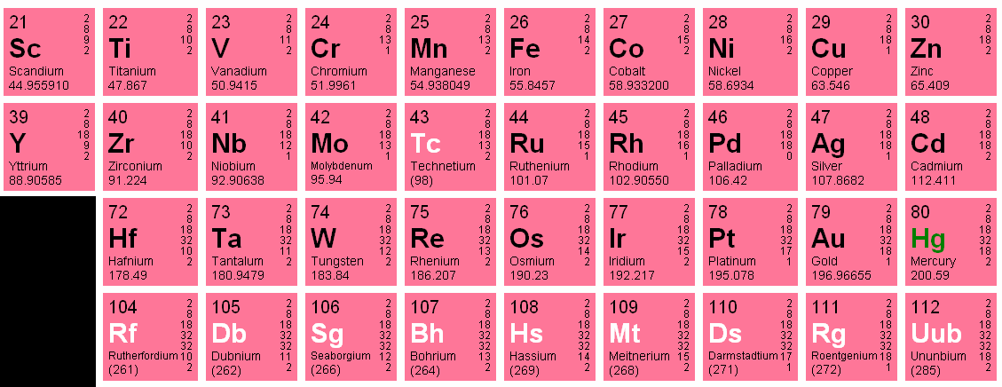
Transition Metals
Elements in Groups 3-12.
Less reactive, harder metals.
Includes metals used in jewelry, money and construction.

Slide 11
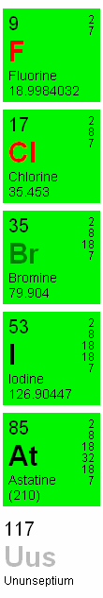

Halogens
Elements in Group 17.
Very reactive, diatomic non-metals.
Always found combined with other
elements in nature.
Chlorine is used to keep bacteria out of swimming pools.

Slide 12
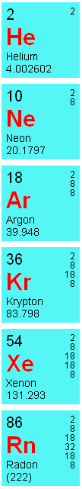


Noble Gases
Elements in Group 18.
VERY unreactive gases.
Used in lighted neon signs.
Helium is used to make party balloons float.

Slide 13
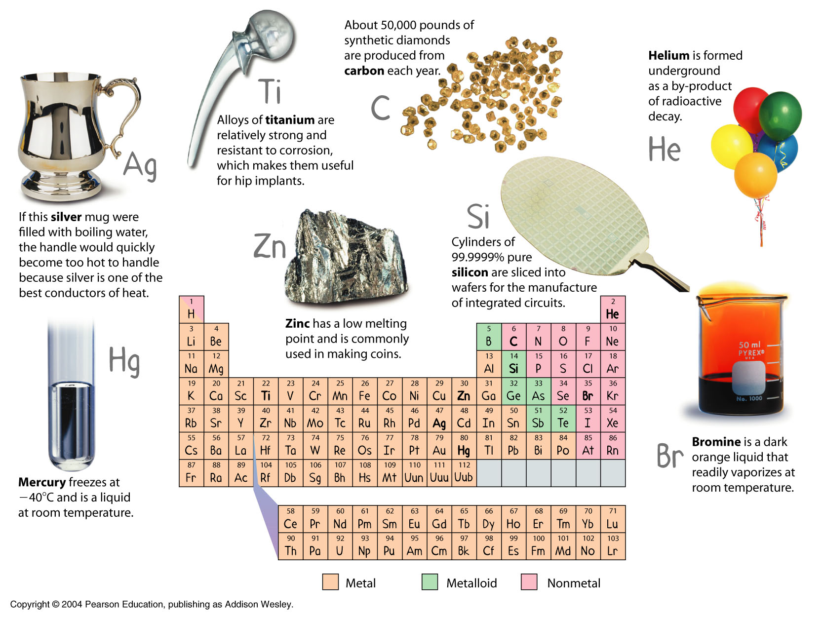
Elements Used Everyday
Can you think of any elements you use every day?
Notes:
Answer:
Oxygen for respiration, Nitrogen in the atmosphere, Copper in coins, Sodium and Chlorine for salt, Hydrogen and Oxygen for water, Aluminum foil for food.

