Slide 1
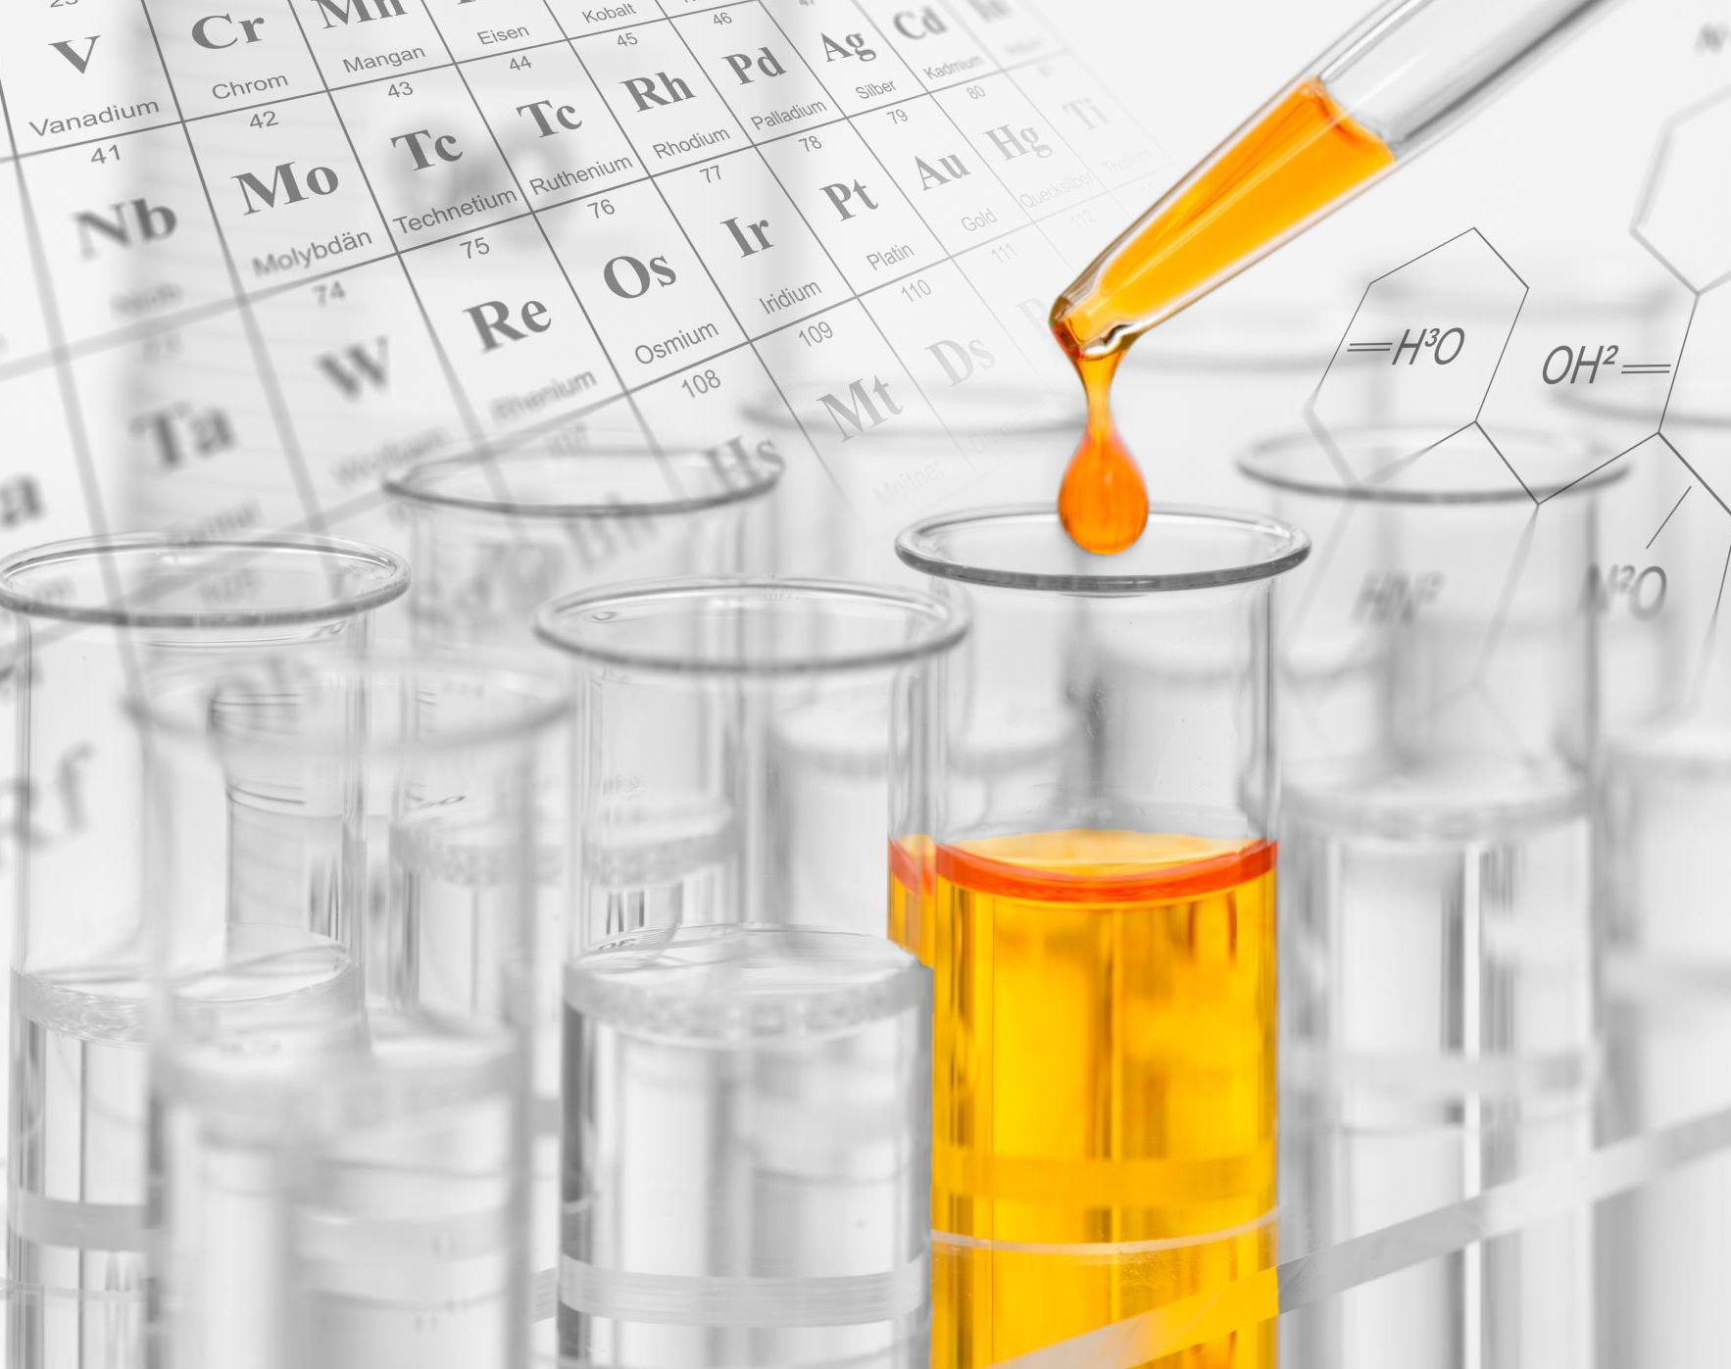
Classifying other chemical reactions

Slide 2
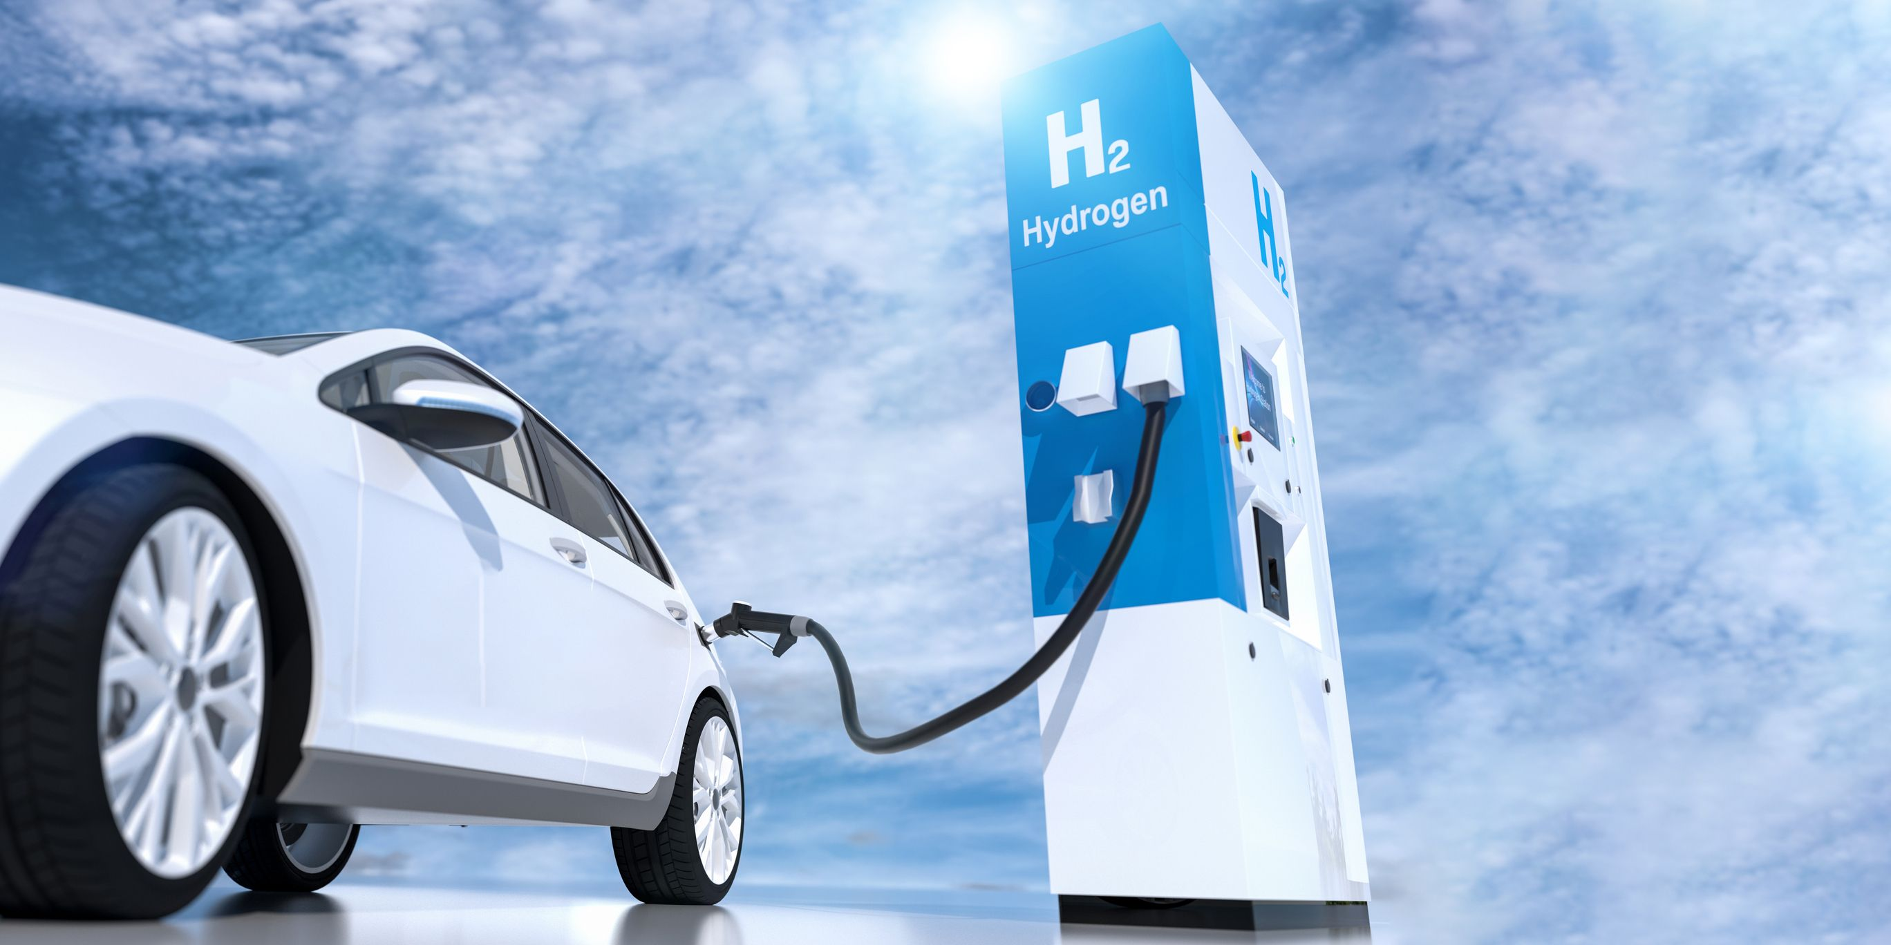
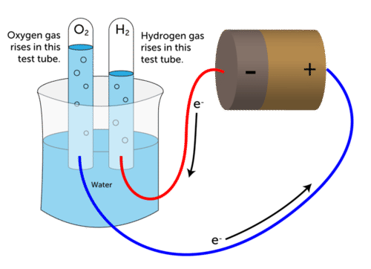
Decomposition reaction When a single reactant breaks apart to form several products. Water→ Oxygen + Hydrogen

Slide 3
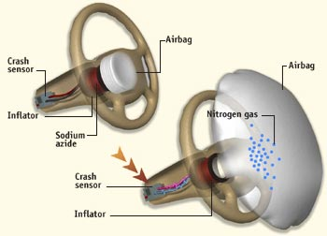
Thermal decomposition:
Some substances will only decompose when heated to high temperatures.
Eg
Sodium Azide → Sodium + Nitrogen gas
2 NaN₃ --> 2 Na + 3 N₂

Slide 4
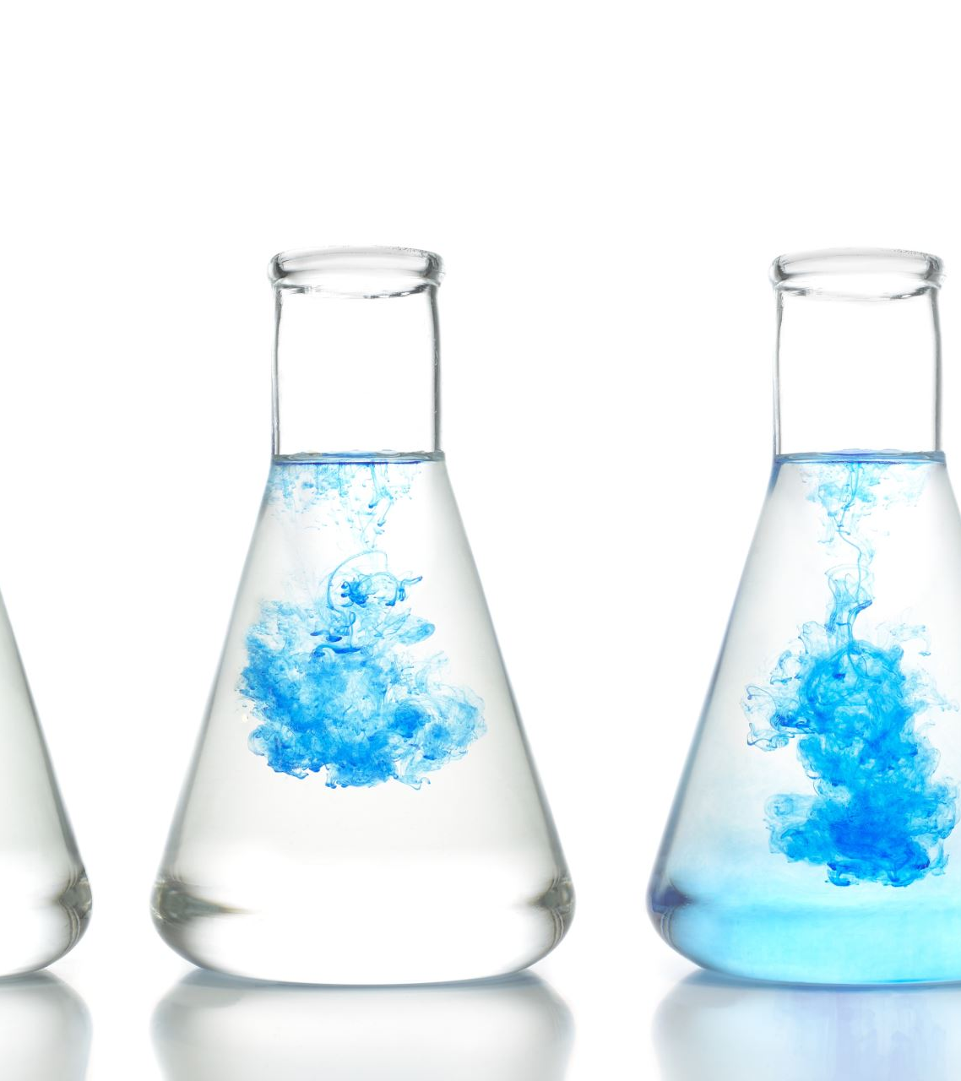
Combination Reaction:
When two reactants combine to form a single product.
Hydrogen gas + chlorine gas → hydrogen chloride gas

Slide 5
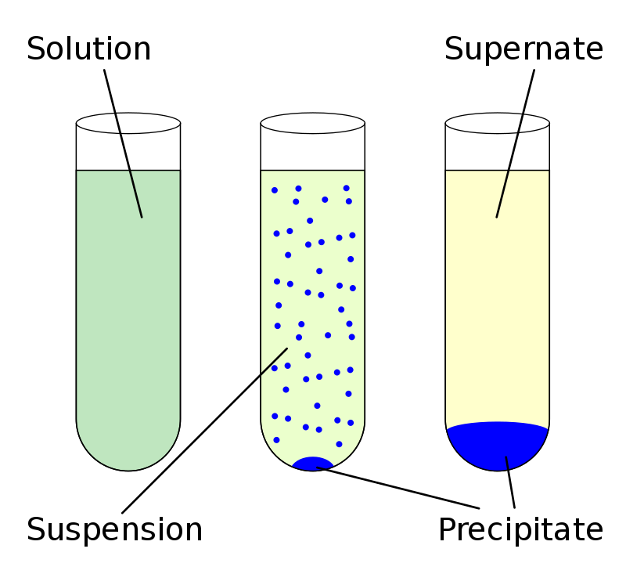
Precipitation Reaction
A precipitation reaction occurs when two soluble reactants combine to form an insoluble product known as precipitate.
Pb(NO3)2(aq) + 2KI (aq) → PbI2(s)(↓) + 2KNO3(aq)
Note your observations:

Slide 6
Reactions with acids
Neutralisation reactions
Acid + base → salt + water
Acid and metal reactions
Acid + metal → salt + hydrogen gas
Acid and carbonates
Acid + carbonate → salt + water + carbon dioxide

Slide 7
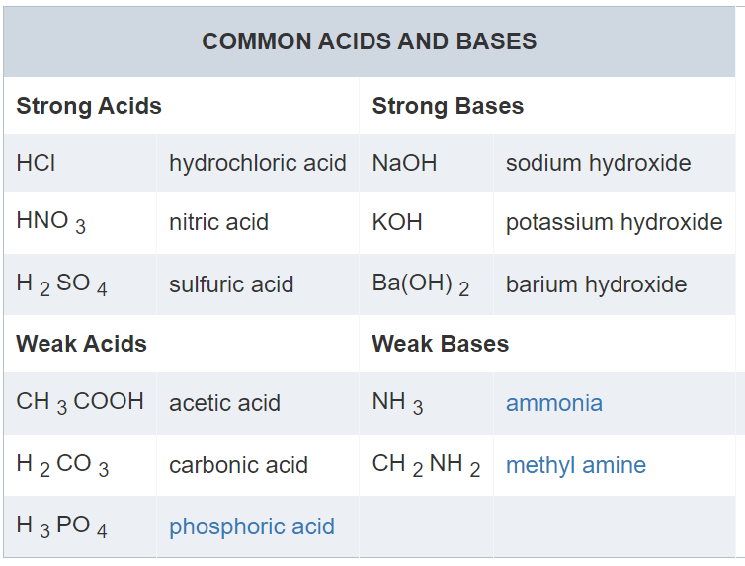

Slide 8
Complete 6.3 and 6.4 from your activity book

