Slide 1
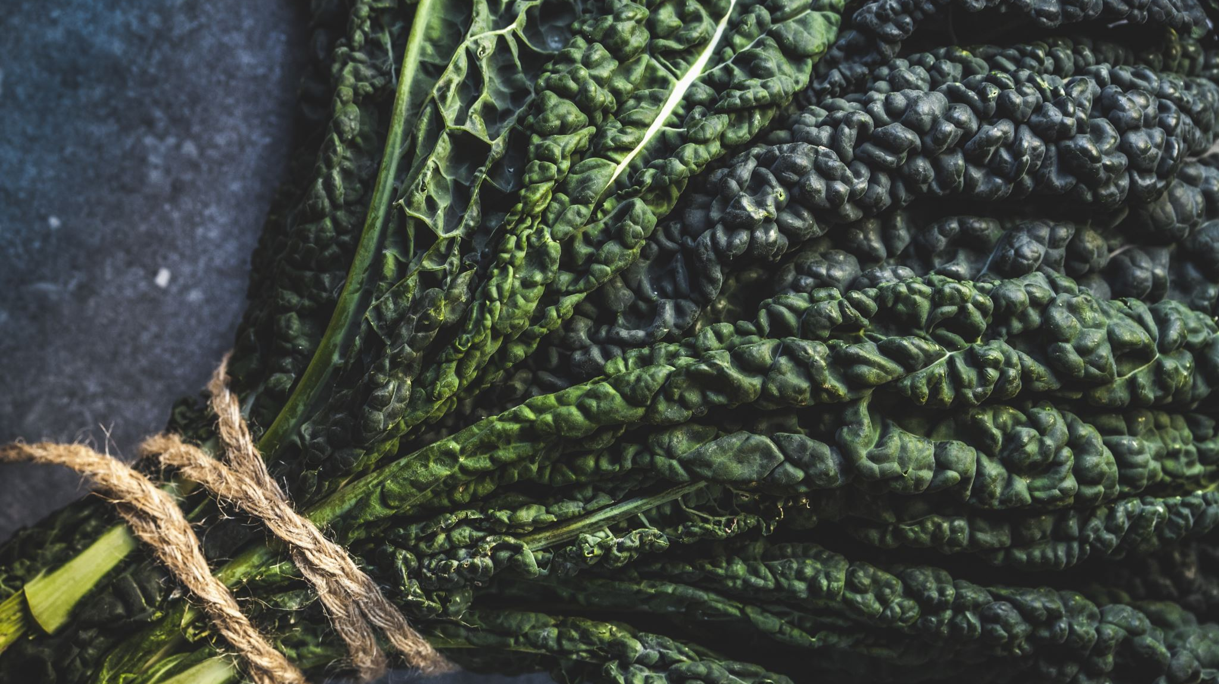
Germination

Slide 2
Seeds and germination explained

Slide 3
Summary

