Slide 1
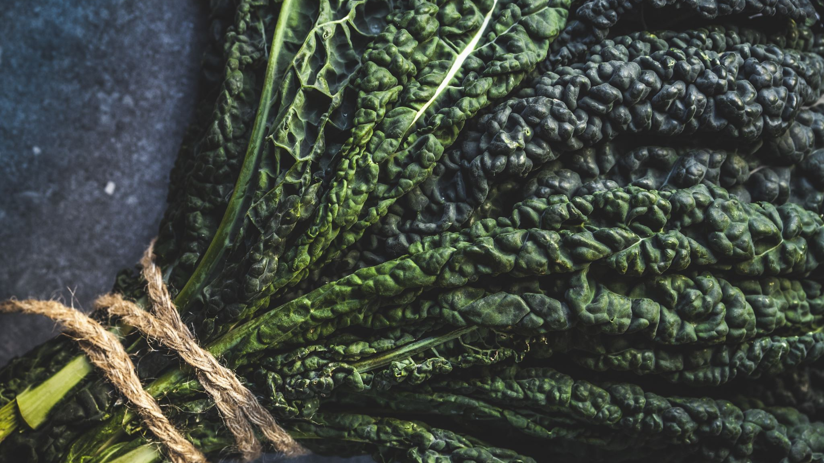
LIGHT

Slide 2
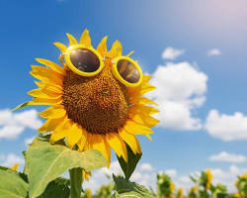
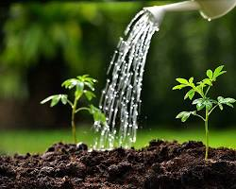
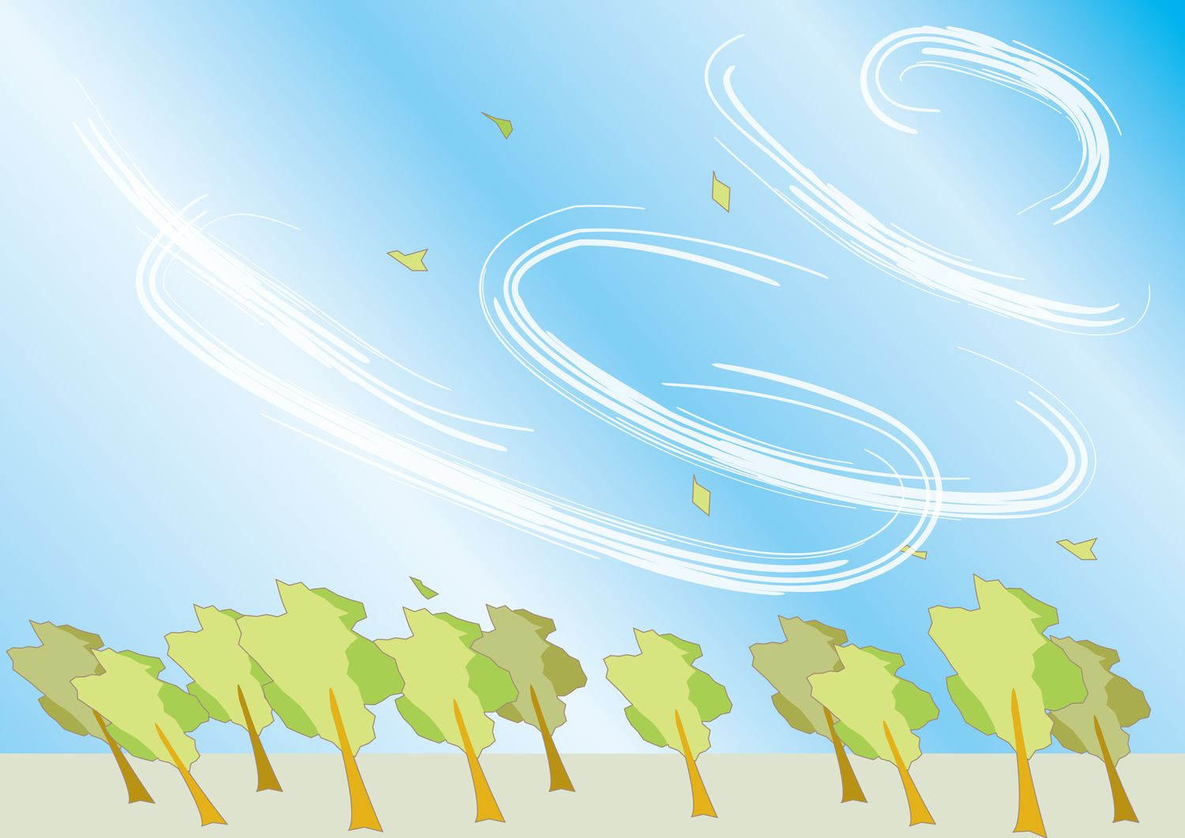
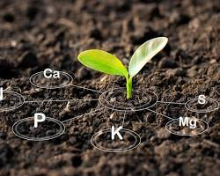
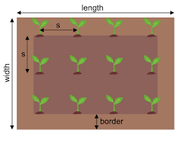

Light

Slide 3
Sunlight = plants energy source
Photosynthesis: Plants use light energy (sunlight) to convert water (H₂O) & carbon dioxide (CO₂) into glucose (C₆H₁₂O₆) for food + oxygen (O₂)
Chlorophyll (in leaves) captures light energy
Chemical reaction:
light energy + H₂O + CO₂ -> C₆H₁₂O₆ + O₂ ]

Slide 4
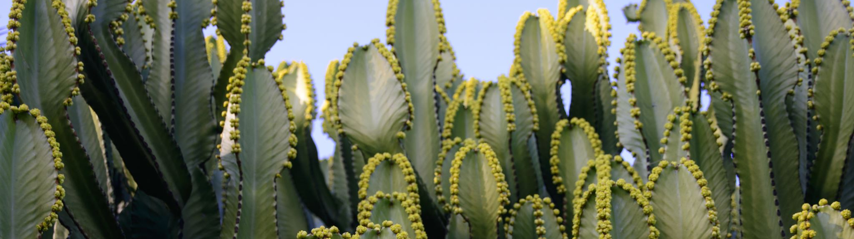
Quantity of light - A Balancing Act
Different light requirements for plants:
High light: Cacti, succulents (bright, direct sunlight)
Low light: Ferns, shade-loving plants (indirect light, filtered sun)
Too little light: Leggy plants, weak stems, pale leaves
Too much light: Scorched leaves, stunted growth
Measured in lux (lumens per square meter) or PPFD (Photosynthetic Photon Flux Density).
Different plants have varying light intensity requirements.
Seedlings generally need less light than mature plants.
A light meter can help you measure the intensity at different distances from the light source.

Slide 5
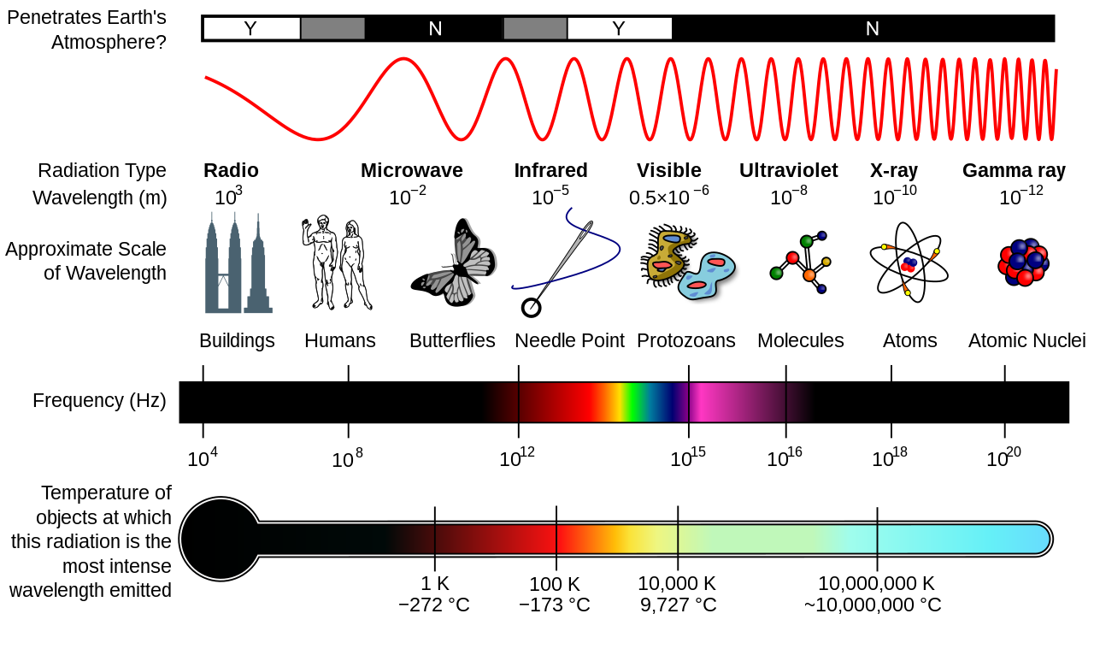
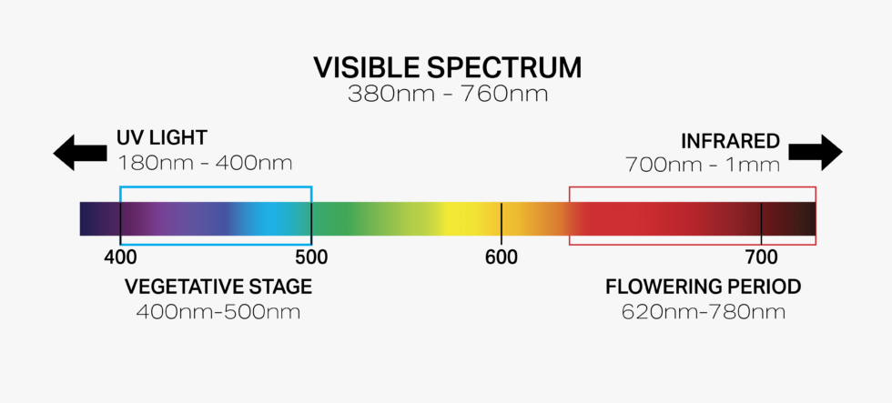


Light Spectrum
Visible Spectrum: Aim to mimic natural sunlight (full-spectrum) or target growth stages (blue/red LEDs).

Slide 6
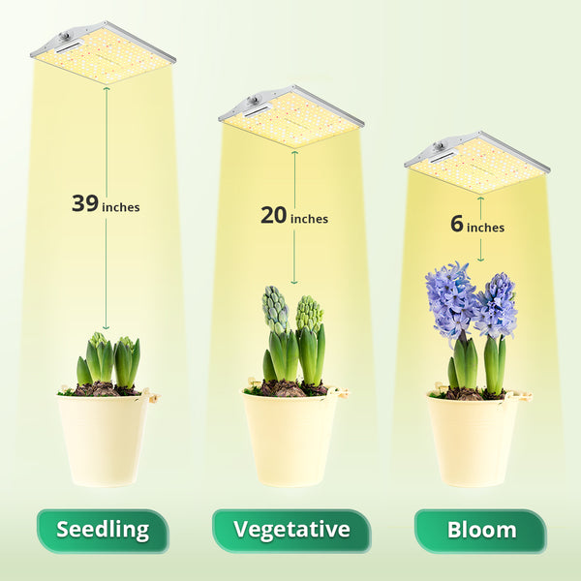
Light Distance:
The closer the light is to the plants, the higher the intensity.
Plants can be stressed by excessive light too close.
Refer to the grow light’s manual for recommendations for optimal placement distance.

Slide 7
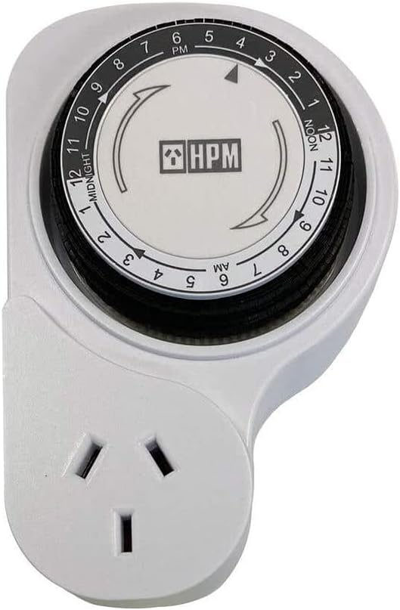
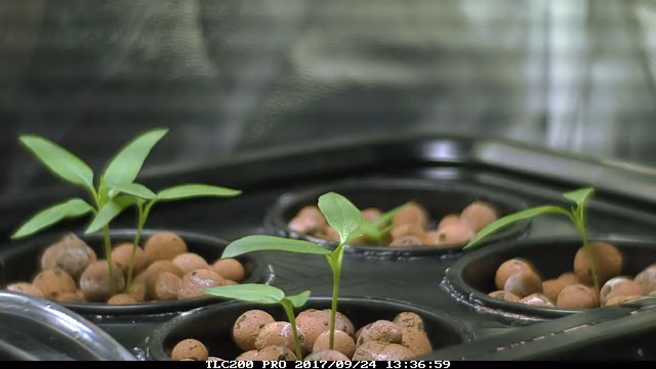
Light Duration (Photoperiod)
Plants respond to day/night cycles.
Seedlings may need 14-16 hours of light, while flowering plants might require 12 hours.
Timers can automate light cycles for consistent growth patterns

Slide 8
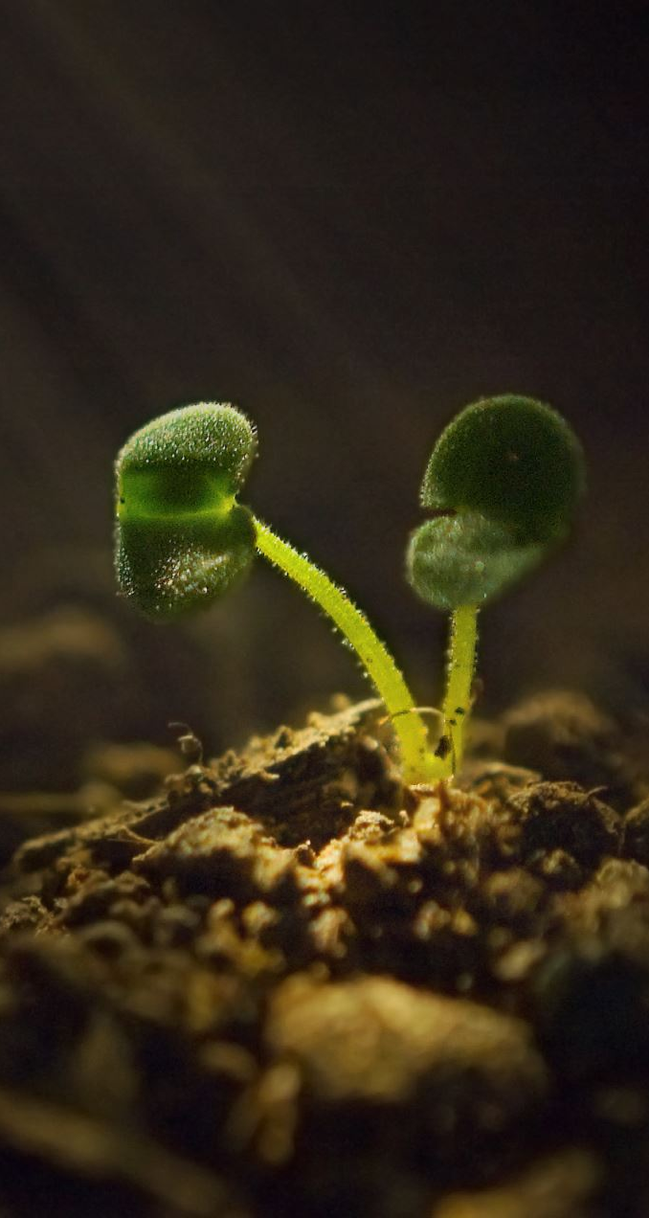
Summary
Indoor Grow Lights: Light Checklist
Spectrum: Mimic natural sunlight (full-spectrum) or target growth stages (blue/red LEDs).
Intensity (lux/PPFD): Varies by plant - seedlings need less than mature plants. Use a light meter to measure.
Distance: Closer = higher intensity, but follow light recommendations to avoid stressing plants. Adjustable hangers are helpful.
Duration (Photoperiod): Mimic day/night cycles with timers (seedlings: 14-16 hrs, flowering: 12 hrs).

