Slide 1
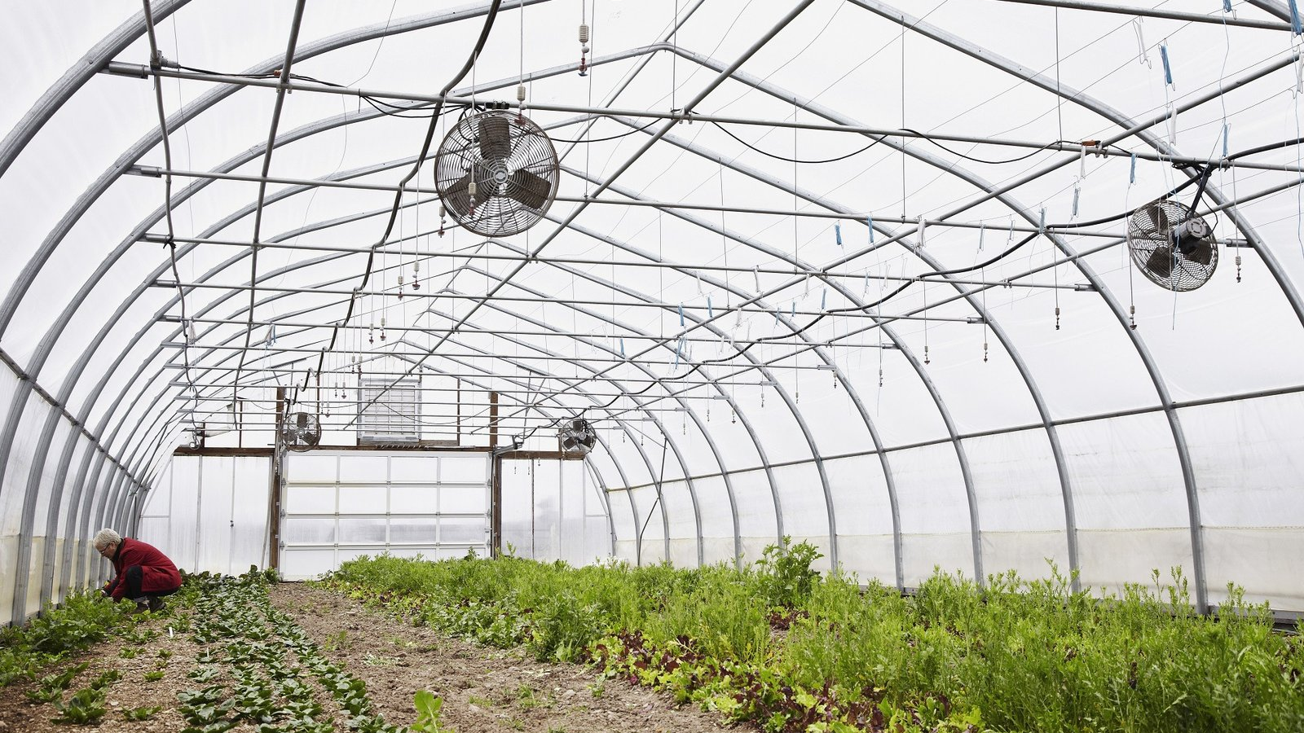
Air

Slide 2
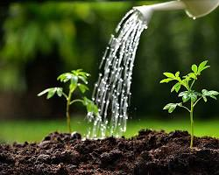
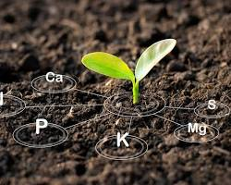
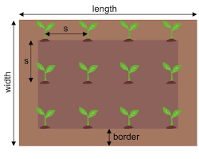
Air

Slide 3
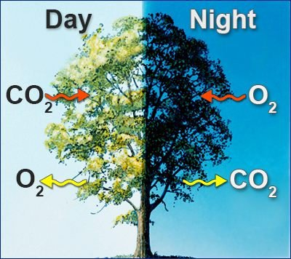
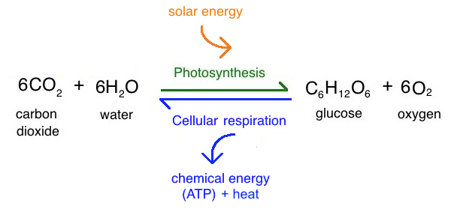
Air Composition for healthy growth
Oxygen is essential for root growth and respiration.
Carbon dioxide is needed for photosynthesis.
A balance is key for optimal growth.

Slide 4
Air Circulation
Airflow prevents mould and diseases.
2 Factors
1. Fresh air – provides a balance of oxygen and carbon dioxide, as well as reducing humidity.
2. Air movement – cools the plants (through evaporation) and reduces the overall temperature, increases the plants access to fresh air for respiration / photosynthesis

Slide 5
Temperature and Humidity
Optimal temperature: 18-24°C (64-75°F) for most microgreens.
Humidity range: 70-80% relative humidity for ideal growth.

Slide 6
The Impact of Low Oxygen Levels on Roots
When oxygen levels in the soil are low, it's a condition known as hypoxia or anaerobic conditions.
This can have severe consequences for root health:
Reduced respiration: With less oxygen, roots can't produce enough energy to sustain their functions. This leads to slowed growth and development.
Nutrient uptake decline: As respiration decreases, so does the root's ability to absorb essential nutrients from the soil.
Root rot: In extreme cases, prolonged hypoxia can lead to root rot caused by harmful bacteria or fungi that thrive in low-oxygen environments.
Ethylene production: Roots under stress from low oxygen produce ethylene, a plant hormone that can inhibit growth

Slide 7
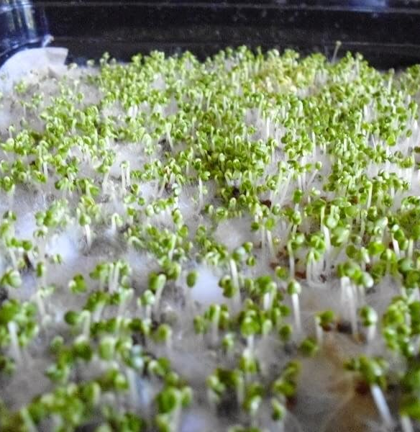
Mould
Read this article

