Slide 1
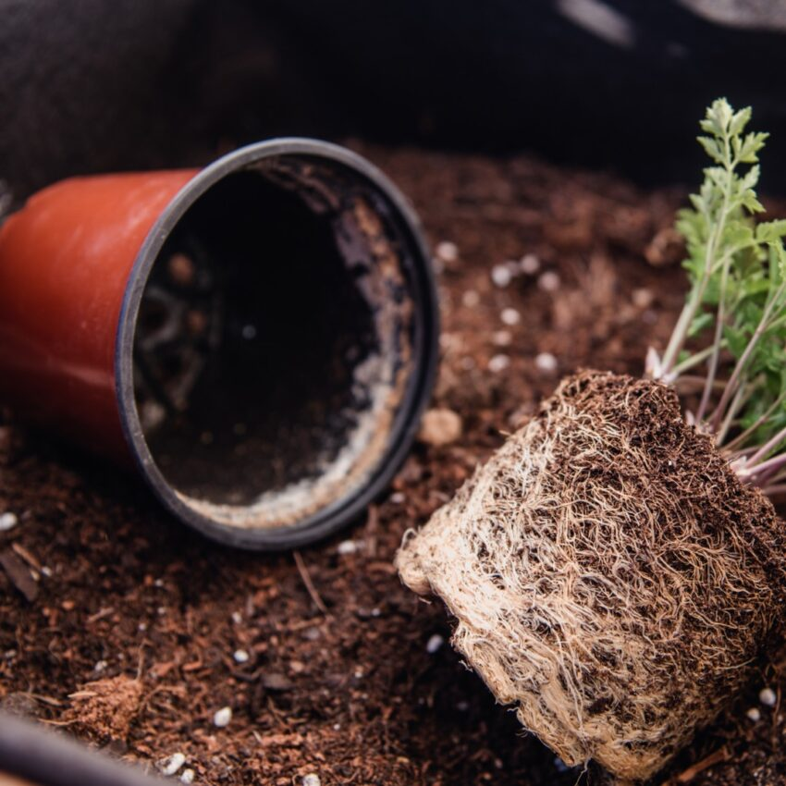
STEM - Horticulture
Space

Slide 2
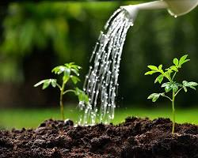
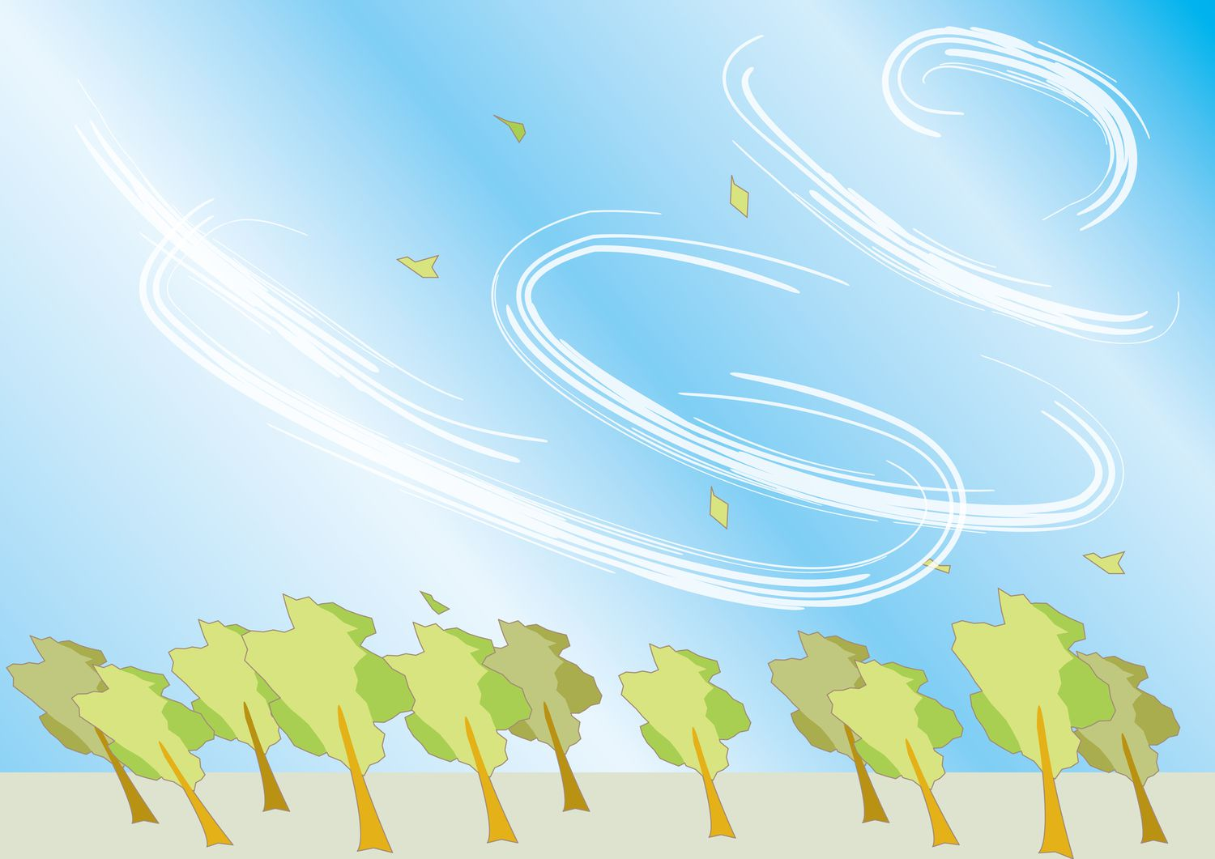
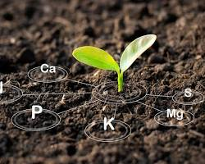
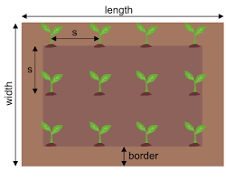
The big 5 – plant survival and growth
Light
Water
Air
Nutrients
Space

Slide 3
SPACE
Root Growth: Plants require sufficient space for their roots to expand and explore the soil for nutrients and water. Crowded roots can lead to competition for resources, stunted growth, and increased susceptibility to diseases.
Shoot Growth: Adequate space allows plants to develop healthy stems, leaves, and flowers. Crowding can result in weak, spindly growth, reduced photosynthesis, and lower yields.
Light Penetration: Proper spacing ensures that sunlight can reach all parts of the plant, promoting photosynthesis and healthy growth. Overcrowding can create shade, limiting light availability to lower leaves.

Slide 4
Root Growth: Needed to expand and explore the soil for nutrients and water. Crowded roots is referred to as being root bound and can lead to competition for resources, stunted growth, and increased susceptibility to diseases.

Slide 5
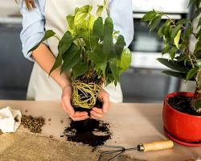
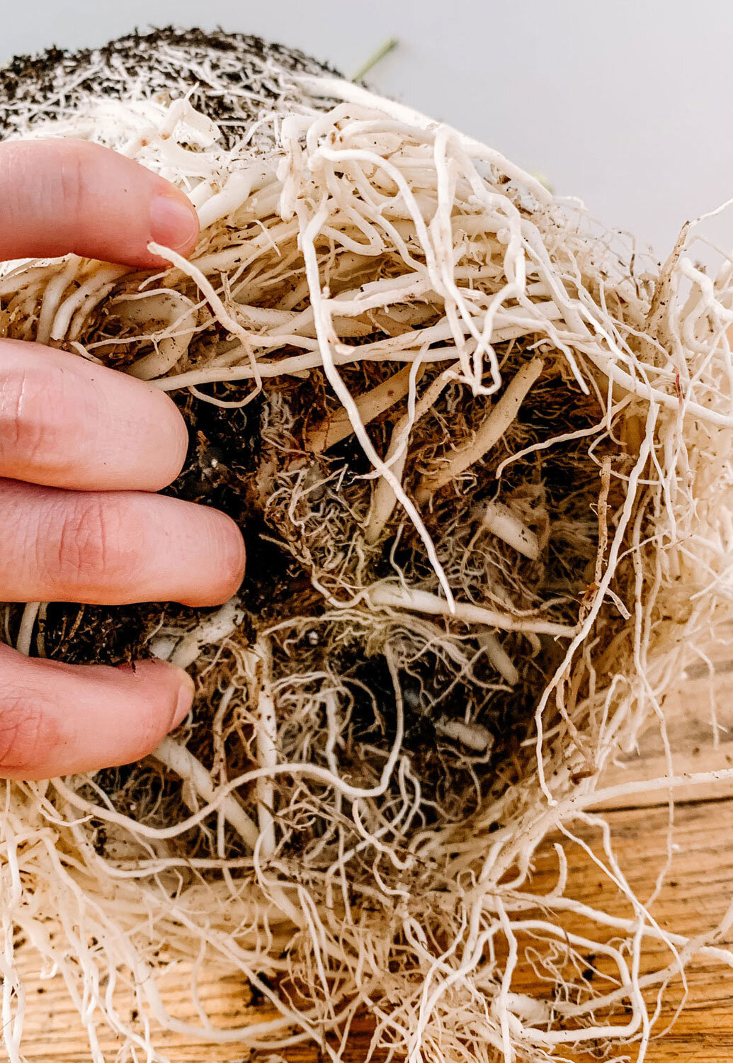
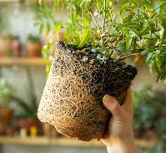
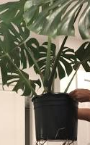
Root Space – “root bound”
Signs of Root Boundness
Roots growing out of drainage holes
Frequent watering
Slow growth
Top-heavy plants

Slide 6
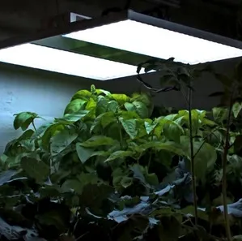
Light Penetration: Overcrowding can create shade, limiting light availability to lower leaves.

