Slide 1

Changing Ecosystems

Slide 2
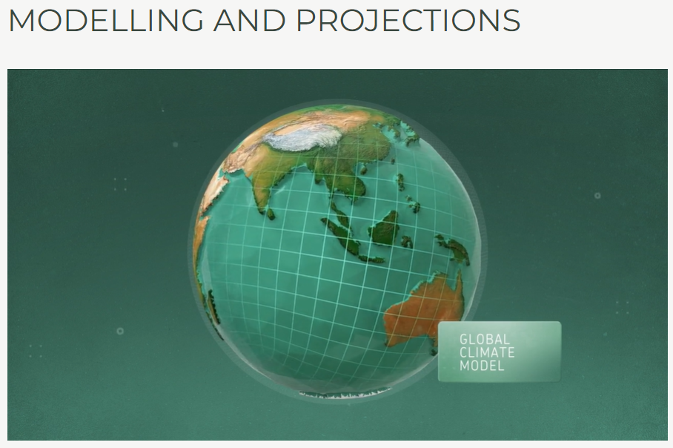
Climate modelling
Make your own notes of current projections from this video

Slide 3
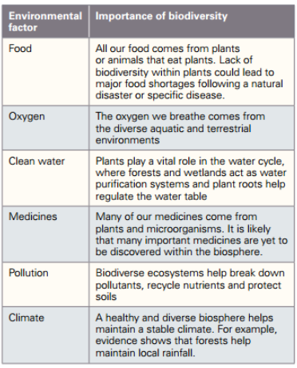
Biodiversity
The number of species on Earth and the genetic diversity within these species

Slide 4
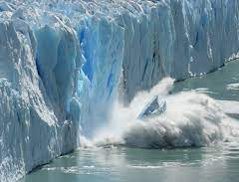
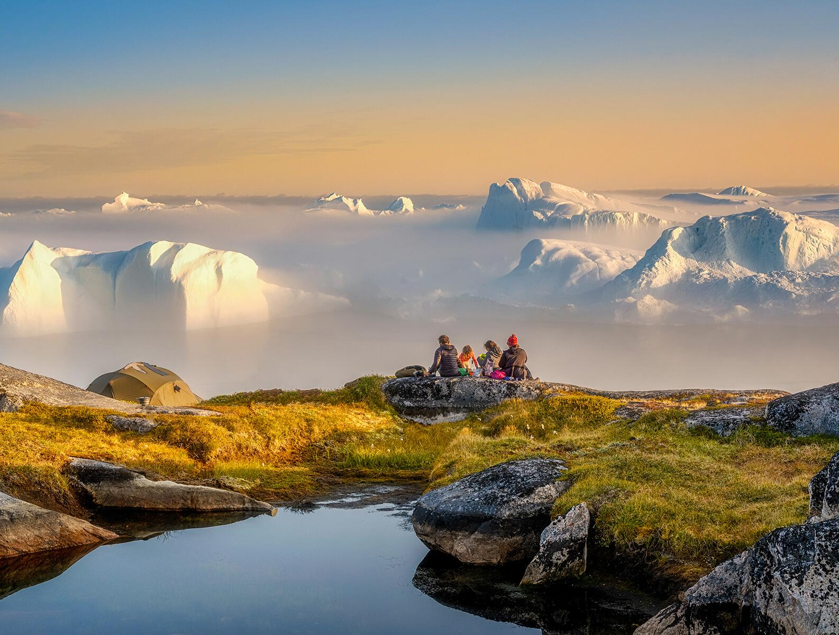
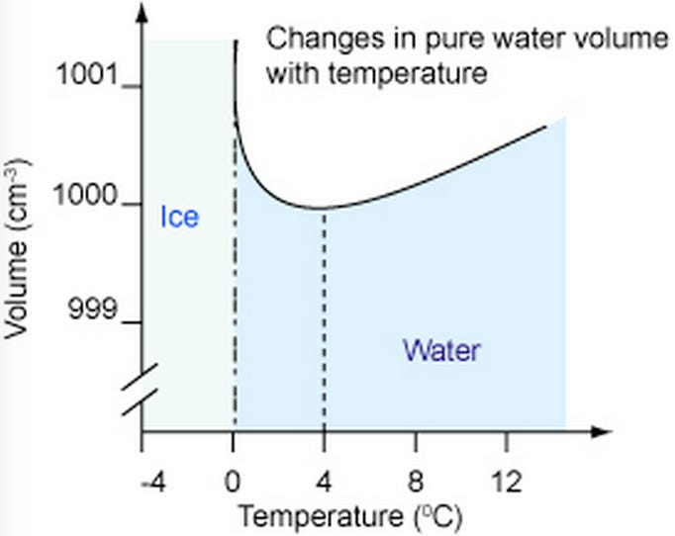
Rising Sea levels
The major factors that affect sea levels are:
Melting of glaciers and polar ice-caps
Melting of massive ice-sheets that cover Greenland and Antarctica
Expansion of ocean water as it warms.

