Slide 1
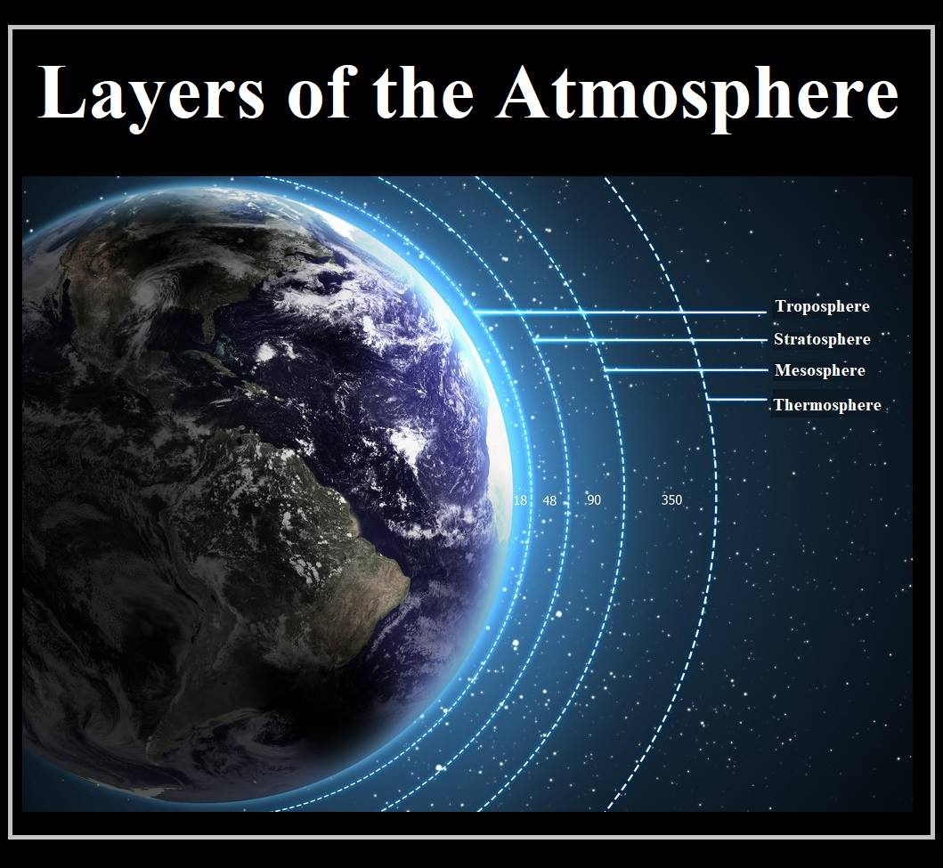
Earth's Atmosphere

Slide 2
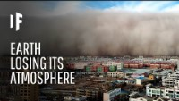

Slide 3
The atmosphere is vital for many reasons:
Life Support: Provides oxygen for living organisms and enables photosynthesis for food production.
Climate Regulation: Maintains a stable climate by moderating temperature extremes and enabling the greenhouse effect.
Protection: Shields Earth from cosmic radiation, meteoroids, and space debris. The Ozone Layer blocks harmful UV radiation, protecting against skin cancer.
Weather Systems: Forms weather patterns, distributes moisture, and ensures freshwater resources.
Psalm 19:1 "The heavens declare the glory of God; the skies proclaim the work of his hands.”

Slide 4
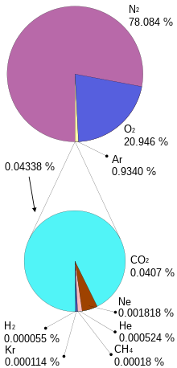
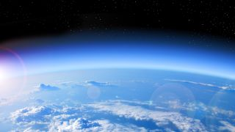
The Atmosphere's Composition

Slide 5


Your task:
Create a 4-page PowerPoint on the following topics:
The biosphere
The hydrosphere
The Lithosphere
Natural events that effect the spheres
The carbon Cycle
Nitrogen Cycle
Phosphorus Cycle
You have 20 minutes
Share the document with me

Slide 6


