Slide 1
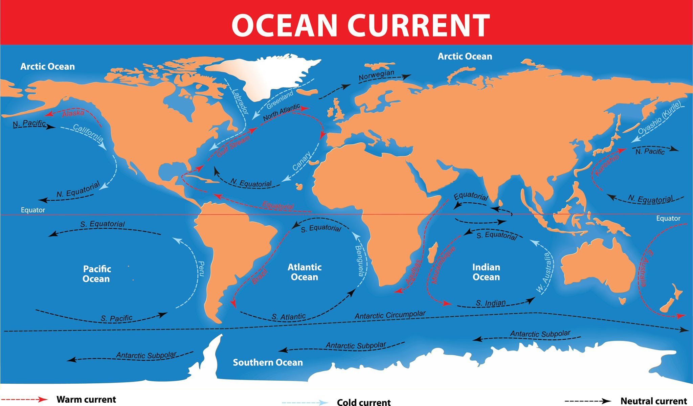
Core concept:
Ocean movement is essential because it transports nutrients and heat around the globe, which supports marine life and influences climate.

Slide 2
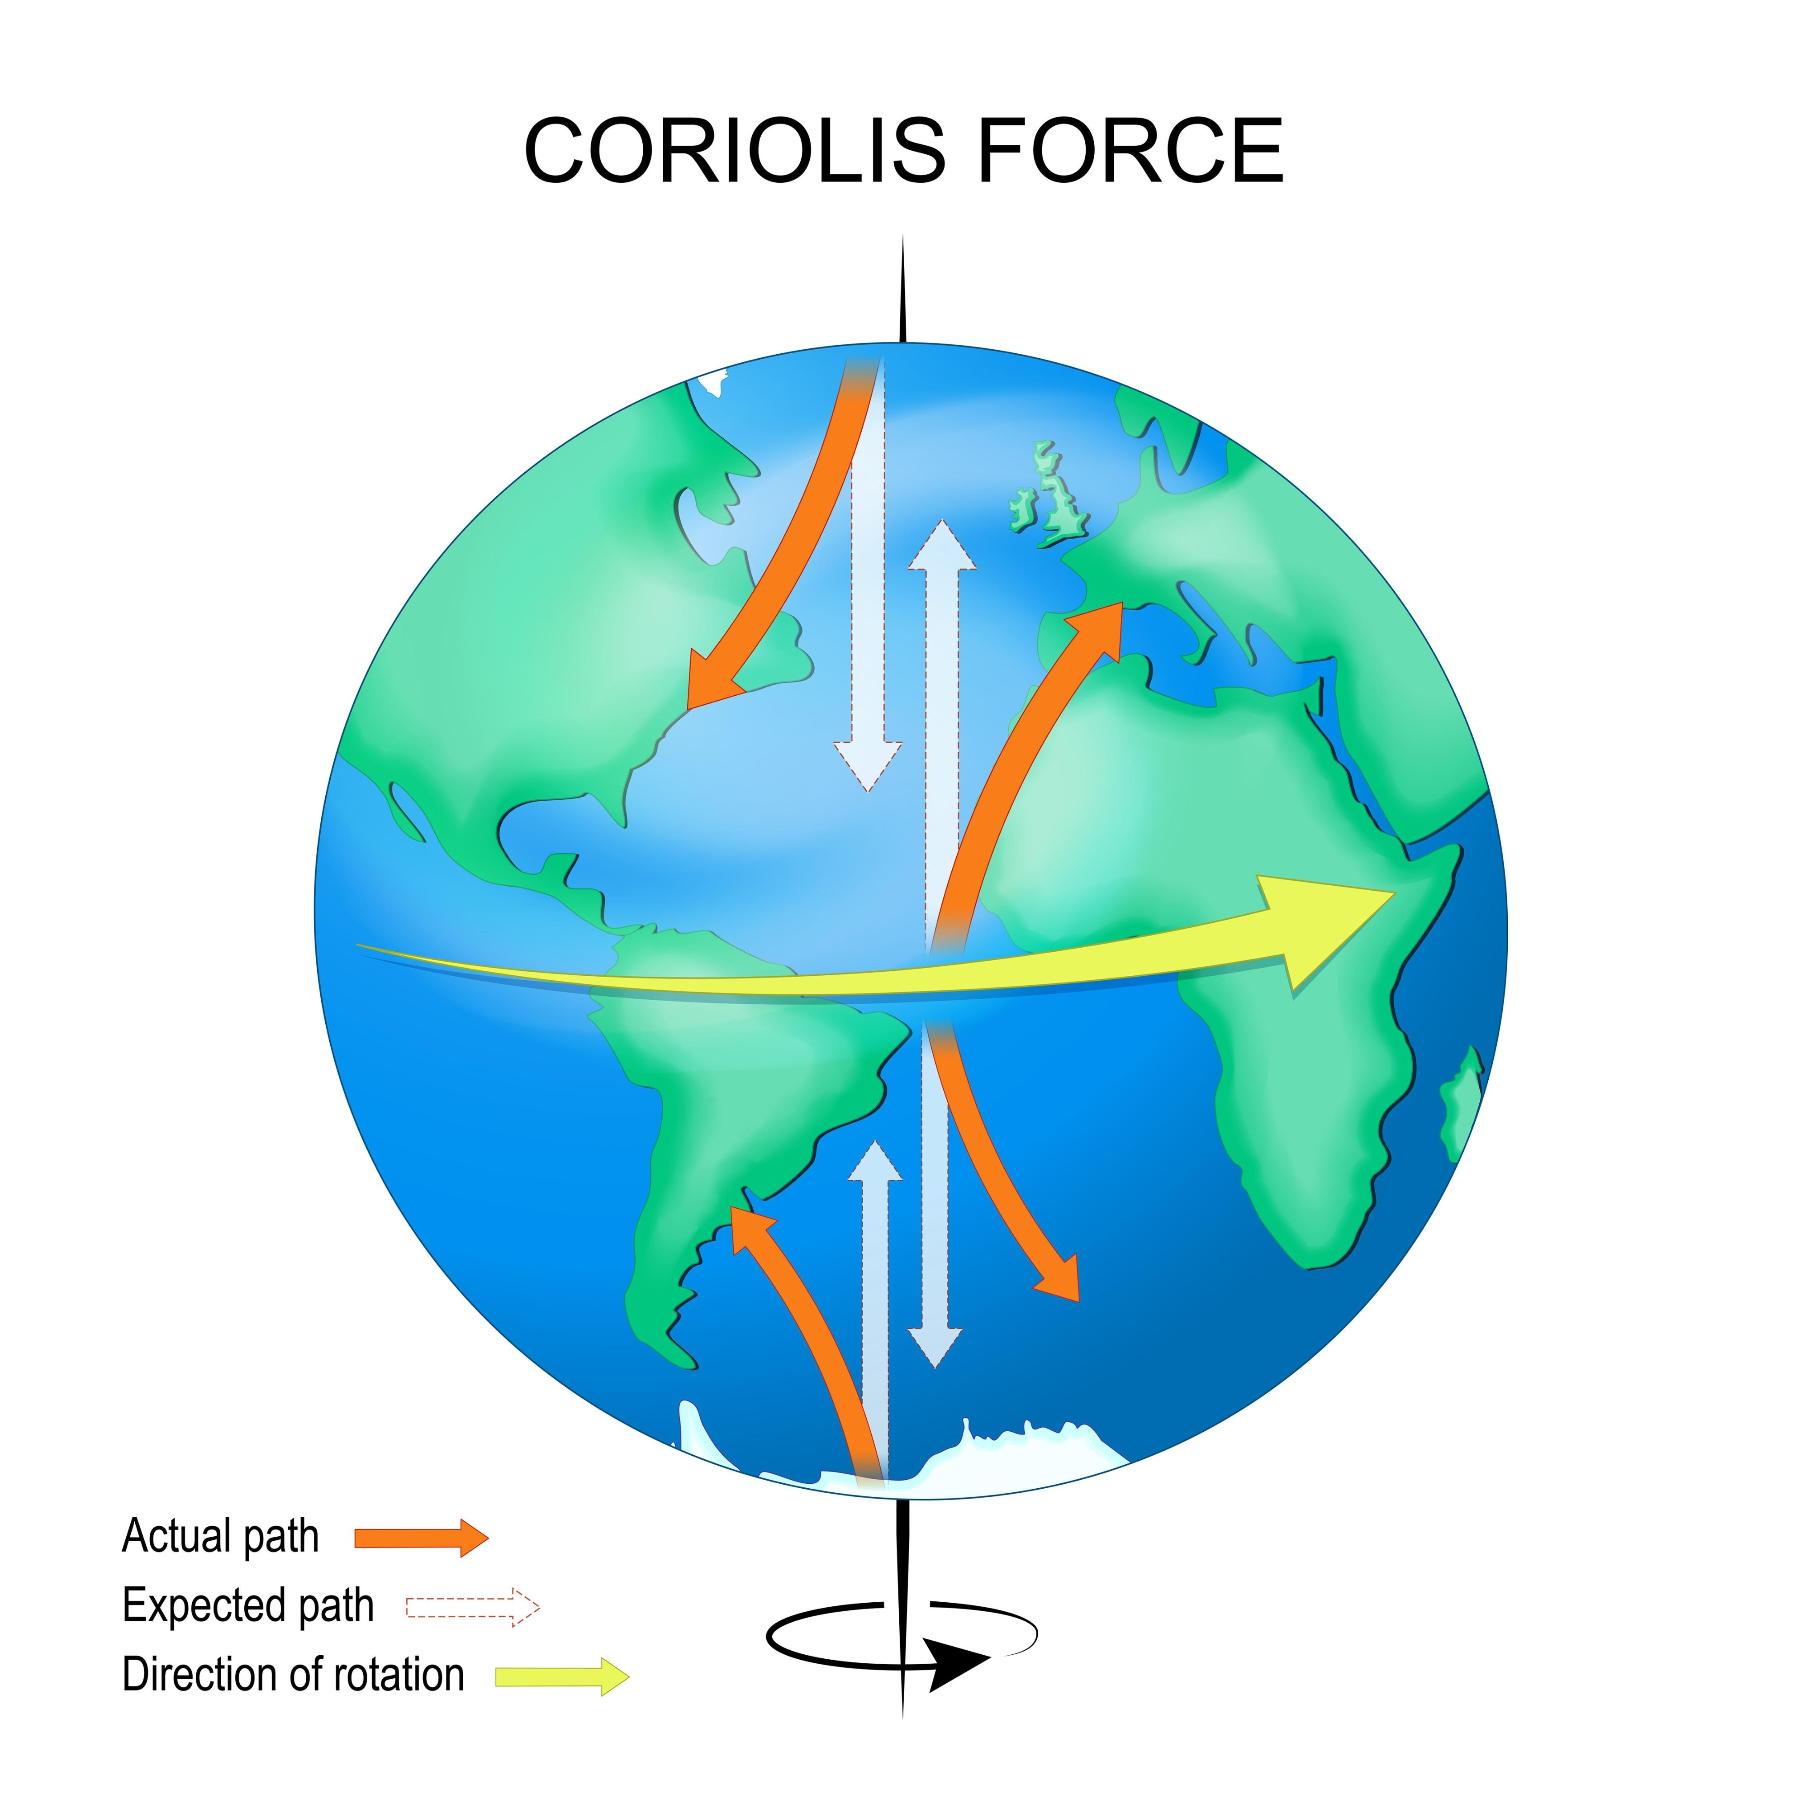
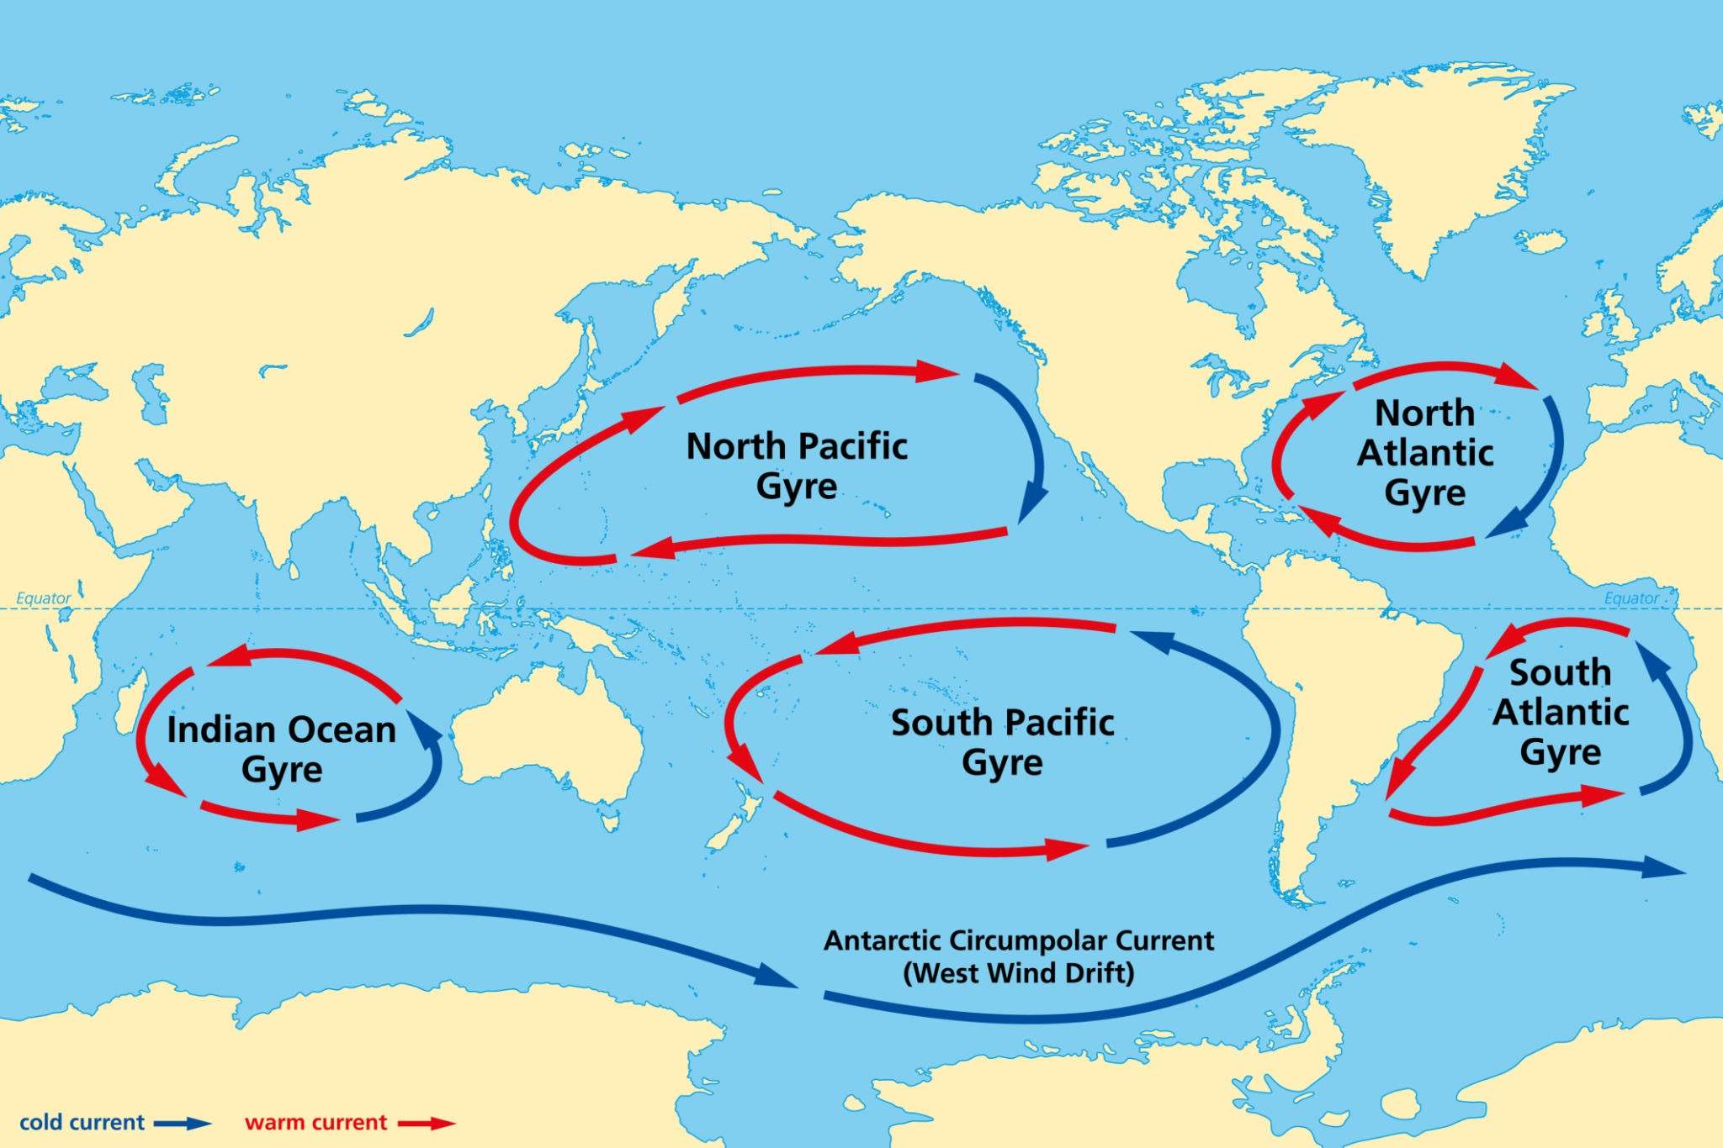
Surface Currents (Driven by Wind)
Currents: The large-scale flow of water in a specific direction.
Waves: Are energy moving through water; the water itself barely moves forward.
Coriolis Effect: The deflection of currents caused by the Earth's rotation. This makes them circular.
Ocean Gyres: Large, rotating ocean currents formed by the Coriolis effect.

Slide 3
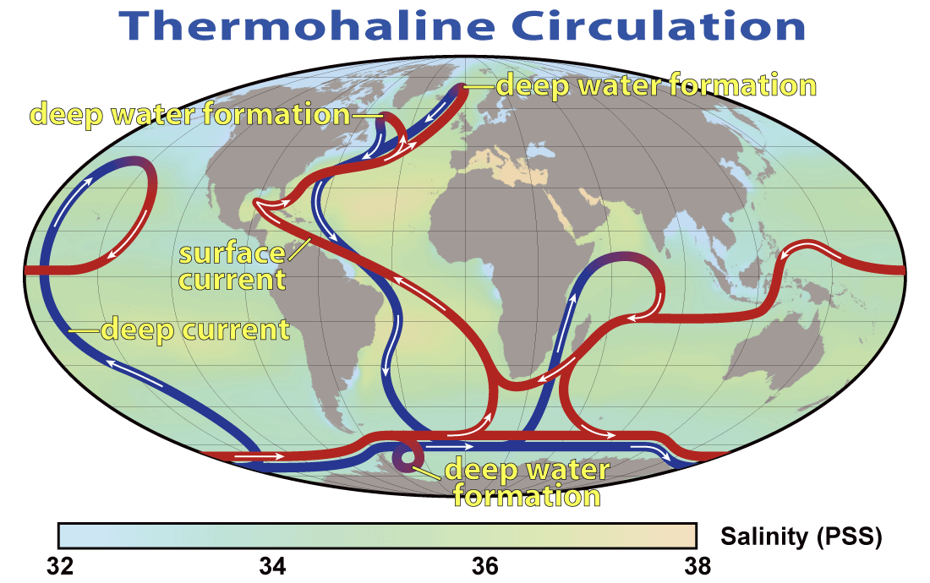
Deep Ocean Currents (Driven by Density)
Thermohaline Circulation: The "global conveyor belt" current driven by differences in temperature (thermo) and salinity (haline).
Process: Cold, salty, dense water sinks at the poles, pushing deep water around the planet.

Slide 4
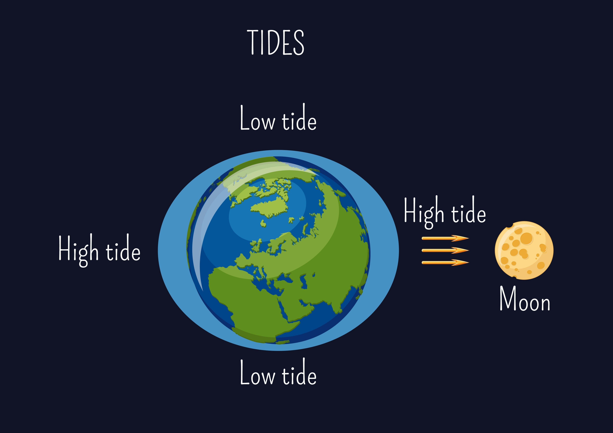
Tides (Driven by Gravity)
Tides: The regular rise and fall of the sea level.
Cause: The gravitational pull of the Moon and, to a lesser extent, the Sun.

