Slide 1
STAGE 1 FOOD AND HOSPITALITY
GOURMET
PIZZA
Practical Activity 1 (25% of total assessment)

Slide 2
AREA OF STUDY 3: TRENDS IN FOOD AND CULTURE
·- food of diverse cultures
·- what influence decision-making about food and hospitality trends in hospitality
- sociocultural influences (family, culture, money, beliefs and lifestyle)

Slide 3
ASSESSMENT PARTS
THREE
Research Task (400 words)
Practical
Evaluation (400 words)

Slide 4
RESEARCH
TASK
400 WORDS
Investigate and critically analyse how the diversity of culture in Australia has impacted Australian foods, in particular, pizza. Research the following question and present your findings:
Pizza has evolved throughout the years in Australia. To what extent does this reflect Australia’s multiculturalism?

Slide 5
INTRODUCTION
Australia is host to a broad range of cultural foods and traditions. Unlike other countries, there has never been food specifically traditional to westernized Australia (Symons, 2014). Rather, Australian cuisine has been widely influenced by other countries. This is due to the migration of a diverse variety of people, bringing with them their culinary traditions (MTA, 2020).

Slide 6
BODY
Possible Body Paragraphs:
+ Immigration to Australia throughout the years and how this has affected food in Australia
+ History of Pizza
+ Pizza menu changes throughout the years (link to immigration)
+ Identifying cultures which are reflected through ingredients we have here in Australia. This includes processes and identifying blended ingredients. (flavours, where these flavours and processes come from)

Slide 7
CONCLUSION
ANSWER THE QUESTION BASED ON WHAT YOU HAVE RESEARCHED

Slide 8
IN-TEXT
Many pizza establishments are making accommodations such as providing options for vegan dietary requirements, an example being the introduction of vegan cheese to common pizza flavour combinations (Khalil, 2019).
REFERENENCE
REFERENCE LIST (IN ALPHABETICAL ORDER)
Khalil, S. 2019, ‘Pizza Hut launches six vegan menu items’ https://www.news.com.au/lifestyle/food/eat/pizza-hut-launches-six-vegan-menu-items/news-story/887191fd191c90117f6766b5a7592c5b ,​ accessed 10/02/2020

Slide 9
What you are getting assessed on
I1
I2
I3
Productive, well-planned, and well-organised investigation of contemporary issues related to the food and hospitality industry or to food and hospitality in family and community settings.
Focused and discerning identification and use of a variety of primary and/or secondary sources, with appropriate acknowledgment.
Highly effective application of literacy and numeracy skills, including clear and consistent use of appropriate terminology.

Slide 10
THE EVOLUTION OF PIZZA

Slide 11
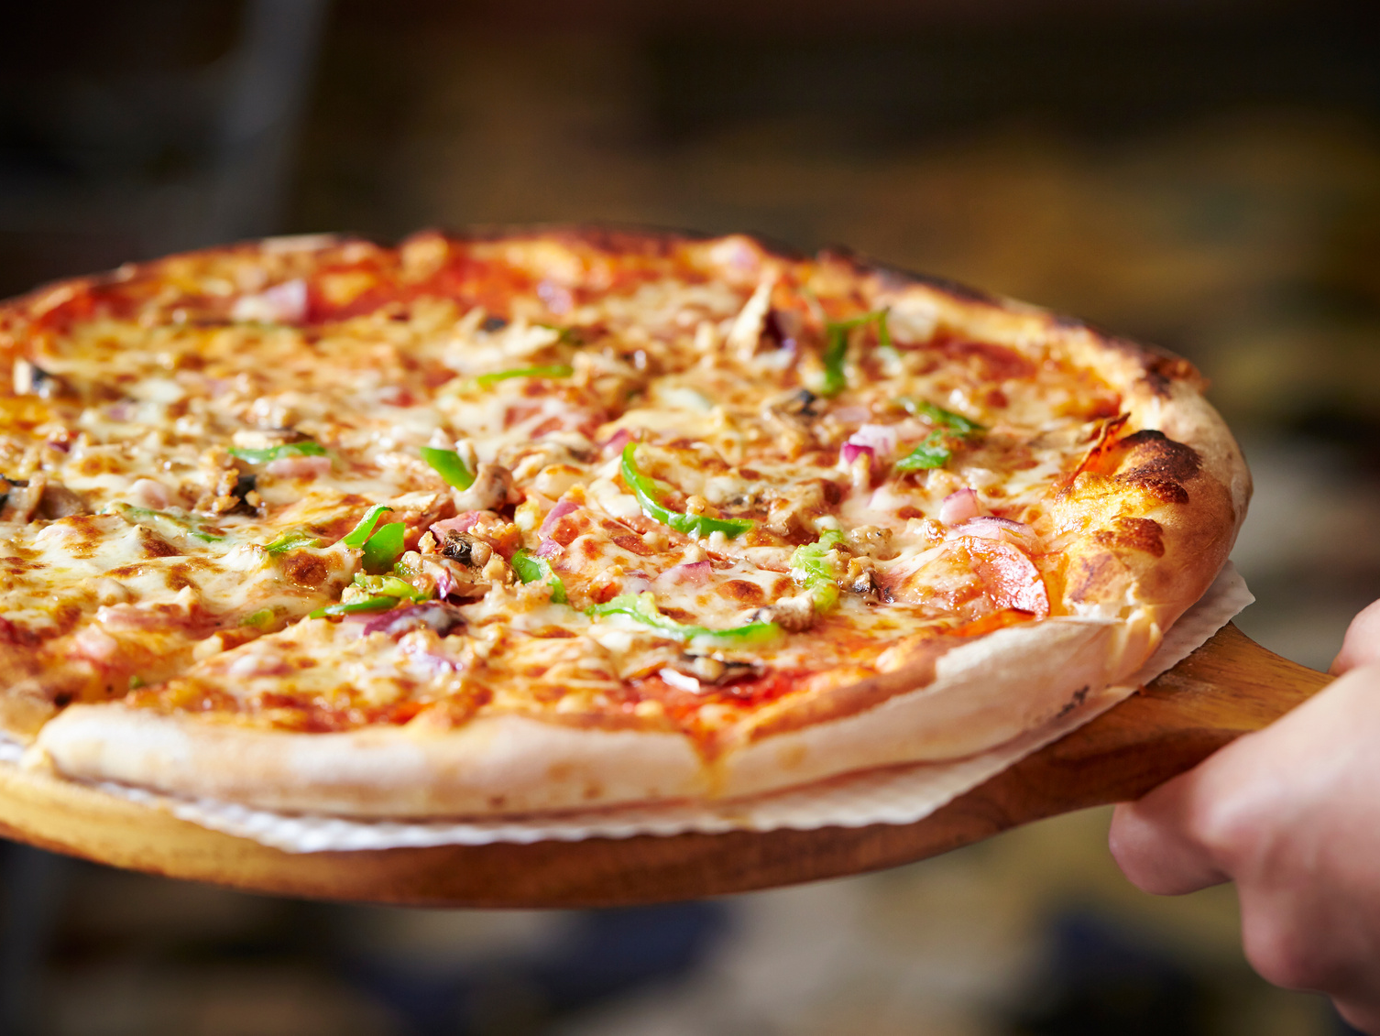
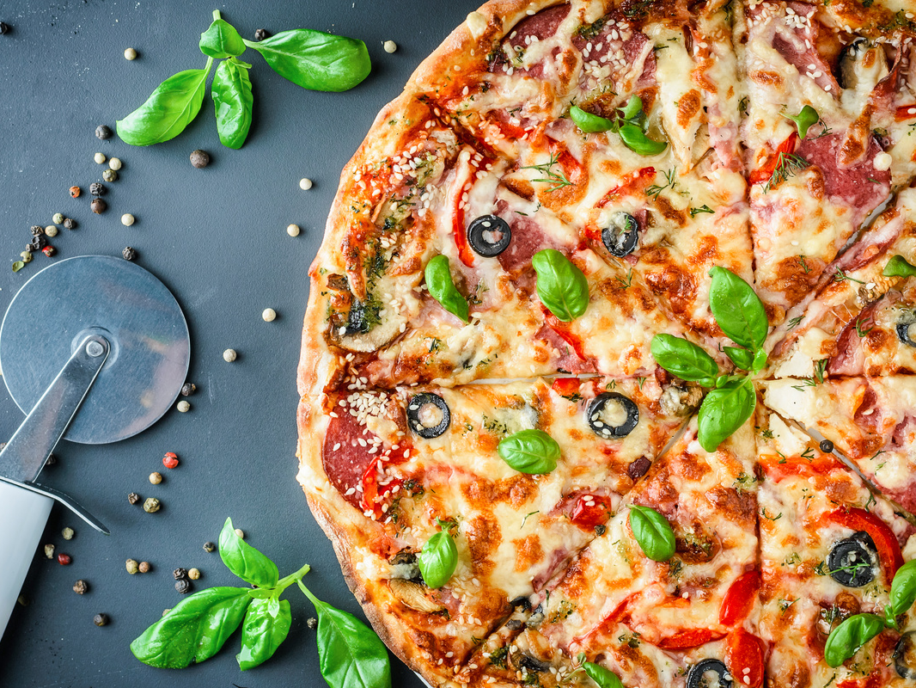
PRACTICAL
As an individual you will need to plan, prepare and present a single serve gourmet pizza, for a trendy and upmarket pizza bar, using ingredients that reflect cultural diversity on our society.
1 DOUBLE LESSON

Slide 12
-DISH MUST REFLECT MULTICULTURALISM IN AUSTRALIA
-Research Contemporary Plating
- RESEARCH HOW TO creating a gourmet pizza

Slide 13
What you are getting assessed on
PA1
PA2
PA3
Astute use of initiative in the development and implementation of safe management practices.
Logical selection and use of appropriate technology for practical activities.
Constructive and sustained application of knowledge and practical skills.

Slide 14
EVALUATION
400 WORDS

Slide 15
What you are getting assessed on
R3
Insightful reflection on contemporary issues related to food and hospitality.

