Slide 1
The Outcome

Slide 2
The Outcome
1000 words
[2000 in year 12]

Slide 3
FOLIO
OUTCOME
EVALUATION
Plan what you’re going to do
Do what you planned
Put it all into an outcome
Discuss how well you did

Slide 5
Synthesis
The combination of different things to form a connected whole.

Slide 6
Folio
Key Findings
Knowledge
Outcome
Skills
Other research that isn’t in your folio

Slide 7
Knowledge
Skills
Outcome
Key Findings

Slide 8
S1
Putting all the things that you did in your research (not just in your folio) together as an answer to your research question. It can take many forms:
Essay
Report
Magazine
Speech

Slide 9
S2
Providing evidence for your answer. This will be using the key findings from your research and correctly referencing them.
In text
Foot notes
End notes

Slide 10
S3
Ideas are expressed clearly, and you have correct spelling, punctuation and grammar.

Slide 11
1000 words
Introduction – 150 words
a
Para 1 – 350 words
a
Para 2 – 350 words
a
Conclusion – 150 words
Introduction – 150 words
Para 1 – 220ish words
Para 2 – 220ish words
Para 3 – 220ish words
Conclusion – 150 words

Slide 12
350 words
~30 words a sentence
Point
Evidence
Explain
Evidence
Explain
Evidence
Explain
Evidence
Explain
Evidence
Explain
Link
5 x evidence sentences
At least five references per para.
Could be the same source
~10 sources for the whole outcome

Slide 13
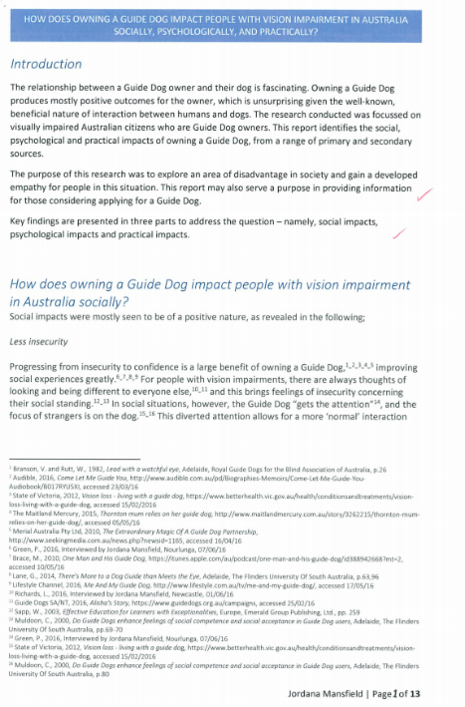

Slide 20
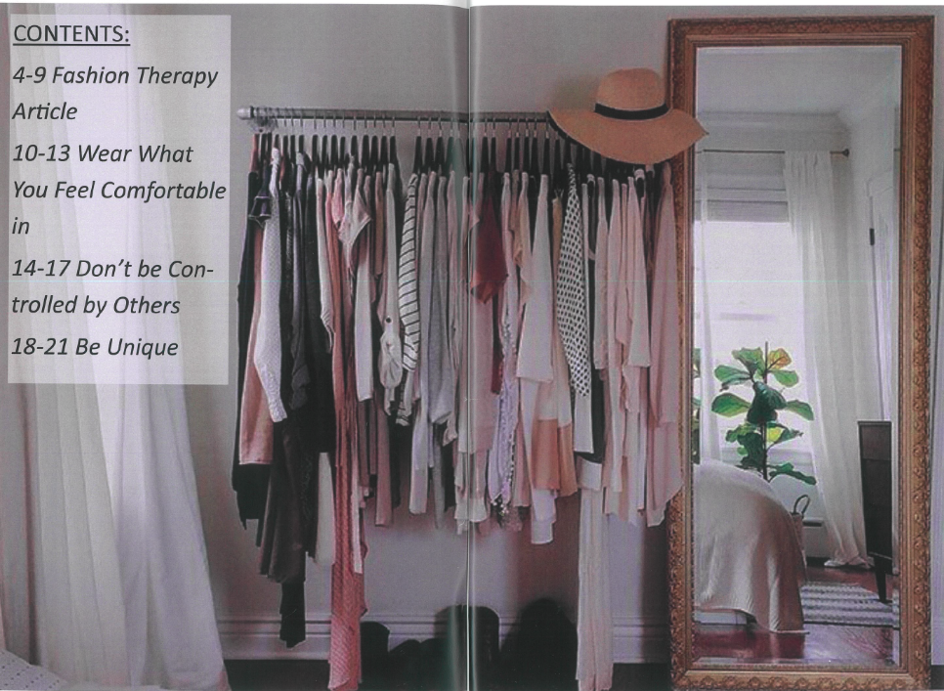

Slide 21
