Slide 1
Bias/Biased
Bias is something you have
Biased is something you are

Slide 2
The Evaluation

Slide 4
Evaluation = Judgement
YOU MUST MAKE A JUDGEMENT: Description alone is not enough.
800 words max

Slide 5
Sections in the evaluation
E1 - Evaluation of the processes used
E2 - Evaluation of decisions made
E3 - Evaluation of outcome

Slide 6
IMPORTANT

Slide 7
Other
Research
Folio
Outcome
Evaluation

Slide 8
E1 - Evaluation of the processes used:
How useful was each process for answering your question?
Explain why, including examples.
Consider pluses and minuses
Don’t just repeat source analysis (you can mention reliability, but it shouldn’t be the whole thing)

Slide 9
E2 - Evaluation of decisions made:
How did you respond to any challenges or opportunities?
Why was this a good/bad decision?
What was the result of this process?
How did it make your outcome better/worse?

Slide 10
E3 - Evaluation of outcome:
How well has your research answered the question? Explain why, considering both strengths and weaknesses.
How might your research be useful to others? How could you or others extend on this research to make it more valuable?
How useful is it for you personally i.e what have you learned, not just info but skills etc?

Slide 11
Judgment Words

Slide 12
SAJO model
Scenario: What was the challenge/opportunity?
Action: What decision did I make?
Judgement: Was this a good decision?
Outcome: What were the consequences of this decision?

Slide 13
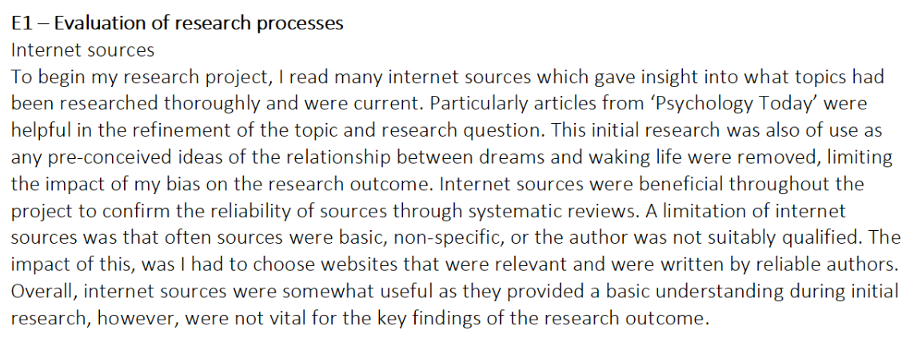

Slide 14
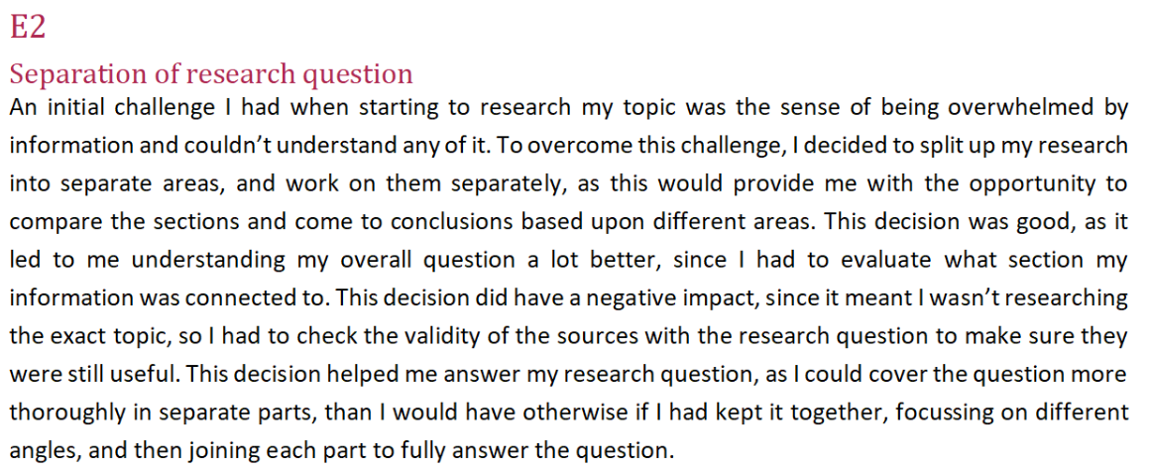

Slide 15
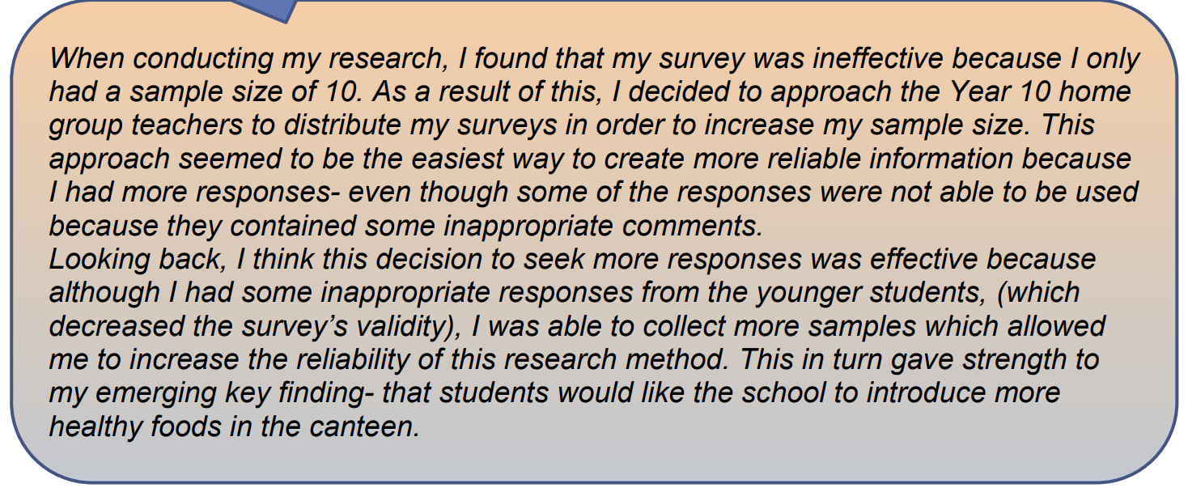
A, B or C?

Slide 16
A, B or C?

