Slide 2
Discuss
What does ‘capable’ mean?

Slide 4
The seven capabilities
literacy
numeracy
information and communication technology capability
creative and critical thinking
personal and social capability
ethical understanding
intercultural understanding.

Slide 6
Literacy
Literacy is reading, remembering, writing, understanding, creating, and speaking.

Slide 7
Numeracy
Numeracy skills means you can reason and work with numbers, problem solve, and think logically.

Slide 8
information and communication technology
How to use current and emerging technologies and understand their impact on society.

Slide 9
Critical and Creative thinking
Think broadly and deeply using reason, logic, imagination, and innovation to identify and analyse complex topics and questions.

Slide 10
personal and social capability
To be aware of your own and others emotional, mental, and spiritual wellbeing.

Slide 11
Ethical Understanding
Develop a deep understanding of ethical issues and how to manage them.

Slide 12
intercultural understanding
Appreciate and respect other people’s social and cultural backgrounds and learn about the diversity of our nation and the world.

Slide 13
The seven capabilities
literacy
numeracy
information and communication technology capability
creative and critical thinking
personal and social capability
ethical understanding
intercultural understanding.

Slide 15
Thorough = Lots of detail and examples. Need to show how developed not just say it.
Don’t say “I developed my ability to speak to people”.
Do say “By interviewing Dr. Jones over the phone I developed my ability to engage with an expert using professional langue which I have not done before.

Slide 16
Informed = You know what you are talking about
I will give you resources on Haiku to help you understand the capability you choose in detail.

Slide 17
Understanding = Knowing what it is
Development = You got better at it

Slide 18
QUALITY OVER
QUANTITY
Pick 1 capability.
You can get an A+ by only doing 1.
Do 2 only if you absolutely must.
It is better to do 1 capability to an A level than to do 2 to a B level.

Slide 19
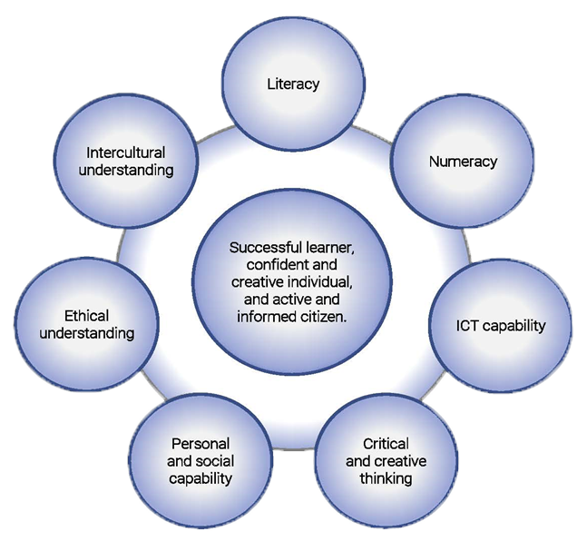
D3 K+S vs. D4 Capabilities

Slide 20
D3 K+S vs. D4 Capabilities
Talk about C&CT in your
D4 capabilities section

Slide 21
D3 K&S vs. D4 Capabilities
You can talk about anything from
the other areas in your
D3 Knowledge and
Skill sections
Talk about C&CT in your
D4 capabilities section

Slide 22
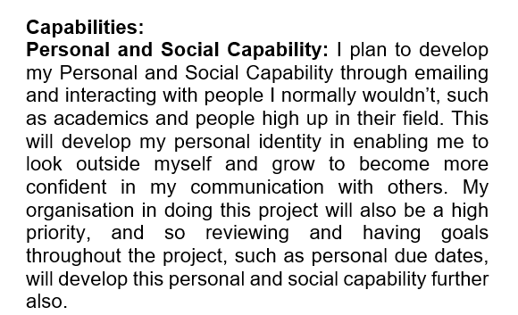
Capabilities statement on page 1 or 2

Slide 23
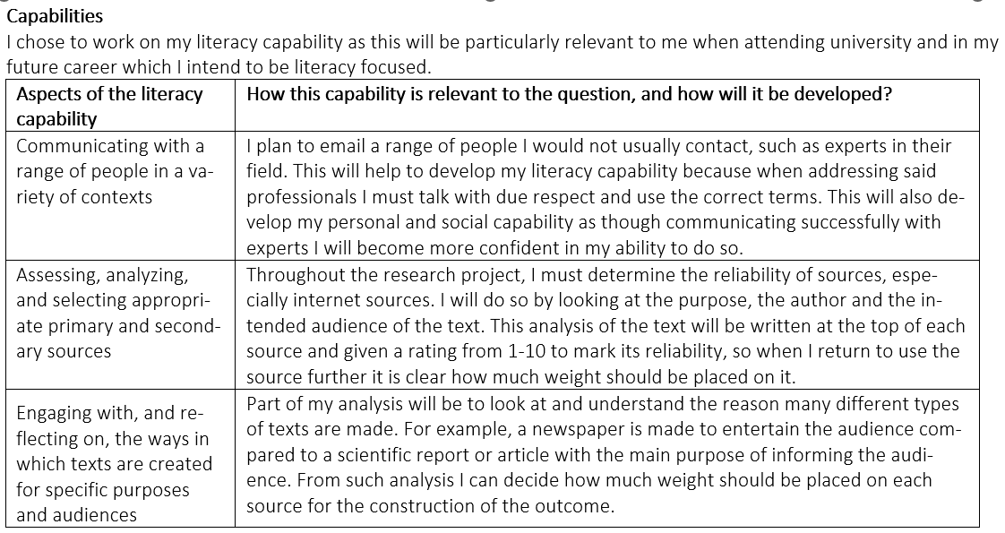
Capabilities statement on page 1 or 2

Slide 24
What you need to do
Pick topic
Write first research question
Preliminary research
Pick which capability you will focus on developing and write short statement of how you plan to develop it

Slide 25
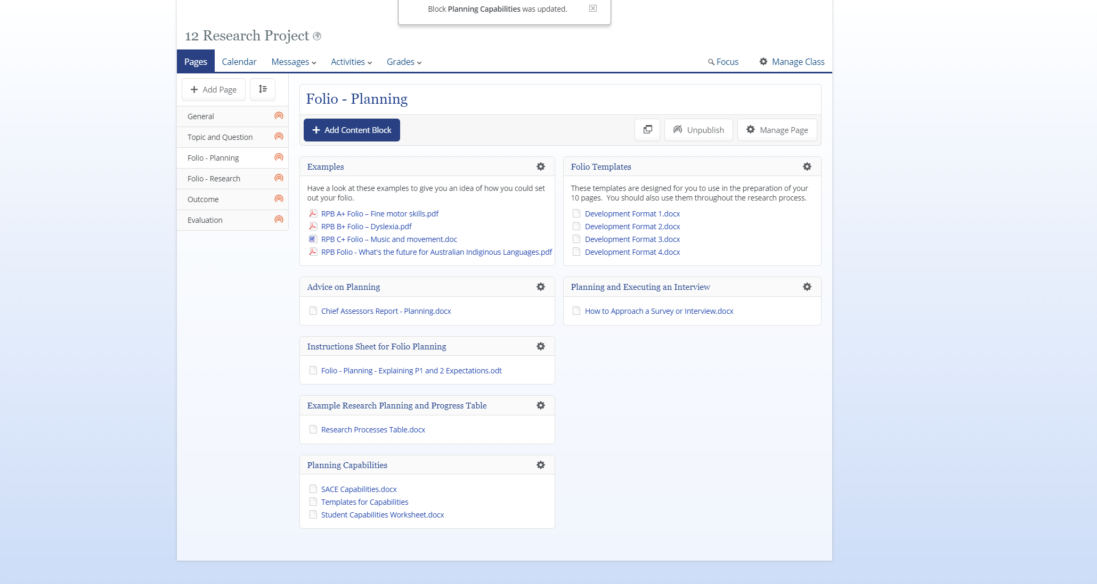
Folio - Planning
Open all 3

Slide 26
First document – SACE capabilties

Slide 27
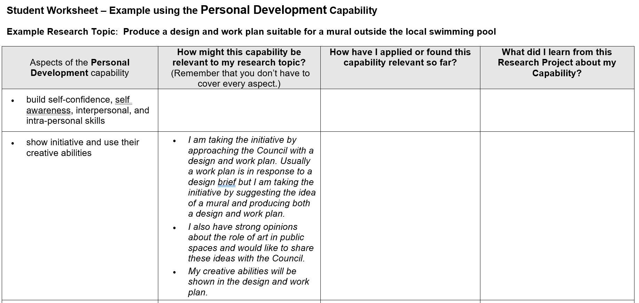
Document 2 - Student Capabilities Worksheet

Slide 29
Document 3 - Templates for Capabilities

Slide 30
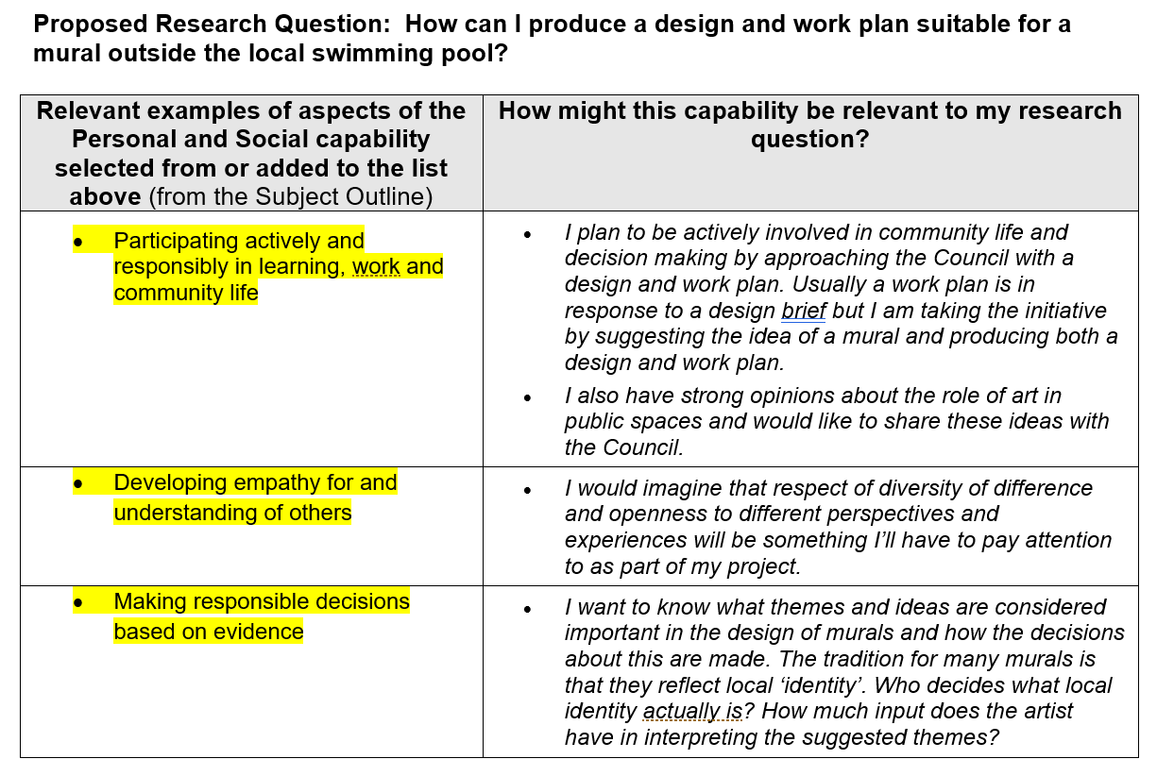

Slide 31
What you need to do
Planning: decide which one of the capabilities you plan to develop through your research.
-Put this planning after your P1 or P2.

Slide 32
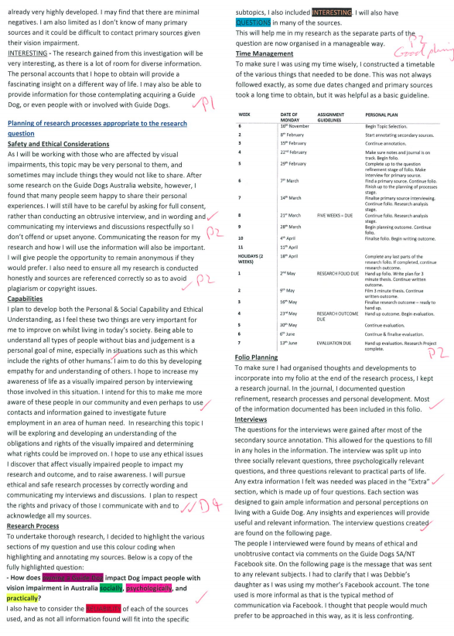

Slide 33
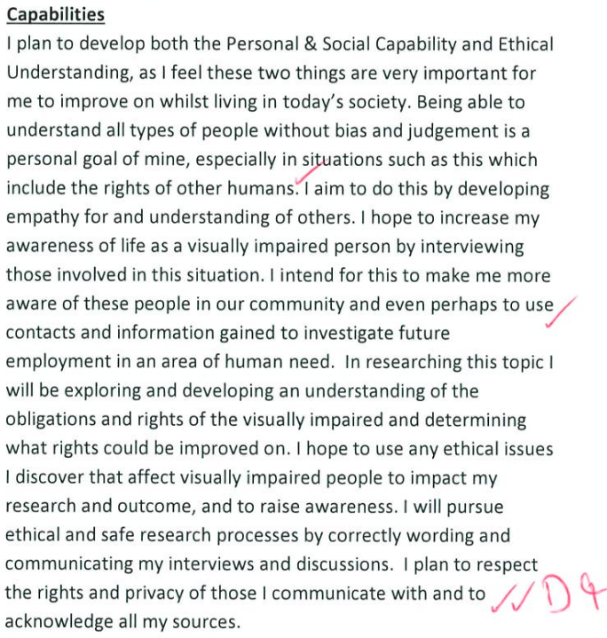

Slide 34
What you need to do
Development: When you start doing the body of your folio, D1-4 where you analyse your sources, you need places where you show how you developed your capability.

Slide 35
