Slide 1
P2 Planning Research Processes

Slide 2
P2
Thorough planning of research processes that are highly appropriate to the research question.

Slide 3
Outcome

Slide 4
Outcome
P1 + Capabilties

Slide 5
Outcome
P1 + Capabilties
?

Slide 6
Processes you can plan to do
Library Searching
Online Searching
Primary Contact
Practical Research
Media Analysis
Archival Research

Slide 7
Things that you can plan to do
Library Searching
e.g. information found from books, journal articles, newspaper articles, articles from databases which were originallly published as hard copies in another format

Slide 8
Things that you can plan to do
Online Searching
e.g. information found using different web sites, blogs, forums, social media tools, Google tools for research, database information

Slide 9
Things that you can plan to do
Primary Contact
e.g. information found from face-to-face interviews, skype interviews, emails etc.

Slide 10
Things that you can plan to do
Practical Research
e.g. information found by trial and error where a skills was repeated until an improvement is noted, work experience, scientific experiments, tests, fieldwork, observations, surveys etc.

Slide 11
Things that you can plan to do
Media Analysis
e.g. information found from TV programs accessed via Clickview or ABC iView, radio podcasts etc

Slide 12
Things that you can plan to do
Archival Research
e.g. Historical documents (original and copies)

Slide 13
Sources are not processes!
A research process is an action you take.

Slide 14
When will you do these things?
Start of process
Most basic/general sources.
Getting your head around the topic, learning the vocabulary of the area you are researching.

Slide 15
When will you do these things?
Mid to End of Process
Specific/in-depth sources
Hands on research
Interviews/surveys

Slide 16
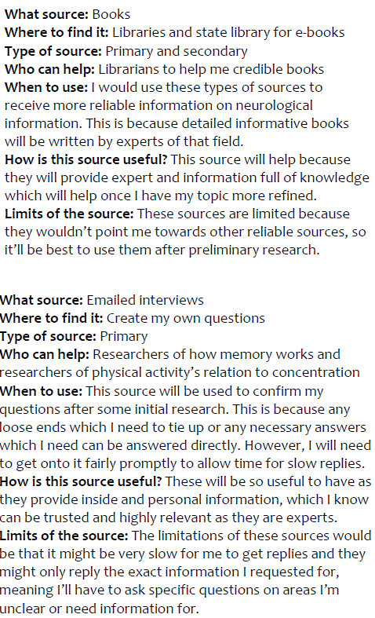

Slide 17
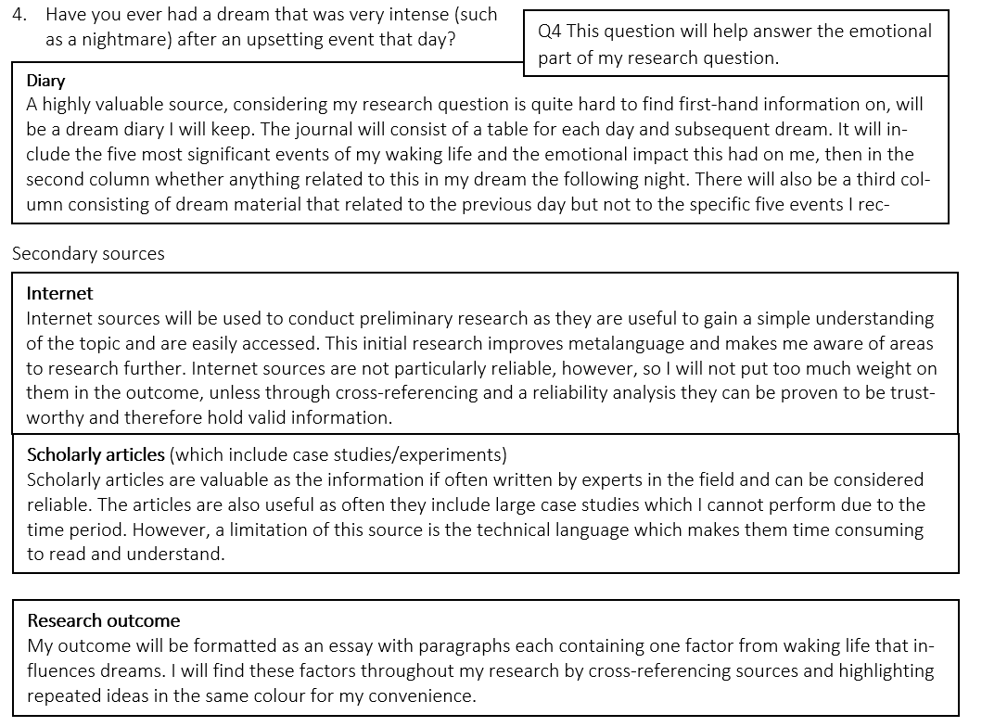

Slide 18
What you need for P2
Plan what you will DO to find enough information to answer your question in 2000 words.
Keep the question in mind, only plan sources that will help to answer the various parts of your question.
Talk about when you will do each process.
Capabilities and ethical considerations can go on this page/section or in P1.

