Slide 1
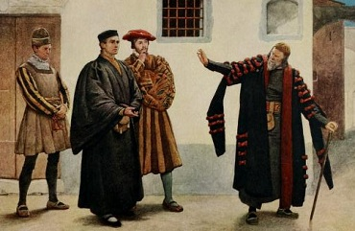
The Merchant of Venice

Slide 2
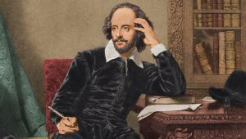
William Shakespeare
1564-1616
English playwright, author and actor
Generally considered England’s greatest author
He wrote 38 plays, 154 sonnets, 2 long narrative poems, and a few other verses.

Slide 3
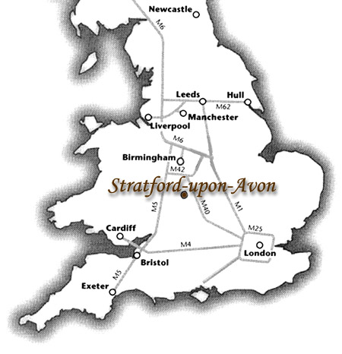
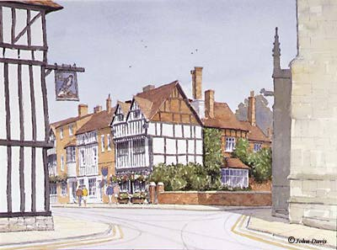
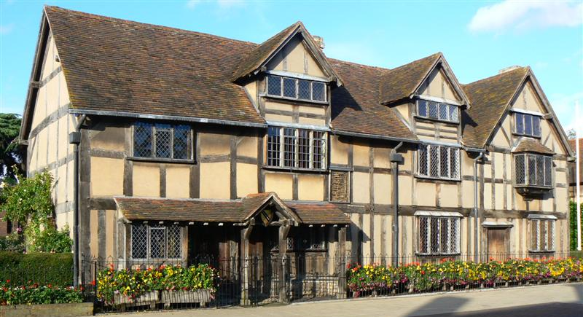
was born in Stratford-upon-Avon, Warwickshire , England in 1564
Parents: John Shakespeare & Mary Shakespeare
Possibly educated at King Edward VI school.
Married Anne Hathaway at the age of 18. His wife was 8 years older he.

Slide 4
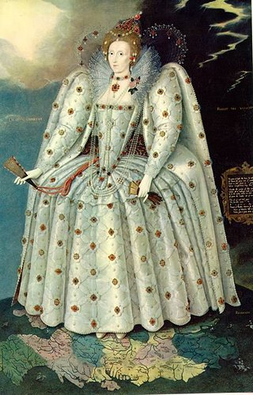
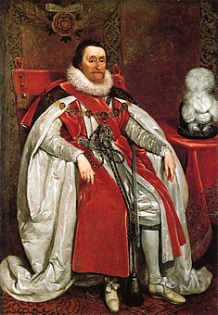
Very little is known about Shakespeare’s early writing career (eg when he started writing, who taught him to write)
He traveled to London to work as an actor and playwright in 1590
2 years later, he had established his reputation
He grew quite wealthy
Was favored by both Elizabeth I (1558-1603 and James I (1603-1625)
He was granted the title for his company of The King’s Men by James I

Slide 5
The Globe Theatre

Slide 6
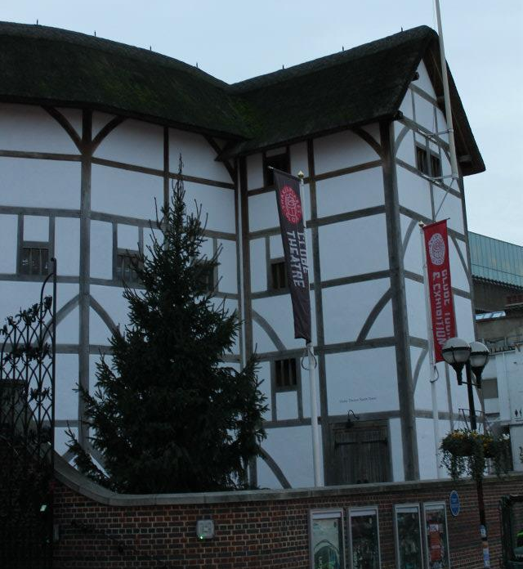

Slide 7
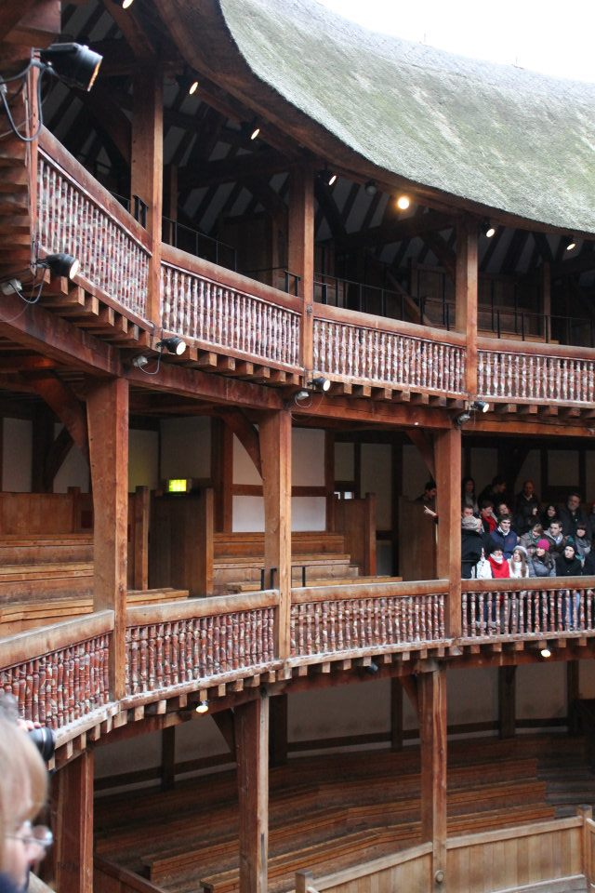

Slide 8
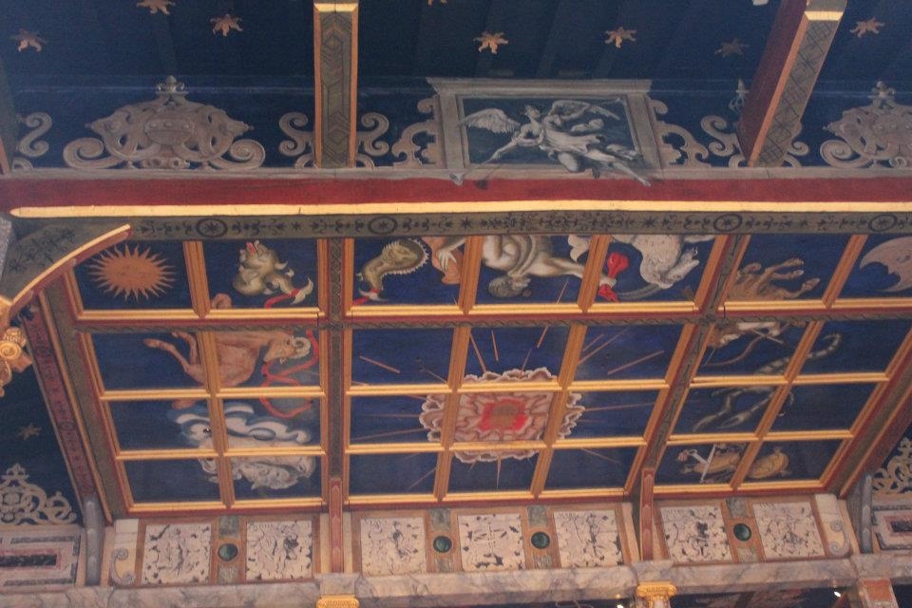

Slide 9
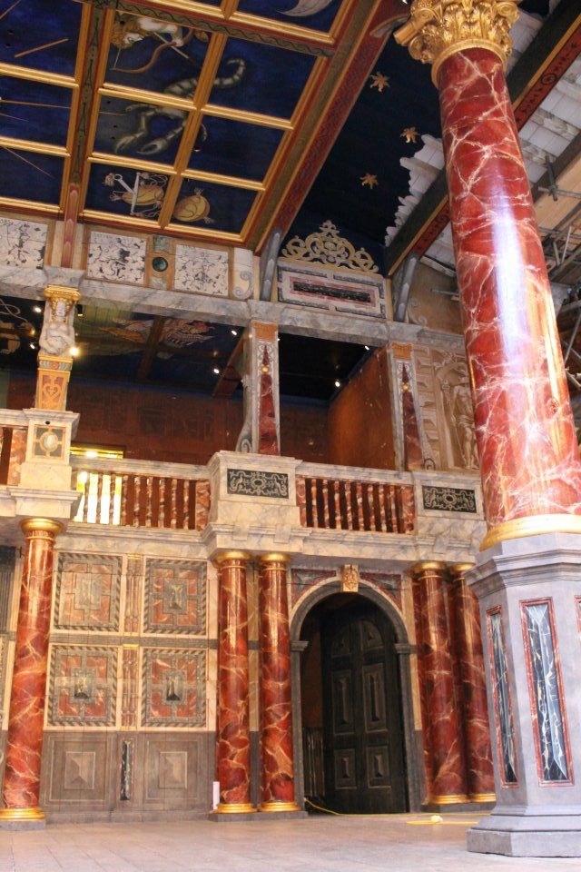

Slide 10
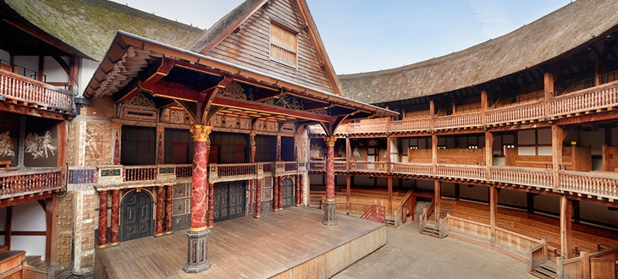
Shakespeare's theatre
There were no kisses on stage in Shakespeare’s plays because all the women were played by boys!
All classes attended – how can you tell?

Slide 11
True or false?
Only men could act on the stage
All the audience had to keep quiet
Only rich people could go to the plays
Eating and drinking were banned
They used trap doors and different levels on the stage
A playhouse was a small house for children
Some people wanted to ban plays
They did not use costumes
They did use props
The people playing comic roles could make up extra bits
There were very few theatres
The plays were always staged at night
Queen Elizabeth hated plays
A player was another name for a musician
Most of the playhouses were round
The audience for a play would be about 20 people

Slide 12
Language
Uses Elizabethan English – renowned for puns.
At the start of the 1500s, the English were not proud of their language… But, translations made of other works at the time and the Bible being translated into English really extended the English language and added a LOT of new words. By the end of the 1500s, English was one of the most varied languages, with the largest number of synonyms.
Shakespeare’s plays are written in blank verse mostly – some of it rhymes, but not all of it. This is NOT how the Elizabethans talked!

Slide 13
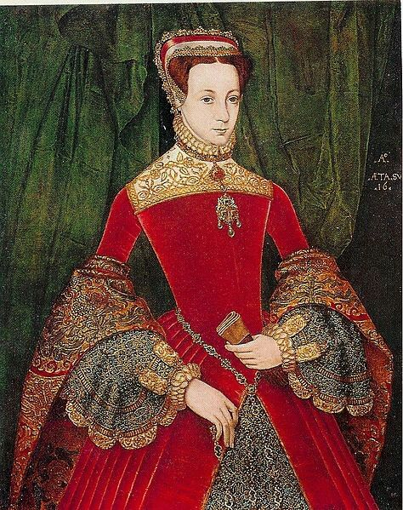
Context
Women
Patriarchy was practiced worldwide
Women were considered physically and intellectually inferior to men
Unmarried girls needed to obey their fathers
Married women needed to obey their husbands. All their property belonged to their husbands.

Slide 14
Portia
Beautiful, intelligent, inherited her late father’s wealth
Not allowed to decide who she will marry but has to follow her father’s will and marry whoever wins her father’s lottery
"O me, the word "choose!" I
may neither choose who I would nor refuse who I
dislike. So is the will of a living daughter curbed by
the will of a dead father. Is it not hard, Nerissa, that
I cannot choose one, nor refuse none? "
She says that when she marries Bassanio all her wealth will belong to him.

Slide 15
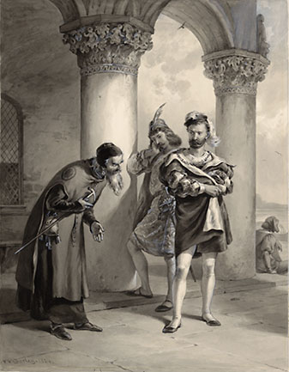
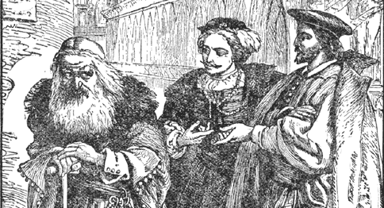
Jews
Play written in 1596 or 1597
Catholicism and its attitudes dominant in Europe – they blamed the Jews for the crucifixion of Christ
The Crusades exacerbated Christian hatred of Jews and in 1290 Edward I of England expelled all Jews
Jews were discriminated against and marginalized, frequently becoming the victims of Christian violence
Not allowed to own land leading to them keeping most of their wealth in coins. This and the fact that Christians couldn’t lend to Christians allowed them to become money lenders. Christians hated going to Jews for money
Often portrayed as villains and became the subject of mockery in literature

Slide 16
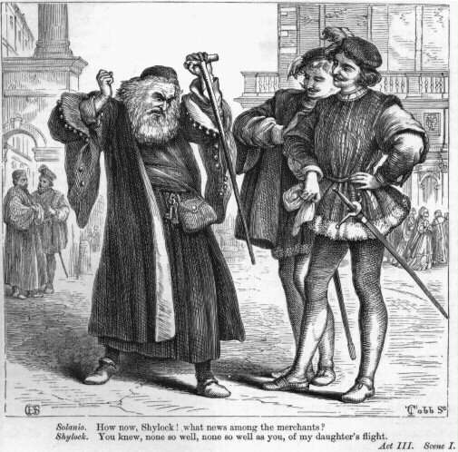
Shylock
Christopher Marlowe's play The Jew of Malta, depicting a murderous Jewish villain became a great popular success, and it is reasonable to presume it might have inspired Shakespeare when he was creating the character ‘Shylock’ in the Merchant of Venice.
Shylock is greedy, mean and ruthless Jewish money lender, who values money more than his own daughter and is so bloodthirsty that he wants as his payment, his enemy’s heart.
However, in comparison to the Jewish villain in Marlowe's The Jew of Malta, Shakespeare's Shylock is a much more complex character and Shakespeare granted him more human features by revealing to audience that Shylock's hatred is born out of the mistreatment he had suffered in a Christian society. This is why many readers and playgoers have found Shylock a compelling and sympathetic figure.
https://clickv.ie/w/_gTr

Slide 17
The main characters in the play:
Shylock - A Jewish moneylender in Venice. Angered by his mistreatment at the hands of Venice’s Christians, particularly Antonio, Shylock schemes to eke out his revenge by ruthlessly demanding as payment a pound of Antonio’s flesh. Although seen by the rest of the play’s characters as an inhuman monster, Shylock at times diverges from stereotype and reveals himself to be quite human. These contradictions, and his eloquent expressions of hatred, have earned Shylock a place as one of Shakespeare’s most memorable characters.

Slide 18
Portia - A wealthy heiress from Belmont. Portia’s beauty is matched only by her intelligence. Bound by a clause in her father’s will that forces her to marry whichever suitor chooses correctly among three caskets, Portia is nonetheless able to marry her true love, Bassanio. Far and away the most clever of the play’s characters, it is Portia, in the disguise of a young law clerk, who saves Antonio from Shylock’s knife.

Slide 19
Antonio - The merchant whose love for his friend Bassanio prompts him to sign Shylock’s contract and almost lose his life. Antonio is something of a mercurial figure, often inexplicably melancholy and, as Shylock points out, possessed of an incorrigible dislike of Jews. Nonetheless, Antonio is beloved of his friends and proves merciful to Shylock, albeit with conditions.

Slide 20
Bassanio - A gentleman of Venice, and a kinsman and dear friend to Antonio. Bassanio’s love for the wealthy Portia leads him to borrow money from Shylock with Antonio as his guarantor. An ineffectual businessman, he needs to marry well to recover his fortunes:
Tis not unknown to you, Antonio,
How much I have disabled mine estate
By something showing a more swelling port
Than my faint means would grant continuance
However, Bassanio proves himself a worthy suitor, correctly identifying the casket that contains Portia’s portrait.

Slide 21
Gratiano - A friend of Bassanio’s who accompanies him to Belmont. A coarse and garrulous young man, Gratiano is Shylock’s most vocal and insulting critic during the trial. While Bassanio courts Portia, Gratiano falls in love with and eventually weds Portia’s lady-in-waiting, Nerissa.

Slide 22
Jessica - Although she is Shylock’s daughter, Jessica hates life in her father’s house, and elopes with the young Christian gentleman, Lorenzo. The fate of her soul is often in doubt: the play’s characters wonder if her marriage can overcome the fact that she was born a Jew, and we wonder if her sale of a ring given to her father by her mother is excessively callous.

Slide 23
Lorenzo - A friend of Bassanio and Antonio, Lorenzo is in love with Shylock’s daughter, Jessica. He schemes to help Jessica escape from her father’s house, and he eventually elopes with her to Belmont

Slide 24
Quiz
Bassanio fancies ?
Antonio is best friends with ?
Shylock hates ?
Portia marries ?
? helps out Antonio
Antonio borrows money from ?
? and ? live in Venice
? is a Christian

Slide 25
Portia’s Mercy Speech
The quality of mercy is not strained. It droppeth as the gentle rain from heaven Upon the place beneath. It is twice blest: It blesseth him that gives and him that takes. 'Tis mightiest in the mightiest; it becomes The thronèd monarch better than his crown. His scepter shows the force of temporal power, The attribute to awe and majesty Wherein doth sit the dread and fear of kings; But mercy is above this sceptered sway. It is enthronèd in the hearts of kings; It is an attribute to God Himself; And earthly power doth then show likest God's When mercy seasons justice. Therefore, Jew, Though justice be thy plea, consider this: That in the course of justice none of us Should see salvation. We do pray for mercy, And that same prayer doth teach us all to render The deeds of mercy. I have spoke thus much To mitigate the justice of thy plea, Which, if thou follow, this strict court of Venice Must needs give sentence 'gainst the merchant there.
What difference does it make to the meaning if the order of the sentence is changed to “like the gentle rain from heaven, it drops”? – Foregrounding/signposting
What impact does the repetition of the word “it” have on the meaning? - Repetition
What does the insertion of the word “Jew” do to our understanding of the text? – Word choice (attitude revealed)
If the sentence was written “none of us would see salvation in the strict course of justice” what would be lost from the meaning here? – juxtaposition/foregrounding
How is Portia's use of pronouns effective here? – Word choice (attitude revealed)
What meaning does the phrase “if thou follow” add to this sentence? – Word choice (significant addition)

Slide 26
Latin Roots
Temporal - Middle English: from Latin temporalis, from tempus, tempor- ‘time’.
Attribute - late 15th century: from Latin verb attribuere, from ad- ‘to’ + tribuere ‘assign’.
Mitigate - late Middle English: from Latin mitigat- ‘softened, alleviated’, from mitis ‘mild’.

Slide 27
Your turn
abstract, abstain, aversion
acrid, acrimony, exacerbate
audible, audience, auditorium
benefit, benign, benefactor
abbreviate, brief
circus, circulate
dictate, edict, dictionary
deduce, produce, educate
founder, foundation, funding
gene, generate, generous
ability, exhibit, inhabit
jury, justice, justify
levitate, elevate, leverage
logic, apologize, analogy
lucid, illuminate, translucent
manual, manicure, manipulate
missile, transmit, permit
omnivorous, omnipotent, omniscent
pacify, pacific, pacifist
tranquil, requiem, acquit
script, proscribe, describe
sensitive, sentient, resent
terrain, territory, extra-terrestrial
timid, timorous
vacuum, vacate, evacuate
video, vivid, invisible

Slide 28
Your turn
Examine how Antonio speaks to Shylock in Act 1 Scene 3. What words and phrases reflect their relationship?
Look at how Shylock speaks to Antonio. Is there an imbalance of power in this relationship? How can you tell – give examples.
What frames Antonio as a hero despite his racism and Shylock as a villain?
You can use Sparknotes to help you

Slide 29
The main themes of the play:
Self-interest vs Love
The divine quality of mercy
Racial discrimination/hatred as a cyclical phenomenon
Father/daughter relationships/Family loyalty
Love and friendship
Money’s rightful place

Slide 30
Symbols
The caskets – gold, silver and lead
The pound of flesh
Leah’s ring
Portia’s ring
With a partner, work out what these symbols mean in the play. Use online sources to help if you need to.

Slide 31
Choose 2 themes
Self-interest vs Love The divine quality of mercy
Racial discrimination/hatred as a cyclical phenomenon
Father/daughter relationships/Family loyalty
Love and friendship Money’s rightful place
Create a mind map for each including examples, characters and quotes and symbols to illustrate how Shakespeare develops these themes in the play.
Quotes/symbols
Example 2
Theme 2
Themes
Theme 1
Main Characters
Example 1

Slide 32
Modern day applications
With a partner, for each of the themes listed below, write down as many modern day situations where they might be relevant as you can.
Self-interest vs Love
The divine quality of mercy
Racial discrimination/hatred as a cyclical phenomenon
Father/daughter relationships/Family loyalty
Love and friendship
Money’s rightful place

Slide 33
PLOT Summary
Main Character 1 needs help/favour from Protagonist because of his character flaw
Protagonist needs help/favour from Antagonist to do so (Protagonist has the power in the relationship and is contemptuous of Antagonist)
Main Character 2 has a problem they can’t seem to solve
Protagonist falls into Antagonist’s clutches (power)
Antagonist has their own problems
Main Character 1 and Main Character 2 make an alliance
Protagonist has even more problems
Main Character 2 rescues Protagonist from Antagonist
Antagonist is punished
Main Character 1 and 2 fall out over broken trust (by Character 1) but make up
Protagonist gets a happy ending

