Slide 1
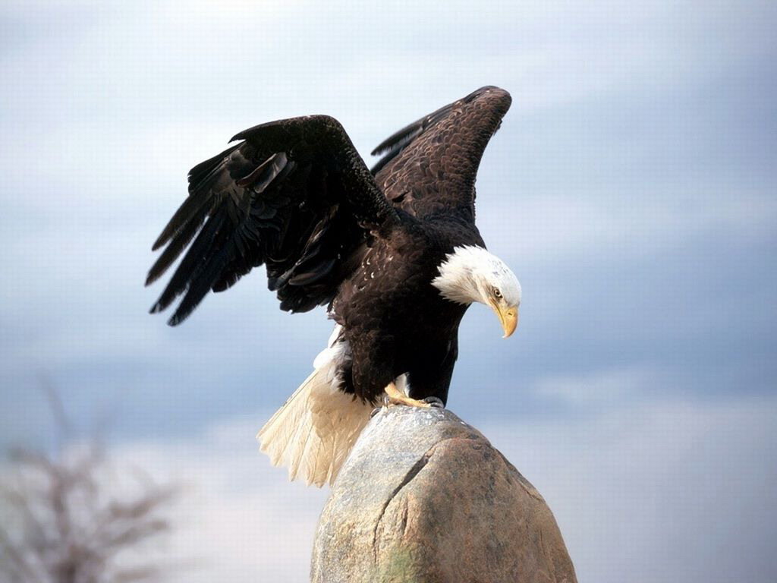
The Main Themes and Techniques in The Eagle by Alfred Lord Tennyson

Slide 2
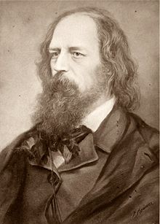
The Context
Alfred Lord Tennyson (1809-1892)
One of the most prominent poets in the history of English literature
Poet laureate
Career covered most of Queen Victoria's reign(1837-1901),
Accurately reflected the mainstream values and moral principles of the British society during Victorian era

Slide 3
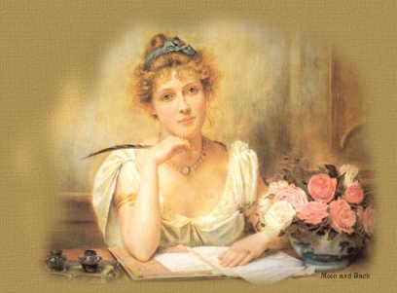
Women During the Victorian Era
Were considered inferior to men despite the ruling monarch of the British empire being female
Had very limited opportunity to have their voice heard in public or to make decisions for themselves
Were expected to be the "angel in the house“: charming, pure, passive, powerless and most importantly, should be dedicated and submissive to her husband.

Slide 4
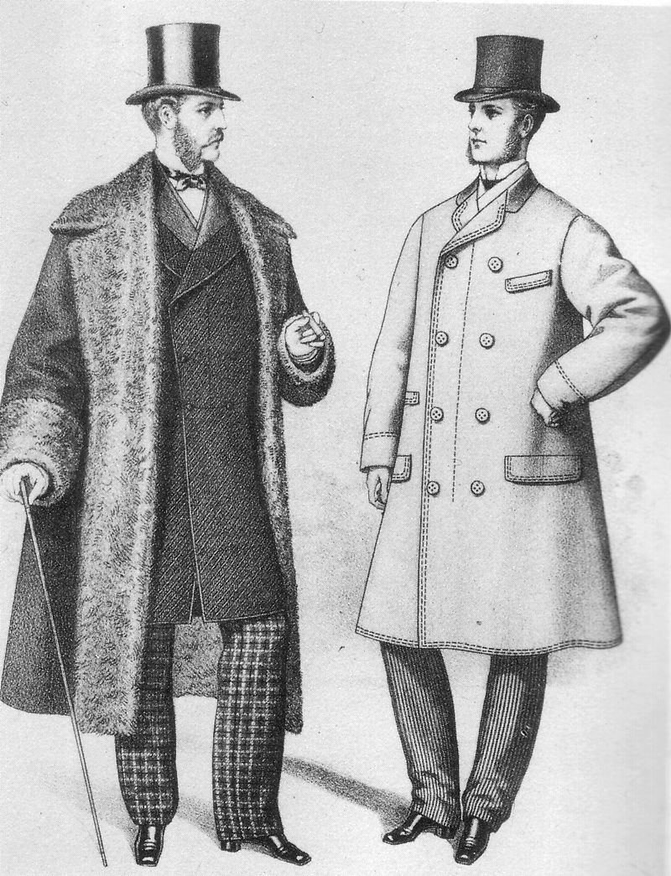
Men During the Victorian Era
‘Masculine’ values were seen to be: courage and endeavour i.e.: undertaking military action, exploration or commercial expansion
Were expected to be active, progressive and be powerful enough to defend the weak
Should contribute his intellect to speculation and invention
Should use his energy for adventure, for war, and for exploring the natural world.

Slide 5
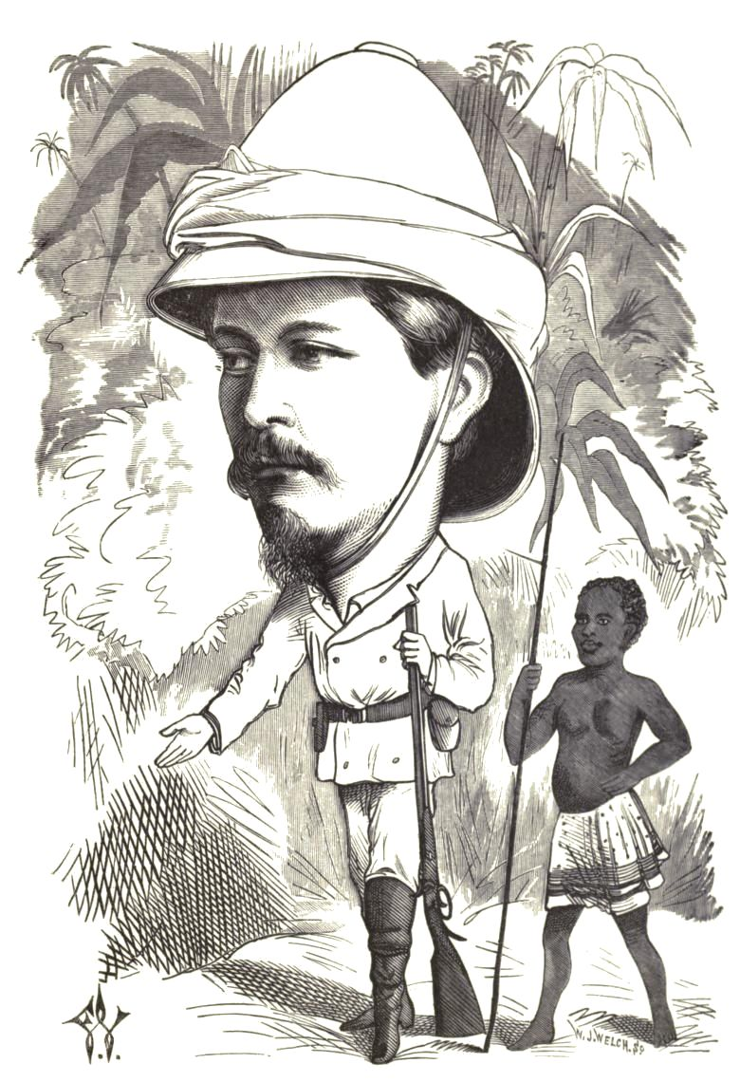
Masculinity and Prejudice
The Victorian era is famous for promoting the ideology of “great men”
Of course these “great men” were never non-white. ‘Natives’ and their ‘exotic’ lands were seen as wild and requiring taming by the brave Christians. It was Christian duty to ‘save’ the poor ignorant, not too bright indigenous populations of colonial territories.
Misogyny was still strong in both popular and intellectual writing

Slide 6
Tennyson’s Victorian Attitudes are Reflected in the Themes Dealt With
1 Man and Masculinity
2 Man and the Natural World

Slide 7
Examples of Techniques Used to Demonstrate Ideas and Themes
Symbolism
Personification
Hyperbole
Imagery

Slide 8
Victorian Ideas on Man and Masculinity
1 Reflected through the technique of symbolism
The eagle stands on the top of a mountain where others cannot reach and looks down on the submissive sea (“crawls”)
It dives “like a thunderbolt” (also a simile)
It projects power and control (“mountain walls”)
The eagle becomes a symbol of a kind of masculine ideal of power, majesty and skillfulness and can be associated with Zeus on Mt Olympus
Impact on audience?

Slide 9
Another Technique Used for Man and Masculinity Theme
2 Reflected through the technique of hyperbole
E.g: “close to the sun”, “thunderbolt”
Exaggeration of the qualities that make the eagle admirable – ‘manly’ qualities like power and skillfulness
Impact on audience?

Slide 10
Victorian Ideas on Man and the Natural World
1 Reflected through the technique of personification
E.g: eagle’s “hands”, the sea “wrinkled” and “crawls”. Plus “he”: qualities of the eagle (power, majesty, and skillfulness) belong to a male.
Thus natural objects are granted human traits despite humans being physically absent
Nature such as the eagle can only be significant when granted man’s features and the grandness of nature can only be meaningful when humans project themselves onto it.
Therefore humans, or more accurately, men are at the top of the hierarchy of living things
Impact on audience?

Slide 11
Another Techniques Used to Develop the Theme of Man and Nature
2 Reflected through the technique of imagery
The author was trying to explore what the natural world could be like from an eagle's perspective
a world that is nearer to heaven than to earth (“close to the sun”)
Descriptive language such as: “crooked”, “lonely”, “ringed”, “azure” is used
The picture created is the eagle on this tall rocky mountain, alone, high above all other lives, with the sun blazing behind him, and the blue sky emphasizing his shape
Impact on audience?

