Slide 1
Discuss these following scenario with your partners:
Imagine you are a computer scientist, and you have written an important paper about cybersecurity. You have been invited to speak at a conference to explain your ideas. As you prepare your slides and notes for your speech, you are thinking about these questions:
What kind of language should I use?
What information should I include on my slides?
Now, imagine you are the same computer scientist, and you have a nephew in 3rd grade. Your nephew’s teacher has invited you to come to his class for Parents’ Day, to explain what you do at work. Will you give the same speech to the class of eight-year-olds? How will your language and information be the same or different?

Slide 2
Context, purpose and audience

Slide 3
Learning Intentions for the Unit
To understand how time and place (context) impact language use
To appreciate how texts are constructed and that they are constructed differently for different purposes, audiences and contexts.
To understand why texts are different because of the audience, purpose and contexts they are created for.

Slide 4
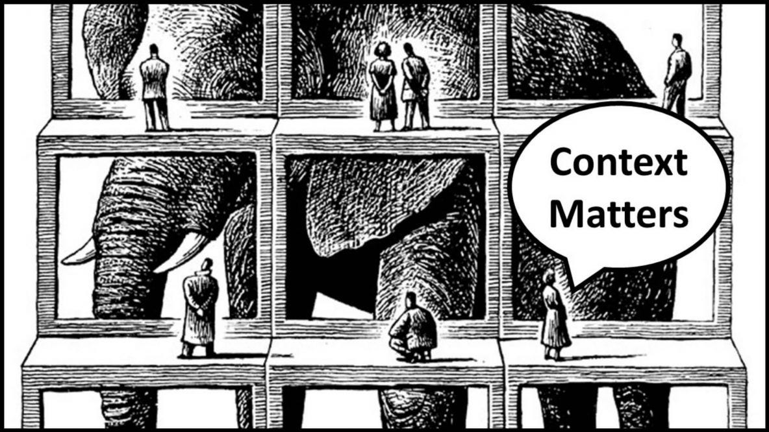
What is Context
Notes:
Sticky Note task- What is context (write it down in your own words)

Slide 5
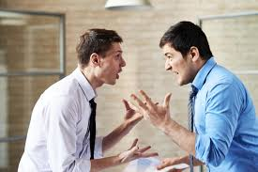
Context
The conditions in which something exists or occurs which can throw light onto the meaning of a surrounding word or passage
If your friend is furious at you for calling them your worst enemy, remind them that the context of those remarks was Opposite Day.

Slide 7
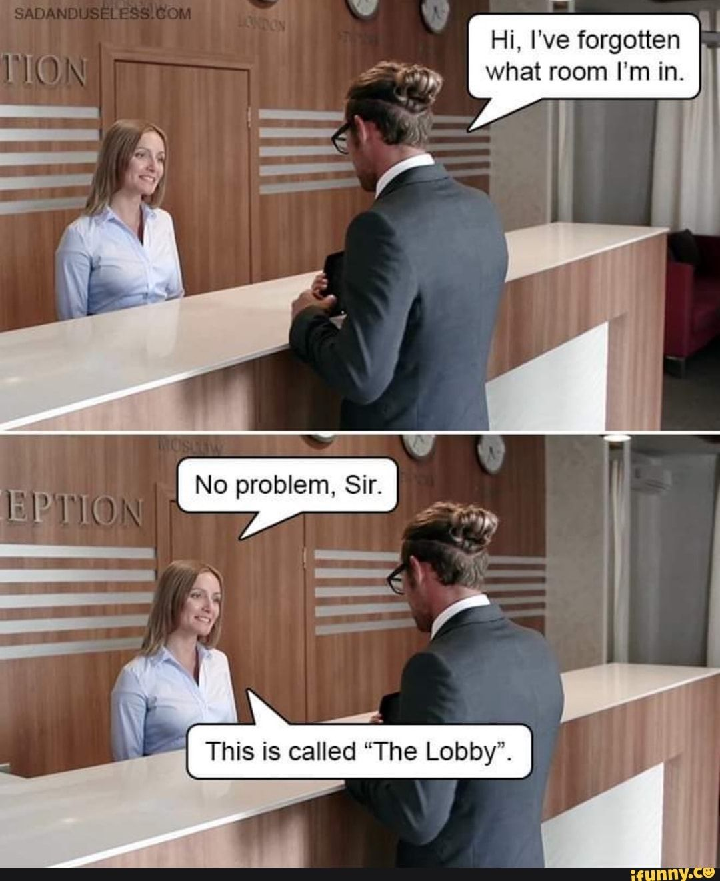

Slide 9
Purpose
The reason for which something is done or created or for which something exists.
There can be more than one ‘purpose’ behind why something exists. Often there is an obvious or broad purpose which can be easily identified, with the actual purpose or intention being harder to interpret (EG Movies are created to entertain audiences)

Slide 10
What is the Purpose of this Poem?

Slide 11
Audience
The people who read the text who have ideas, beliefs, experiences and values specific to them. These ideas, beliefs, experiences and values are shaped by their culture, gender, education, age, income and enthusiasms.
When texts or film are created the creator (Author, Director, writer etc) may have a specific audience which they are aiming at. They will utilise techniques within this piece with the aim of engaging their target audience. This doesn't mean no one else can understand the text, it is just the aim.

Slide 12
Who is the target audience of the Lion, the Witch and the Wardrobe?

Slide 13
Inside Out Movie
Eleven-year-old Riley has moved to San Francisco, leaving behind her life in Minnesota. She and her five core emotions, Fear, Anger, Joy, Disgust and Sadness, struggle to cope with her new life.

Slide 14
Think about: - What context is important for the viewer of this film to fully interpret the plot Who is likely the intended audience for this film. Why? What is the purpose of this film (apart from entertainment). What messages is is trying to send?
Notes:
https://www.youtube.com/watch?v=yRUAzGQ3nSY
Students have 3x sticky notes. One for Purpose, one for Audience and one for context

Slide 15
Remember Tone
As you consider your audience, purpose, and context, you will need to think about your word choice as well. For example, say these two phrases out loud:
Super sick kids
seriously ill children
Do they mean the same thing? Would you use the phrases in the same way? How about:
lots of stuff
many items
The words we choose help determine the tone of our writing, which is connected to audience, purpose, and context. Formal Vs Informal Tone

Slide 16
Today’s Task
Change the article to target an elderly resident of a nursing home to be able to watch Netflix.
You can choose whether you are teaching them to access Netflix on
Their iPhone
Their Laptop
Their Smart TV
You must consider
Language which would be appropriate for the target audience (whether they are more formal, informal, technical, or casual)
The breakdown of steps and how this is communicated for the target audience
The context of the situation
Notes:
https://www.wikihow.com/Watch-Movies-Online-With-Netflix

Slide 17
Context:
Audience:
Purpose:

Slide 18
Context, purpose and audience

Slide 19
Today’s Task
Change the article to target an elderly resident of a nursing home to be able to watch Netflix.
You can choose whether you are teaching them to access Netflix on
Their iPhone
Their Laptop
Their Smart TV
You must consider
Language which would be appropriate for the target audience (whether they are more formal, informal, technical, or casual)
The breakdown of steps and how this is communicated for the target audience
The context of the situation
Notes:
https://www.wikihow.com/Watch-Movies-Online-With-Netflix

Slide 20
Context
The context of a text can include
When a text was constructed
The historical events or people of a period
The geographic location of a text
The economic conditions within a period
Cultural, religious or social values at a particular period
Context is closely related to Values and Attitudes

Slide 21
Values & Attitudes
Values are the moral, cultural, political and religious beliefs that a society or community hold in general. Values change over time
Attitudes are individual's views towards a society’s values. Some people celebrate the values of the society (they like them) and others challenge them (disagree or dislike them)

Slide 22
Audience & Target Audience
Audience are the people who listen or engage with a text
The Target Audience are the people who which a text or piece of media is directly aimed and marketed at. This is very segmented and specific
Attributes can include
Age
Education
Economic Status
Political Views
Social Views
Religious Views
Language/Ethnicity
Personal Interests/Hobbies

Slide 23
Purpose
The reason for which something is done or created or for which something exists.
There can be more than one ‘purpose’ behind why something exists. Often there is an obvious or broad purpose which can be easily identified, with the actual purpose or intention being harder to interpret (EG Movies are created to entertain audiences)

Slide 24
Grandparent Wikihow Article- Purpose
The purpose of this article is to ………………….. (What is the aim or desired end result from following your article)
What skills, abilities or knowledge should be developed from this article?
How will you adapt your article to ensure you develop these skills abilities or knowledge in your target audience? (What do you need to do?)
Notes:
The purpose of the article is to provide step-by-step guidance specifically tailored to the needs and preferences of grandparents, ensuring they can confidently navigate their iPhone devices and access Netflix to enjoy their favorite shows and movies. It aims to build the skills to allow grandparents to comfortably and confidently utilise their smartphone for entertainment purposes.

Slide 25
Grandparent Wikihow Article - Target Audience
Attributes can include
Age
Education
Economic Status
Political Views
Social Views
Religious Views
Language/Ethnicity
Personal Interests/Hobbies
This article is aimed at ………
Notes:
Grandparents aged 60 and above, who may have limited experience with smartphones and streaming services but are eager to learn. Grandparents who own an Iphone. Grandparents who actively want to be online and access streaming platforms

Slide 26
Grandparent Wikihow Article- Context
When a text was constructed
The historical events or people of a period
The geographic location of a text
The economic conditions within a period
Cultural, religious or social values at a particular period
What are the social values of expectations during this time in Society when relating to technology? (How does society feel about technology)
How do the older generation (60+) feel about technology and its current role in society (Values).
What is your target audience’s attitude toward this (do they agree or disagree?)
Notes:
In today's digital age, staying connected with family members and accessing entertainment options has become increasingly reliant on technology. Grandparents, who may not have grown up with smartphones or streaming services, are now seeking ways to adapt and incorporate these technologies into their lives to stay connected and entertained.

Slide 27
Things to Think about
What does your Target Audience expect from your article?
What language do you use (What language will the target audience understand, what language do the target audience expect?)
What graphics need to be included (what will assist your target audience to understand your instructions)
What layout is utilised (how best can you convey the required information to your target audience)
Tone (How do your instructions make your target audience feel about their abilities and capabilities with technology?)
Assumptions & Pre Existing Knowledge (What are you assuming is pre existing knowledge for your target audience?)

