Slide 1
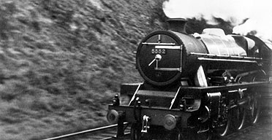
The Main Themes and Techniques in The Night Mail by W.H Auden

Slide 2
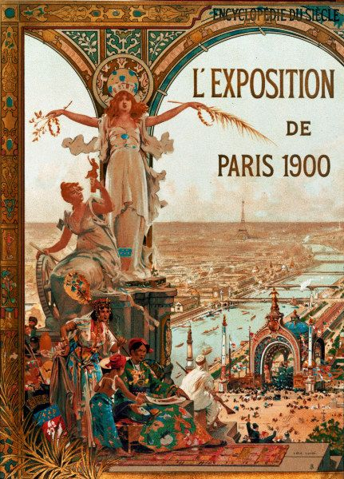
1.The Context
Optimism-the newly discovered technologies of the 19th century had been continually developed, refined, and then implemented on a wide scale in 20th century
Belief that human life would continue to be improved by the "unlimited, and undreamed of" power they possessed in technology

Slide 3
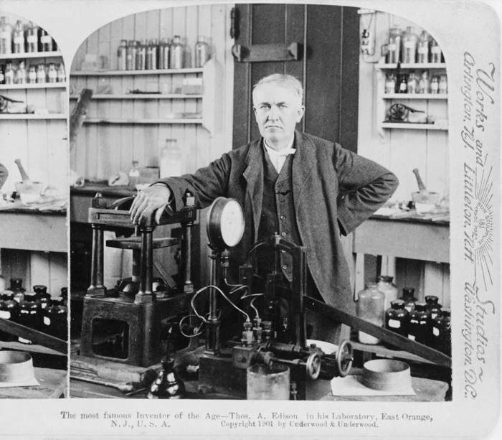
Examples of Technology Advances
In 1919 Ernest Rutherford conducted the first artificially induced nuclear reaction
Electric power became universally available in developed countries-life was becoming much more convenient and enjoyable.

Slide 4
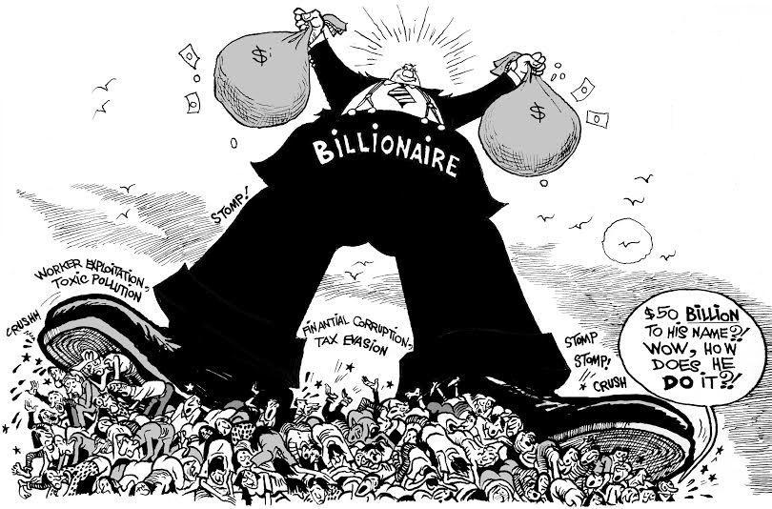
On The Other Hand
Major concerns surfaced about the relationship between capital (money) and labour – ie Socialism
Conflicts between workers and bosses caused by exploitation
“Factory acts” in Britain: reduce the abuses, regulate maximum labour hours and improve working conditions and safety for workers.

Slide 5
Socialism
The idea of socialism began to be generally accepted
To them socialist society meant common ownership would replace private ownership of production, distribution and exchange
Their hopes were fueled by Karl Marx's revolutionary “scientific” socialist philosophy.

Slide 6
Marx’s Theories
Socialist ideas dominated the 20th century
Resulted in decades of ideological confrontation between the West and Soviet Union in the Cold War era
Marxists strongly opposed capitalism – the idea that the market will find its way
Both agree on modernism- the power of human beings to make, improve and reshape their society, with the aid of scientific knowledge, technology and practical experimentation

Slide 7
Discussion
Is our attitude towards scientific technology today different from the people who lived 100 years ago?

Slide 8
The Poem
It was written in 1936 to accompany a documentary film of the same title
It is about a London, Midland, and Scottish Railway mail train travelling from London to Scotland.
Basic intention: to celebrate how quickly and effectively the modern industry can bring letters to all sorts of people

Slide 9
2.The Main Themes and Examples of Techniques That Support Them

Slide 10
Celebration of Modern Technology.
Delivered through the technique of personification .
E.g:"her" , "she“, ”shoulders”, ”snort”

Slide 11
Effect:
It is easier to relate to a character as humans than an impersonal thing because that is how we are made.
How is this impact made?
The train is presented as having a personality. The evidence shows it is affable, reliable, heroic
We feel more positive toward it because it sounds like it is nice.

Slide 12
The Equality of Mankind
reflected through the technique of repetition
E.g: "letters for the poor, letters for the rich" , "letters of thanks, letters from banks" and "Letters with faces scrawled on the margin”

Slide 13
Effect:
The repetition makes us feel that there are a lot of letters by emphasising every time a letter is mentioned but also in the poem the letters are described differently and are all together on the train and treated the same by the train.
How is the impact created?
You feel that no matter whether you are rich or poor or what your purpose for sending the letter was, the train will treat value your letters equally and deliver them on time.

Slide 14
Universal Brotherhood
reflected through the technique of a rhetorical question
E.g: “For who can bear to feel himself forgotten?"

Slide 15
Effect:
The question requires an answer and focuses the attention on the answer
How is the effect created?
The question recalls the story of the train as it passes across every county. The train is reaching everyone, nobody is going to be forgotten by her, and the train brings the people of the universe closer to one another. So the train ensures the universal brotherhood between the people having different colour and creed, cast and culture.

