Slide 1
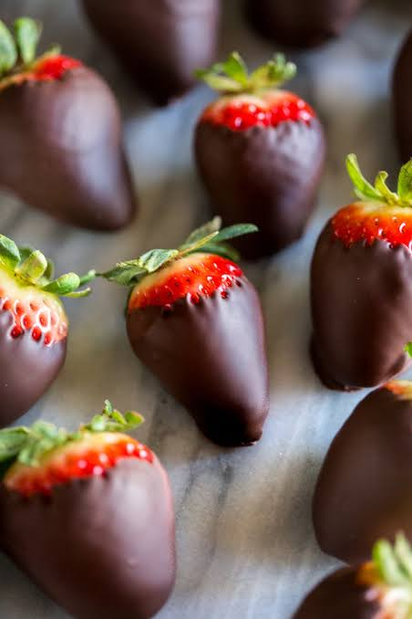
Markets in Action
The laws of Supply and Demand

Slide 2
Demand
An interaction between buyers (who demand goods and services) and sellers (who supply goods and services).
We live in a market economy – defined as freedom of choice and action between consumers and firms which determine economic output and price.
Markets don’t need to be a physical place.

Slide 3
The law of Demand
Demand for a good or service can be defined as the quantity that buyers are willing and able to buy at a particular price.
As the price of a good or service rises, the quantity demanded will fall. The opposite occurs when prices fall.

Slide 4
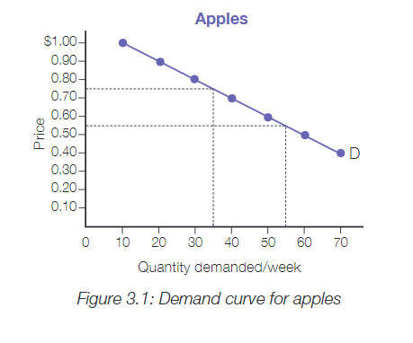

Slide 5
Complete Question 1 on your work sheets

Slide 6
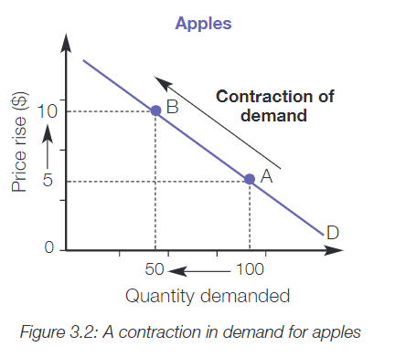
Expansion or contraction
An increase in price will result in a contraction.
At $5 per kilo, consumers would buy 100 kilos of apples, whereas, if the price rose to $10 per kilo, the demand would contract to 50 kilos.

Slide 7
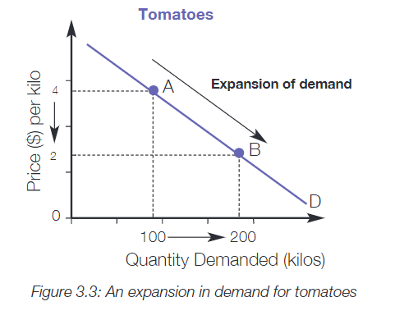
Expansion or contraction
A decrease in price will result in an expansion or extension of demand.
At $4 per kilo, consumers would buy 100 kilos of tomato's, whereas, if the price drop to $2 per kilo, the demand would expand to 200 kilos.

Slide 8
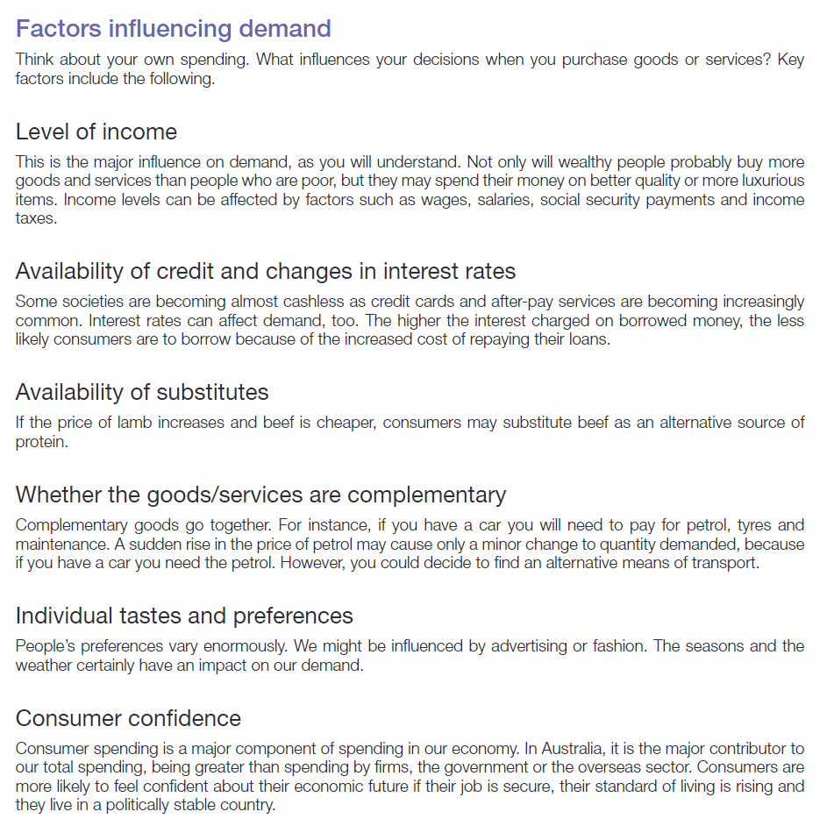

Slide 9
Aunty Beryl wants to make and sell chocolate covered strawberries and conducts her research
Luke
Sarah
Jayne
Price per chocolate strawberry | Quantity demanded per week
10 | 20
20 | 15
30 | 10
40 | 0
50 | 0
Price per chocolate strawberry | Quantity demanded per week
10 | 25
20 | 20
30 | 15
40 | 10
50 | 5
Price per chocolate strawberry | Quantity demanded per week
10 | 10
20 | 10
30 | 10
40 | 5
50 | 0
The Law of Demand is that the quantity demanded will decrease as the price increases.

Slide 10
Plot the following demand curve for chocolate strawberries
A demand curve shows the quantity demanded at a range of prices
Price
Price per chocolate strawberry | Quantity demanded per week
10 | 10000
20 | 8000
30 | 6000
40 | 4000
50 | 2000
Quantity

Slide 11
Complete Question 2 - 4 on your work sheets

Slide 12
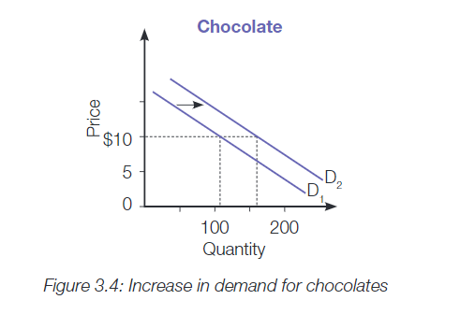
Changes in the demand curve
Other than a change in the price of the item being plotted
What is all wage earners received a tax cut?
Demand for chocolate may increase – greater number demanded at the same price.
At $10, wage earners would buy 165 chocolates instead of 115.

Slide 13
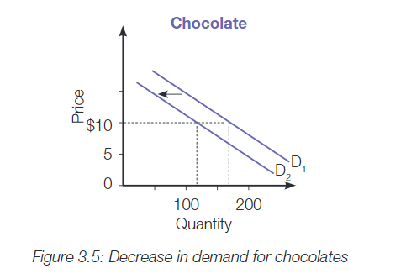
What if there was a heatwave?
Demand for chocolate may decrease – less demand even though there has not been a price change.
At $10, consumers would only buy 120.

Slide 14
Complete Question 5 - 7 on your work sheets

Slide 15
The law of Supply
Supply is the quantity of a good or service that producers are willing and able to supply at a particular price
Chocolate covered strawberries

Slide 16
Aunty Beryl is one of may suppliers of chocolate strawberries in Adelaide – all driven by a profit motive. Each willing to dip more strawberries in chocolate if they expect higher prices.
Aunty Beryl
The fine foods company
Confectionary Supplies
Price per chocolate strawberry | Quantity demanded per week
10 | 50
20 | 100
30 | 150
40 | 200
50 | 250
Price per chocolate strawberry | Quantity demanded per week
10 | 250
20 | 500
30 | 750
40 | 1000
50 | 1250
Price per chocolate strawberry | Quantity demanded per week
10 | 600
20 | 600
30 | 600
40 | 2000
50 | 2000
The Law of Supply is that the quantity supplied will increase as the price rises.

Slide 17
Plot the following supply curve on the same graph as the demand curve for chocolate strawberries
A supply curve shows the quantity supplied will increase as prices increase
Price
Price per chocolate strawberry | Quantity demanded per week
10 | 2000
20 | 4000
30 | 6000
40 | 8000
50 | 10000
Quantity

Slide 18
Equilibrium – the market price at which buyers want to buy the same quantity that sellers want to sell.
This point it determined through interaction of supply and demand – a point were both are satisfied – market efficiency.
Price
Price per chocolate strawberry | Quantity demanded per week
10 | 2000
20 | 4000
30 | 6000
40 | 8000
50 | 10000
Quantity

Slide 19
Shortage – tells suppliers that they not only can produce more, but could also charge a higher price – some consumers are prepared to pay more.
Price
Price per chocolate strawberry | Quantity demanded per week
10 | 2000
20 | 4000
30 | 6000
40 | 8000
50 | 10000
SHORTAGE
Quantity

Slide 20
Shortage – tells suppliers that they have produced too much and they need to encourage buyers back to the market by reducing prices and demanding more quantity.
SURPLUS
Price
Price per chocolate strawberry | Quantity demanded per week
10 | 2000
20 | 4000
30 | 6000
40 | 8000
50 | 10000
Quantity

Slide 21
Equilibrium – the market price at which buyers want to buy the same quantity that sellers want to sell.
This point it determined through interaction of supply and demand – a point were both are satisfied – market efficiency.
Price
Price per chocolate strawberry | Quantity demanded per week
10 | 2000
20 | 4000
30 | 6000
40 | 8000
50 | 10000
Quantity

Slide 22
Excess – having too many strawberries and feeling sick.

Slide 23
Shifts in supply and demand

Slide 24
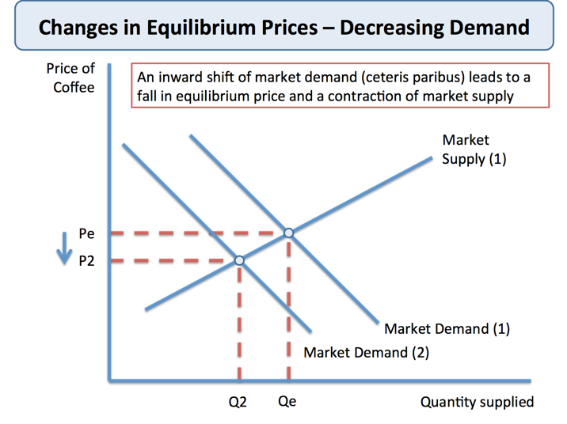
Shifts in supply and demand

Slide 25
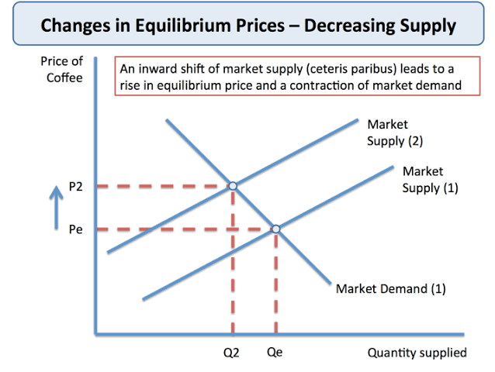
Shifts in supply

