Slide 1
Chapter 4: Government Involvement in the Economy

Slide 2
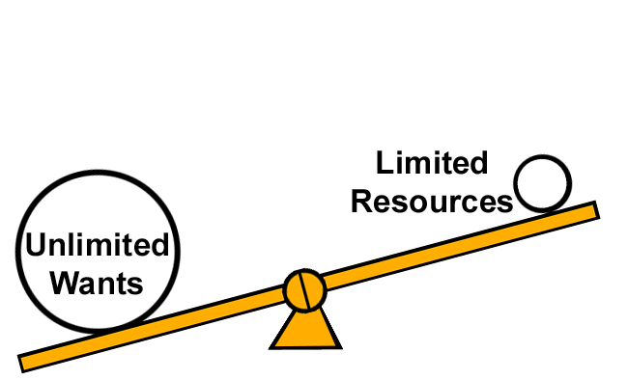
The main problem of an economy is of economizing scarce resources.
Economics is the study of the allocation of scarce resources to alternative ends.
The problem of scarcity arises because human wants are numerous and the means to satisfy them are limited.
This leads to the problem of choice-of selecting alternative uses to which scarce resources can be put.

Slide 3
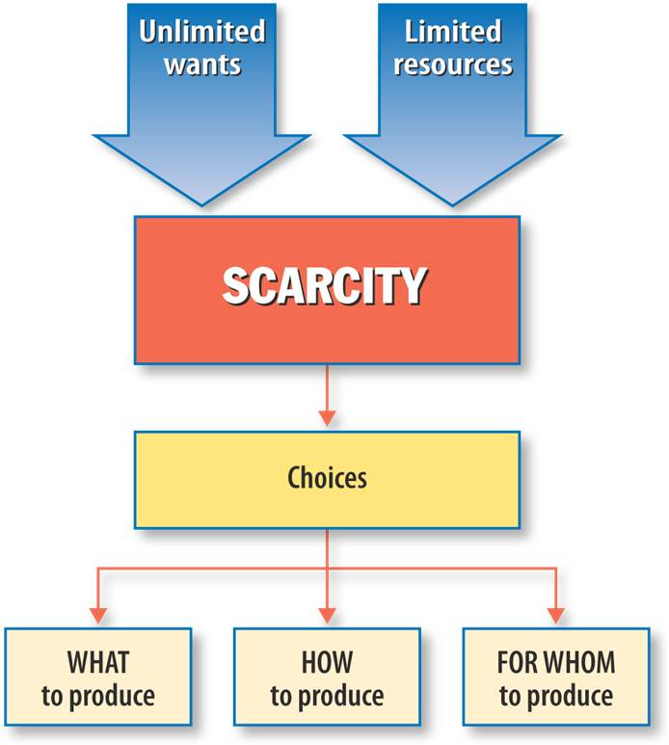

Slide 4
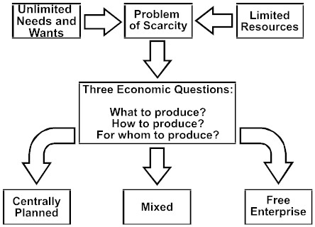
This exists in every economic system, whether it is capitalist, socialist or mixed economy.

Slide 5
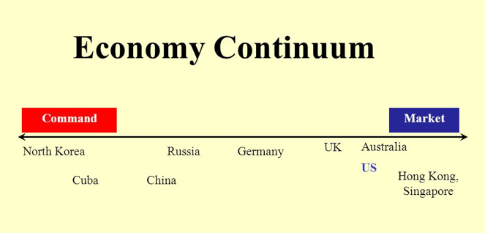

Slide 6
Market vs Planned Economies

Slide 7
Activity 1
Market Economy: Crash Course - Government and Politics

Slide 8
Activity 1
Market Economy: Crash Course - Government and Politics

Slide 9
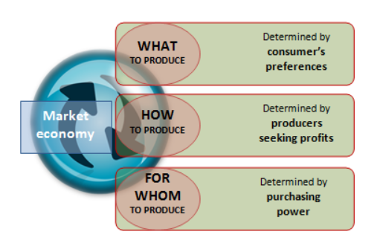
The Market Economy

Slide 10
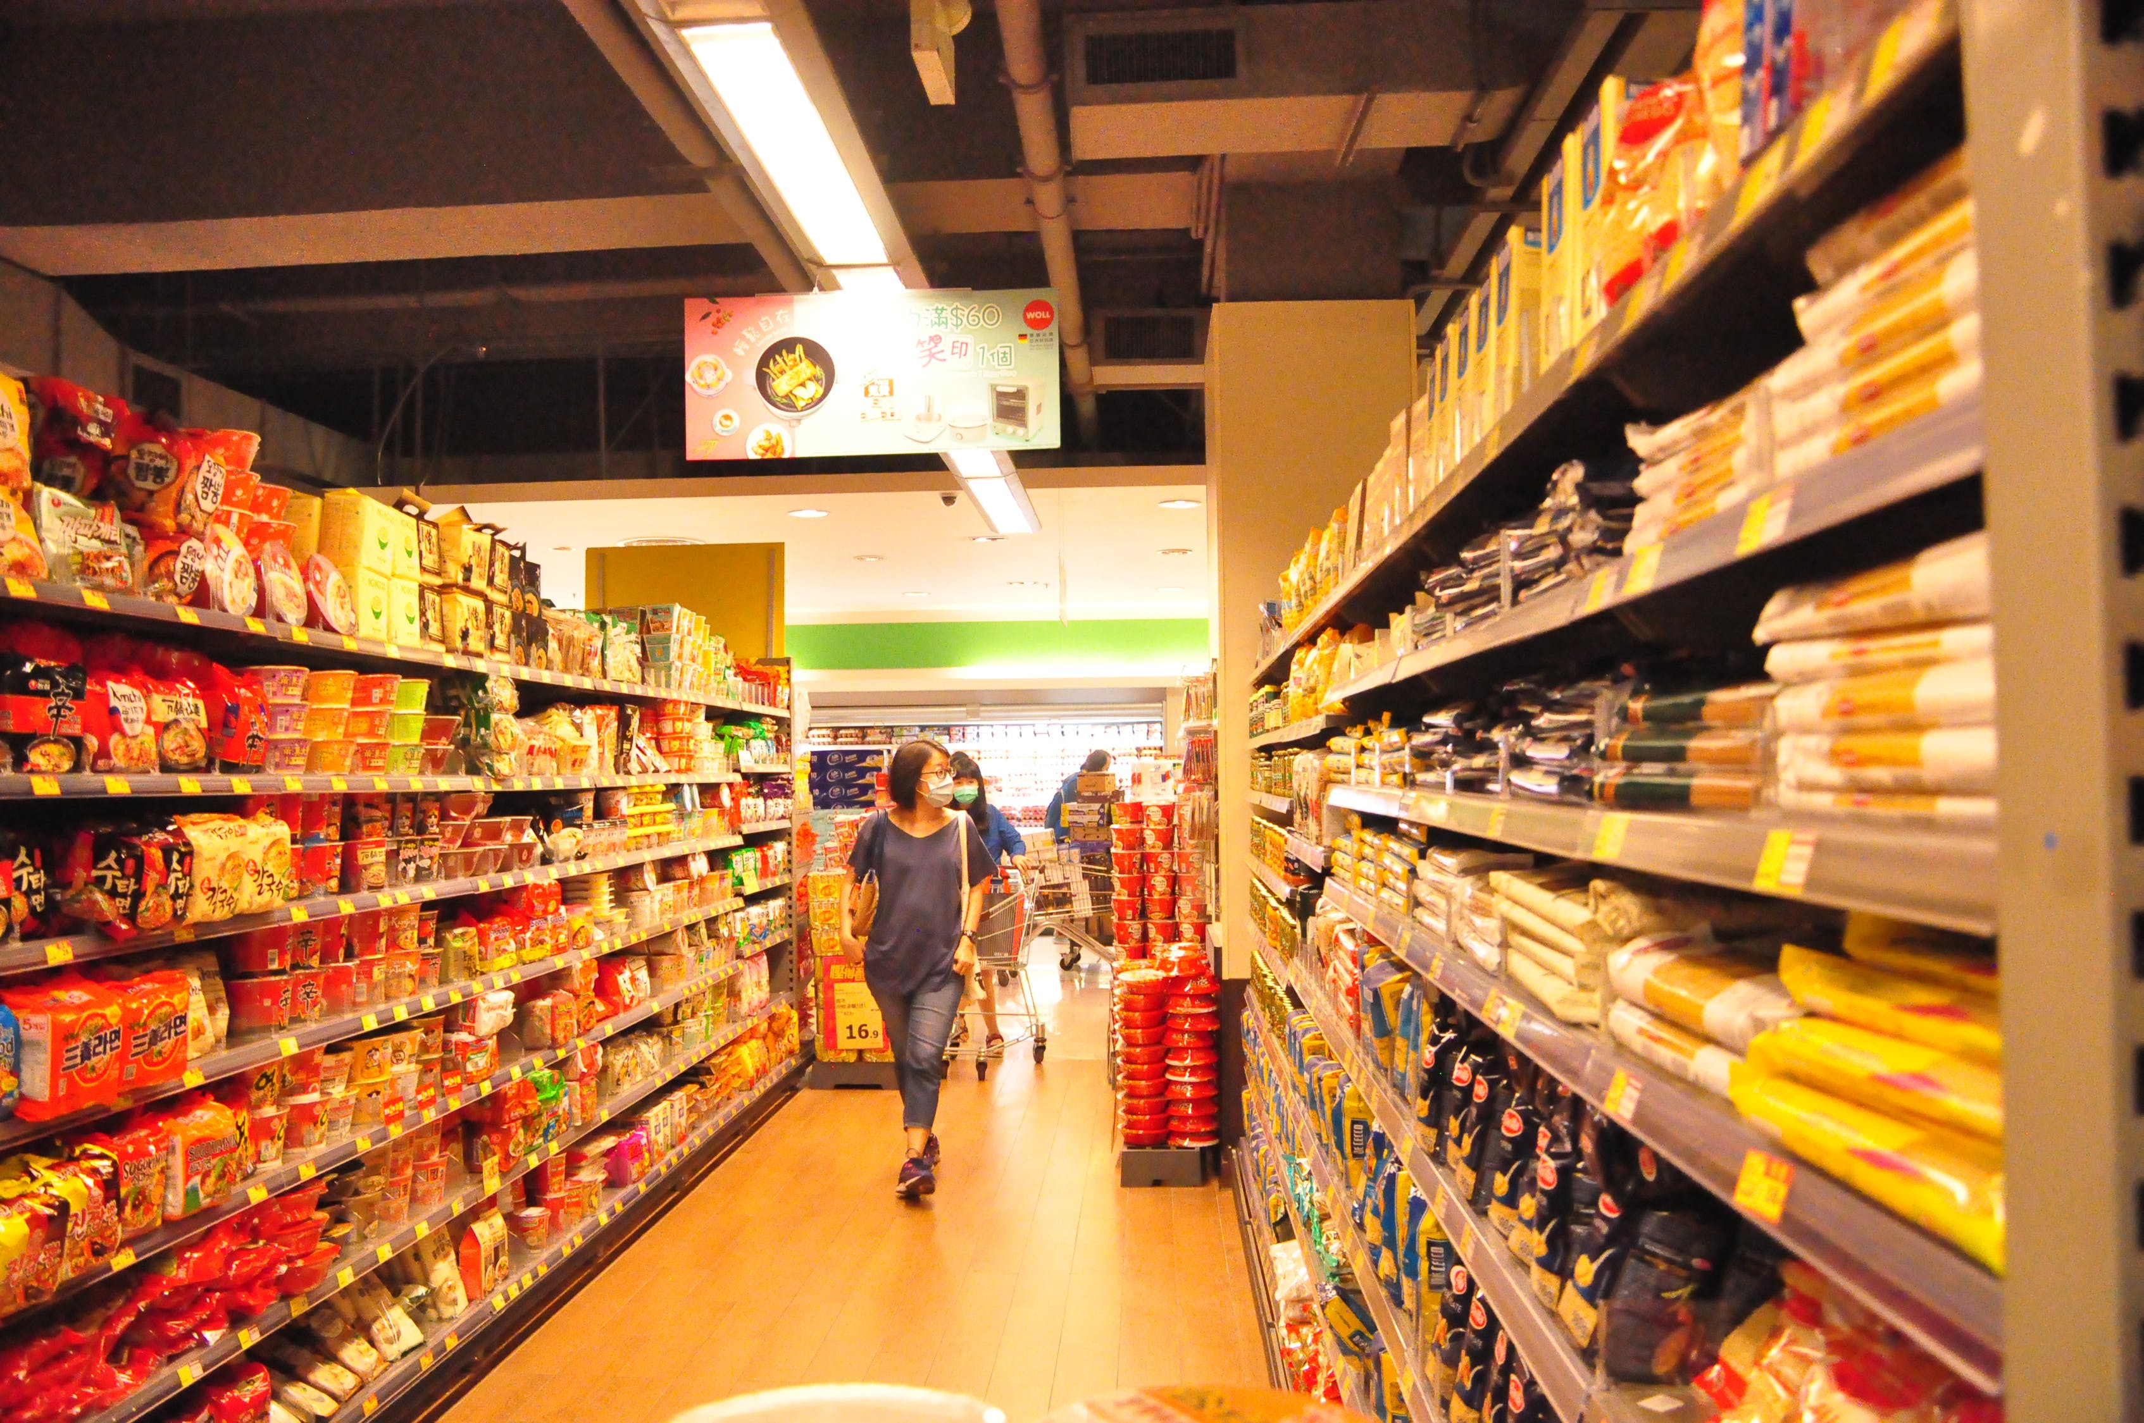
The Market Economy
In the market economy, the emphasis is on individual decision making.
Businesses respond to consumer demand and operate in the market with profit-making as a major motivator.

Slide 11
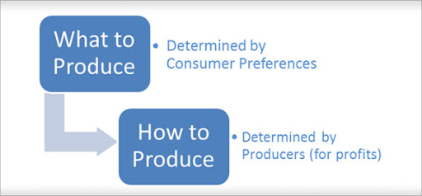
In reality, there is no pure market economy.
The government passes laws for a range of reasons, including social cohesion and public health.
These laws will affect the ‘What to Produce’ question.
Without government intervention, those without skills in demand, or those with significant health issues, may receive no income or fall into poverty.
Through features such as a minimum wage, and taxation benefits for many families, the extremes of poverty can be avoided.
Market economy should be called a ‘Mixed Market Economy’ because all countries have some degree of government involvement.

Slide 12
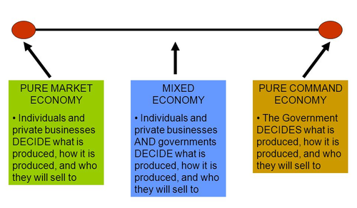

Slide 13
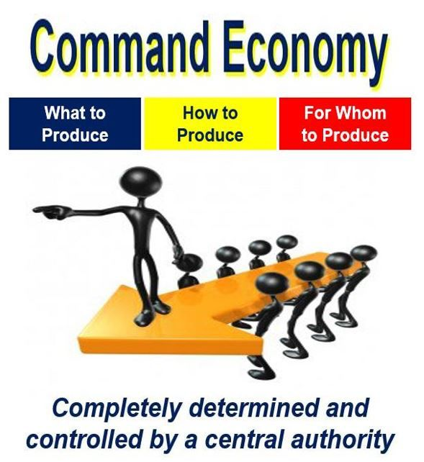
Reading
Reasons for the shift from the command economy

Slide 14
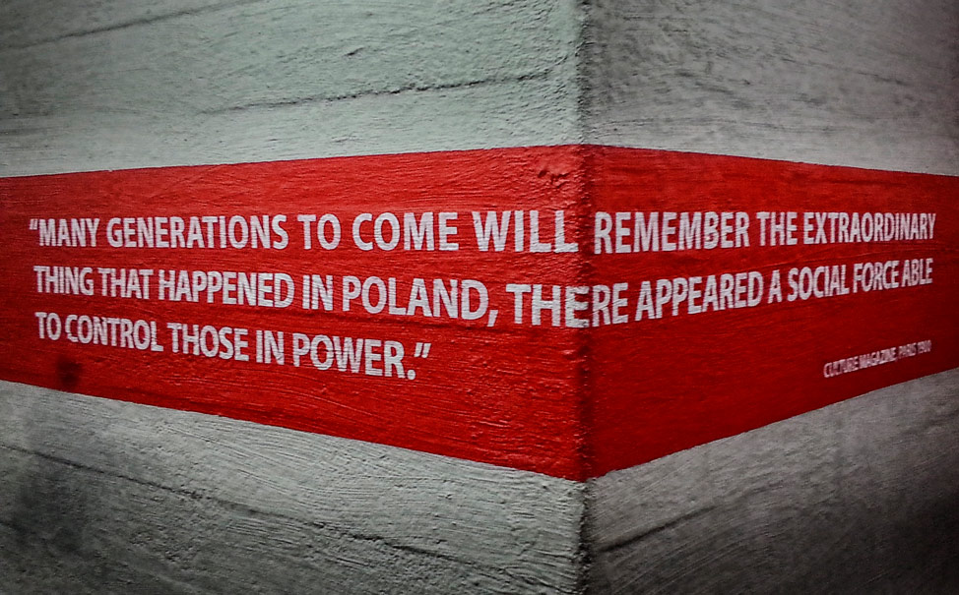
Activity
Commanding Heights Poland’s Solidarity

