Slide 1


Year 11 Economics
Week 2

Slide 2
Learning Outcomes
By the end of today’s lesson you will be able to…..
Explain why costs and benefits are important to economics.
How costs and benefits can be categorised.
Identify the variables that need to be considered in a cost / benefit analysis.

Slide 3

Economic Problem
Unlimited Wants
Limited Resources
Complementary, Recurring, Collective, Individual, Vary, Change over Time, Age
Capital, Land, Labour, Enterprise
Cost / Benefit Analysis
Categories – Private, External, Social
Variables – Identify, Externals, Time, Distribution
Opportunity Cost
Production Possibility Frontier (PPF)
Scarcity of Resources
Choice
What to produce
How to produce
For whom to produce

Slide 4
Revision
  Comment on the following:
  Needs
  Wants
  Resources
Recall – what did Adam Smith mean by the ‘Invisible Hand’

Slide 5
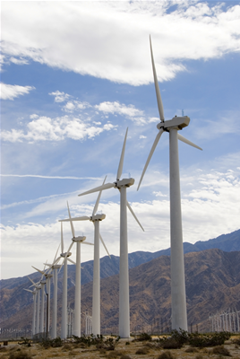
The Economic Problem
Unlimited Wants
Scarce Resources – Land, Labour, Capital, enterprise
Resource Use
Choices
Notes:
Discussion can take place here about the key elements of the economic problem – the unlimited wants of humans against the scarce resources that exist to meet those wants. The notion of supply and demand can be introduced here and students can be involved by making a list of all the things they would like to buy if they had unlimited amounts of money! If then asked to trim that list down to meet a budget the more outrageous items disappear. This then introduces the notion of having to make choices – this issue can be discussed further using examples drawn from students own experiences about the choices they have had to make – possibly involving the choice of subjects they have had to make at college or school in relation to the time available, etc! How we use our scarce resources can also be linked into this discussion. The wind turbines highlight an issue raised in the In the News section (http://www.bized.ac.uk/cgi-bin/chron/chron.pl?id=1928) about the intention to build wind farms in areas of the UK and the controversies that it creates – useful to link theory and practice at an early stage.

Slide 6
The Economic Problem
What goods and services should be produced? Should the economy focus on being self-sufficient or concentrate on what it is good at? Should it devote resources to health and education or defence and policing? Should we devote more resources to housing? Should an economy use resources producing goods that are essentially useless - like 'free' toys in cereal packets, football sticker cards and so on?
How should goods and services be produced? Should the economy use a system that is labour intensive, thereby ensuring everyone who wants a job has one, or should we use more efficient methods of production that involve the use of machines, even if this means more pollution and fewer jobs? Should we devote more land to production and thus solve some problems of feeding the population at the expense of encroaching into areas of natural beauty?
Who should get the resources that the economy has produced? Should an economy be geared to providing goods and services to every person as equally as possible or should those who work hard get more? How do we distribute our resources?
Notes:
This is the traditional three key questions any economic system has to answer. Many students would have difficulty defining what an ‘economy’ actually is! It is useful at this stage to clear this up – a system for the production and exchange of goods and services to satisfy the wants and needs of the population. This is open ended enough to be able to incorporate all manner of economic systems from a barter system that still exists in remote parts of the world to sophisticated economic systems such as the UK and US! The questions and the examples raised can be used for discussion – get the students to express their views at this stage and be as controversial as possible to stimulate discussion and involvement!

Slide 7
How have wants changed over time?
 | Food | Housing | Leisure
1019
1919
2019

Slide 8
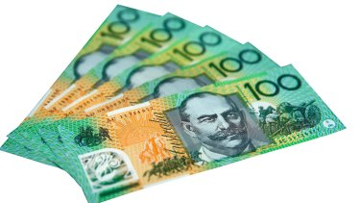
Discussion:
Imaging being 25 and looking to make your fortune. What goods and services do you predict will be in high demand over the next 20 years?
What resources have become important in Australia over the past 50 years and why?

Slide 9
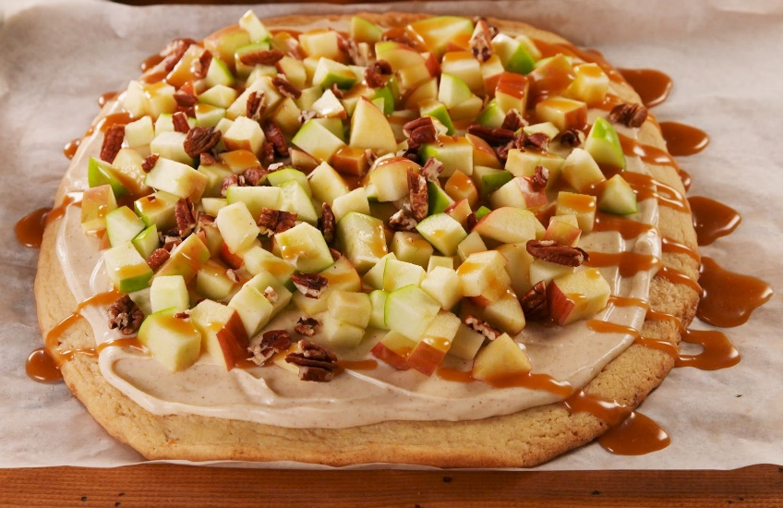
Costs and benefits
Costs and benefits are terms used in economics instead of advantages and disadvantages.
The term ‘costs’ can refer to money but usually means a whole lot of other factors.
A good analogy – being on a diet. Should I have the apple or the left over pizza.
https://www.youtube.com/watch?v=7tdKkeNClPE

Slide 10
Costs can be categorised
In economics it can be difficult to make the right decision as there are so many variables:
Private costs or benefits – the decision maker experiences personally the advantages and disadvantages of making the decision.
External costs or benefits – there are others around the decision maker that are affected even though they were not involved in making the decision.
Social costs or benefits – a whole society can be affected by a decision. Should I build a stadium, should I build or close a powerplant. Governments try and make decisions based on which idea has the greatest ratio of social benefit to social cost.

Slide 11
A cost / benefit analysis should include the following variables:
Identification – is it really good to highlight the cost / benefit of an issue? For example conducting a feasibility study into building a new marina or the relocation of an airport or prison can upset a community
External costs or benefits – Some costs are really hard to quantify. What cost can you put on the destruction of a habitat of endangered birds. What about closing a bank or community store?
Time – Some costs are not obvious – the lead smelter built in Port Pirie 100 years ago has had catastrophic impacts on many children.
Distribution – Is the benefit for everyone or is it a cost? Whose opinion is more important. The McDonalds built next door to you is cool if you love burgers but not if you hate noise.

Slide 12
Activity:
Conduct a Cost / Benefit analysis of closing the only bank in the town of Keith.
Issue:
This has been written from the perspective of:
Category | Costs | Benefits
Private
External
Social
Conclusion:

Slide 13
Activity:
Conduct a Cost / Benefit analysis of taking a year off after year 12 to explore Europe before starting work or study.
Issue:
This has been written from the perspective of:
Category | Costs | Benefits
Private
External
Social
Conclusion:

Slide 14
Independent Learning
Select 5 of the questions and give a detailed explanation as to why they are economic
Provide feedback to the class on your answers

Slide 15
Opportunity Cost
Definition – the cost expressed in terms of the next best alternative sacrificed
Helps us view the true cost of decision making
Implies valuing different choices
Notes:
This is a key concept and one that often causes problems and misunderstanding but is central to students thinking like an economist. The crucial thing to knock out of students is their thinking that everything costs ‘money’. Because we have to make choices there are issues surrounding value judgements about what is important and what is not – it should not be difficult to stimulate discussion about what issues of government spending are important and what are not!

Slide 16
