Slide 1


Welcome to Year 11 Economics
Stage 1 - 2019

Slide 2
Program length
  16 weeks
Topics to be covered:
  The Economic problem – 4 weeks
  The Share Market – 2 weeks
  Economic systems – 4 weeks
  The market mechanism – 4 weeks
  Market failure – 2 weeks
Assessment Tasks:
  Tests, Essays, Reports and Investigations - or a combination of all four

Slide 3
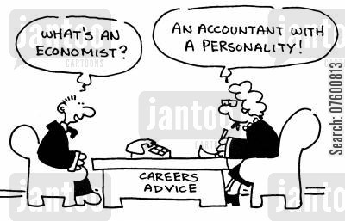
Where can economics take me?
Accountant | Agricultural economist | Urban planner
Company Secretary | Auctioneer | Bank officer
Government clerk | Diplomat | Credit officer
Customs broker | Farm Manager | Economist
Exporter / Importer | Industrial relations | Stock broker
Financial planner | Recruitment consultant | Political scientist
Public servant | Station agent | Retail buyer
Sales representative | Secondary School teacher | Town planner
Trade Union Official | Market researcher | Natural resource manager

Slide 4
Learning Outcomes
By the end of today’s lesson you will be able to…..
Explain the fundamental nature of economics - unlimited wants and scarce resources and the need to make choices
Understand the three questions related to the economic problem and its implications for an economy
Define opportunity cost with the use of an example

Slide 5
What is Economics??
Independently derive a definition of economics using examples where possible.
Share your definition with your team members and then use all of your definitions to create the best one possible.

Slide 6
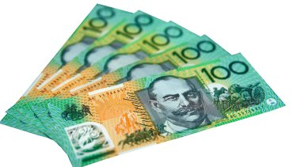
For your birthday you receive $500 from your friends……..
…..what do you do with it?
(You’ve just made an economic decision)

Slide 7
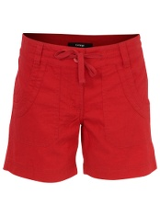
You’ve just bought some new shorts from Kmart
Some economic questions you could ask…..
Wonder how they can be sold so cheaply?
Ever consider the allegations of labour exploitation made against some retailers?
Do you just buy without thinking about it?
Could it be made cheaper in Australia, why / why not?
What is the quality of my product?
Do I need them?

Slide 8
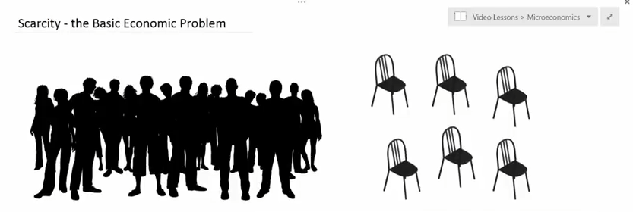
Definition of Economics:
The social science that studies the allocation of scarce resources between society’s competing wants and needs.
Economic systems:
The means by which society chooses to allocate scarce resources – who will get them, what will be produced with them, and who will receive the finished output (the three basic economic questions!)

Slide 9
What is economics??
Economics is essentially a subject that looks at choices - how individuals, governments and businesses make them and what the consequences of making those decisions are. There is a strong likelihood that every issue raised in the class involves some form of decision or choice - for example, if fines were the answer to pollution - the choice being to pollute and get fined or not pollute and avoid the fine - the question may then be how much of a fine is necessary before those
who choose to pollute feel the cost of doing so is too great?

Slide 10
Independent Learning
Select 5 of the questions and give a detailed explanation as to why they are economic
Provide feedback to the class on your answers

Slide 11
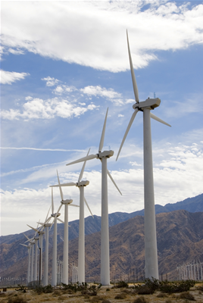
The Economic Problem
Unlimited Wants
Scarce Resources – Land, Labour, Capital, enterprise
Resource Use
Choices
Notes:
Discussion can take place here about the key elements of the economic problem – the unlimited wants of humans against the scarce resources that exist to meet those wants. The notion of supply and demand can be introduced here and students can be involved by making a list of all the things they would like to buy if they had unlimited amounts of money! If then asked to trim that list down to meet a budget the more outrageous items disappear. This then introduces the notion of having to make choices – this issue can be discussed further using examples drawn from students own experiences about the choices they have had to make – possibly involving the choice of subjects they have had to make at college or school in relation to the time available, etc! How we use our scarce resources can also be linked into this discussion. The wind turbines highlight an issue raised in the In the News section (http://www.bized.ac.uk/cgi-bin/chron/chron.pl?id=1928) about the intention to build wind farms in areas of the UK and the controversies that it creates – useful to link theory and practice at an early stage.

Slide 12
The resource game
All economic systems have to answer THREE KEY QUESTIONS:
WHAT to produce?
HOW to produce it?
FOR WHOM it should be produced?
FOR WHOM should the chocolates be produced?
But is this fair?.........What are the problems with the idea?..........
MY IDEA
PAIR IDEA
OUR GROUP IDEA
WHOLE CLASS IDEA

Slide 13
The Economic Problem
What goods and services should be produced? Should the economy focus on being self-sufficient or concentrate on what it is good at? Should it devote resources to health and education or defence and policing? Should we devote more resources to housing? Should an economy use resources producing goods that are essentially useless - like 'free' toys in cereal packets, football sticker cards and so on?
How should goods and services be produced? Should the economy use a system that is labour intensive, thereby ensuring everyone who wants a job has one, or should we use more efficient methods of production that involve the use of machines, even if this means more pollution and fewer jobs? Should we devote more land to production and thus solve some problems of feeding the population at the expense of encroaching into areas of natural beauty?
Who should get the resources that the economy has produced? Should an economy be geared to providing goods and services to every person as equally as possible or should those who work hard get more? How do we distribute our resources?
Notes:
This is the traditional three key questions any economic system has to answer. Many students would have difficulty defining what an ‘economy’ actually is! It is useful at this stage to clear this up – a system for the production and exchange of goods and services to satisfy the wants and needs of the population. This is open ended enough to be able to incorporate all manner of economic systems from a barter system that still exists in remote parts of the world to sophisticated economic systems such as the UK and US! The questions and the examples raised can be used for discussion – get the students to express their views at this stage and be as controversial as possible to stimulate discussion and involvement!

Slide 14
Opportunity Cost
Definition – the cost expressed in terms of the next best alternative sacrificed
Helps us view the true cost of decision making
Implies valuing different choices
Notes:
This is a key concept and one that often causes problems and misunderstanding but is central to students thinking like an economist. The crucial thing to knock out of students is their thinking that everything costs ‘money’. Because we have to make choices there are issues surrounding value judgements about what is important and what is not – it should not be difficult to stimulate discussion about what issues of government spending are important and what are not!

