Slide 1
Year 10 - Vocabulary
Term 2 - Week 1

Slide 2
written exchange
rit-en / eks-chayn-juh
Part of Speech: noun
Sentence: The written exchange between Maria and Ben reveals how delighted they are to be going overseas soon.
Definition: a conversational passage that is written, between two or more persons directed towards a particular subject

Slide 3
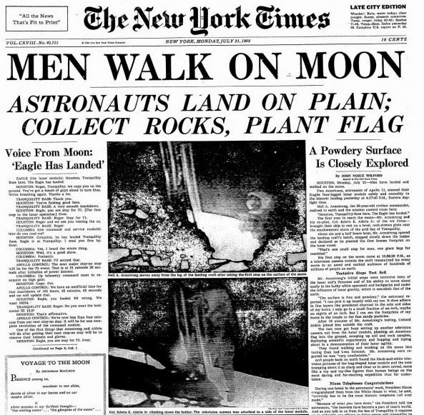
body of text
bod-ee /ov /tekst
Part of Speech: noun
Sentence: “The body of text in this magazine discusses many issues relating to climate change.”
Definition: the text forming the main content of a book, magazine, web page, or any other printed or digital work

Slide 4
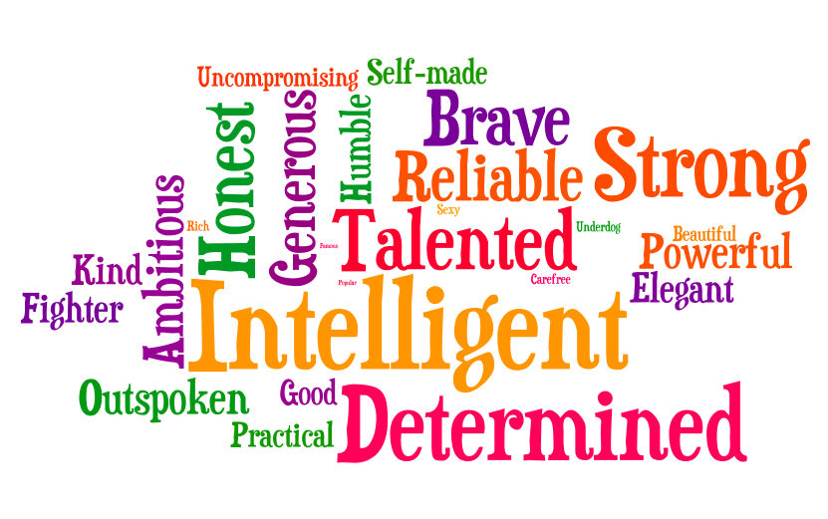
character trait
kar-ak-tuh / trate
Part of Speech: noun
Sentence: Nicholas’ compassion is one of his defining character traits
Definition: a feature of someone’s behavior or an inherent value that they hold, both good and bad

Slide 5
chronology
kron-o-loj-ee
Part of Speech: noun
Sentence: They met for the first time three years ago according to the chronology of events
Definition:
the arrangement of events or dates in the order of their occurrence

Slide 6
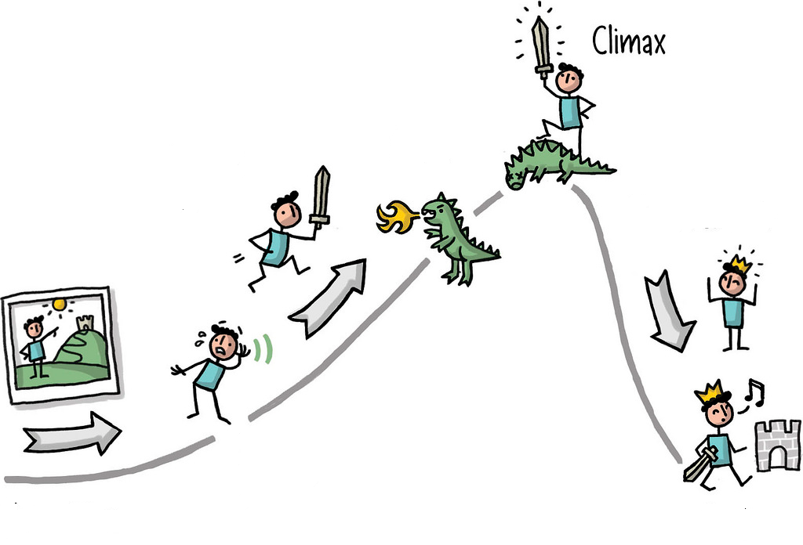
climax
klai-max
Part of Speech: noun
Sentence: Clara was on the edge of her seat during the climax of the movie as it portrayed a lot of action.
Definition: a turning point in the story and the moment with the highest tension and drama
Synonyms: peak, pinnacle, summit
Antonyms: anti-climax

Slide 7
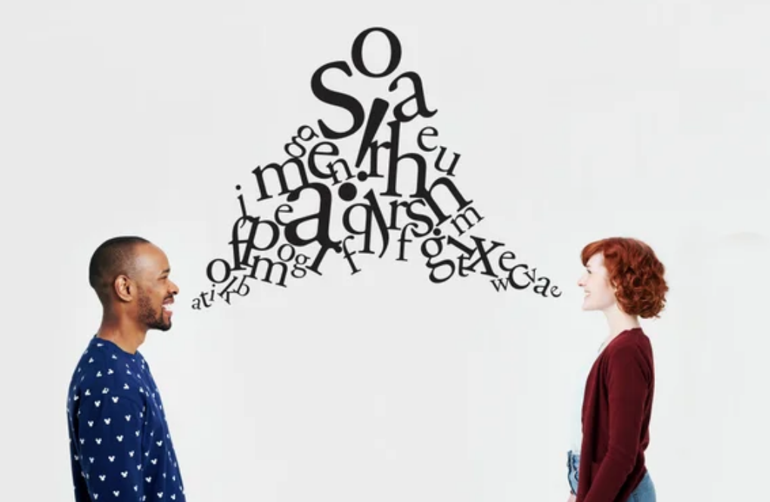
express
eks-press
Part of Speech: verb
Sentence: Marjorie was able to express how she felt about winning the race during her speech at assembly.
Definition: to put your thoughts into words or actions
Synonyms: communicate, convey, indicate
Antonyms: conceal, hide

Slide 8
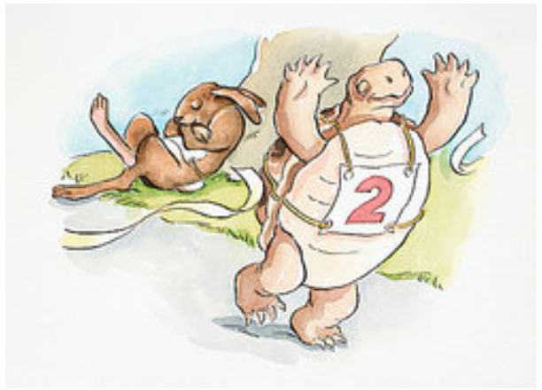
fable
fay-buul
Part of Speech: noun
Sentence: Her father told her fables every night before bed time in hopes that she would grow up to be a good person.
Definition: a short story that aims to teach a moral lesson

Slide 9
fictional
fik-shun-nul
Part of Speech: noun
Sentence: This fictional series about a young wizard was written by J.K. Rowling.
Definition: a story that is derived from one’s imagination and therefore not based on facts or real occurrences

Slide 10
gesture
jess-chuh
Part of Speech: noun
Sentence: He gestured toward the door frantically to signal that the monster was on the other side.
Definition: an action that expresses one’s ideas, feelings or attitude

Slide 11
graphic
graf-ik
Part of Speech: noun
Sentence: The description of the battlefield was too graphic and therefore not appropriate for Primary School students.”
Definition: when the writing contains explicit details allowing you to vividly visualise what it is describing in your head

