Slide 1
YEAR 10 WORDS TO USE TO DESCRIBE WHAT’S HAPPENING

Slide 2
illustration
eel-lus-tray-shun
Part of Speech: noun
Sentence: The pamphlet illustrates why it is important for students to have breakfast before going to school.
Definition:
explaining or clarifying something

Slide 3
inference
in-fuh-rens
Part of Speech: noun
Sentence: It is possible to make inferences about the character’s age based upon the author’s description of his beard and wrinkly skin.
Definition:
the process of arriving at a conclusion by using the available information to connect the dots or making logical assumptions

Slide 4
motivated
moh-tiv-ayt-ed
Part of Speech: adjective
Sentence: The squad was motivated by their coach’s chocolate reward to do their best in the race.
Definition:
being influenced by an internal or external factor to take action

Slide 5
negative
negg-ah-tiv
Part of Speech: adjective
Sentence: She had a very negative experience due to all the disasters that occurred that night.
Definition: an undesirable situation, event, attitude or person

Slide 6
object
ob-jekt
Part of Speech: verb
Sentence: All of the students objected to their teacher’s suggestion that they should stay inside during lunch to finish their assignment.
Definition: express one's opposition to or disagreement with something

Slide 7
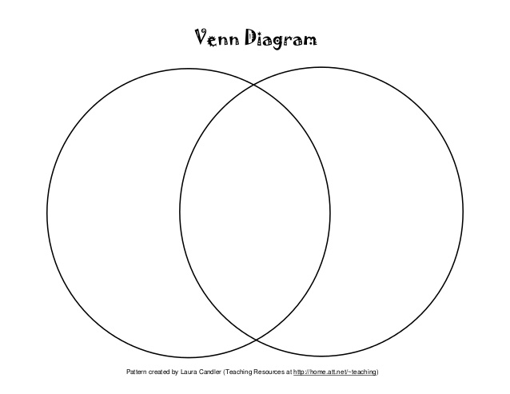
common feature
kom-in / fee-chuh
Part of Speech: noun
Sentence: The use of birds for symbolism was a common feature in both movies.
Definition: when a text has similar attributes or employs the same literary techniques

Slide 8
convention
kon-venn-shun
Part of Speech: noun
Sentence: John’s assignment followed the correct conventions of a comparative essay.
Definition:
A way in which something is usually done

Slide 9
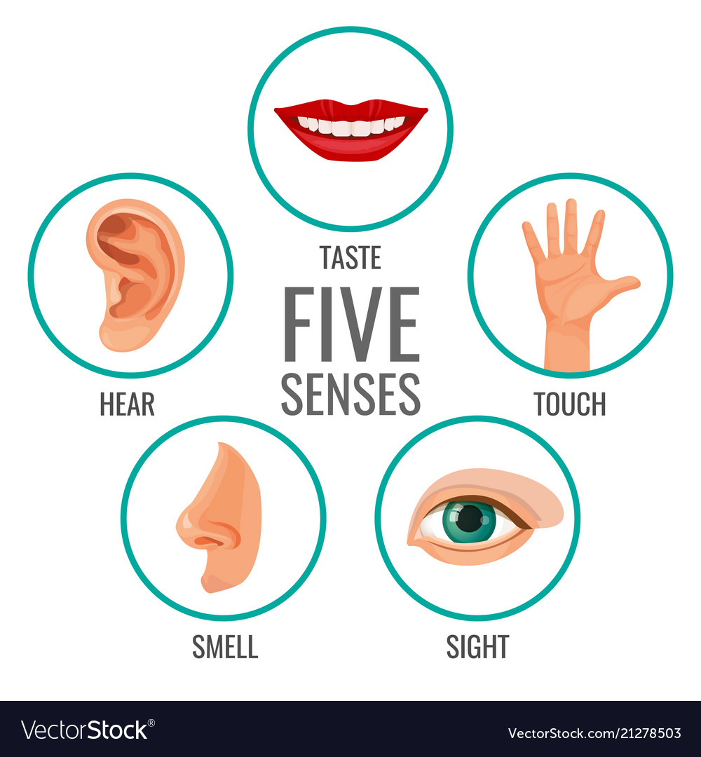
descriptive language
Dee-scrip-tiv / lan-gwij
Part of Speech: noun
Sentence: The poet used descriptive language to convey how fearful and panicked his character felt.
Definition:
The use of detailed adjectives to provide the reader with vivid images by appealing to their senses.

Slide 10
dialogue
di-ah-log
Part of Speech: noun
Sentence: Chapter four contained lots of dialogue between Mia and her friend which allowed them to resolve their problems
Definition: a conversation between two or more people as a feature of a book, play, or film.

Slide 11
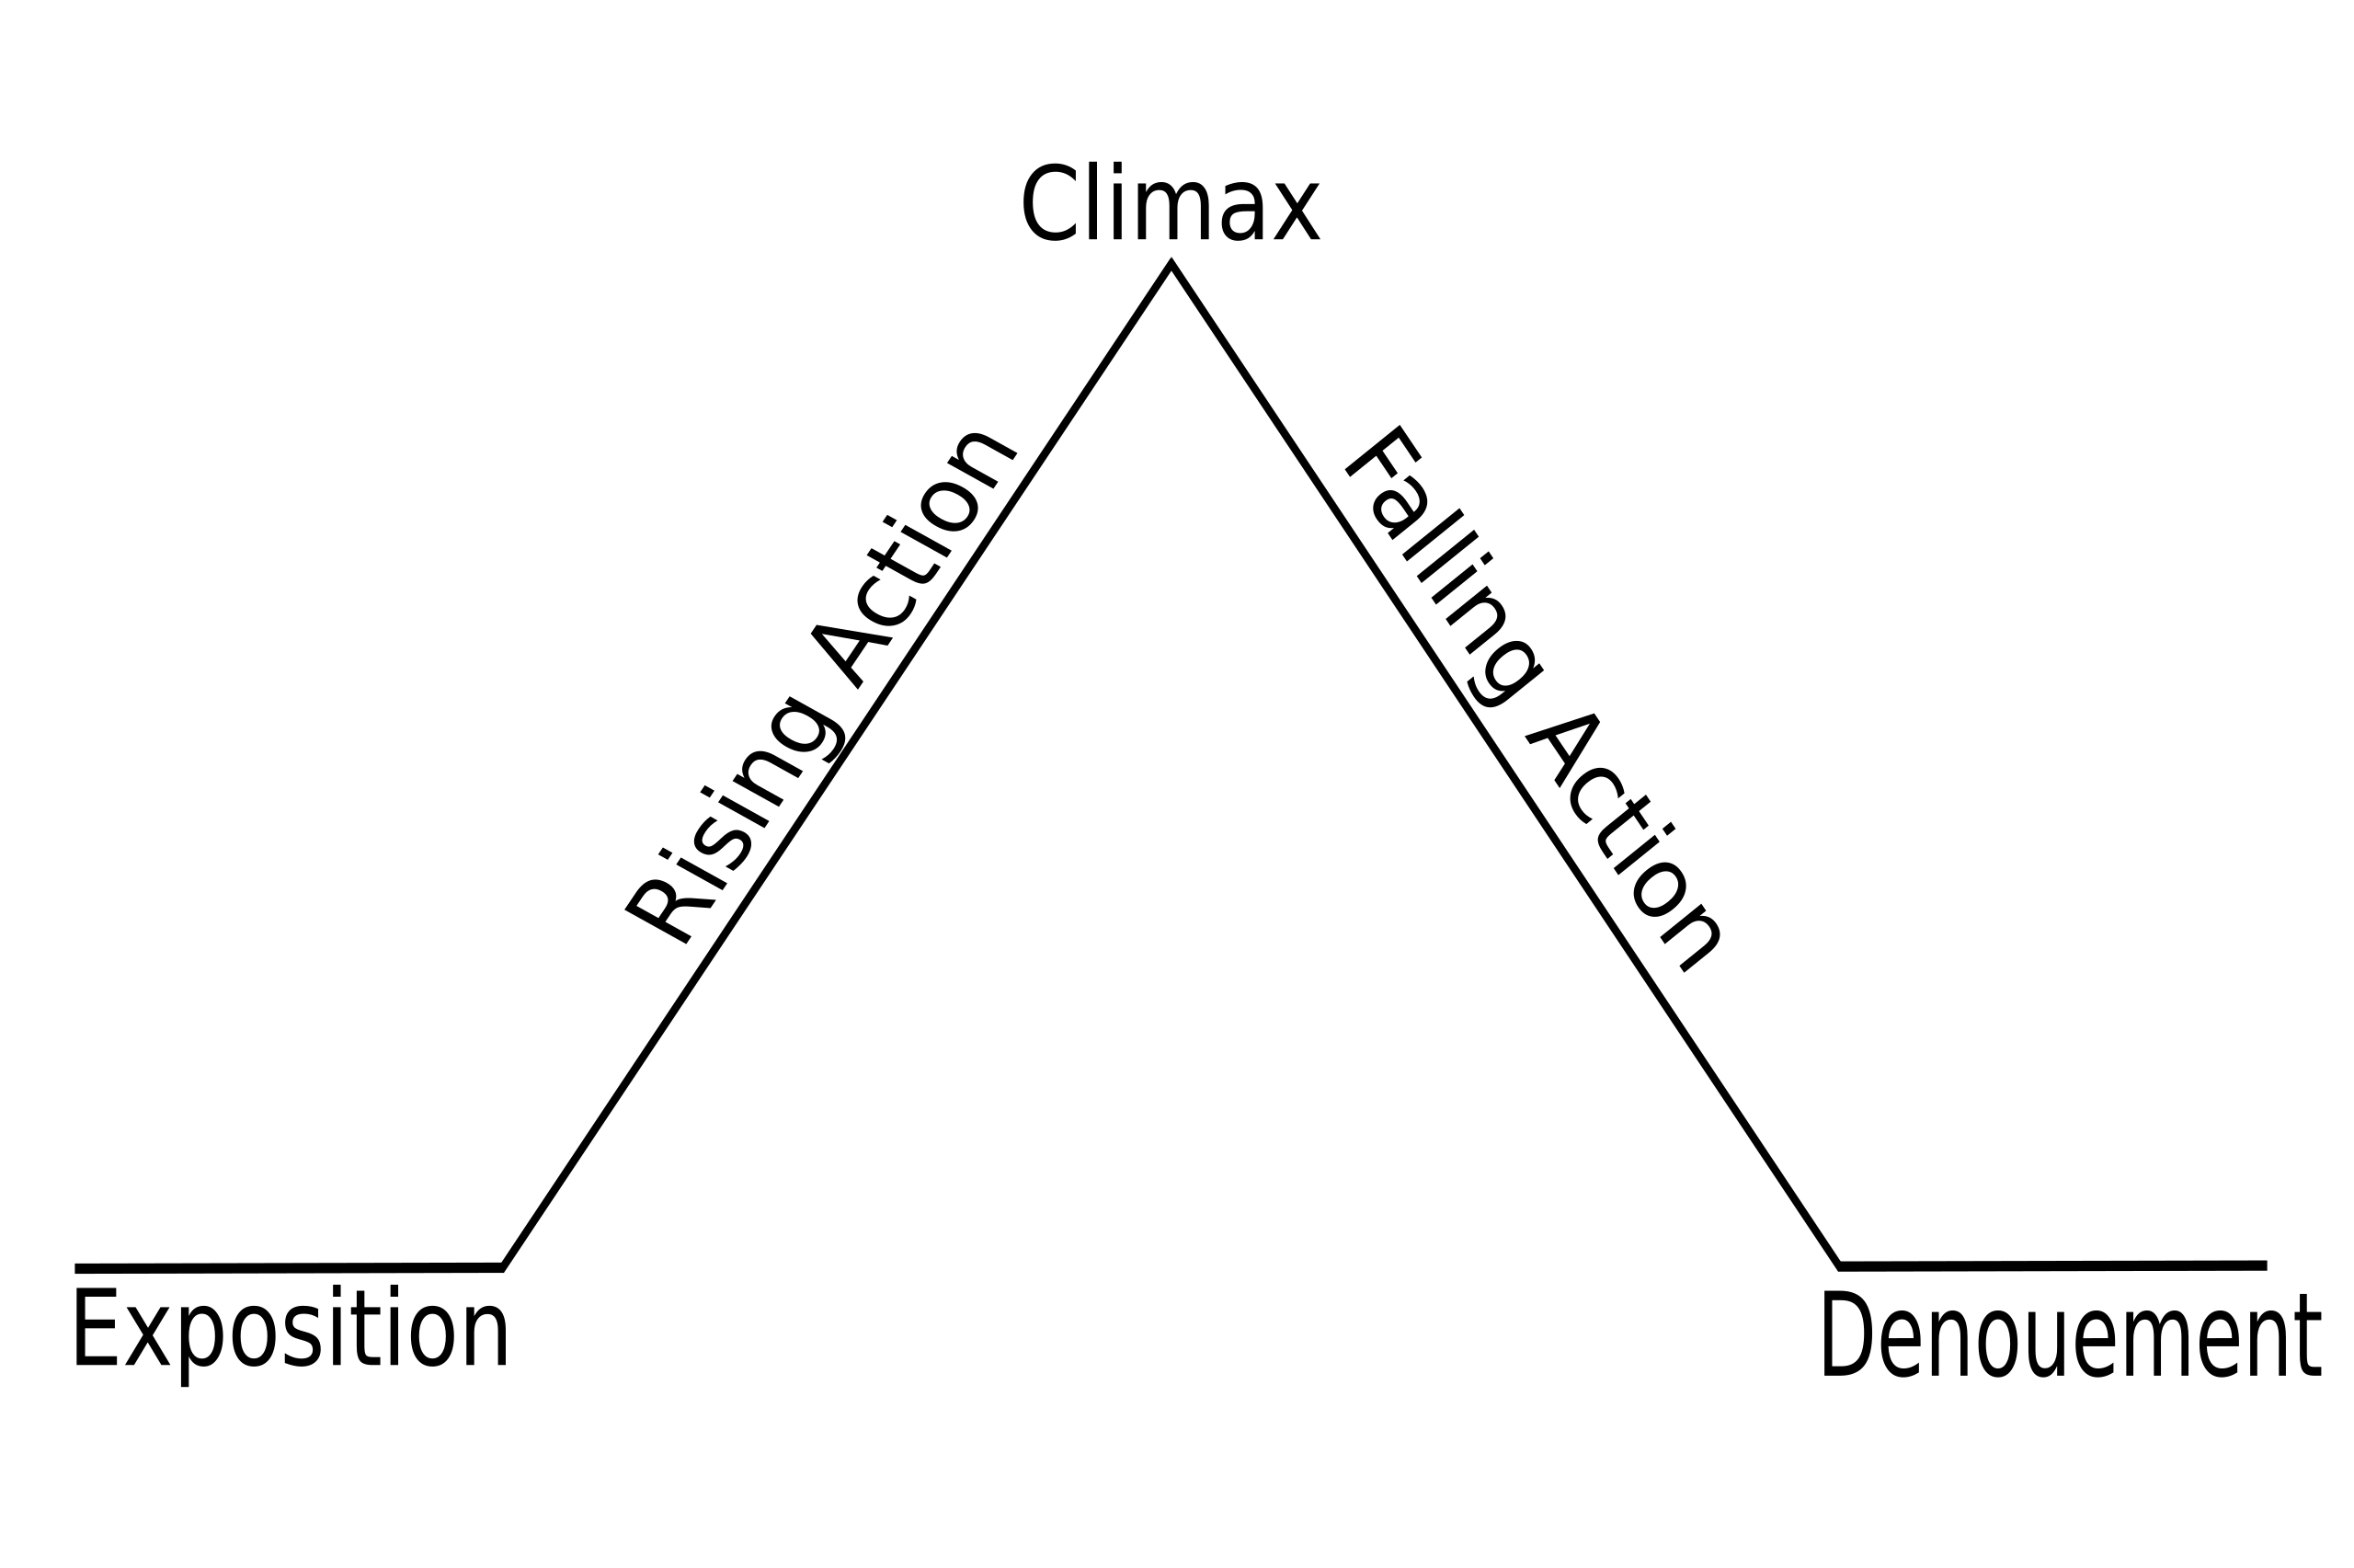
episode
epp-ee-sohd
Part of Speech: noun
Sentence: There was a short episode within the book whereby Nathan recalled his past adventures.
Definition: a coherent narrative unit within a larger dramatic work

