Slide 1
YEAR 10 Week 4: Essay Vocabulary

Slide 2
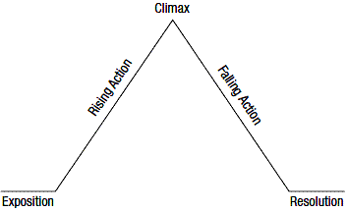
story element
Part of Speech: noun
Sentence: Connor’s film was missing a major story element which left his audience with a cliff hanger.
Definition: one of the five components (of a storyline which allow the action to develop in a logical way.

Slide 3
supporting detail
Part of Speech: noun
Sentence: The supporting detail made the story feel more realistic.
Definition: additional information which complements the main idea or theme

Slide 4
symbolism
Part of Speech: noun
Sentence: The group of doves flying overhead was used to symbolise peace.
Definition: the use of objects to represent ideas

Slide 5
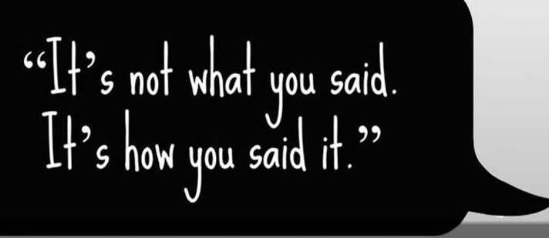
tone
Part of Speech: noun
Sentence: The informal language used gave the chapter a more casual tone
Definition: the general attitude or mood conveyed by the writer through their choice of words

Slide 6
third person narrative
Part of Speech: noun group
Sentence: It was more difficult to know what the character’s were thinking because it was a third person narrative.
Definition: a story which is told through the perspective of the author, not the characters

Slide 7
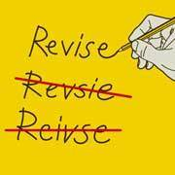
revise
Part of Speech: verb
Sentence: Lucy revised her calendar of the events of the week to allow for events not previously considered.
Definition: to view something again and make changes

Slide 8
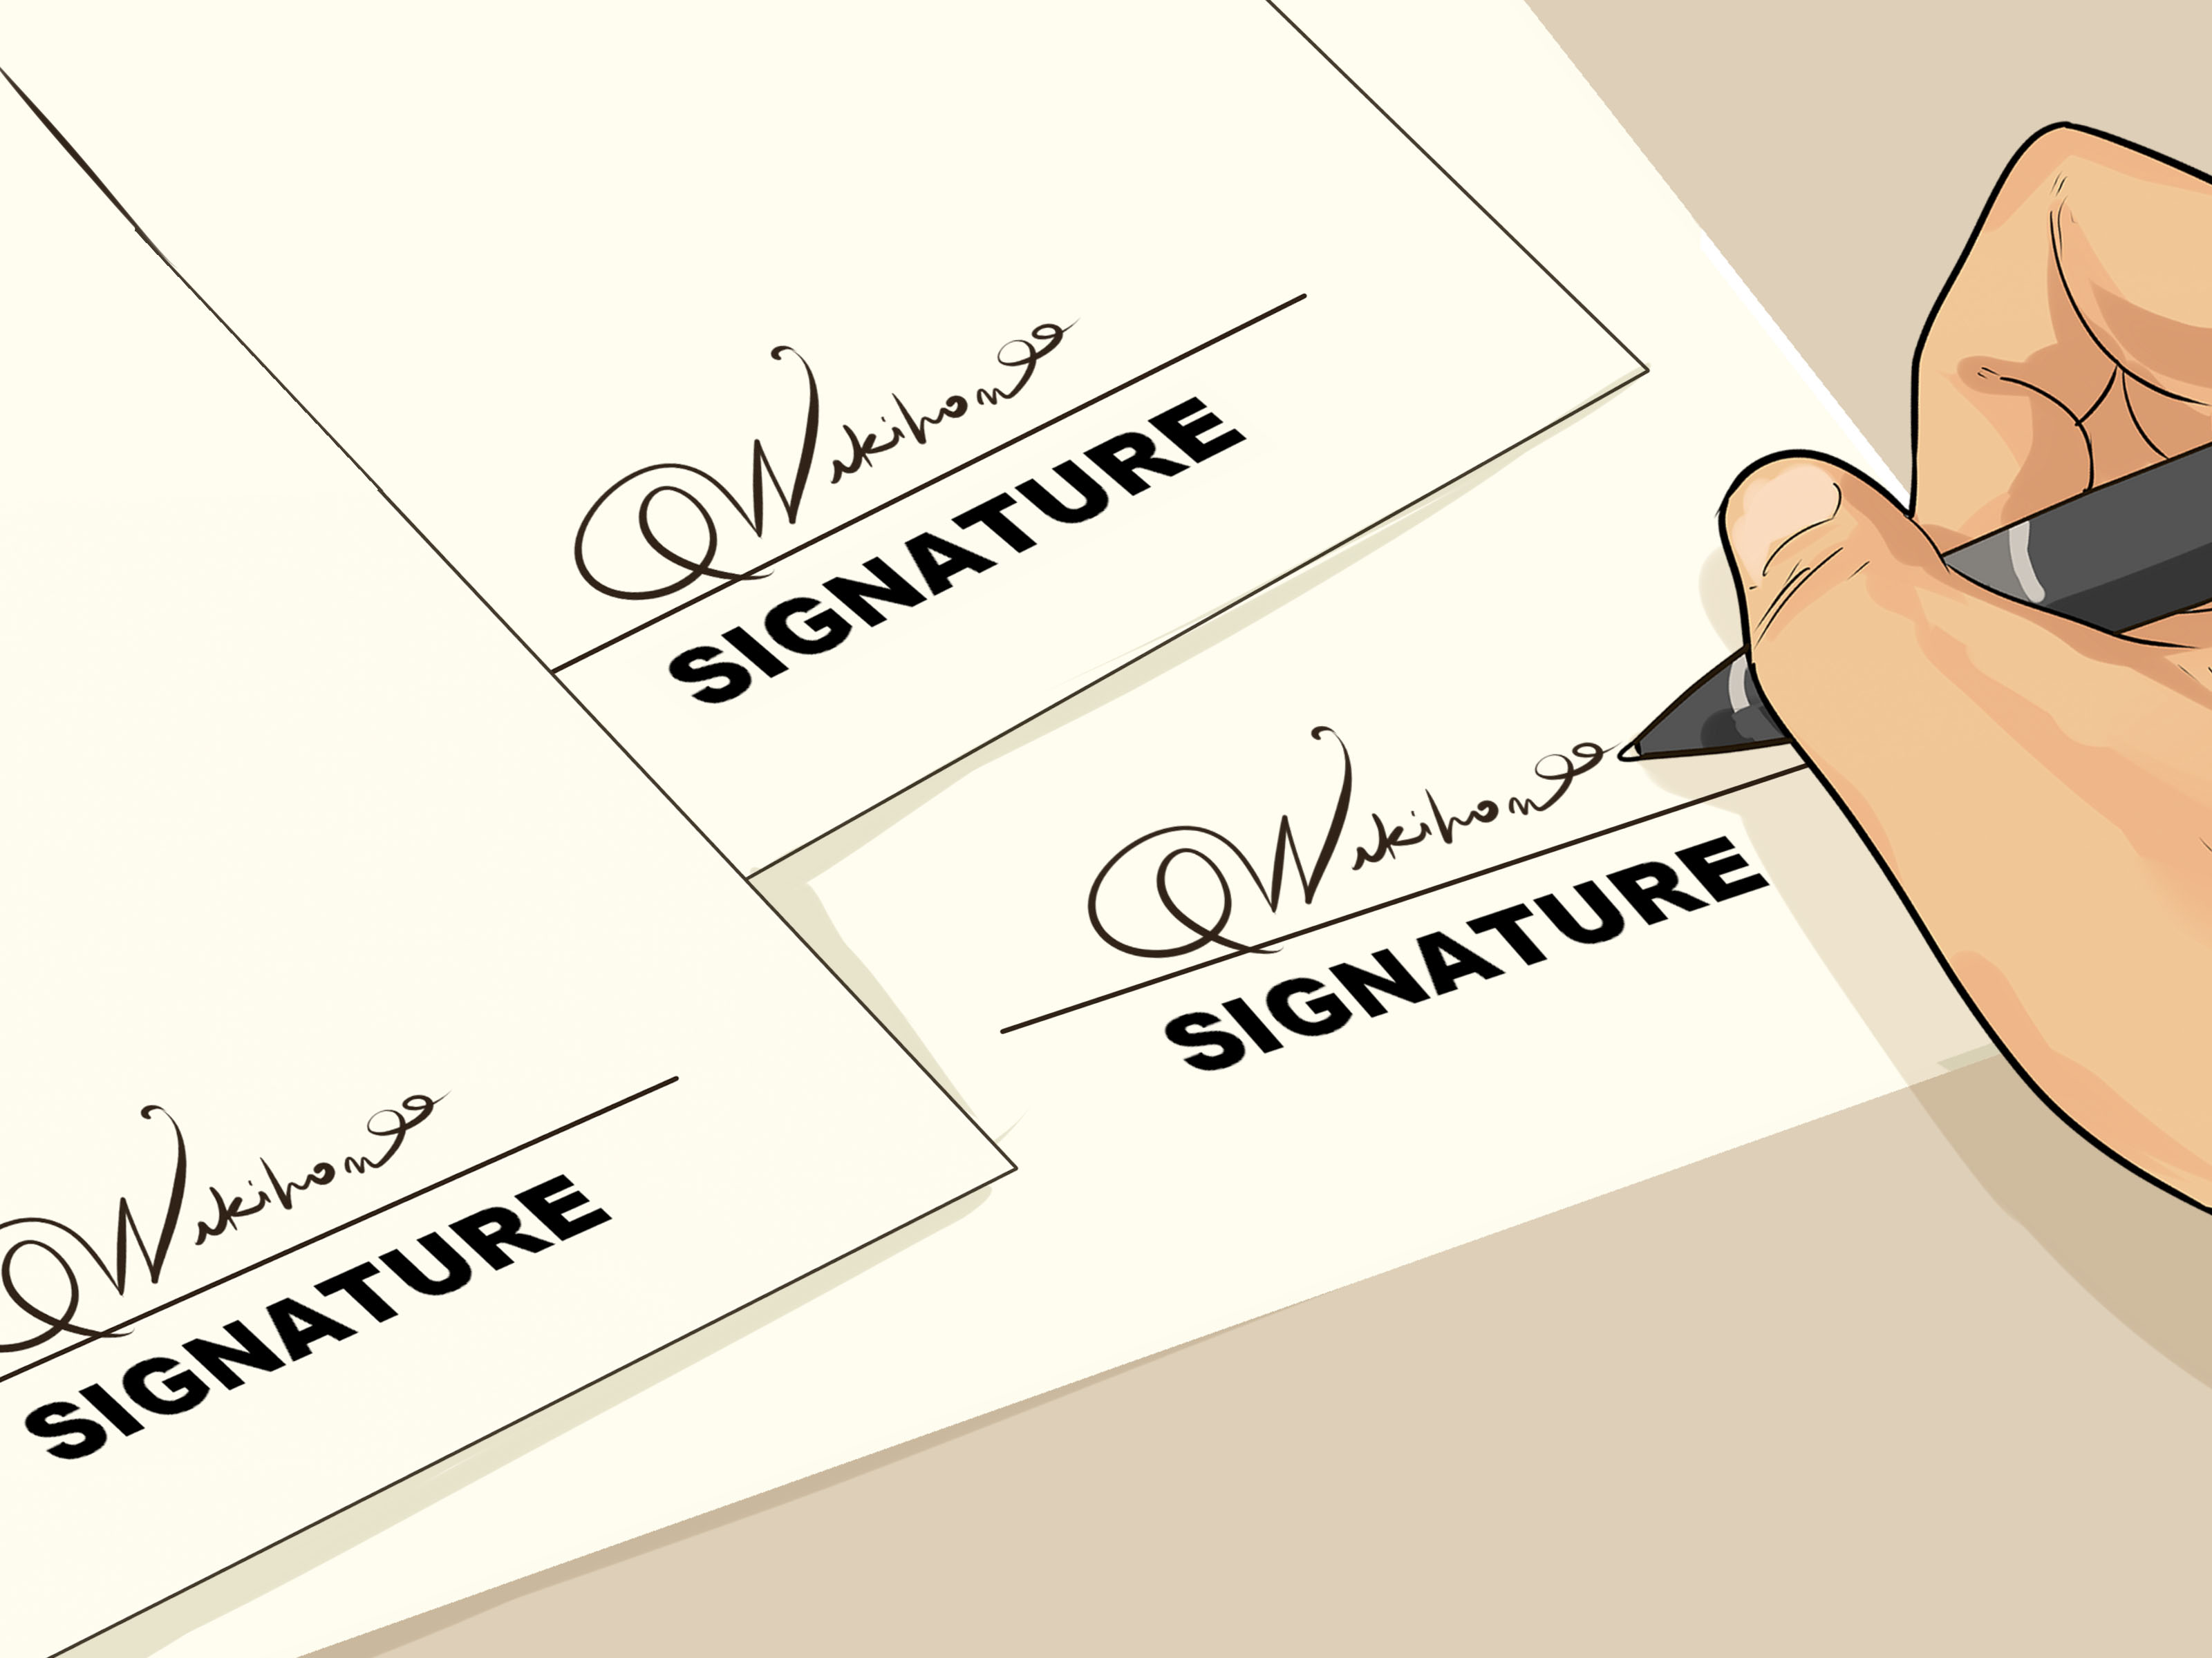
signature
Part of Speech: noun
Sentence: The fast zoom in was one of the director’s signature camera shots
Definition: when the author becomes known for their consistent use of a unique literary technique

Slide 9
source
Part of Speech: verb
Sentence: The source of the information was not reliable and the document couldn’t be used
Definition: to obtain an idea that originates from somewhere else

Slide 10
strategy (n)
strategise (v)
Sentence: The author’s strategy was to insert many clues within the story before revealing who the murderer was.
definition: a plan of action devised at the beginning to help map out what will happen

Slide 11
target
Part of Speech: verb
Sentence: The character’s target during this book was a perfect exam score.
definition: to directly work towards a specific goal

