Slide 1
YEAR 10 Week 3: Words specific to Text types+ Words to Describe What’s Happening

Slide 2
Context Clues
Part of Speech: noun
Sentence: The skill of close reading requires you to define new words based on context clues.
Definition:
Hints that an author gives to help define a difficult or unusual word within a text based on the words or sentences which surround the difficult word

Slide 3
First Person Narrator
Part of Speech: noun
Sentence: Stories told by a first person narrator can be very powerful because they have credibility that others generic stories do not have.
Definition:
A mode of storytelling in which a narrator relays events from their own point of view using the first person i.e. "I" or "we", etc.

Slide 4
Minor Character
Part of Speech: adjective
Sentence: The minor characters in the situational comedy (sit-com) didn’t appear very often, but had a major impact on the plot.
Definition:
A supporting character is a character in a narrative that is not the focus of the primary storyline, but appears or is mentioned in the story enough to have an effect on the story.

Slide 5
glittering generality
Part of Speech: Adjective + Noun
Sentence: Advertisements often contains glittering generalities and very little substance.
Definition: A glittering generality is an emotionally appealing phrase so closely associated with highly valued concepts and beliefs that it carries conviction without supporting information or reason. Such highly valued concepts attract general approval and acclaim.

Slide 6
motive
Part of Speech: Noun
Sentence: When examining oneself, it’s helpful to think about your motives for your successes and failures.
Definition: a reason for doing something.

Slide 7
revise
Part of Speech: verb
Sentence: It’s always wise to revise an email before sending it to others.
Definition: examine and make corrections or alterations to written or printed matter

Slide 8
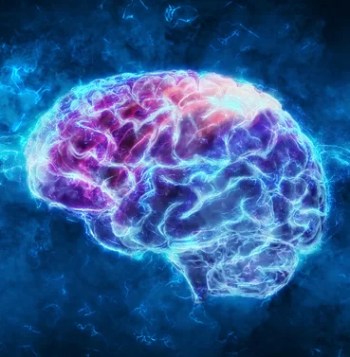
decode
Part of Speech: verb
Sentence: The teacher helped the student decode the poem so they could understand the poet’s message.
Definition:
To interpret language clues in a text to create an intelligible understanding of the passage being read

Slide 9
document
Part of Speech: verb
Sentence: If your boss consistently treats you like rubbish, you better document each situation or else you won’t have anything to present to the mediator.
Definition:
record (something) in written, photographic, or other form.

Slide 10
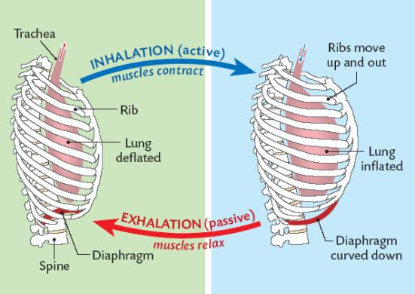
contraction
Part of Speech: noun
Sentence: When we inhale, the contraction of the muscles helps us to inhale, provide oxygen to the blood. During exhalation, the muscles relax.
Definition: the process of becoming smaller

Slide 11
manner
Part of Speech: noun
Sentence: It can be helpful to understand the manner to conduct business in another country before going there.
Definition: a way in which a thing is done or happens.

