Slide 1
YEAR 10 Week 5

Slide 2
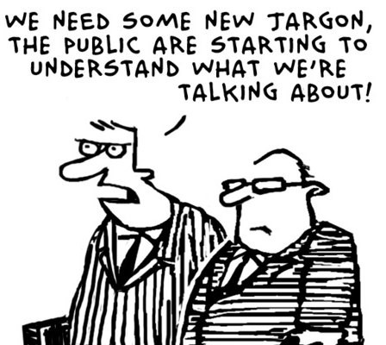
jargon
Part of Speech: noun
Sentence: The politicians used jargon to excite the emotions of the audience and, yet, promise nothing.
Definition: the language, especially the vocabulary, peculiar to a particular trade, profession, or group

Slide 3
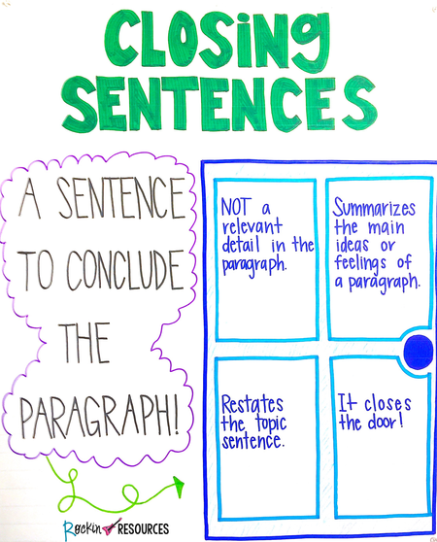
concluding sentence
Part of Speech: noun
Sentence: Make sure each paragraph has an effective concluding sentence!
Definition: A closing sentence that indicates that you are bringing closure to a paragraph. For each paragraph, the reader should be able to identify what your key points are, based on the concluding sentence.

Slide 4
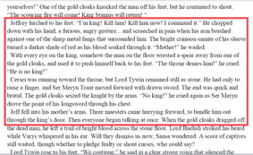
passage
Part of Speech: noun
Sentence: Please read the passage highlighted in red and answer the following questions.
Definition: a portion or section of a written work; a paragraph, verse, etc. (often multiple paragraphs)

Slide 5
juxtaposition/juxtaposed
Part of Speech: noun/verb
Sentence: The new spire’s juxtaposition with to the old one revealed the massive changes in building techniques over time.
Definition: to place close together or side by side, especially for comparison or contrast.

Slide 6
mass media
Part of Speech: noun
Sentence: The nature of the mass media outlets that have appeared in the last 20 years include online sources such as podcasts.
Definition: any of the means of communication, such as television or newspapers, that reach very large numbers of people.

Slide 7
animation/animated
Part of Speech: noun/verb
Sentence: the character in the book was described as having an animated face.
Definition: full of life or excitement; lively.

Slide 8
composition
Part of Speech: noun
Sentence: The composition of the poster was pleasing to the eye and therefore effective on the audience
Definition: the act of combining parts or elements to form a whole.

Slide 9
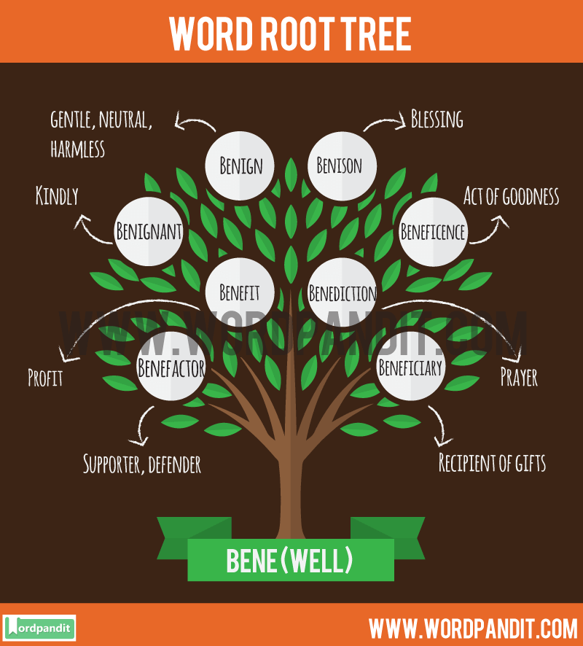
derivation
Part of Speech: noun
Sentence: If you trace back the history of English, many words find their derivation from other countries.
Definition: the source from which something is taken; origin

Slide 10
generalisation
Part of Speech: noun
Sentence: “Beware of adding too many generalisations to your essay,” is a lovely example of a generalisation.
definition: a proposition asserting something to be true either of all members of a certain group when it may not be entirely true

Slide 11
inconsistency
Part of Speech: noun
Sentence: The inconsistency of both parties in the marriage, (and the lack of desire to correct it) lead to the divorce.
definition: lacking agreement, as one thing with another or two or more things in relation to each other

