Slide 1
Year 10 - Vocabulary
Term 3 – List 6 Overall

Slide 2
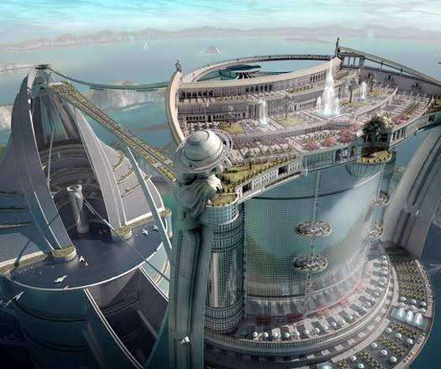
mental image
Part of Speech: noun
Sentence: The artist’s mental image of the futuristic city was beyond my ability to imagine.
Definition: A mental picture of something not real or present that is produced by the memory or the imagination.

Slide 3
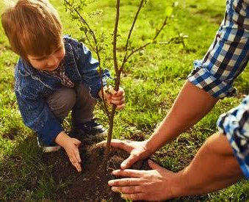
purpose
Part of Speech: noun
Sentence: The boy’s dad explained the purpose for planting trees was to benefit the future.
Definition: the reason for which something exists or is done, made, used, etc.

Slide 4
villain
Part of Speech: noun
Sentence: Traditional villains look suspicious; in real life they’re not as obvious.
Definition: a cruelly malicious person who is involved in or devoted to wickedness or crime; scoundrel.

Slide 5
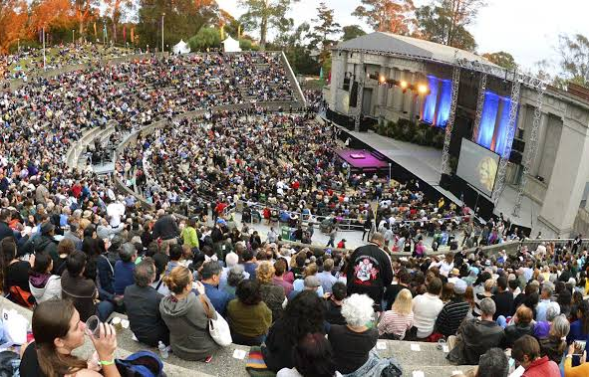
audience
Part of Speech: noun
Sentence: The audience piled into the ancient Greek theater to hear the live concert. Definition: the persons reached by a book, radio or television broadcast, etc…public

Slide 6
central idea
Part of Speech: noun
Sentence: The young author’s central idea was that young people have more culturally relevant ideas than the oldies.
Definition: the dominant impression or the universal, generic truth found in the story.

Slide 7
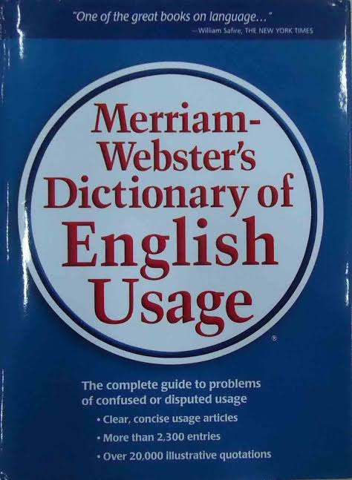
usage
Part of Speech: noun
Sentence: Claire realised it’s not just enough to understand the definition of a word, she also had to understand the usage.
Definition: habitual or customary use; long-continued practice

Slide 8
biographical
Part of Speech: adj
Sentence: The new historical fiction was biographical in that the main character’s life closely followed the life of Abraham Lincoln.
Definition: relating to a person's life

Slide 9
catalogue
Part of Speech: verb
Sentence: The National Audubon Society catalogues species of birds according to which regions of the world the birds live.
Definition: to produce a list or record

Slide 10
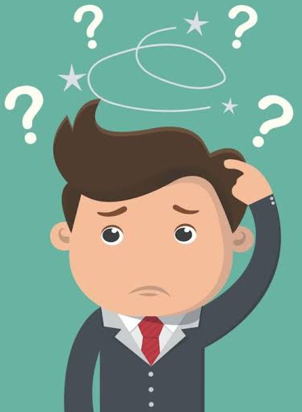
clarification
Part of Speech: noun
Sentence: Ted was confused, so he scratched his head and asked for clarification.
Definition: to make (an idea, statement, etc.) intelligible; to free from ambiguity.

Slide 11
compile
Part of Speech: verb
Sentence: The apprentice was learning how to compile a catalog of all the different hair colour dyes on the market.
Definition: to put together (documents, selections, or other materials) in one book or work.

