Slide 1
Year 10 - Vocabulary
Term 3 – List 7 Overall

Slide 2
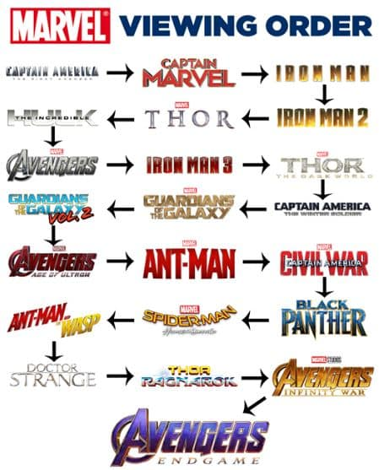
chronological order
Part of Speech: noun
Sentence: The little details fall into place when you watch the Marvel movies into chronological order.
Definition: the arrangement of things following one after another in time:

Slide 3
point of view
Part of Speech: noun
Sentence: Sometimes it’s difficult to see things from a higher point of view when a difficult situation has just occurred.
Definition: a specified or stated manner of consideration or appraisal; standpoint

Slide 4
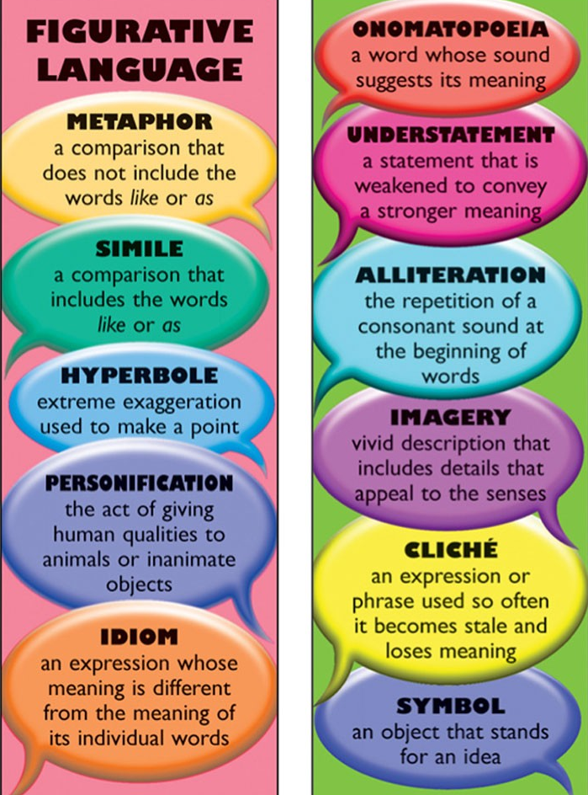
figurative language
Part of Speech: noun
Sentence: “Go easy on the figurative language and make sure you use a bit of logic in your argument.”
Definition: language that contains or uses figures of speech, especially metaphors.

Slide 5
fully developed character
Part of Speech: noun
Sentence: Generally speaking, the more fully developed characters in the story, the more difficult it is to predict the resolution. Definition: more realistic and complex and show a true depth of personality

Slide 6
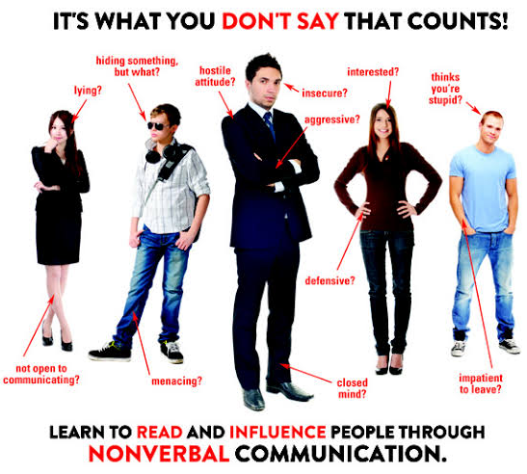
nonverbal cue
Part of Speech: noun
Sentence: Nonverbal cues include the following: body movements, body orientation, nuances of the voice, facial expressions, details of dress, and choice and movement of objects that communicate.
Definition: all the communication between people that do not have a direct verbal translation

Slide 7
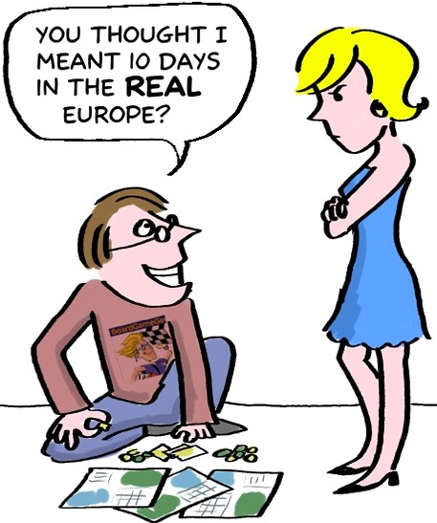
drawing conclusions
Part of Speech: verb
Sentence: Sometimes the greatest misunderstandings come from drawing conclusions without asking for what was actually meant.
Definition: drawing conclusions refers to information that is implied or inferred.

Slide 8
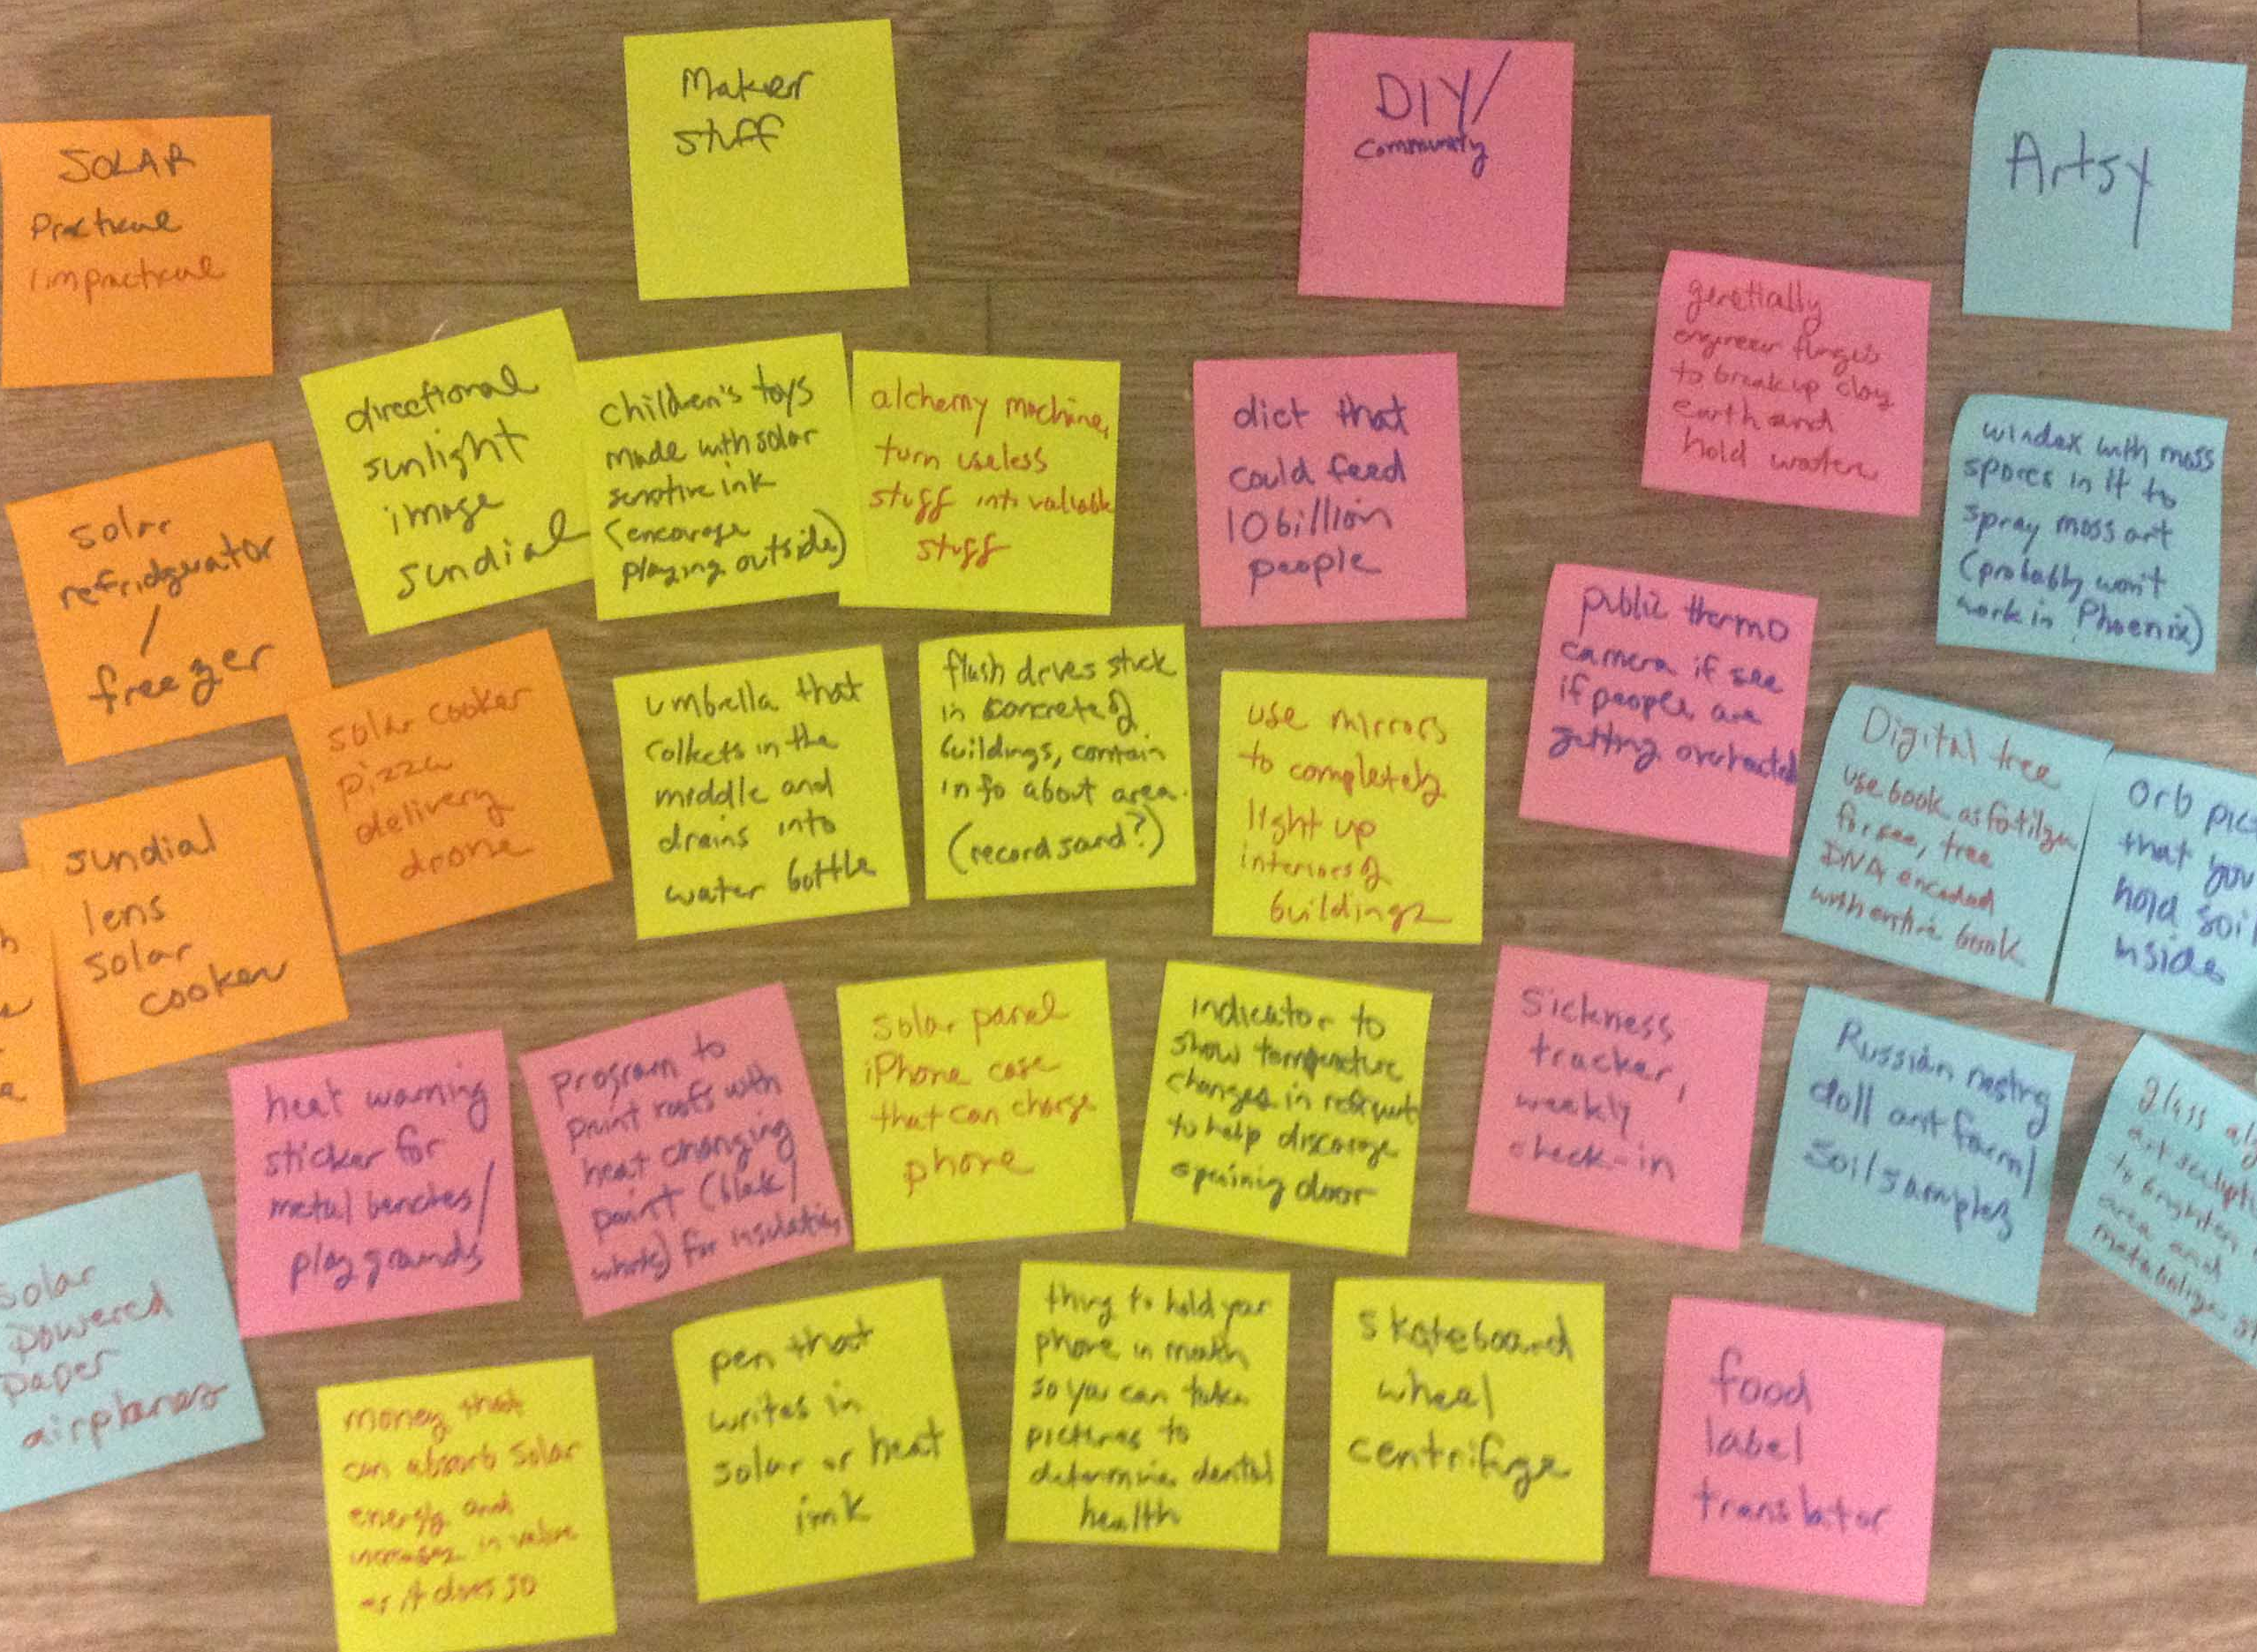
construct meaning
Part of Speech: verb
Sentence: Some authors use “Post-it” notes to help organise their ideas so they are able to effectively construct meaning in their stories.
Definition: to create something, (such as a story) by organizing ideas, words figurative language…

Slide 9
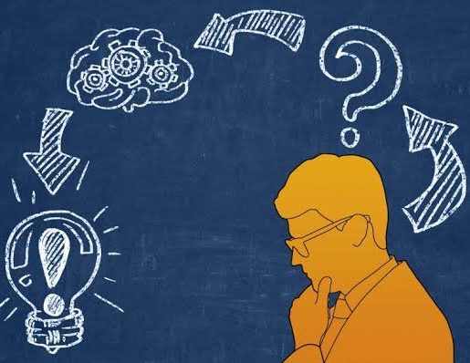
positing
Part of Speech: verb
Sentence: When starting the thinking process, it’s important to posit the possibility of something seemingly absurd.
Definition: to lay down or assume as a fact or principle; to postulate.

Slide 10
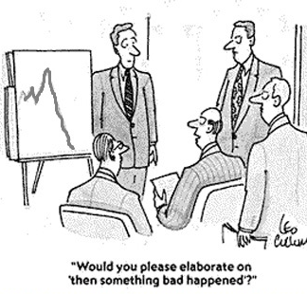
elaborate/elaboration
Part of Speech: verb/noun
Sentence: Scott simply showed a graph to reveal the bad news rather than elaborate; the board members required more information.
Definition: to add details to; expand

Slide 11
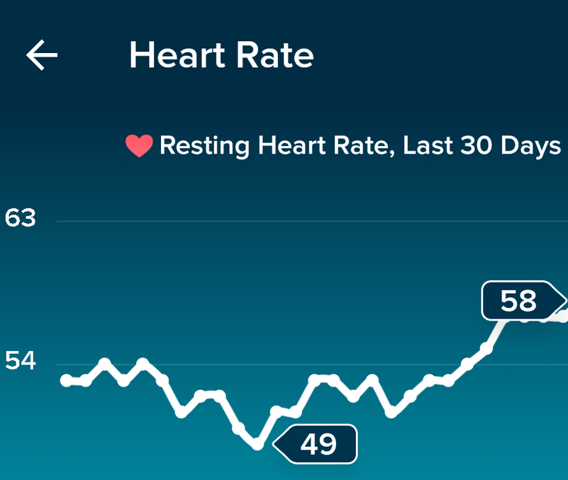
periodically
Part of Speech: adj
Sentence: Lucas’ new watch indicated that his heart rate periodically dropped below 50 beats per minute over the last 30 days.
Definition: occurring or appearing at regular intervals:

