Slide 1
Year 10 - Vocabulary
Term 3 – List 8 Overall

Slide 2
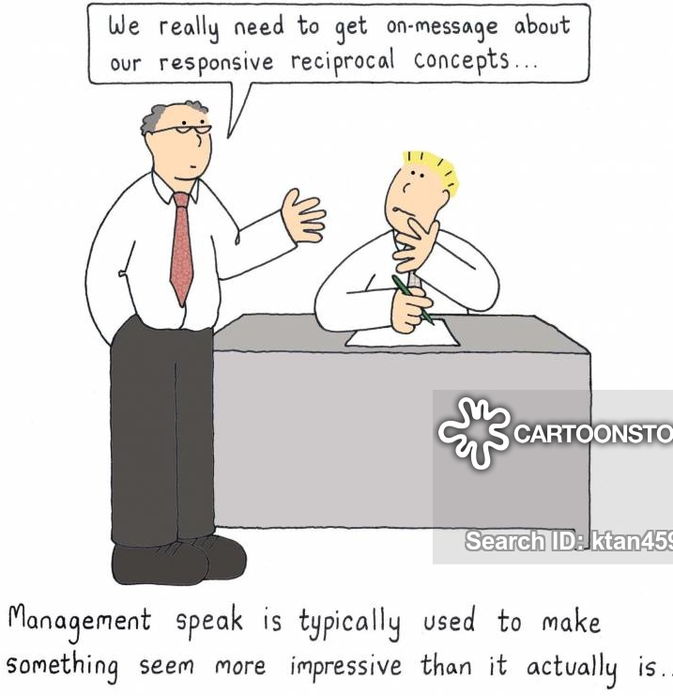
Technical language
Part of Speech: noun
Sentence: The business world has its own jargon or technical language that you’ll have to learn if you want to operate it in.
Definition: the skills or terms that are best understood by people who specialize in that field

Slide 3
Analogy
Part of Speech: noun
Sentence: Can you complete the analogy to the right?
Definition: a comparison in which an idea or a thing is compared to another thing that is quite different from it, so as to help explain it by using something familiar

Slide 4
Counter Argument
Part of Speech: noun
Sentence: Including the counter argument into your thinking creates credibility because you’ve thought from many points of view.
Definition: An argument or set of reasons put forward to oppose an idea or theory developed in another argument

Slide 5
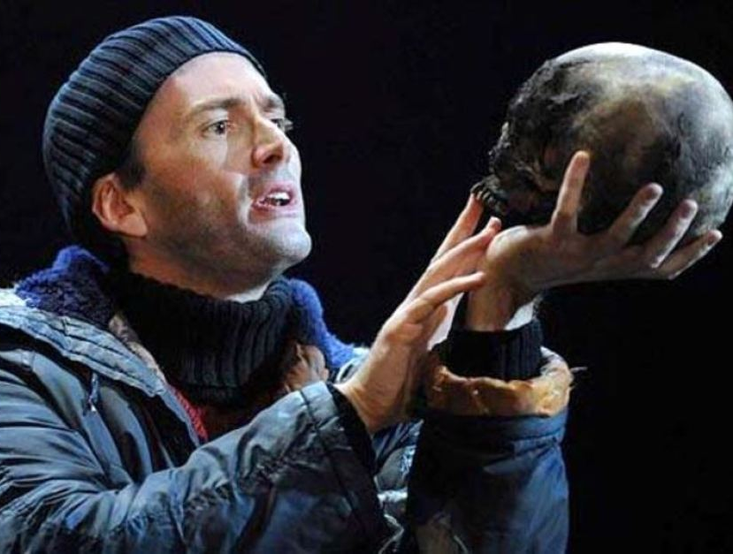
Interior Monologue
Part of Speech: noun
Sentence: Shakespeare’s character Hamlet was revolutionary in that he’d delivery interior monologues to the audience called a soliloquy.
Definition: a piece of writing or a speech expressing a character's inner thoughts

Slide 6
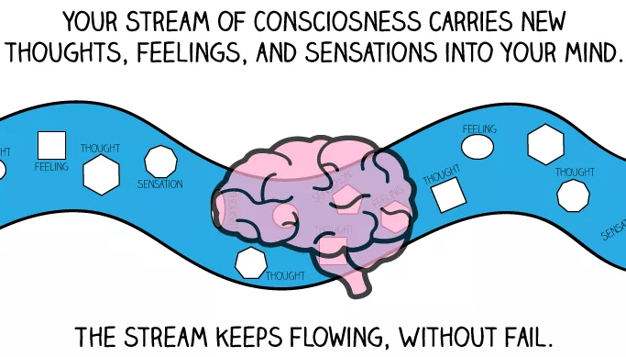
Stream of Consciousness
Part of Speech: noun
Sentence: Once you are aware of your stream of consciousness, you won’t just let junk flow through your mind!
Definition: a literary style in which a character's thoughts, feelings, and reactions are depicted in a continuous flow uninterrupted by description or conventional dialogue

Slide 7
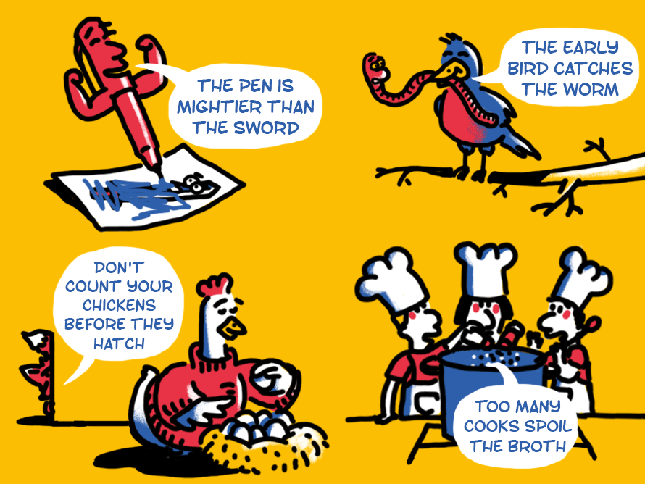
Proverbial
Part of Speech: adj.
Sentence: There are a range of proverbial phrases that can make learning English difficult.
Definition: (relating to a word or phrase) referred to in a proverb or idiom.

Slide 8
Ambience
Part of Speech: noun
Sentence: It wasn’t just the outstanding food that created a buzz, it was the ambience; people wanted
to be there!
Definition: the character and atmosphere of a place

Slide 9
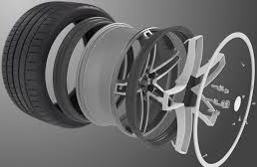
Deconstruct
Part of Speech: verb
Sentence: When trying to better understand how wheels are made, Marty decided to deconstruct it.
Definition: To reduce something to its constituent parts in order to reinterpret it

Slide 10
Incongruent
Part of Speech: adj
Sentence: Jack’s laughter was incongruent with the fear he was feeling inside.
Definition: incompatible; not suitable or not fitting well with something else

Slide 11
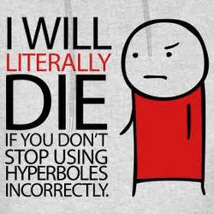
Overstatement
Part of Speech: noun
Sentence: In an age of fake news, overstatement is so common that we don’t know what to believe.
Definition: the action of stating something too strongly; exaggeration.

