Slide 1
Year 10 - Vocabulary
Term 3 – List 9 Overall

Slide 2
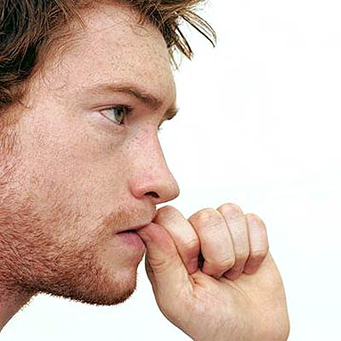
Perspective
Part of Speech: noun
Sentence: Tommy’s perspective on the last minute change of plans helped everyone cope.
Definition: a particular attitude towards or way of regarding something;
a point of view.

Slide 3
Subordinate character
Part of Speech: noun
Sentence: Dory is a subordinate character in “Finding Nemo”.
Definition: a character with an important role in a story who is not actually the story's protagonist; Subordinate characters play roles that help the story's plot move forward

Slide 4
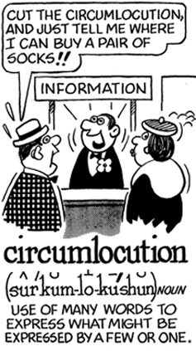
Circumlocution
Part of Speech: noun
Sentence: Don’t you hate it when you ask a simple question and get circumlocution instead of a simple answer?
Definition: The use of many words where fewer would do, especially in a deliberate attempt to be vague or evasive.

Slide 5
Persona
Part of Speech: noun
Sentence: Companies collect information on their each buyer’s persona and it’s usually quite accurate.
Definition: the aspect of someone's character that is presented to or perceived by others.

Slide 6
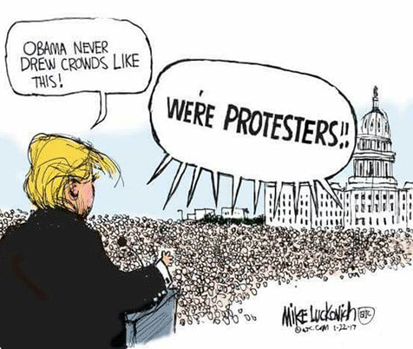
satire
Part of Speech: noun
Sentence: Satire pokes fun at real issues to help make positive change.
Definition: the use of humour, irony, exaggeration, ridicule and stereotypes to expose and criticize people's stupidity or vices, particularly in the context of contemporary politics and other topical issues.

Slide 7
stress
Part of Speech: Verb
Sentence: Different words are stressed by using different parts of the mouth.
Definition: To give particular emphasis or importance to (a point, statement, or idea) made in speech or writing.

Slide 8
vernacular
Part of Speech: Noun
Sentence: Cliff had a peculiar vernacular which indicated he was from somewhere down south.
Definition: the language or dialect spoken by the ordinary people in a particular country or region.

Slide 9
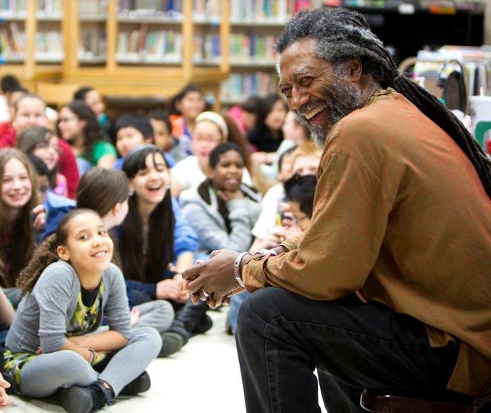
anecdotal
Part of Speech: Adj.
Sentence: Karl used anecdotes throughout his presentation to keep the kids engaged.
Definition: not necessarily true or reliable, because based on personal accounts rather than facts or research.

Slide 10
digression
Part of Speech: Noun
Sentence: Students will often try to get teachers to spend more time on digressions than learning intentions.
Definition: a temporary departure from the main subject in speech or writing

Slide 11
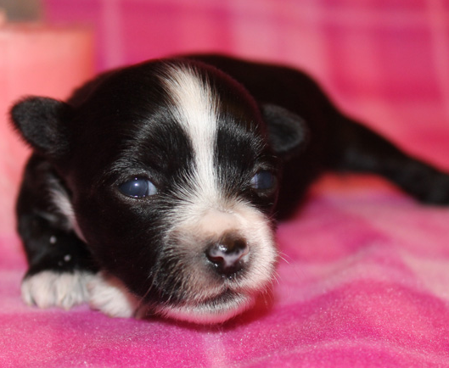
sombre
Part of Speech: Adj.
Sentence: The sombre puppy seemed to miss his mommy.
Definition: having or conveying a feeling of deep seriousness and sadness.

