Slide 1
The Story Circle

Slide 2
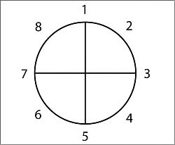
The story Circle
A character is in a zone of comfort,
But they want something.
They enter an unfamiliar situation.
They adapt to it.
Get what they wanted.
Pay a heavy price for it.
Then return to their familiar situation.
Having changed.

Slide 3
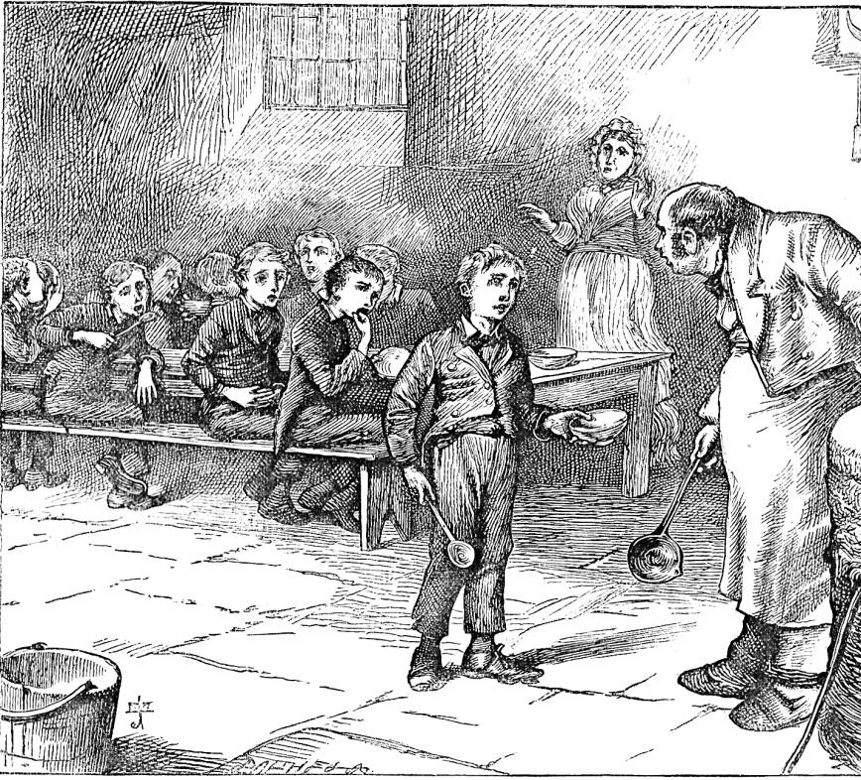
1. A character is in a zone of comfort,
They are going about their normal life.
It might not be ‘comfortable’.
E.g they might be an orphan living on the street

Slide 4
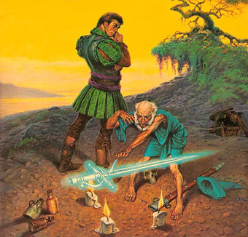
2. but they want something.
Something happens to cause a change in their life or they have an epiphany that causes them to want something.
Someone working the same boring job for 20 years might decide that if they don’t seek adventure now they will never get the chance.
A wizard might appear and give the character a magic sword and they decide they will use it to take over the world.

Slide 5
3. They enter an unfamiliar situation,
To get what they want they need to leave their zone of comfort.
E.g Harry Potter leaves the muggle world behind and enters Hogwarts.
To become more popular a boy leaves his old friends and hangs around the ‘bad boys’.

Slide 6
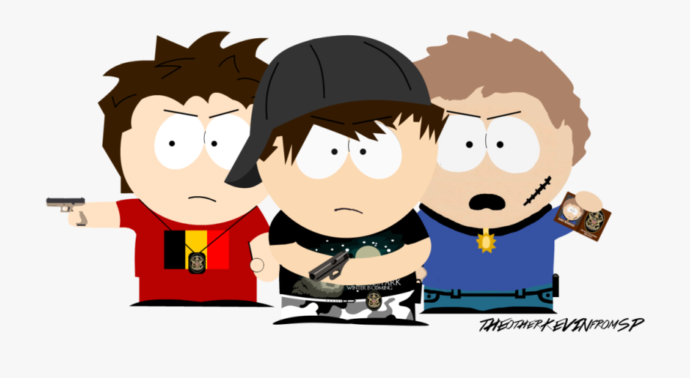
4. They adapt to it.
They get used to their new situation. They may have to learn new skills or change who they are as a person.
E.G Harry Potter learns magic and all the language of the wizarding world and realises that he fits in better there than he does in the muggle world.
A boy who is trying to be cooler starts to misbehave like the new bad boys he’s hanging around with so they like him.

Slide 7
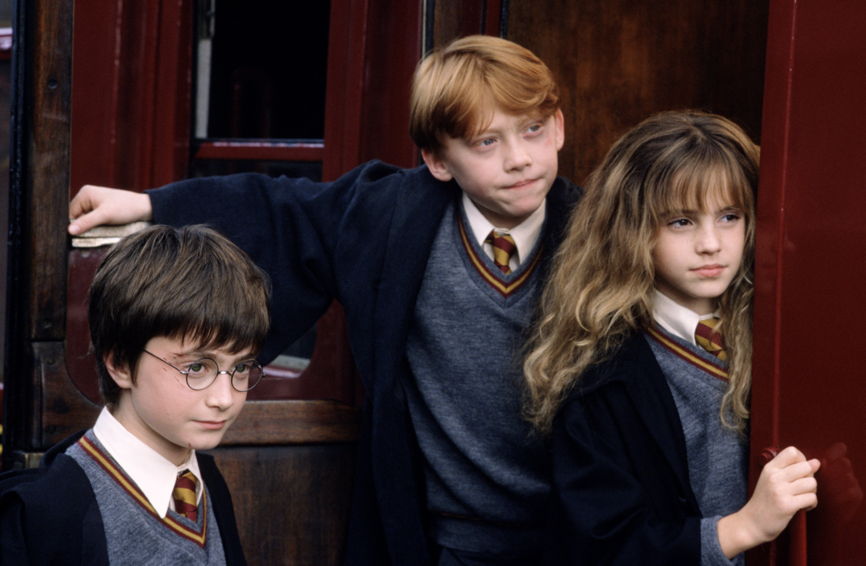
5. Get what they wanted.
They achieve the goal that they set out for in the first place. Their time spent in their new situation is rewarded.
E.G Harry Potter ends up with two close friends.
The new cool kid is accepted by the ‘bad boys’ and become part of their gang.

Slide 8
6. Pay a heavy price for it.
In achieving their goal something bad happens. Usually this is a direct result of them trying to reach their goal.
E.G Harry Potter must go through the trials at the end of the first book with his two new friends and nearly dies.
The boy who has joined the ‘bad boys’ get arrested for graffiti when he’s hanging out with them.

Slide 9
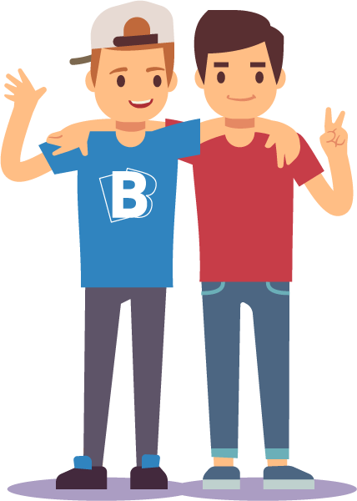
7. Then return to their familiar situation.
They finally get back to the situation where they started.
E.G Harry Potter goes back to the Dursley’s for the summer holidays.
The boy goes back to his old friends that he previously left.

Slide 10
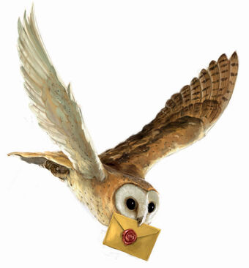
8. Having changed.
Even though they are back in their zone of comfort their experience has changed who they are.
E.G Harry Potter now has friends he can send letters to and scares his Aunt and Uncle into giving him a better room by threatening them with magic.
The boy now appreciates his friends and realises that being friends with them is far better than being with the ‘bad boys’

