Slide 1
Israel
They were under the Judges for 400 years
They were under the kings for another 200 - 300 or so years.
Israel, in the north, were taken away by the Assyrians and never returned – they were part of the scattering of the Jews throughout the world.
Judah, in the south, lasted over 100 years longer but were taken away by the Babylonians. These were the Jews that returned to the land.

Slide 2
Israel Cont
There was 400 years where the Bible doesn’t record anything after this time and before Jesus time
After Jesus time, in 70 AD, the Romans took the Jews into captivity again and scattered them across the whole Roman world.
They stayed scattered around the whole world until 1948 when Israel became a nation again.

Slide 3
Old Testament Culture
Patriarchal society – large families the ideal (4-8 people normal) – 3 generations could live together
Buried dead in caves
Houses baked clay and straw brick or wattle and daub. Had a flat roof and stairs up to it. Large houses had a courtyard in the middle. Not much space for gardens inside walls of town but women might grow veg etc if space in courtyard. Kept animals inside.
Lived in villages around a well or spring – no real large towns – biggest Jerusalem, the capital

Slide 4
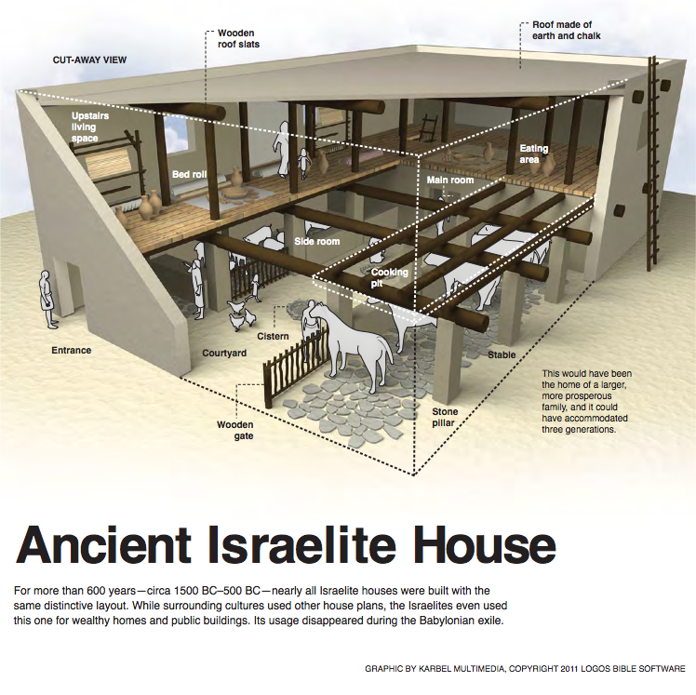
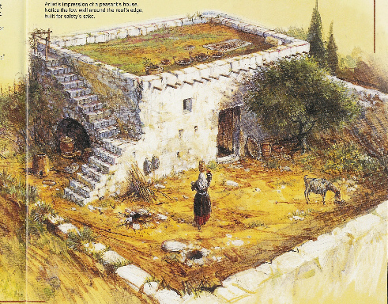
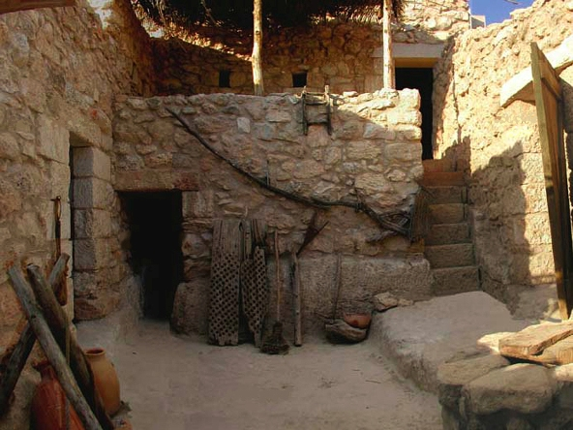
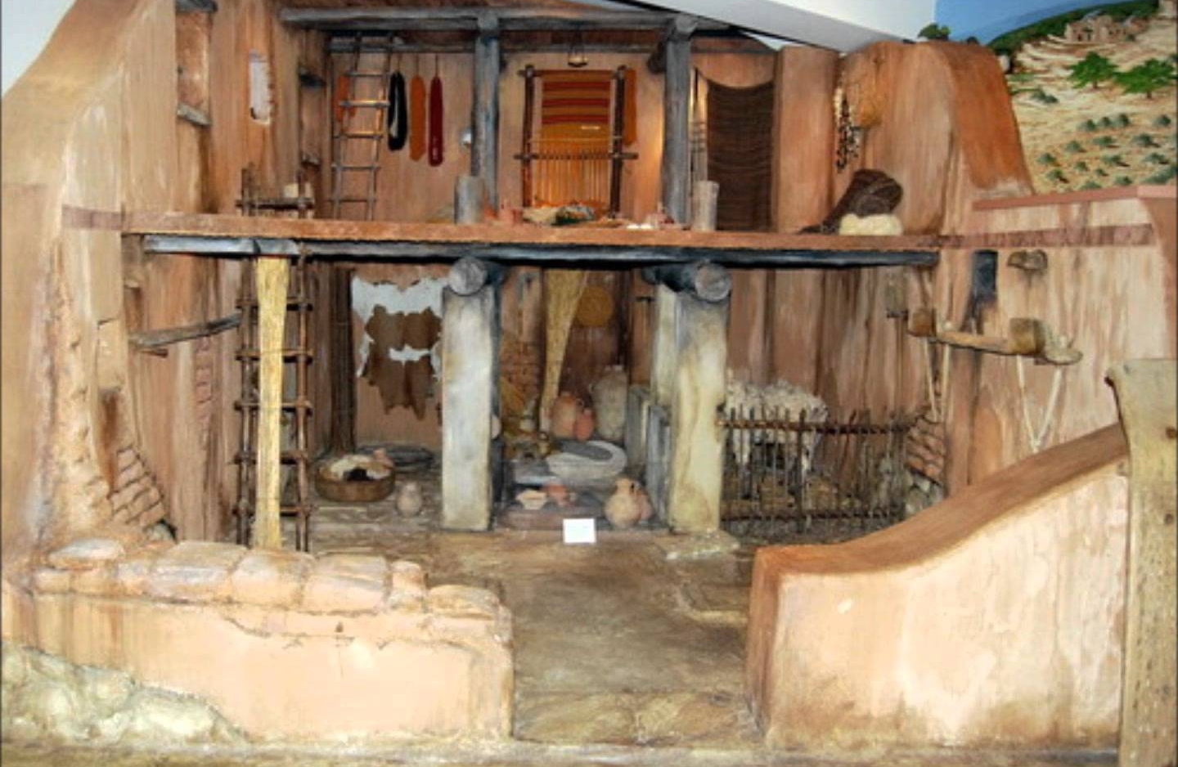

Slide 5
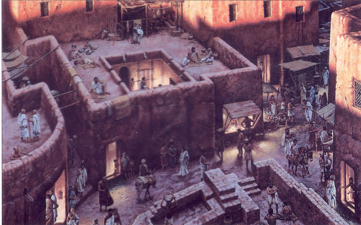
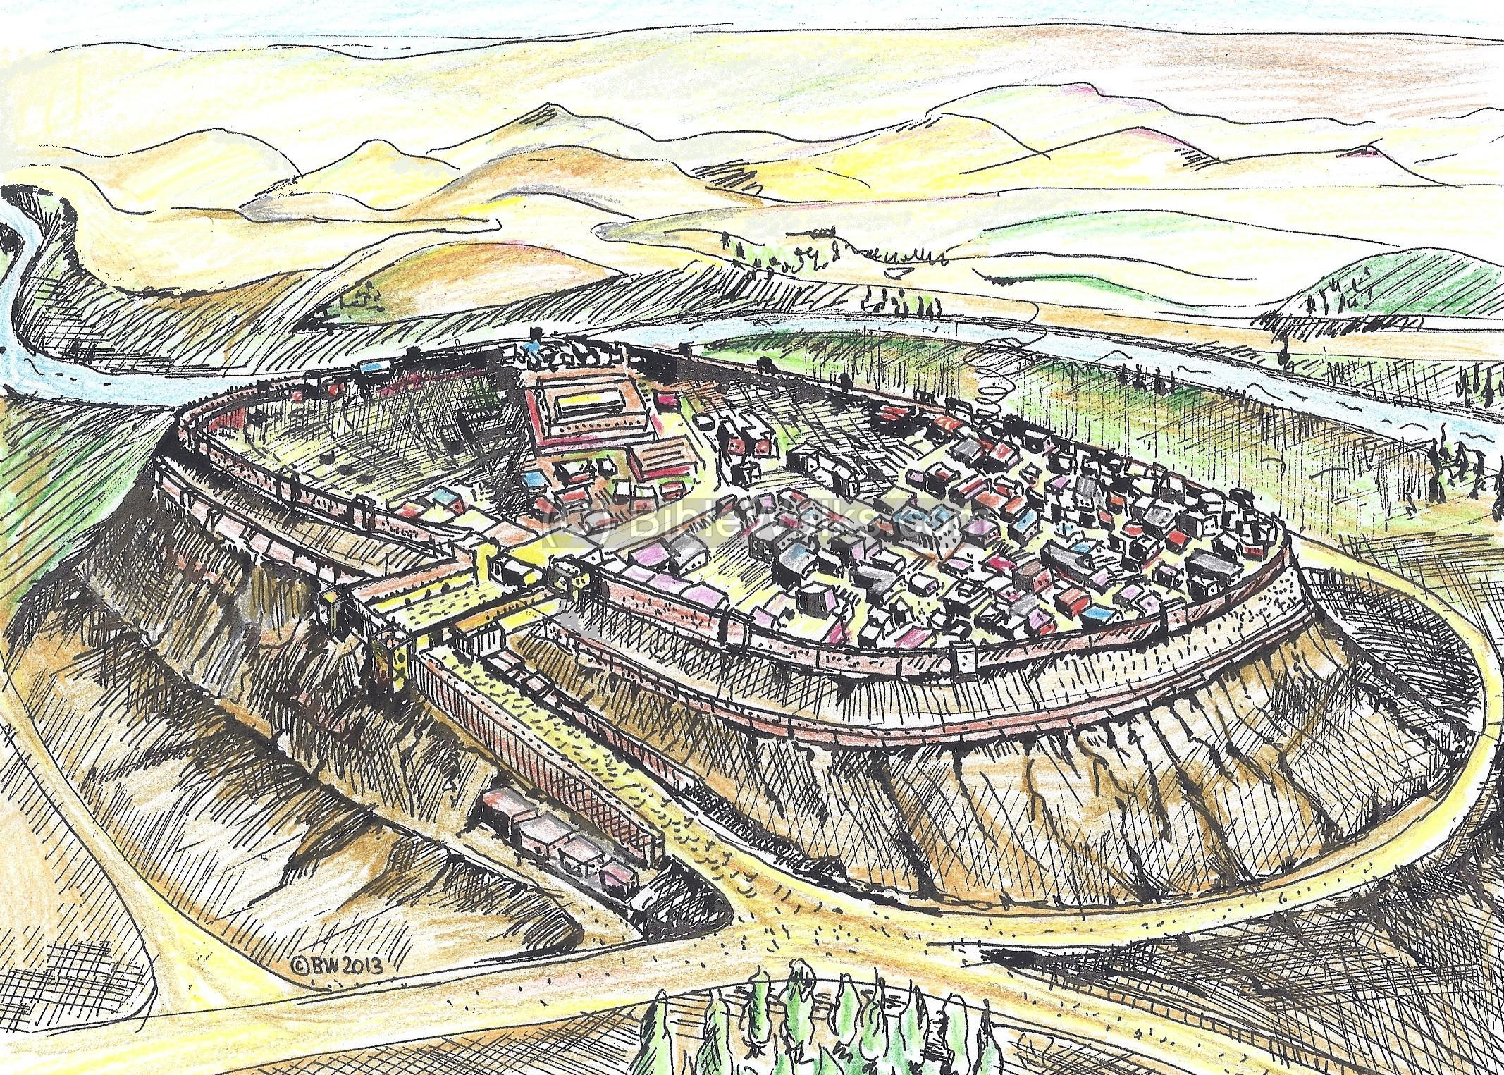
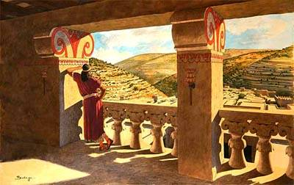
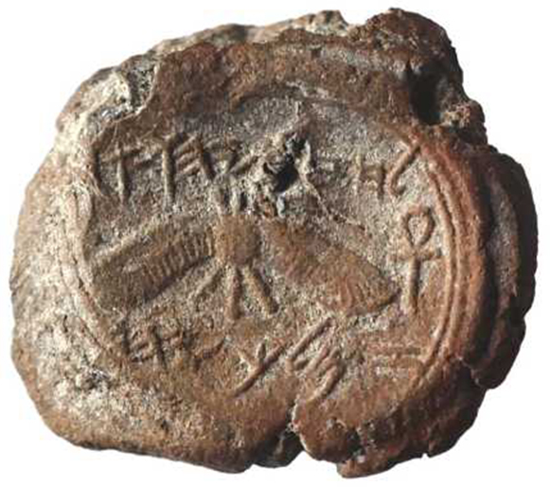
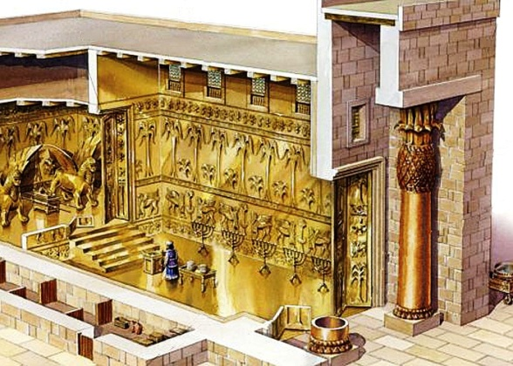
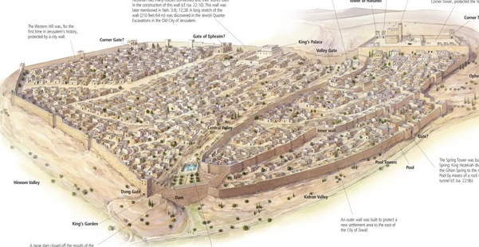

Slide 6
Mild climate so much of life outdoors
Mostly farmers of crops and animals – kept donkeys and sheep had huge fat tails
Clothes made of wool and goat hair for cheap clothes and tents etc. Also used linen. Shoes were generally sandals and taken off inside. Everyone wore tunics and head coverings. Men had beards and women long hair.
Ate bread of wheat, barley, grapes/wine, lamb, goat, beef, olives/oil, dates, pomegranates, figs, lentils, beans, cucumber, onion, leek, garlic, fish, salt, almonds, honey. Also drank milk from sheep or goats and made yoghurt, cheese and butter. Mostly bread was flat. Deut 8:7-8

Slide 7
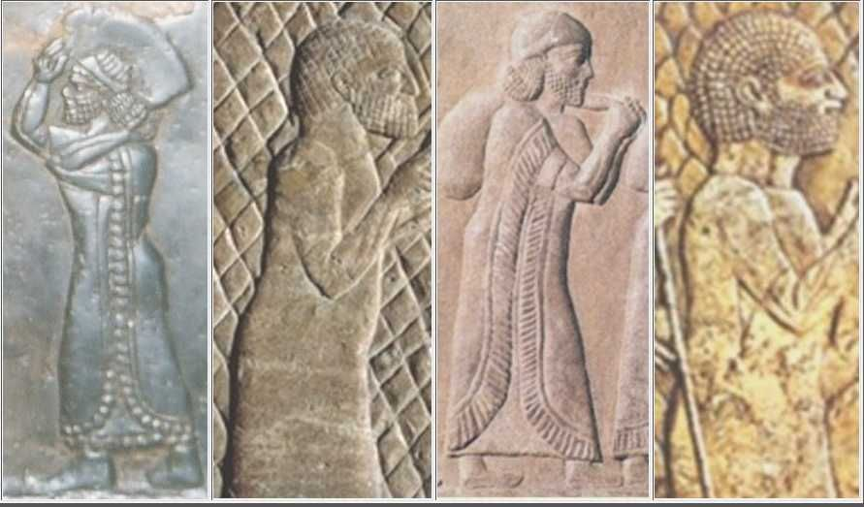
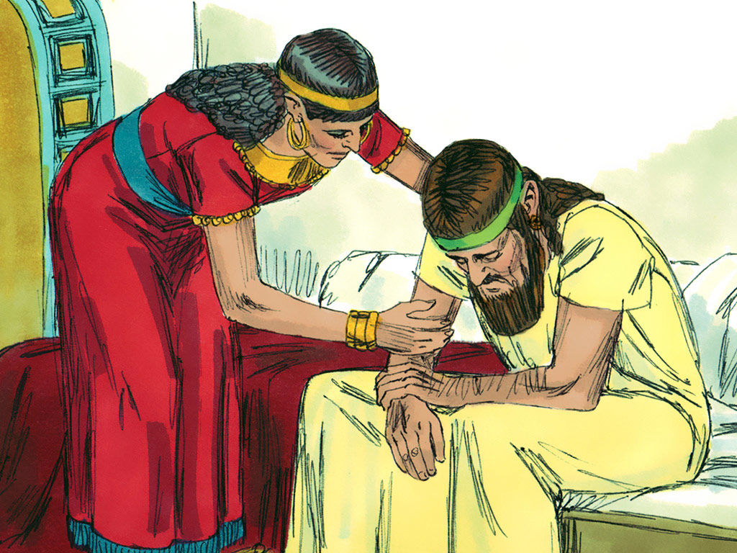
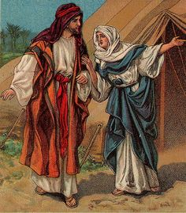
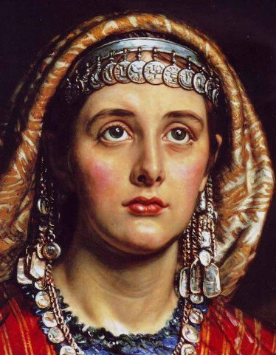

Slide 8
Also kept slaves – could sell yourself if had debt but had to be redeemed in year of jubilee (every 50 years). Could choose to stay with master, however.
Women cared for the home
Men had spiritual responsibility – had to go to the tabernacle/temple 3x a year.
Priests and Levites responsible to teach all about God and the law
Music popular – David invented new instruments
Writing treasured – there grew a class called the Scribes. They were those that wrote the law and studied it.
Played games like dice and board games

Slide 9
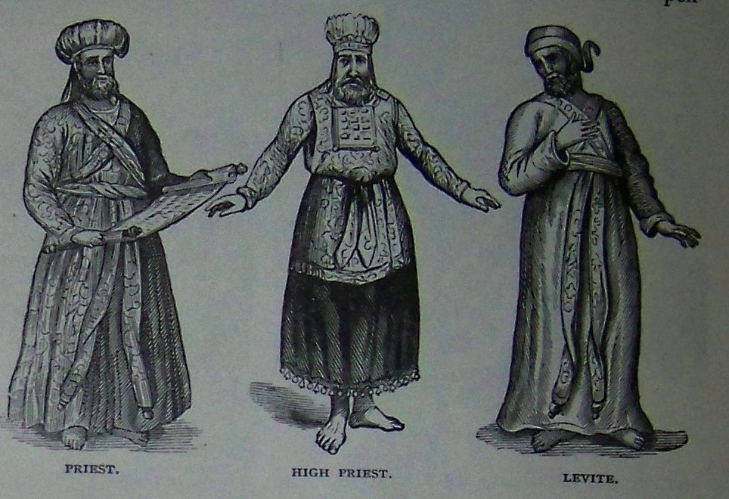
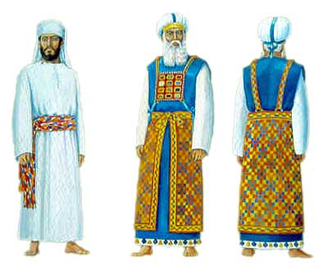
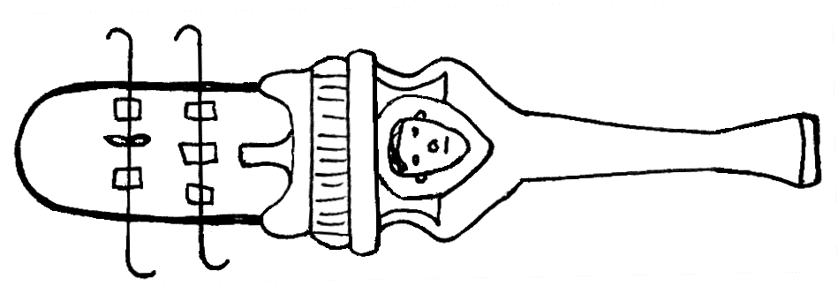
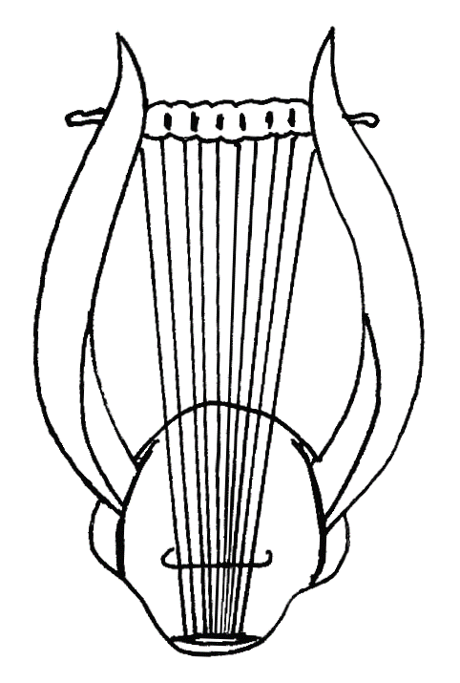
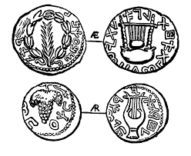

Slide 10
