Slide 1
Why I prescribe Jogging.

Slide 3
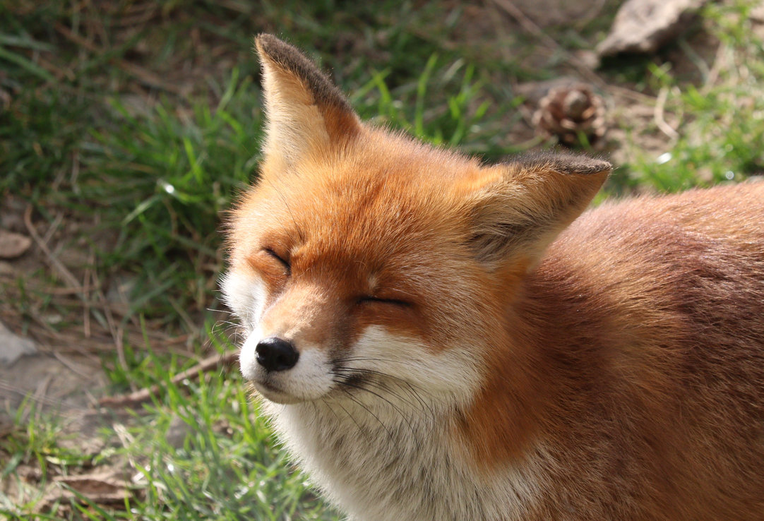
My Emotional State
Me Before Jogging | Me After Jogging

