Slide 1
Game Theory

Slide 2
SACE requirements
Students develop an understanding of the duopoly market structure through a basic study of game theory
They solve simple 2 × 2 games and explore and understand the concepts of pay-off, preferences and Nash equilibrium
We therefore will use a 2 player matrix as follows:

Slide 3
Introduction
https://www.youtube.com/watch?v=MHS-htjGgSY

Slide 4
Vocabulary
Payoff
Nash Equilibrium
Strictly dominated Strategy
Rational Agents
Unstable State
Dominant Strategy
Weakly dominant
Pareto-optimality

Slide 5
Types of Games
Games classified by:
Number of players
SACE wants you to understand 2 player games
Extent to which their goals conflict or coincide
Constant Sum Games – where there is pure conflict/competition
Variable Sum Games – where players can all win and lose
Co-operative games – where players communicate and make binding agreements
Non co-operative games – where players communicate but cannot make binding agreements
The extent of information they have
E.g. Chess vs Poker

Slide 6
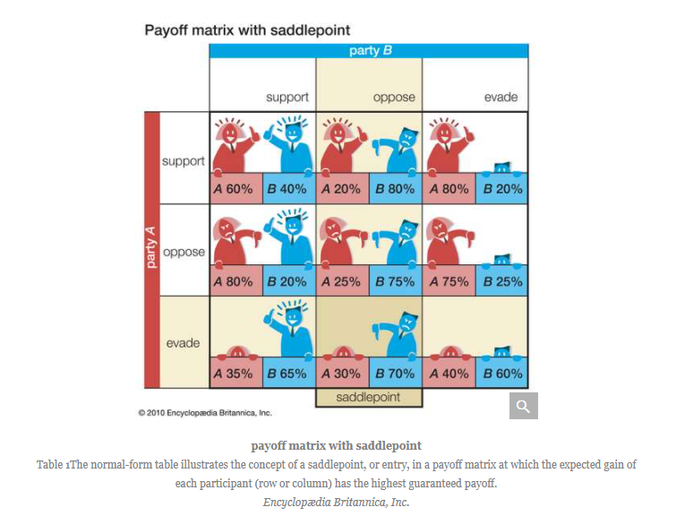
Constant sum games (pure conflict)
A Saddle point is the outcome that rational players would choose
What outcome would you choose?
Why is the most rational decision for party A to evade?

Slide 7
A typical 2x2 game
By convention, we always list the row players payoff first, then the column player second

Slide 8
How 2x2 games work
By convention, we always list the row players payoffs first, and the column players earnings second. |  | PLAYER 2
 |  | LEFT | RIGHT
PLAYER 1 | TOP | 1,2 | 0,0
 | BOTTOM | 0,0 | 2,1

Slide 9
How 2x2 games work
Step 1: Look for a DOMINANT strategy for both players.
A DOMINANT Strategy is a strategy that, no matter what their rivals do, brings them the best payoff.
Look at the following matrix to see if either player has a dominant strategy.

Slide 10
If Player 2 chooses Left, Player 1’s optimal choice is to choose Top because 1 is better than 0. |  | PLAYER 2
 |  | LEFT | RIGHT
PLAYER 1 | TOP | 1,2 | 0,0
 | BOTTOM | 0,0 | 2,1

Slide 11
If Player 2 chooses right, Player 1’s optimal choice is to choose bottom . |  | PLAYER 2
 |  | LEFT | RIGHT
PLAYER 1 | TOP | 1,2 | 0,0
 | BOTTOM | 0,0 | 2,1

Slide 12
Because Player 1’s optimal choice depends on what Player 2 does, Player 1 DOES NOT have a dominant strategy. |  | PLAYER 2
 |  | LEFT | RIGHT
PLAYER 1 | TOP | 1,2 | 0,0
 | BOTTOM | 0,0 | 2,1

Slide 13
What about Player 2? Do they have a dominant strategy? Work it out. |  | PLAYER 2
 |  | LEFT | RIGHT
PLAYER 1 | TOP | 1,2 | 0,0
 | BOTTOM | 0,0 | 2,1

Slide 14
Player 2 DOES NOT have a dominant strategy. Therefore there is no dominant strategy equilibrium in this game |  | PLAYER 2
 |  | LEFT | RIGHT
PLAYER 1 | TOP | 1,2 | 0,0
 | BOTTOM | 0,0 | 2,1
Notes:
The reason is because the best option is dependent on what the other player does

Slide 15
2x2 game in an oligopoly market

Slide 16
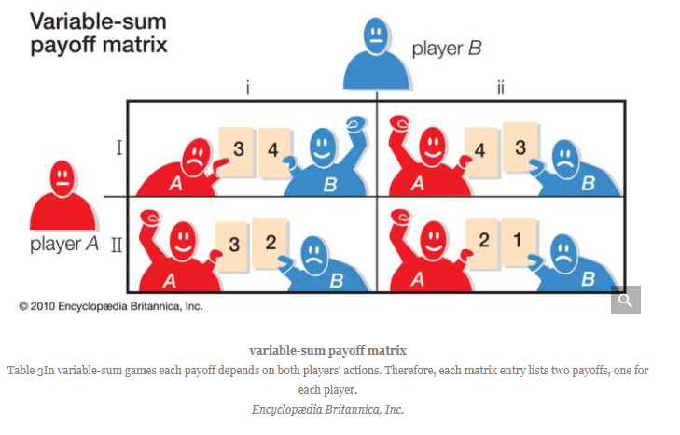
2 person variable sum games
Games where players have common and opposed interests
The extent to which information is given and players communicate can have a huge effect on the outcome

Slide 17
What is the rational choice?
To determine the most rational decision, you need to find the ‘Nash Equilibrium’.
The Nash Equilibrium is a stable state in a game where no player can gain an advantage by changing his strategy, assuming the other participants also do not change their strategies.

Slide 19
The Nash Equilibrium
A Nash equilibrium is named for its originator, John Nash, the subject of the film “A Beautiful Mind” in which Nash was played by Russell Crowe.
Nash shared the Nobel Prize for Economics in 1994 for his Game Theory.
You need to know how to find it in a pay-off matrix at the end of the year. I’m certain it will be in the exam.

Slide 20
The Nash Equilibrium
A Nash equilibrium exists when each player’s strategy is the best response to the other players’ strategies AND each has no incentive to change their strategy.
The first part of the definition is the same as a dominant strategy. It is the part after AND that will determine whether it is a Nash equilibrium.
Please note, sometimes, there can be more than 1 Nash Equilibrium.

Slide 21
The Nash Equilibrium
To find the Nash Equilibrium of a game, for each outcome (e.g. for each quadrant of the matrix) ask yourself the following question:
“Given what the other player is doing, does either player have an incentive to change what they are doing at this outcome?”
If the answer is YES for EITHER player, that outcome is NOT a Nash equilibrium.
If the answer for BOTH players is NO, the outcome is a NASH EQUILIBRIUM.

Slide 22
Nash Equillibrium
A beautiful Mind – movie clip
Nash Equilibrium - YouTube
Why a beautiful mind was wrong
A Beautiful Mind Got Nash Equilibrium Wrong - YouTube

Slide 23
Nash Equilibrium
How to find the Nash Equilibrium – using examples
Nash Equilibrium Examples - YouTube

Slide 24
The Nash Equilibrium
https://www.youtube.com/watch?v=t9Lo2fgxWHw

Slide 25
Nash Equilibrium
Does either player have an incentive to change what they are doing at this point, given what the other player is doing? Given that Player 1 is playing Top, Player 2 does not have an incentive to change from left to right. |  | PLAYER 2
 |  | LEFT | RIGHT
PLAYER 1 | TOP | 1,2 | 0,0
 | BOTTOM | 0,0 | 2,1

Slide 26
Nash Equilibrium
Given that Player 2 is playing Left, Player 1 does not have an incentive to switch from Top to Bottom. E.g. 1 is better than 0. Since neither player has an incentive to change what they are doing, the outcome is a NASH equilibrium. Is there another Nash Equilibrium? Work it out. |  | PLAYER 2
 |  | LEFT | RIGHT
PLAYER 1 | TOP | 1,2 | 0,0
 | BOTTOM | 0,0 | 2,1

Slide 27
Nash Equilibrium
Given that Player 2 is playing Right, Player 1 DOES have an incentive to move from Top to Bottom (e.g. 2 is better than 0) and therefore this is NOT a Nash Equilibrium. |  | PLAYER 2
 |  | LEFT | RIGHT
PLAYER 1 | TOP | 1,2 | 0,0
 | BOTTOM | 0,0 | 2,1

Slide 28
Nash Equilibrium
Given that Player 1 is playing Bottom, Player 2 DOES have an incentive to move from Left (0) to Right (1). Therefore this is NOT a Nash Equilibrium. |  | PLAYER 2
 |  | LEFT | RIGHT
PLAYER 1 | TOP | 1,2 | 0,0
 | BOTTOM | 0,0 | 2,1

Slide 29
Nash Equilibrium
If Player 1 is playing Bottom, Player 2 has no incentive to move from Right (1) to Left (0). If Player 2 is playing Right, Player 1 does NOT have an incentive to move from Bottom (2) to Top (0). Therefore, this outcome is ALSO a Nash Equilibrium. |  | PLAYER 2
 |  | LEFT | RIGHT
PLAYER 1 | TOP | 1,2 | 0,0
 | BOTTOM | 0,0 | 2,1

Slide 30
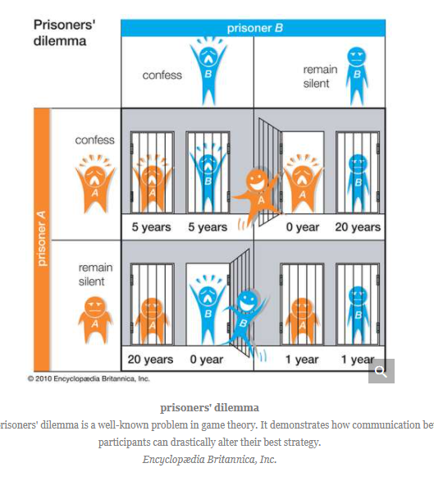
The Prisoners Dilema
What would you do?
Find the Nash Equilibrium

Slide 31
Nash Equilibria and oligopoly/duopoly markets
Prisoners Dilemma Examples: Oligopoly, Carbon Emission & Dating - YouTube

Slide 32
Split or steal
Communication is vital
Can you trust them?
https://www.youtube.com/watch?v=U2la85p--eo
Create a simple 2x2 game for this episode of Split or Steal
What is the Nash Equilibrium?

Slide 33
Split or Steal
How can you change the game?
golden balls. the weirdest split or steal ever! - YouTube
Create a simple 2x2 game for the Nick and Ibrahim episode

Slide 34
Split or steal
What happened with Nick and Ibrahim?
How was the game changed by Nick?
Game Theory Part 4: Taking a Closer Look at Golden Balls - YouTube
Rational decision making, while taking into consideration what is going on in the ‘game’ also need to consider other factors such as how the player will be viewed. Social pressure is an important factor
Golden Balls - £100,000: Complete End Round Pt1 - YouTube
Was she right or wrong?

Slide 35
The Pareto Principle
Linked to the Nash Equilibrium is the Pareto Principle.
Pareto efficiency, or Pareto optimality, is an economic state where resources cannot be reallocated to make one individual better off without making at least one individual worse off.
Pareto efficiency implies that resources are allocated in the most economically efficient manner, but does not imply equality or fairness.
An economy is said to be in a Pareto optimum state when no economic changes can make one individual better off without making at least one other individual worse off.

Slide 36
The Pareto Principle
Pareto efficiency is when an economy has its resources and goods allocated to the maximum level of efficiency, and no change can be made without making someone worse off.
Pure Pareto efficiency exists only in theory, though the economy can move toward Pareto efficiency.
Alternative criteria for economic efficiency based on Pareto efficiency are often used to make economic policy, as it is very difficult to make any change that will not make any one individual worse off.

Slide 37
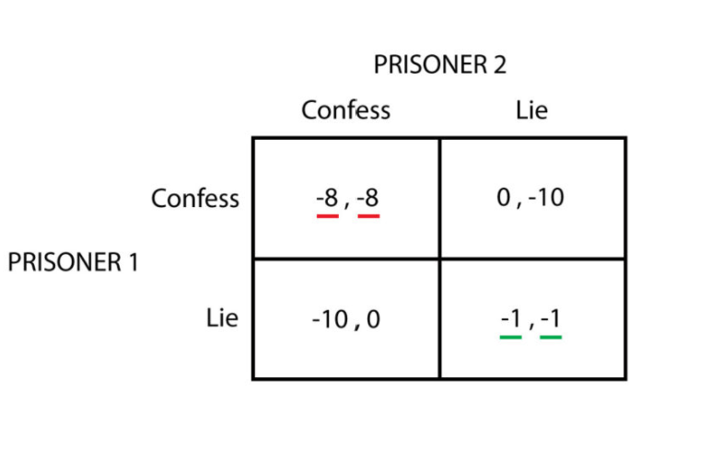
The Pareto Principle
(L,L) is Pareto optimal
No profile gives both players a higher payoff
(L,C) is Pareto optimal
No profile gives player 1 a higher payoff
(C,L) is Pareto optimal - same argument for player 2
(C,C) is Pareto dominated by (L,L)
Ironically, (C,C) is the dominant strategy equilibrium

Slide 38
The duopoly market structure
From the video below, note down where you can see links to the characteristics of oligopoly as well as the evaluation criteria we have used in class
https://www.youtube.com/watch?v=PCcVODWm-oY&t=14s

Slide 39
Dominated and Dominant Strategy
Dominant Strategy:
a strategy that gives higher payoffs no matter what the opponent does;
Dominated Strategy:
a strategy is dominated if there exists another strategy that is dominant.
So far we have only assumed that each player is rational to determine the outcome of the game.

Slide 40
Stretch your understanding
Game Theory - YouTube

Slide 41
Game Theory and the Free Rider Principle

