Slide 1
Welcome to Year 11 Economics
Stage 1 - 2021

Slide 2
Program length
16 weeks
Topics to be covered:
Thinking like an economist – 6 weeks
Scarcity, Choice, Opportunity Cost, Cause and effect
Economic scenarios – 10 weeks
Markets in action, Economic decision-making, Government involvement in the economy, Trade in the global economy, Elective
Assessment Tasks:
Tests, Essays, Reports and Investigations - or a combination of all four

Slide 3
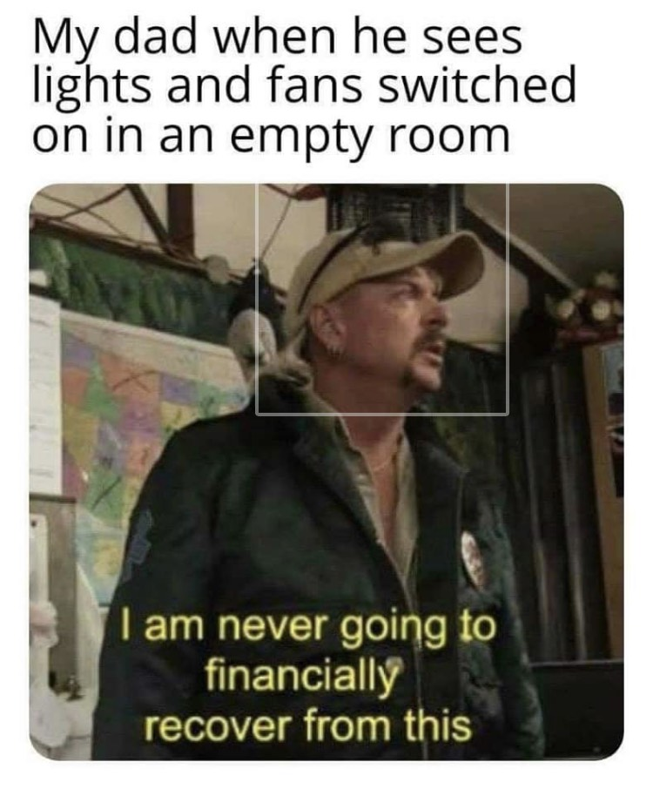

Slide 4
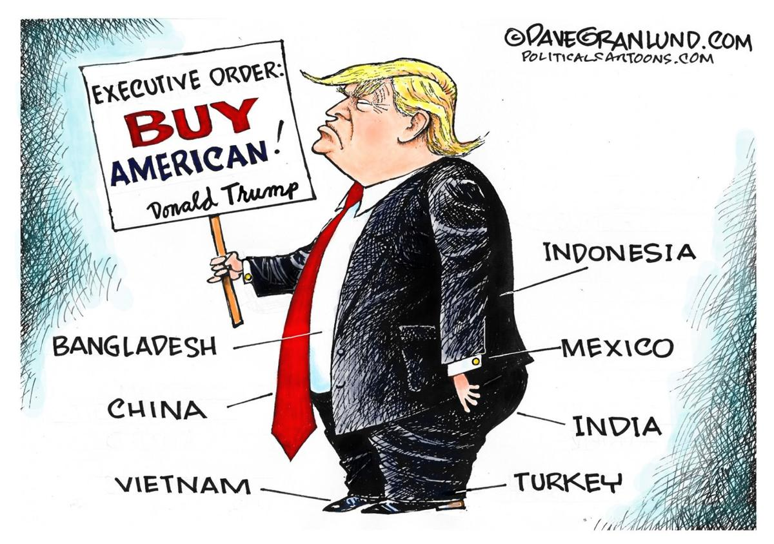

Slide 5
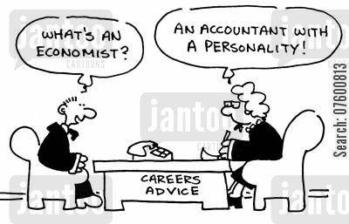
Where can economics take me?
Accountant | Agricultural economist | Urban planner
Company Secretary | Auctioneer | Bank officer
Government clerk | Diplomat | Credit officer
Customs broker | Farm Manager | Economist
Exporter / Importer | Industrial relations | Stock broker
Financial planner | Recruitment consultant | Political scientist
Public servant | Station agent | Retail buyer
Sales representative | Secondary School teacher | Town planner
Trade Union Official | Market researcher | Natural resource manager

Slide 6
What is Economics??
You’ve just bought some new shorts from Kmart
What are some economic questions you could ask…..
Wonder how they can be sold so cheaply?
Ever consider the allegations of labour exploitation made against some retailers?
Do you just buy without thinking about it?
Could it be made cheaper in Australia, why / why not?
What is the quality of my product?
Do I need them?
https://www.youtube.com/watch?v=ct-L27SIRmk

Slide 7
Definition of Economics:
The social science that studies the allocation of scarce resources between society’s competing wants and needs.
Economic systems:
The means by which society chooses to allocate scarce resources – who will get them, what will be produced with them, and who will receive the finished output (the three basic economic questions!)

