Slide 1
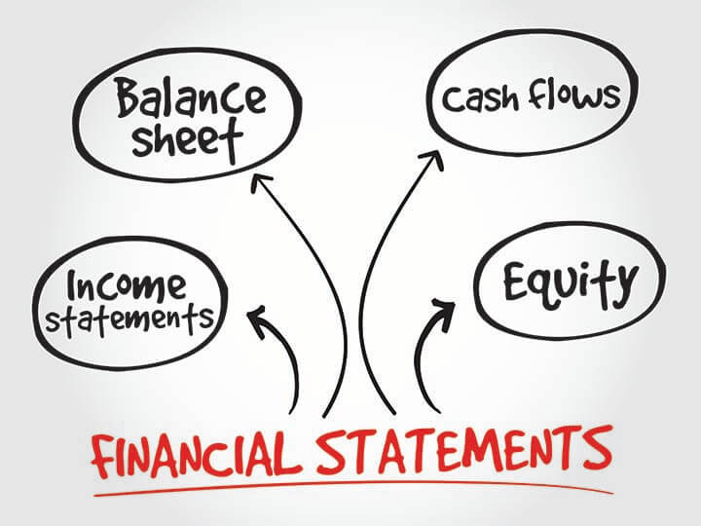
BUSINESS INNOVATION
Stage 2
Introduction to Financial Statements

Slide 2
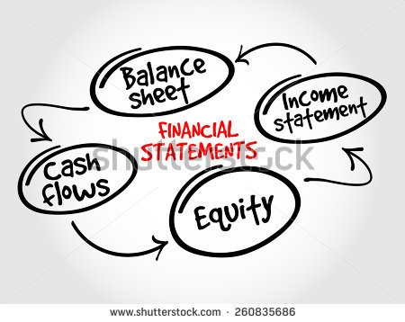
FOUR BASIC FINANCIAL STATEMENTS
The principal financial statements of a corporation are:
Balance Sheet
Income Statement
Statement of Shareholders’ Equity
Statement of Cash Flows
Notes accompany these financial statements.
To evaluate the financial condition, the profitability, and cash flows of an entity, the user needs to understand the statements and related notes.

Slide 3

FOUR BASIC FINANCIAL STATEMENTS
Balance Sheet – provides a snapshot of a firm’s financial position at one point in time.
Income Statement – summarizes a firm’s revenues and expenses over a given period of time.
Statement of Retained Earnings – shows how much of the firm’s earnings were retained, rather than paid out as dividends.
Statement of Cash Flows – reports the impact of a firm’s activities on cash flows over a given period of time.

Slide 4

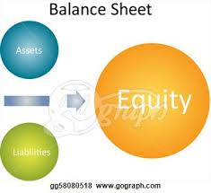
BALANCE SHEET – Statement of Financial Position
A balance sheet shows the financial condition of an entity as of a particular date.
The balance sheet consists of three major sections:
Assets - the resources of the firm;
Liabilities - the debts of the firm; and
Stockholders’ Equity - the owners’ interest in the firm.

Slide 5

BALANCE SHEET – Statement of Financial Position
At any point in time, the total assets amount must equal the total amount of the contributions of the creditors and owners.
This is expressed in the accounting equation:
Assets = Liabilities + Stockholders’ Equity

Slide 6
BALANCE SHEET – Statement of Financial Position
ACCOUNTING EQUATION
ASSETS = LIABILITIES + OWNER’S EQUITY
OR
A = L + O.E.

Slide 7

BALANCE SHEET
A balance sheet identifies a company’s assets and claims to those assets by creditors and owners at a specific date.
The purpose of this statement is to demonstrate where the company stands, in financial terms, at a specific date.
Balance sheet is also known as ‘Statement of Financial Position’.

Slide 8
BALANCE SHEET: ASSETS
Cash
A/R
Inventories
Total CA
Gross FA
Less: Dep.
Net FA
Total Assets
2019
7,282
632,160
1,287,360
1,926,802
1,202,950
263,160
939,790
2,866,592
2018
57,600
351,200
715,200
1,124,000
491,000
146,200
344,800
1,468,800

Slide 9
BALANCE SHEET: LIABILITIES AND EQUITY
Accts payable
Notes payable
Accruals
Total CL
Long-term debt
Common stock
Retained earnings
Total Equity
Total L & E
2019
524,160
636,808
489,600
1,650,568
723,432
460,000
32,592
492,592
2,866,592
2018
145,600
200,000
136,000
481,600
323,432
460,000
203,768
663,768
1,468,800

Slide 10
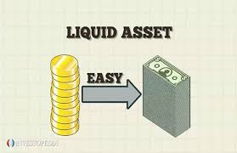
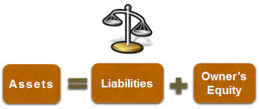
BALANCE SHEET
It is a summary of the accounting equation and, like the equation, the total of assets reported on the balance sheet must be equal to the combined total of liabilities and equity.
The assets are listed in order of their liquidity, or the length of time it typically takes to convert them to cash.

Slide 11
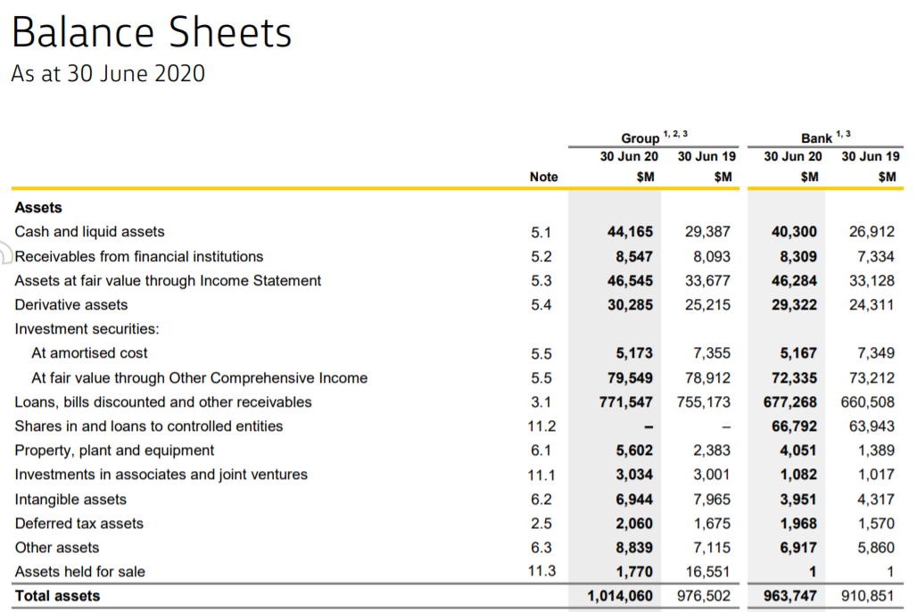
BALANCE SHEET – Commonwealth Bank

Slide 12
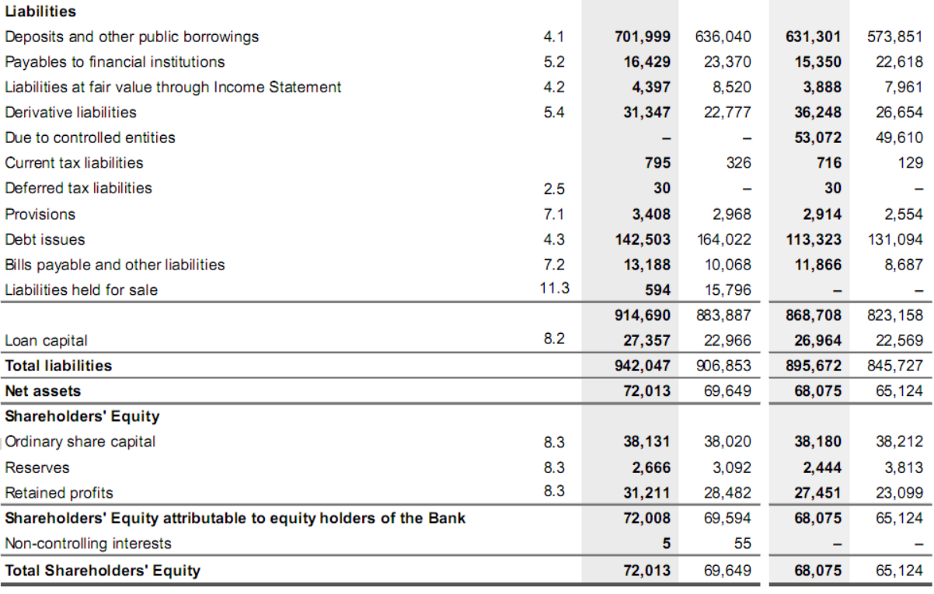
BALANCE SHEET – Commonwealth Bank

Slide 13
BALANCE SHEET
Balance sheet formats differ across nations.
  For example, nations influenced by British financial reporting report the least liquid assets first and cash last (e.g. Australia)
  Nations influenced by the United States report a balance sheet emphasizing liquidity.

Slide 14
Using the Four Quadrants of the Balance Sheet and Why?
ASSETS
LIABILITIES
Current Liabilities
Current Assets
=
Long-Term Liabilities
Long-Term Assets
Equity
Owner Contributions
Retained Earnings

Slide 15

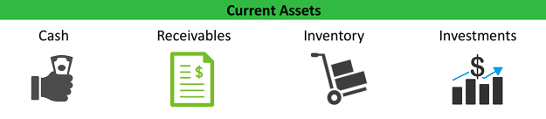
BALANCE SHEET
CURRENT ASSETS are those assets that are expected to be
converted into cash within one year.
For Example: Cash, Short-term Investments, Inventory,
Accounts Receivable, etc.

Slide 16
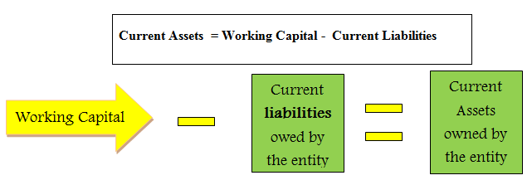
BALANCE SHEET

Slide 17
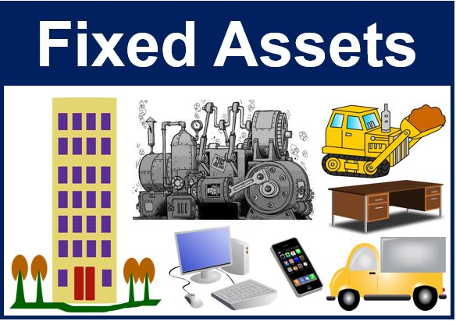
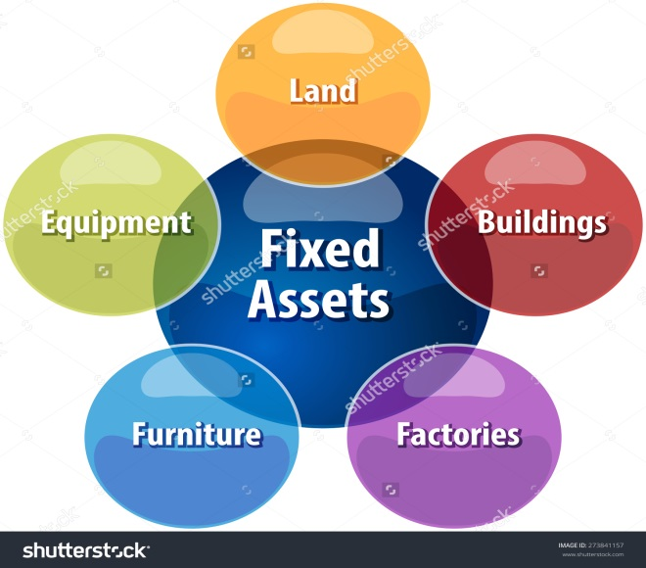
BALANCE SHEET
FIXED ASSETS are those assets that are acquired for
continuing use, i.e. for more than one financial year, with a
view of earning income or making profits from their use.
For Example: Land, Building, Motor vehicles, Equipment, etc.

Slide 18

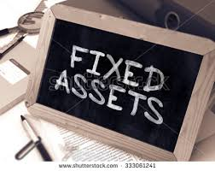
BALANCE SHEET
A fixed asset isn’t acquired for resale.
Fixed assets are also called Long-term Assets or Non-Current Assets..

Slide 19
CURRENT ASSETS
Although the assets are all stated in terms of dollars, only cash represents actual money.
Receivables are bills others owe to the reporting company.
Inventories show the dollars the company has invested in raw materials, work-in-process, and finished goods available for sale.

Slide 20
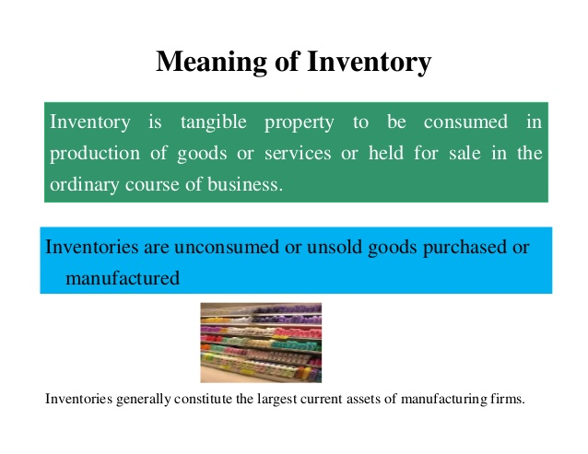
CURRENT ASSETS

Slide 21

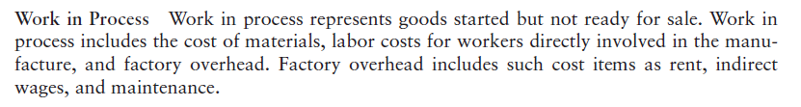

CURRENT ASSETS

Slide 22
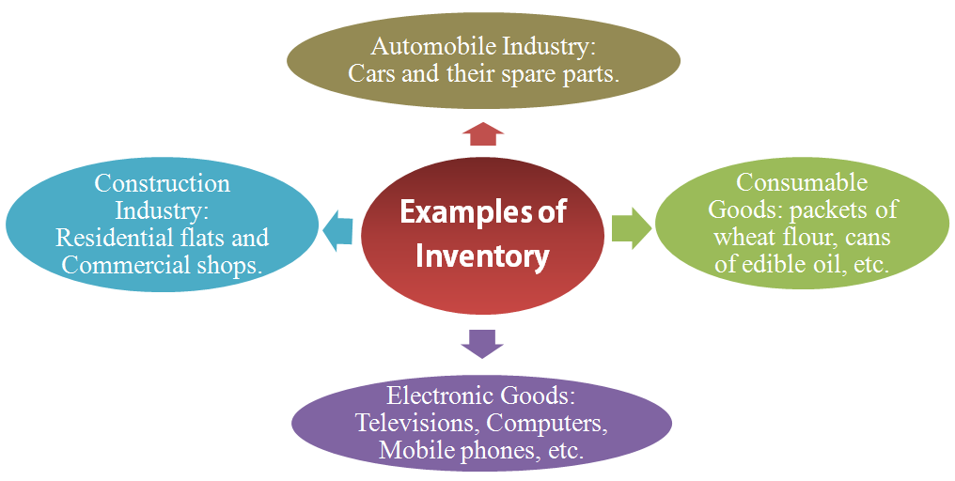
CURRENT ASSETS

Slide 23
CURRENT ASSETS
Since retailing and wholesaling firms do not engage in the manufacture of a product but only in the sale, their only inventory item is merchandise.
These firms do not have raw materials, work in process inventory, or finished goods.

Slide 24
CURRENT ASSETS
A prepaid is an expenditure made in advance of the use of the service or goods.
It represents future benefits that have resulted from past transactions.
  For example, if insurance is paid in advance for three years, at the end of the first year, two years’ worth of the outlay will be prepaid.
  The entity retains the right to be covered by insurance for two more years.
Typical prepaids include rent, taxes, insurance, etc.

Slide 25


TANGIBLE & INTANGIBLE ASSETS
Assets may have definite physical form such as buildings, machinery, equipment or an inventory of merchandise.
This category of assets is known as Tangible Assets.

Slide 26
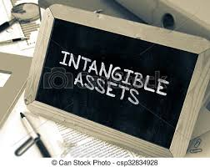
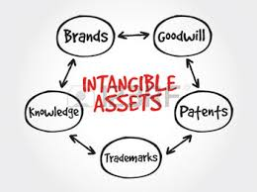
TANGIBLE & INTANGIBLE ASSETS
On the other hand, some assets exist not in physical or tangible form, but in the form of valuable legal claims or rights such as copy rights, trademarks, goodwill, research & development, etc.
This category of assets is known as Intangible Assets.

Slide 27
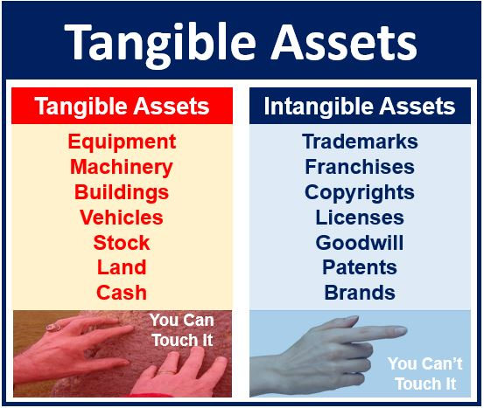
TANGIBLE & INTANGIBLE ASSETS

Slide 28
FIXED ASSETS
Net Fixed Assets reflect the amount of money the company paid for its fixed assets when it acquired those assets in the past, less accumulated depreciation.

Slide 29
FIXED ASSETS
Land is shown at acquisition cost and is not depreciated because land does not get used up.
Land containing resources that will be used up, however, such as mineral deposits and timberlands, is subject to depletion.
Depletion expense attempts to measure the wearing away of these resources.
It is similar to depreciation except that depreciation deals with a tangible fixed asset and depletion deals with a natural resource.

Slide 30
FIXED ASSETS
Buildings
Structures are presented at cost plus the cost of permanent improvements.
  Buildings are depreciated (expensed) over their estimated useful life.
Machinery is listed at historical cost, including delivery and installation, plus any material improvements that extend its life or increase the quantity or quality of service.
  Machinery is depreciated over its estimated useful life.

Slide 31


FIXED ASSETS
Investments
Long-term investments.
e.g. stocks and bonds of other companies.
Long-term investments are different from marketable securities, where the intent is to hold for short-term profits and to achieve liquidity.

Slide 32
FIXED ASSETS
Accumulated Depreciation
Depreciation is the process of allocating the cost of buildings and machinery over the periods benefited.
The depreciation expense taken each period is accumulated in a separate account (Accumulated Depreciation).
Accumulated depreciation is subtracted from the cost of plant and equipment.
The net amount is the book value of the asset.
It does not represent the current market value of the asset.

Slide 33
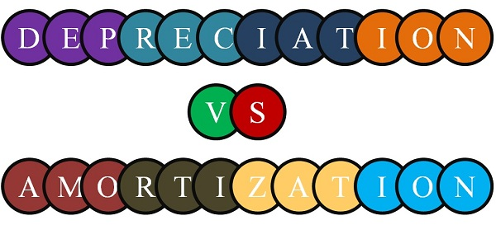
DEPRECIATION & AMORTIZATION
Depreciation and Amortization are important components of total operating costs.
Since these are similar, depreciation and amortization are often lumped together on the income statement.

Slide 34


DEPRECIATION & AMORTIZATION
Depreciation is the systematic allocation of the cost of an asset to expense during the periods of its useful life.
  Depreciation is a non-cash outlay.
Amortization is a non-cash charge similar to depreciation expense except that it is used to write off the costs of intangible assets.

Slide 35
ACCUMULATED DEPRECIATION
Accumulated Depreciation is a contra-asset account, representing that portion of the asset’s cost that has already been allocated to expense.
A contra asset account is an account “with a credit balance which is offset against or deducted from an asset to produce the proper balance sheet valuation for the asset”

Slide 36
ACCUMULATED DEPRECIATION
For Example
Accumulated depreciation, allowance for doubtful accounts, etc.
    Building 5000
Less: Accumulated Depreciation 1000 4000

Slide 37
THE PRINCIPLE OF CONSISTENCY
The Principle of Consistency states that once a particular accounting method is adopted, it will not be changed from period to period.
Consistency is intended to make financial statements of a given company comparable from year to year.
However, the company may use different depreciation methods for different assets.

Slide 38
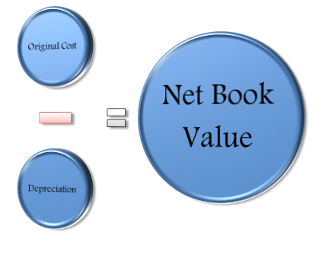
BOOK VALUE
Assets are shown in the balance sheet at their book values;
Book Value = (Cost of the Asset) - (Accumulated Depreciation)

Slide 39
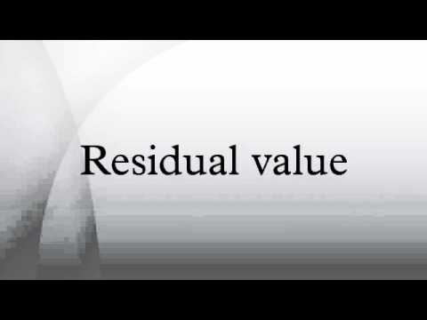
RESIDUAL VALUE
Residual Value is the portion of an asset’s cost expected to be recovered through sale or trade-in of the asset at the end of its useful life.
Residual value is also called salvage value.

Slide 40
METHODS TO CALCULATE DEPRECIATION EXPENSE
There are a number of depreciation methods that a firm can use.
Often, a firm depreciates an asset under one method for financial statements and another for income tax returns.
A firm often wants to depreciate slowly for the financial statements because this results in the highest immediate income and highest asset balance.
The same firm would want to depreciate faster for income tax returns because this results in the lowest immediate income and thus lower income taxes.
Over the life of an asset, the total depreciation will be the same regardless of the depreciation method selected.

Slide 41
METHODS TO CALCULATE DEPRECIATION EXPENSE
Straight Line Method
Units of Production Method
Sum of Years’ Digits Method
Declining Balance Method

Slide 42


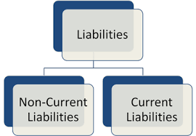
LIABILITIES
Liabilities are probable future sacrifices of economic benefits arising from present obligations of a particular entity to transfer assets or provide services to other entities in the future as a result of past transactions or events.
Liabilities are usually classified as either current or long-term liabilities.

Slide 43
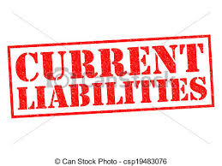
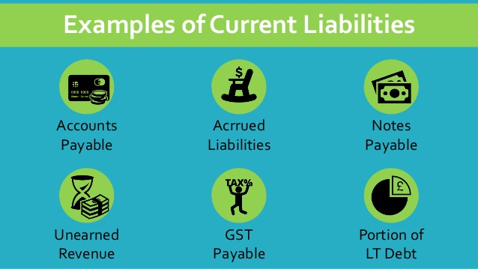
CURRENT LIABILITIES
Current Liabilities are obligations whose liquidation is reasonably expected to require the use of existing current assets.

Slide 44


CURRENT LIABILITIES
Payables
These include short-term obligations created by the acquisition of goods and services, such as accounts payable (for materials or goods bought for use or resale), wages payable, and taxes payable.
Payables may also be in the form of a written promissory note - notes payable.

Slide 45


CURRENT LIABILITIES
Unearned Income
Payments collected in advance of the performance of service are termed unearned.
They include rent income and subscription income.
Rather than cash, a future service or good is due the customer.

Slide 46
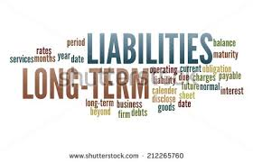
LONG-TERM LIABILITIES
Long-term Liabilities are those due in a period exceeding one year or one operating cycle, whichever is longer.
Long-term liabilities are generally of two types:
Financing arrangements of assets
Operational obligations

Slide 47
LONG-TERM LIABILITIES
Liabilities Relating to Financing Agreements
The long-term liabilities that are financing arrangements of assets usually require systematic payment of principal and interest.
They include notes payable, bonds payable, and credit agreements.

Slide 48
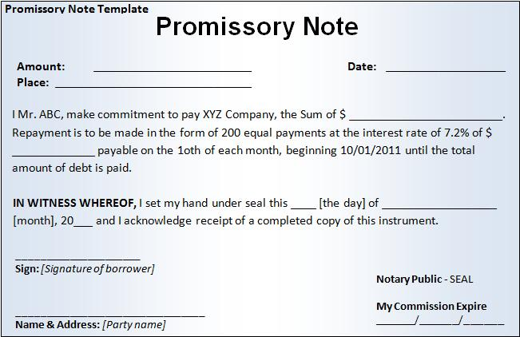
LONG-TERM LIABILITIES
Notes Payable
Promissory notes due in periods greater than one year are classified as long term.
If secured by a claim against real property, they are called mortgage notes.

Slide 49
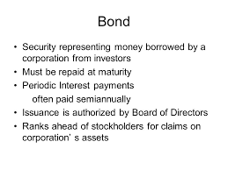
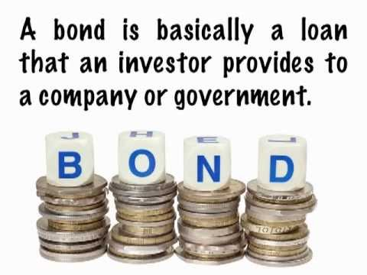
LONG-TERM LIABILITIES
Bonds Payable
A bond is a debt security normally issued with $1,000 par per bond and requiring semiannual interest payments.
Bonds payable is similar to notes payable.
  Bonds payable are usually for a longer duration than notes payable.

Slide 50
LONG-TERM LIABILITIES
Liabilities Relating to Operational Obligations
Long-term liabilities relating to operational obligations include obligations arising from the operation of a business, mostly of a service nature, such as pension obligations, postretirement benefit obligations other than pension plans, deferred taxes, and service warranties.

Slide 51

THE BALANCE SHEET:
LIABILITIES VS. STOCKHOLDERS’ EQUITY
The claims against assets are of two types:
Liabilities (or money the company owes); and
Stockholders’ ownership position
The capital supplied by common stockholders -- common stock, paid-in capital and retained earnings -- is the Common Stockholders’ Equity (Net Worth).
Total equity is common equity plus preferred equity.

Slide 52

THE BALANCE SHEET: BREAKDOWN OF THE COMMON EQUITY ACCOUNTS
The common equity section is divided into two accounts:
Common Stock (The common stock account arises from the issuance of stock to raise capital)
Retained Earnings (The retained earnings are that portion of the firm’s earnings that has been saved rather than paid out as dividends)

Slide 53
STATEMENT OF SHAREHOLDERS’ EQUITY
Firms are required to present reconciliations of the beginning and ending balances of their stockholders’ equity accounts.
This is accomplished by presenting a “statement of stockholders’ equity.”
Retained earnings is one of the accounts in stockholders’ equity.

Slide 54
STATEMENT OF RETAINED EARNINGS
The statement that shows/reports how much of the firm’s earnings were retained in the business rather than paid out as dividends is called “Statement of Retained Earnings”.
The figure for retained earnings that appears in this statement is the sum of the annual retained earnings for each year of the firm’s history.

Slide 55
STATEMENT OF RETAINED EARNINGS
(2019)
$203,768
160,176
(11,000)
$352,944
Balance of retained earnings, July 01, 2018
Add: Net income, 2019
Less: Dividends paid
Balance of retained earnings, June 30, 2019

Slide 56
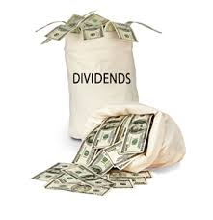
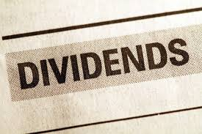
STATEMENT OF RETAINED EARNINGS
The term dividend means distribution of cash by a corporation to its stockholders.
The amount received by each stockholder is in proportion to the number of shares owned.
Dividends are paid only through action by the board of directors.

Slide 57

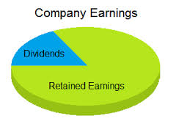
STATEMENT OF RETAINED EARNINGS
Changes in retained earnings between balance sheet dates are reported in the statement of retained earnings.
Changes in retained earnings occur because common stockholders allow the firm to reinvest funds that otherwise could be distributed as dividends.

Slide 58

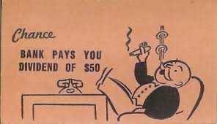
STATEMENT OF RETAINED EARNINGS
In order to finance the growth of the company, it is normal practice to retain part of the profit of a period within the business rather than to pay out the whole of it as dividend.

Slide 59
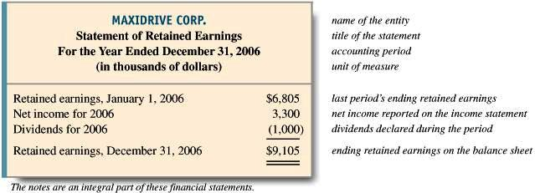
STATEMENT OF RETAINED EARNINGS

Slide 60
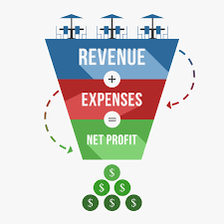
THE INCOME STATEMENT
The income statement may be defined as “a summary of the revenue, expenses, and net income or net loss of a business entity for a specific period of time”
The income statement is called a profit and loss statement, or operating statement, or statement of operations.

Slide 61
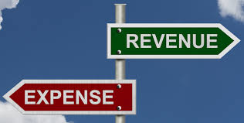

INCOME STATEMENT
(STATEMENT OF EARNINGS)
The income statement summarizes revenues and expenses and gains and losses, ending with net income.
It summarizes the results of operations for a particular period of time.
Net income is included in retained earnings in the stockholders’ equity section of the balance sheet.

Slide 62

THE INCOME STATEMENT:
REVENUE
Revenue is the price of goods sold or services rendered during an accounting period.
or
Revenue is the increase in capital resulting from the sale of goods or rendering of services by the business entity.
For example: Sales revenue, interest revenue, commission revenue, etc.

Slide 63
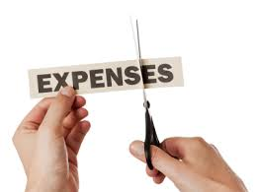
THE INCOME STATEMENT:
EXPENSES
Expenses are the costs of goods sold and/or services used up in the process of earning revenue.
or
Expenses are the decrease in capital caused by the revenue-producing operations of the business.
For Example: Rent expense, wages expense, utilities expense, etc.

Slide 64
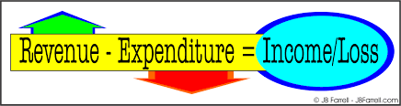
THE INCOME STATEMENT:
NET INCOME
The increase in capital resulting from profitable operations of a business is called Net Income.
Net income is the excess of revenues over expenses for the accounting period
or
Revenues > Expenses = Net Income

Slide 65

THE INCOME STATEMENT:
NET LOSS
The decrease in capital resulting from the unprofitable operations of a business is called Net Loss.
Net loss is the excess of expenses over revenue for the accounting period
or
Revenues < Expenses = Net Loss

Slide 66
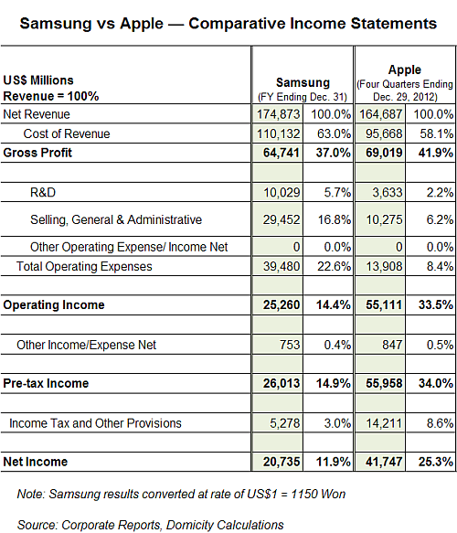
INCOME STATEMENT
APPLE vs. SAMSUNG

Slide 67
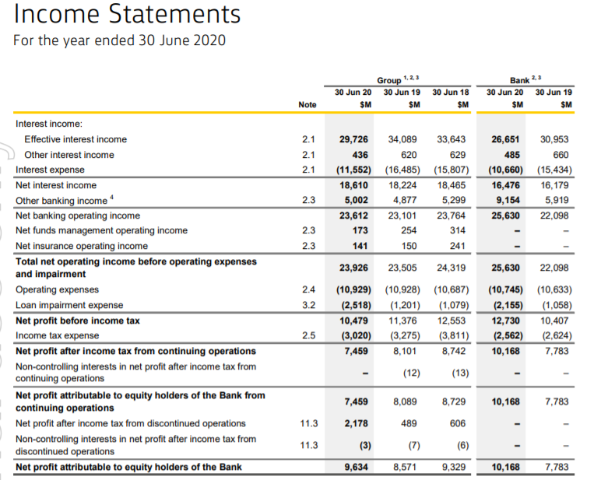
Income Statement - Commonwealth Bank

Slide 68
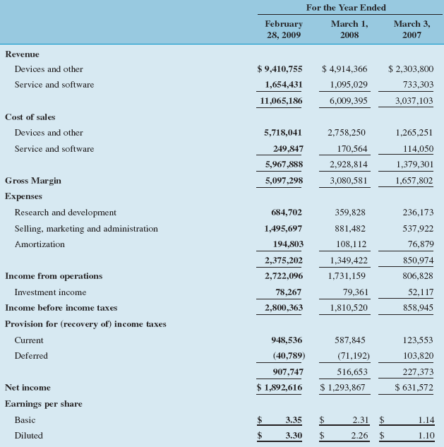
The Income Statement – Research In Motion Ltd.
FY 2009
100.00%
Revenue
46.07%
Gross margin
24.60%
Operating margin
17.10%
Net margin

Slide 69
THE FORM OF THE INCOME STATEMENT
Net Revenue – Cost of Goods Sold = Gross Margin
Gross Margin – Operating Expenses = Operating Income before Tax (EBIT)
Operating Income before Tax – Interest Expense = Income before Taxes (EBT)

Slide 70
THE FORM OF THE INCOME STATEMENT
Income before Taxes – Income Taxes = Income After Taxes (EAT) or Net Income
EAT or Net Income – Preferred Dividends = Net Income Available to Common Stockholders

Slide 71
STATEMENT OF CASH FLOWS
The statement of cash flows details the inflows and outflows of cash during a specified period of time — the same period that is used for the income statement.
The statement of cash flows consists of three sections:
  Cash flows from operating activities,
  Cash flows from investing activities, and
  Cash flows from financing activities.

Slide 72
STATEMENT OF CASH FLOWS
Cash flow statement describes the cash inflows and outflows of an enterprise during a period.
This statement reports cash inflows and outflows based on the firm’s operating activities, investing activities, and financing activities.
Change in cash = Cash from operations + Cash from investment + Cash from financing

Slide 73
STATEMENT OF CASH FLOWS
CASH FLOW FROM OPERATING ACTIVITIES
It shows impact of transactions not defined as investing or financing activities.
These cash flows are generally the cash effects that enter into the determination of net income.
Cash Inflows
From sales of goods or services
From interest and dividend income

Slide 74
STATEMENT OF CASH FLOWS
CASH FLOW FROM OPERATING ACTIVITIES
Cash Outflows
To pay suppliers for inventory
To pay employees for services
To pay lenders (interest)
To pay government for taxes
To pay other suppliers for other operating expenses

Slide 75
STATEMENT OF CASH FLOWS
CASH FLOW FROM OPERATING ACTIVITIES
It would seem more logical to classify interest and dividend income as an “investing” inflow, while interest paid certainly looks like a “financing” outflow.
But the SSAP (Statement of Standard Accounting Practices) and FRS (Financial Reporting Standard) classified these items as operating flows.

Slide 76
STATEMENT OF CASH FLOWS
CRITICAL IMPORTANCE OF CASH FLOW FROM OPERATING ACTIVITIES
In the long run, a business must generate a positive net cash flow from its operating activities if the business is to survive.
A business with negative cash flows from operations will not be able to raise cash from other sources indefinitely.

Slide 77

STATEMENT OF CASH FLOWS
CRITICAL IMPORTANCE OF CASH FLOW FROM OPERATING ACTIVITIES
In fact, the ability of a business to raise cash through financing activities is highly dependent upon its ability to generate cash from its normal business operations.
Creditors and stockholders are reluctant to invest money in a company that does not generate enough cash from operating activities to assure prompt payment of maturing liabilities, interest and dividends.

Slide 78
STATEMENT OF CASH FLOWS
CASH FLOW FROM INVESTING ACTIVITIES
It shows impact of buying and selling fixed assets and debt or equity securities of other entities.
Cash Inflows
From sale of fixed assets (property, plant and equipment)
From sale of debt or equity securities (other than common equity) of other entities

Slide 79
STATEMENT OF CASH FLOWS
CASH FLOW FROM INVESTING ACTIVITIES
Cash Outflows
To acquire fixed assets (property, plant and equipment)
To purchase debt or equity securities (other than common equity) of other entities

Slide 80
STATEMENT OF CASH FLOWS
CASH FLOW FROM FINANCING ACTIVITIES
It shows impact of all cash transactions with shareholders and the borrowing and repaying transactions with lenders.
Cash Inflows
From borrowing (Short-term and long-term)
From sale of firm’s own equity securities (i.e. by issuing stock)

Slide 81
STATEMENT OF CASH FLOWS
CASH FLOW FROM FINANCING ACTIVITIES
Cash Outflows
To repay amounts borrowed
To repurchase firm’s own equity securities
To pay shareholders’ dividends

Slide 82
The Cash Flow Statement – Research In Motion, Ltd.
Operating Activities
Financing Activities
Investing Activities

Slide 83
Cash Flow Statement
Cash from operations
Cash from investing
Beginning Balance Sheet
Ending Balance Sheet
Cash from financing
Cash
Net change in cash
Cash
+ Other Assets
+ Other Assets
Statement of Shareholders’ Equity
Total Assets
Total Assets
Investment and
disinvestment
- Liabilities
by owners
- Liabilities
Net income and other earnings
Owners’ equity
Net change in owners’ equity
Owners’ equity
Income Statement
Revenues
Expenses
Net income

Slide 84
Relationship Between Balance Sheets and Income Statement
Balance Sheet (12/31/09) |  |  | Income Statement |  |  | Balance Sheet (12/31/10)
 |  |  | (01/01/10 - 12/31/10)
Assets |  |  | Net sales | 300,000 |  | Assets
Current assets | 74,300 |  | Cost of Goods Sold | 208,000 |  | Current assets | 76,400
Fixed assets | 95,000 |  | Gross Profit | 92,000 |  | Fixed assets | 84,000
Total | 169,300 |  | O&M Expenses | 58,720 |  | Total | 160,400
 |  |  | Net Operating profit | 33,280
Liabilities & Equities |  |  |  |  |  | Liabilities & Equities
 |  |  | Non-operating Profit | 5,200
Current liabilities | 44,500 |  | Taxable Income | 28,080 |  | Current liabilities | 28,000
Other liabilities | 32,000 |  | Income Taxes | 8,424 |  | Other liabilities | 30,000
Total | 76,500 |  | Net Income | 19,656 |  | Total | 58,000
Preferred stock | 10,000 |  | Cash Dividends | 10,056 |  | Preferred stock | 10,000
Common stock | 40,000 |  |  |  |  | Common stock | 40,000
Capital surplus | 10,000 |  | Retained earnings | 9,600 |  | Capital surplus | 10,000
Retained earnings | 32,800 |  |  |  |  | Retained earnings | 42,400
Total | 169,300 |  |  |  |  | Total | 160,400

Slide 85
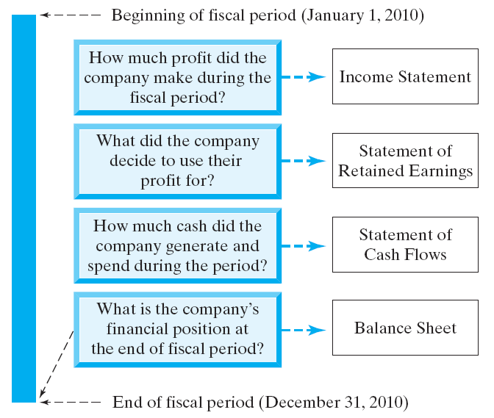
Financial Status for Business

Slide 86
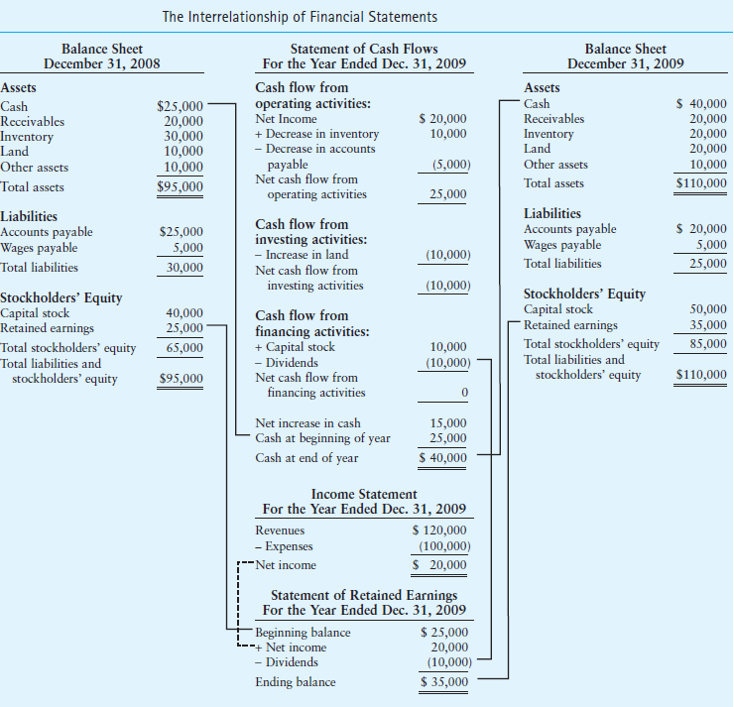

Slide 87
How to Use Profit Check Points
ABC Company, Inc. Statement of Operations (Year Ended December 31, 20xx)
Sales | $5,000,000 | 100.0%
Less: Cost of Goods Sold | 3,250,000 | 65.0%
Gross Profit (margin) | 1,750,000 | 35.0%
Less: Selling, G&A Expenses | 1,000,000 | 20.0%
Operating Profit (margin) | 750,000 | 15.0%
Less: Interest | 250,000 | 5.0%
Net Income Before Taxes (NIBT) | 500,000 | 10.0%
Less: Taxes | 175,000 | 3.5%
Net Income (margin) | $325,000 | 6.5%
Bottom line

