Slide 1
Solution Finding

Slide 2
Progress so far
Tools to show iterations
Value Proposition Canvas
Helps to keep you focused on the customer needs
Validation Board
Used to test your ideas
Ideation – to come up with a potential solution
Tech vs Trend matrix
Opposite thinking
Analogy thinking

Slide 3
Testing your ideas
Assumption mapping
Gaining feedback
Use at least 3 different methods
Very quick methods include:
Storyboarding
Product box
Speed boat
Data sheet
Feature stub
Interviews – may be of the most value
You need to go cheap and early before you put too much time into your solution
Gain regular and valuable feedback

Slide 4
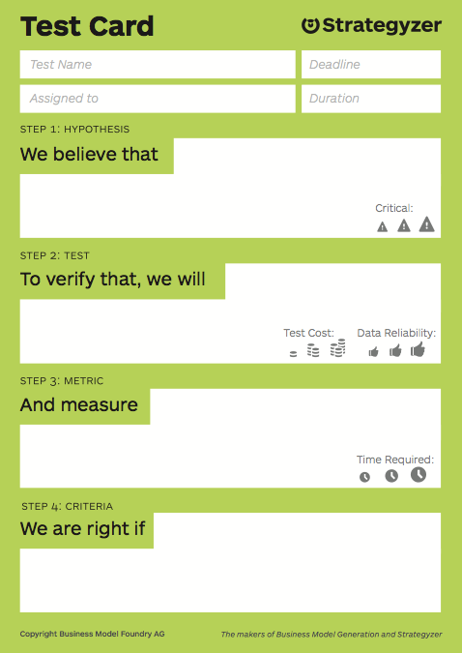
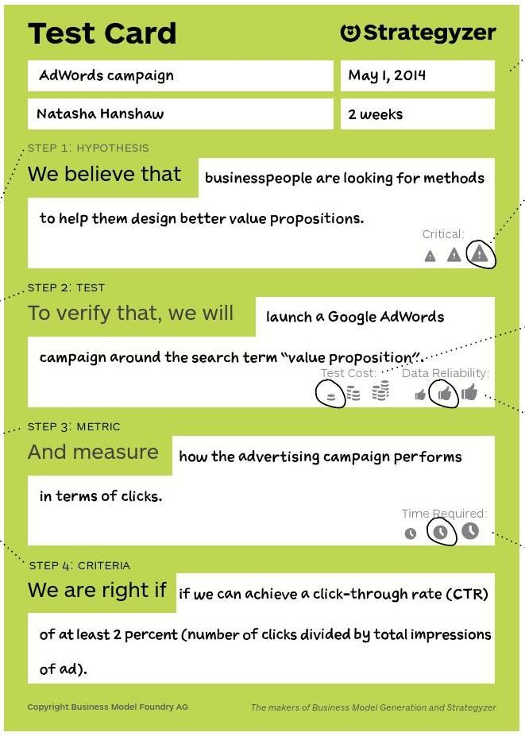
Design an experiment

Slide 5
Refining your ideas
Physical Product Solution | Software Solution | Service Solution
Customer interview | Customer interview | Customer interview
Search trend analysis | Online ad | Search trend analysis
Paper prototype | Simple landing page | Online ad
3D prototype | Email campaign | Simple landing page
Explainer video | Clickable prototype | Email campaign
Crowdfunding | Mock sale | Pre-sale
Pop-up Store | Wizard of oz | concierge

Slide 6
Experiment samples
Located on Haiku
Example of a story board

Slide 7
Your assignment
I’ll be expecting to see at least 3-4 of these processes as well as an iterated VPC and Validation board
Focus now needs to be on testing your ideas and assumptions

