Slide 1
Marketing Strategies

Slide 2
Learning Intention
I will learn how marketing relates to the Business Model Canvas
I will learn how the 7 P’s can be incorporated into the BMC

Slide 3
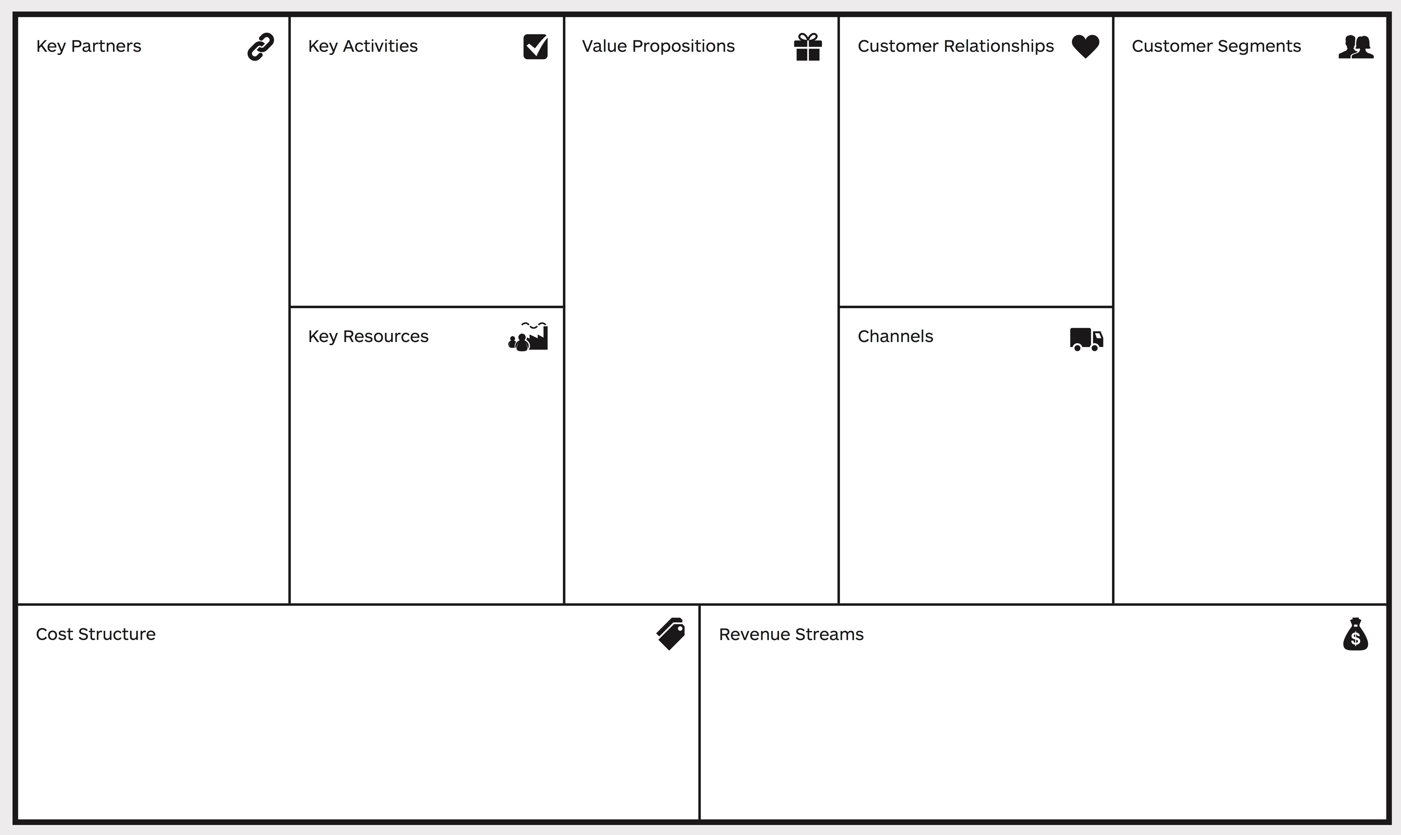
Marketing and the BMC
Product
People
Process
Marketing consists essentially of the 7P’s
Product, Pricing, Promotion, Placement, People, Process, Physical Evidence
Each of the P’s need to be thought about in completing a marketing plan for a business
Promotion
Placement
Physical Evidence
Pricing

Slide 4
The Marketing Canvas
The 7 P’s is a good methodology, but it also lacks the depth that other strategies offer.
Using a marketing canvas provides this added depth for an overall plan
There are many different canvas types for Marketing that are aimed at doing the same thing.
There is no right or wrong canvas
Choose one that works for you and ‘run with it’

Slide 8
Market segmentation
In determining an effective marketing mix, you need to understand who your market is.
Who are you ‘targeting’?
By undertaking the design process, you will understand your customers in a fair amount of detail.
Look at your customers again and think about their characteristics
You have done an ‘empathy map’ and developed an ‘archetypal customer’
Now, look at developing a customer persona

Slide 9
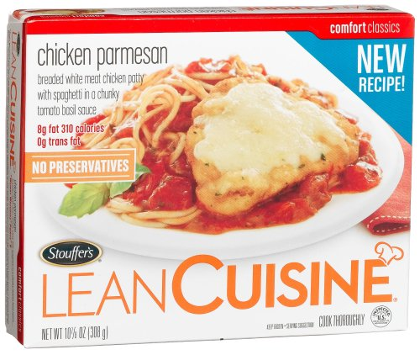
Segmenting consumer markets
Segmentation variables
The characteristics of people or groups that are used by marketing managers to divide a total market into segments
Demographic segmentation
Age, gender, income etc…
Geographic segmentation
Dividing the market into geographic locations
Psychographic segmentation
Personality, characteristics, socioeconomic status, lifestyles
Behavioural segmentation
Customers relationship to the product
E.g. Lean Cuisine is targeted at people wanting to lose weight

Slide 10
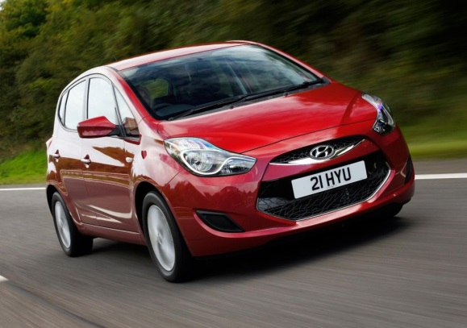
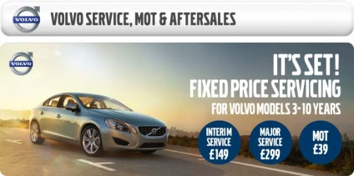
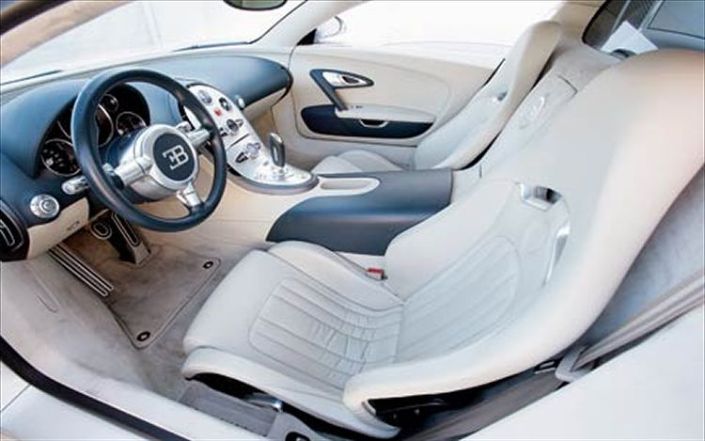
Differentiating your product
How are you going to position your product and is this consistent with your business model?
Some typical ways you might position yourself in the market might be by
Top quality service
Value for money
Convenience
Environmentally friendly
More features
Ethical products

Slide 11
Positioning yourself
The technique marketers use to try and create an image or identity for a product compared to competing brands
What are your competitors doing? How can you be better/different to them?

Slide 12
Marketing strategies
Before looking at a CANVAS, think about the 7 P’s and how they apply to your business.
This is a good starting point

Slide 13
Product strategies
Total product concept
The tangible and intangible benefits a product gives you. What is your value proposition?
Includes things like
Brand name
Image/prestige
After sale service
Warranty
packaging

Slide 14
Product strategies
Branding
A brand is a personality and costs a lot of money to develop.
Think about the brands for the following products
Levi’s
Uncle toby’s
Holden
Kellogg’s
Arnott’s
Colgate
Cadbury
McDonalds
Telstra
Coke
Nike
KFC
Quiksilver
Vegemite
Speedo
Apple

Slide 15
What do you think of??

Slide 16
What do you think of??

Slide 17
What do you think of??

Slide 18
What do you think of??

Slide 19
Branding
Branding also includes the use of logo’s that identify everything the brand stands for.
Allows you to instantly recognise the product
Branding strategies may include:
National brand
E.g. billabong, Kraft, Miele
House brand
E.g. Myer has it’s own brands like Reserve, wild Rhino, Miss Shop
Generic brand
E.g. no Frills, Black and Gold, Home brand select

Slide 20
QANTAS
Do some preliminary research online about what the ‘brand’ of Qantas is.
Consider the following video in your research
https://www.youtube.com/watch?v=Mg85u6ct_K0
What would you say the ‘brand’ of Qantas is?
What are some common elements in their advertising and use of the 7 P’s in general?
How does this fit with the business model of qantas?

Slide 21
Product strategies
Packaging
Involves development of the package and the graphic design for a product
Should give a positive impression of the product and encourage first time users
It also
Preserves the product
Protects it from damage
Attracts customers attention
Divides into convenient units – E.g. 100gm, 250gm
Assists with the display of the product
Makes transport and storage easier
Gives impressions about the product by the colours used
Yellow container for dishwasher detergent reminds you of…

Slide 22
Pricing strategies
Pricing an innovative new product
Usually use market penetration pricing or Price skimming pricing
Market penetration
Setting a low price for a new product in order to attract a large number of buyers and a large market share
Market-skimming pricing
Setting a high price for a new product to skim maximum revenue from the segments willing to pay the high price. The company makes fewer, but more profitable sales.

Slide 23
Pricing strategies
Cost-based pricing
Adding a standard mark-up to the cost of a product
The simplest form of pricing
Usually used by tradies, lawyers, accountants and other professionals

Slide 24
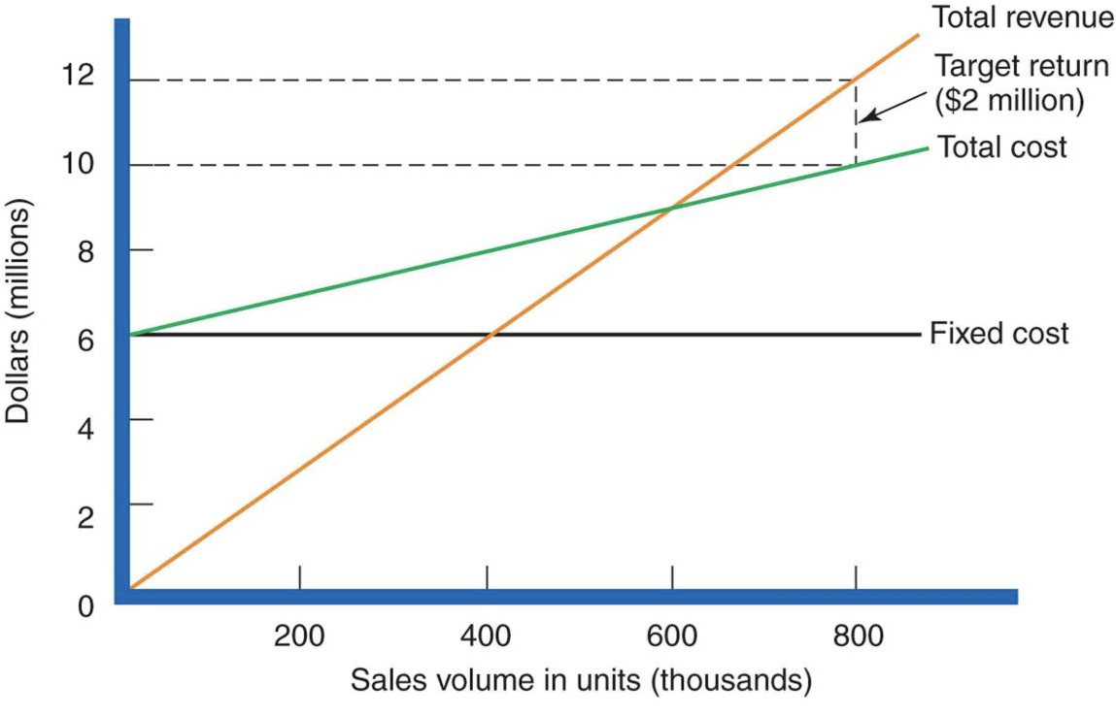
Pricing strategies
Break-even pricing
Pricing with a target in mind. This will usually also include a profit figure.

Slide 25
Pricing strategies
Value-based pricing
Setting price based on the consumers perceptions of value rather than on the sellers cost
This is different to cost-based pricing in the following ways
Cost-based pricing
Product – Cost – Price – Value – Customers
Value-based pricing
Customers – Value – Price – Cost - Product

Slide 26
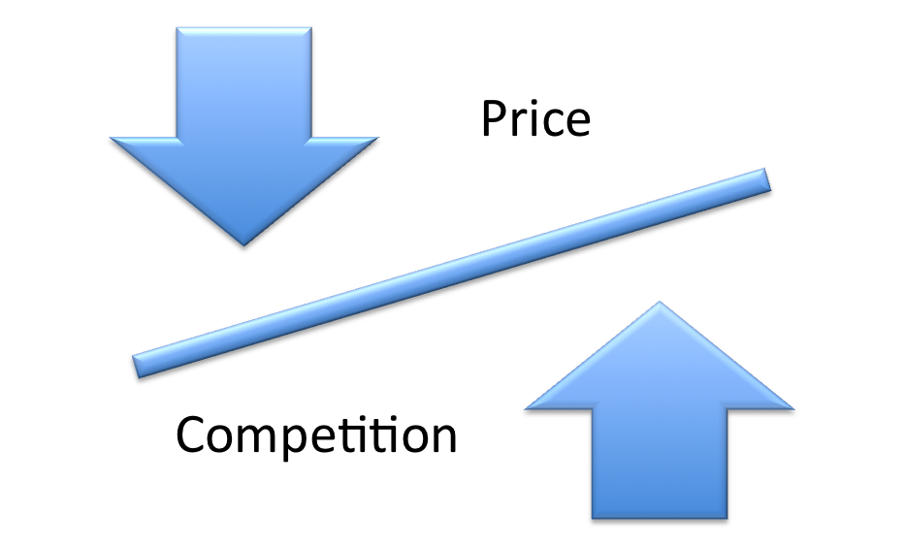
Pricing strategies
Competition-based pricing
Market-based pricing
Follows the laws of supply and demand
Going rate pricing
Setting price based on following competitors prices rather than on company costs and demand

Slide 27
Promotion strategies
The promotion mix contains 4 elements
Advertising
Personal selling and relationship marketing
Sales promotion
Publicity and public relations

Slide 28
Advertising
A paid, non-personal message communicated through a mass medium
The purpose of advertising is to inform, persuade and remind customers
Gives businesses the ability to reach a large audience or a very small target market segment
Who do the superbowl ads reach?
http://www.bing.com/videos/search?q=best+ad+of+2012&view=detail&mid=85585F83DA9B516BEE0B85585F83DA9B516BEE0B&first=0&FORM=NVPFVR&adlt=strict

Slide 29
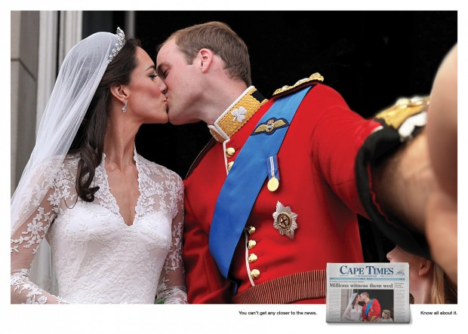
Advertising
Types may include:
Mass marketing
TV, Radio, Newspapers, Magazine
Direct marketing catalogues
Individually addressed catalogues
Telemarketing
Personal contact to consumer
E-marketing
Via the internet
Social media advertising
Using sites like facebook or twitter
Viral promotions
E.g. t-mobile, lion king, telekinesis and Carrie
Billboards
Large signs placed in strategic locations

Slide 30
Advertising
When advertising you should consider:
The type of product and its positioning
Size of the target market and it’s characteristics
Businesses marketing budget
Costs of the advertising
The products position in the product life cycle

Slide 31
Personal selling
Involves the activities of a sales representative directed to a customer in order to make a sale
Relationship marketing is the development of relationships over time with clients so that repeat purchases are made
Sales promotion
E.g. the ladies in woolworths that cook you food

Slide 32
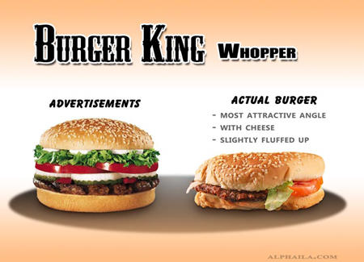
Publicity and PR
Publicity is any free news story about a business
PR are those activities that aim at creating and maintaining favourable relations between a business and its consumers

Slide 33
Place/distribution strategies
Distribution channels
Traditional
Producer to customer
Producer to retailer to customer
Producer to wholesaler to retailer to customer
Producer to agent to wholesaler to retailer to customer
Innovative or ‘non-store’ selling
Retailing conducted away from traditional retail stores
Online businesses
Telemarketing

Slide 34
Place/distribution strategies
Market coverage
The number of firms a business chooses for its outlets
Businesses can cover the market in one of 3 ways
Intensive distribution
When you want to saturate the market with your product
Selective distribution
Only using a moderate proportion of stores to sell your product
Exclusive distribution
The use of only a few stores in a large area to sell your product. Largely used in niche marketing

Slide 35
The other 3 P’s
Used in the service side of the business
People
Processes
Physical evidence
These must all be consistent with the businesses image and marketing approach

Slide 36
E-marketing
This is an essential method of marketing, particularly as consumers are becoming more ‘connected’.
Webpages
Podcasts
SMS
Blogs
Social media advertising
Influencers

