Slide 1
Learning Intention
I will learn how the Government can control the Business cycle

Slide 2
Interest rates and the Cash Rate
The Cash rate is set by the RBA. It sets the interest rate that banks are charged.
Banks then pass this interest rate on to their business and consumer customers in their loans
How much the banks charge on loans
High Interest rates
More going to the bank, less for us to spend
Low interest rates
Less going to the bank, more for us to spend
Notes:
The cash rate is the rate of interest that the Reserve Bank of Australia (RBA) charge on short term overnight loans to banks. This rate of interest is then passed along to banks customers (individuals and businesses) in the interest that is charged on home loans and business loans. Banks will also put their profit margin on top of the interest charged by the RBA.
For example:
RBA cash rate = 0.75%
Banks Interest rate = 2.5%
In this instance, the RBA is charging banks 0.75%, and the banks are adding an extra 1.75% to this rate on their home and business loans. This means that the banks are making 1.75% profit on the loans.
Why do interest rates matter?
Most people have a home loan or business loan
The interest consumers pay, means they can no longer spend that amount of money on other things e.g. cars, holidays, food, clothes etc… this then limits the amount of injections into the economy.
When there are high interest rates, it means consumers and businesses have less spare cash to buy other things
When interest rates are high, it is also a disincentive to businesses to borrow money and expand their business, and for consumers to get a home loan
Interest rates are an important mechanism in either slowing the economy down, or trying to speed it up.
When we’re in a trough or downturn – lower the interest rate
So that we can get more cash circulating, which helps keep and create jobs
When in an upturn or peak – increase the interest rate
So that prices don’t get too expensive and we can remain competitive with the rest of the world

Slide 3
Interest rates
How will high interest rates affect the:
Circular flow model (in particular injections and leakages)
The business cycle
Notes:
It affects the business cycle by:
Money leaking out of the economy. This will be the case in a peak/upturn. We don’t want the economy to be going too fast because this will lead to high prices (because everyone has money, but there is only limited supply of goods and services), as well as making us less competitive in the international market.
It affects the circular flow model by:
Increasing leakages and decreasing injections – this is particularly the case in the finance sector
Investment decreases – because loans cost too much money. This will stop money flowing around the economy
Savings – these will increase if there is economic uncertainty

Slide 4
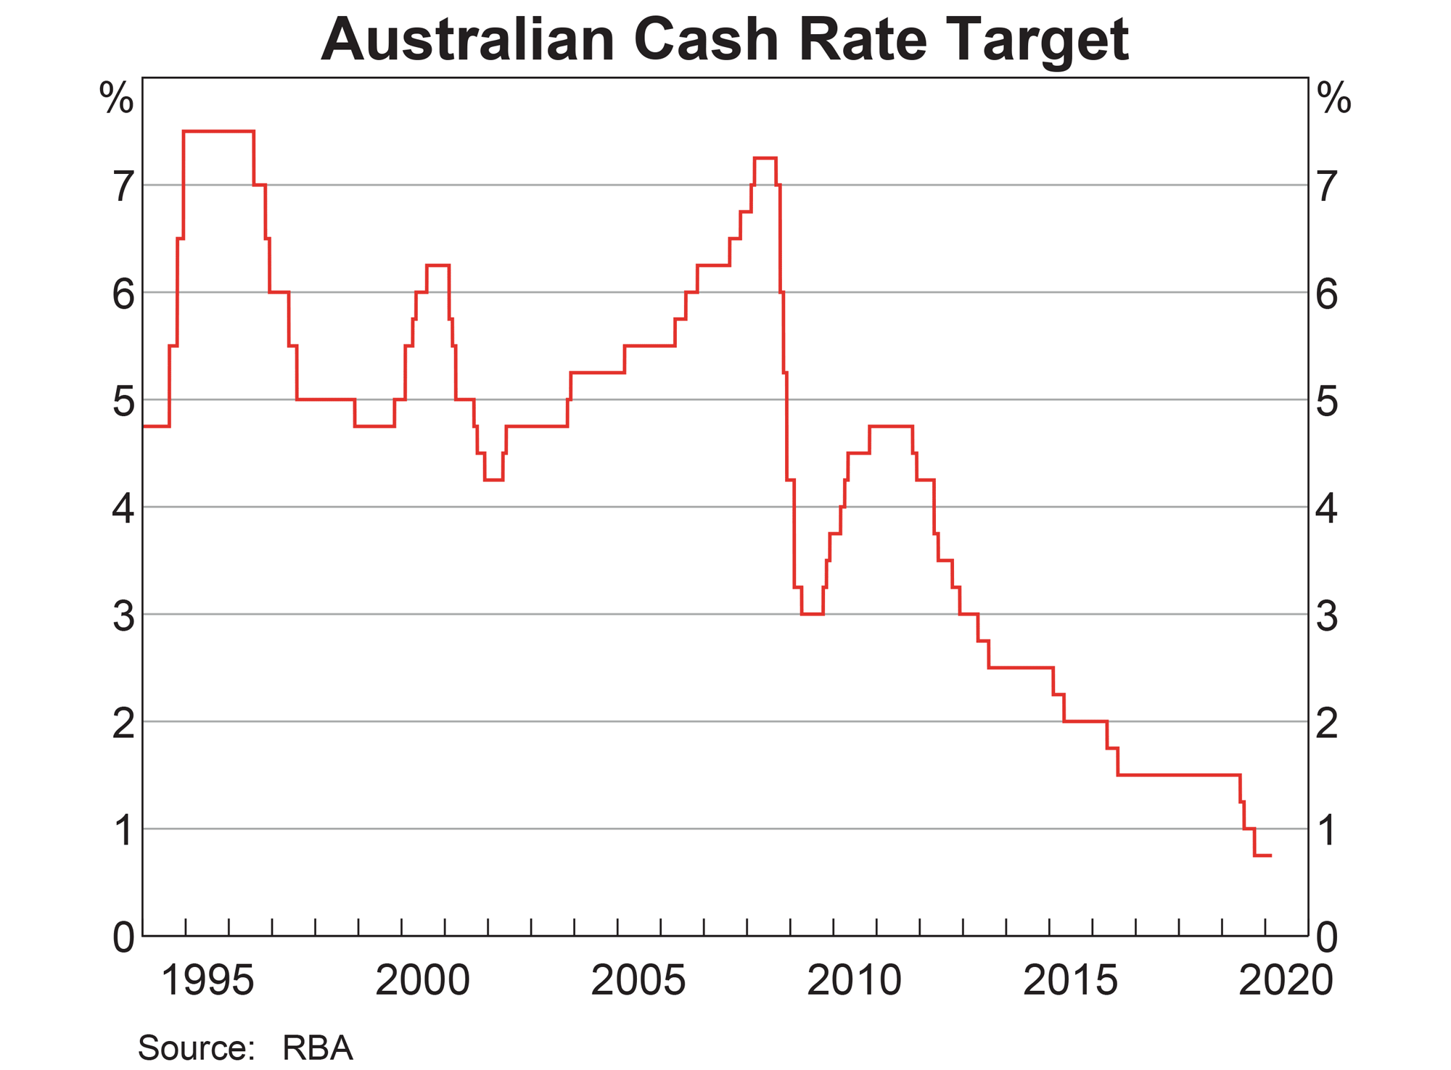
2002-2007 upturn/peak 2008 GFC! 2010-2020 downturn

Slide 5
Currently at 0.25%

Slide 6
What does the Government do?
Fiscal policy
Surplus budget – not spending everything, and keeping some over
Used in a peak/upturn
Deficit budget – spending more than they have
Used in a trough/downturn
Currently, COVID-19 has meant they need to spend even more
Notes:
Fiscal policy is about the government budget. This is set each May for the coming year. It outlines where the government is going to spend their money for the next 12 months.
There can be 3 outcomes of the budget
Deficit budget – when we’re spending more than we are getting in through the way of taxation. This creates more injections into the economy
Balanced budget – when our spending equals our taxation revenue
Surplus budget – when we’re getting more taxation revenue than we are spending. This creates more leakages in the economy
In a peak/upturn, the Government will likely have a surplus budget. In a downturn/trough, the government will likely have a deficit budget.

Slide 7
In a downturn
The GFC
School gyms initiative
Payments – to tax-payers
Insulation scheme
Notes:
During the GFC in 2008, we had an economic stimulus package to stimulate economic activity. This was aimed at certain areas. Those being, construction and retail particularly. The reason for this was that those two industries were the hardest hit by the GFC.
As a result of these impacts, the government took the following measures to both stimulate the economy as well as try and address the problems in those industries – and keep people in those industries in jobs.
School gyms – addressed a growing need in Australia for state of the art educational facilities. Also gave construction companies work
Insulation scheme - if you wanted to get insulation in your homes, then the government made it very cheap by paying a portion of the bill for you. This allowed people in that industry to continue to work
Payments to tax payers – to help support the retail industry, tax-payers were given payments of $900 and $1000 each. This was then able to be spent on retail items
The problem with these payments however was that people just put it off debt, rather than spending it in retail.

Slide 8
Current measures
For individuals
Job keeper payment - $1,500 per fortnight
Income support - $550 per fortnight
Payment to support households - $750 x 2
Pensioners - $342 per fortnight
Superannuation rules relaxed
For businesses
$100,000 cash support – to pay the bills
Support for apprentices
Notes:
These measures are designed to increase injections in the economy because so many people have lost their jobs and the Government needs to keep the economy moving.
Currently the government has spent $130Bn in this stimulus package. In the GFC, they spent $57Bn

Slide 9
Learning Intention
I will learn how the Government can control the Business cycle

